Slide 1

Introduction to XProc 3.0 – Part 2
Markup UK 2020
Webinar

Slide 2
What have we learned in part 1?
XProc is a pipeline language for documents, it chains steps
Documents flow in and out of steps through ports
One input and one output port can be primary: These ports automatically connect
Primary ports are called source and result by convention
You can connect a port to:
Another port (either implicit for primary ports or explicit: <p:pipe> or @pipe)
To a document stated inline (<p:inline>)
To a document on disk (<p:document> or @href)
Options are additional switches for the steps and/or your pipelines
And most important: I’m Kanava, the XProc logo!

Slide 3
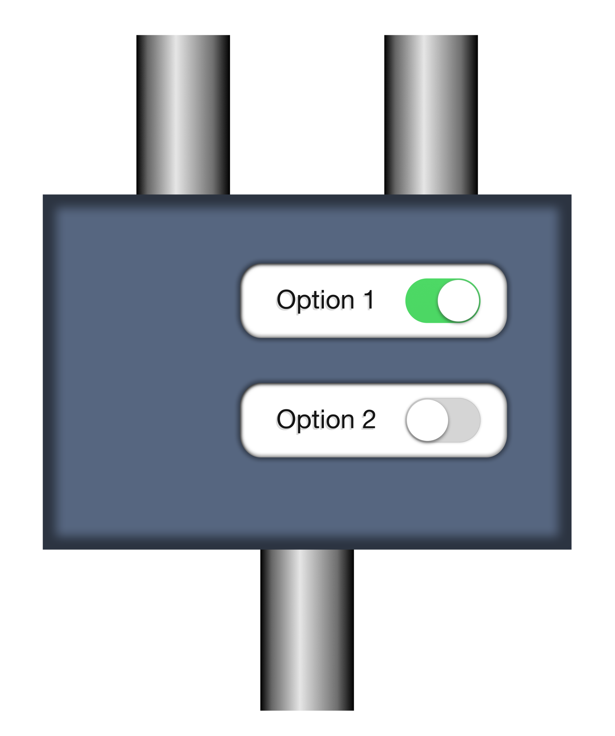
Options revisited
Set an option’s value:
<p:add-attribute
match="/*"
attribute-name="timestamp"
attribute-value="{current-dateTime()}"/>
Declare an option for your own step:
<p:option name="author" select="'Erik'"/>
source
options
p:add-attribute
match
attribute-name
attribute-value
result
Piece of cake, you’ve seen this last time…

Slide 4
Setting option’s values 1: Use attributes
<p:add-attribute match="/*" attribute-name="timestamp"
attribute-value="{current-dateTime()}"/>
Use AVTs (Attribute-Value Templates) {…} to insert XPath expressions
Works only for:
Simple atomic values (strings, integers, booleans, etc.)
Single values (so no sequences!)
Map and array typed values, for instance: <p:xslt parameters="map{ ‘myparam’: ‘myvalue’}“ …
It’s syntactic sugar…

Slide 5
Setting option values 2: Use <p:with-option>
See: markupuk-2020/101-B/example-1/example-1a.xpl
<p:add-attribute> <p:with-option name="match" select="'/*'"/> <p:with-option name="attribute-name" select="'timestamp'"/> <p:with-option name="attribute-value" select="current-dateTime()"/> </p:add-attribute>
Much more verbose, but sometimes you can’t do without…

Slide 6
To quote or not to quote…
<p:add-attribute match="/*" …
???
<p:with-option name="match" select="'/*'"/>
The match option needs an XPath expression
Passed to p:add-attribute as a string
Processed by the step itself, not by the surrounding pipeline
An attribute’s value is just an atomic value (with the AVTs expanded)
Any select attribute in a pipeline contains an XPath expression
This will be processed by the pipeline
The resulting value will be passed to the step

Slide 7

Don’t try this at home
See: markupuk-2020/101-B/example-1/example-1b.xpl
<p:add-attribute> <p:with-option name="match" select="/*"/> <p:with-option name="attribute-name" select="'timestamp'"/> <p:with-option name="attribute-value" select="current-dateTime()"/> </p:add-attribute>
/* will be executed against the implicit connection
Result passed as option’s value: This is a piece of text to demonstrate …
The match option expects a valid XPath expression, which this is not…
Result: Error…
No more quotes…
$!$#@!…

Slide 8
Some use-cases for <p:with-option>
If you need to pass something more complex than a single atomic value: See: markupuk-2020/101-B/example-1/example-1c.xpl <p:directory-list path="."> <p:with-option name="include-filter" select="('\.txt$', '\.xml$')"/> </p:directory-list>
If you want to process your XPath expression against something floating out of another port: <p:with-option name="attribute-value" select="/*/@status" pipe="some-port@some-step"/>
It’s getting complicated… Don’t worry, most of the times setting options will be really simple!

Slide 9
Goodbye and thank the fish again!
Your guide today: Erik Siegel – erik@xatapult.nl
Specification: https://spec.xproc.org/
Processors:
Morgana: https://www.xml-project.com/
Calabash: https://xmlcalabash.com/
Articles on XProc: https://www.xml.com
Book: https://xmlpress.net/publications/xproc-3-0/
See you!
And remember, Kanava says:
XProc rocks…

Slide 10

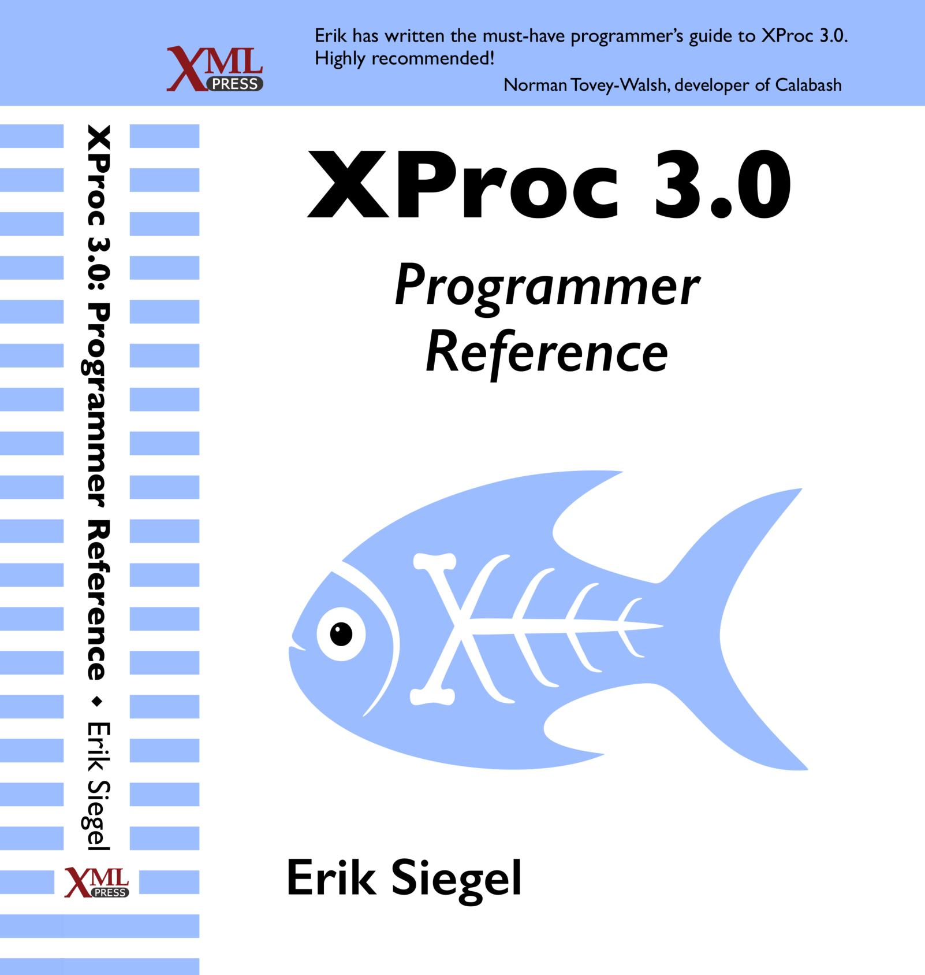
Who Am I?
Erik Siegel
Content Engineer, XML Specialist, Technical Writer
Company: Xatapult
Groningen, The Netherlands
Customers mostly in publishing and standardization
Part of the XProc 3.0 editing committee
Writer of the XProc 3.0 Programmer Reference
Contact:
erik@xatapult.nl www.xatapult.com www.linkedin.com/in/esiegel/ +31 6 53260792

