Slide 1

Introduction to XProc 3.0 – Part 2
Markup UK 2020
Webinar

Slide 2
What have we learned in part 1?
XProc is a pipeline language for documents, it chains steps
Documents flow in and out of steps through ports
Documents can be XML, HTML, text, JSON oir binary
One input and one output port can be primary: These ports implicitly connect (unless explicitly connected)
Primary ports are called source and result by convention
You can connect a port to:
Another port (either implicit for primary ports or explicit: <p:pipe> or @pipe)
To a document stated inline (<p:inline>)
To a document on disk (<p:document> or @href)
Options are additional switches for the steps and/or your pipelines
And most important: I’m Kanava, the XProc logo!

Slide 3
What are we going to do today?
Revisit options
Setting option with attributes or <p:with-option>
Variables
How to create, how to use
Core (or Compound) steps
Show example of multiple document handling using <p:for-each>
Sounds kinda interesting, tell me more!

Slide 4
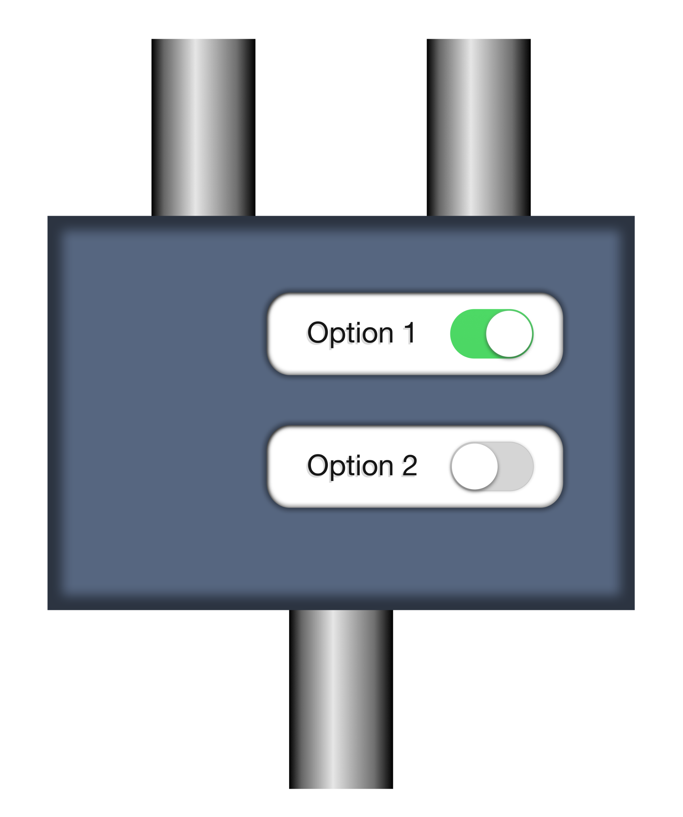
Options revisited
Set an option’s value:
<p:add-attribute
match="/*"
attribute-name="timestamp"
attribute-value="{current-dateTime()}"/>
Declare an option for your own step:
<p:option name="author" select="'Erik'"/>
source
options
p:add-attribute
match
attribute-name
attribute-value
result
Piece of cake, you’ve seen this last time…

Slide 5
Setting option’s values 1: Use attributes
<p:add-attribute match="/*" attribute-name="timestamp"
attribute-value="{current-dateTime()}"/>
Use AVTs (Attribute-Value Templates) {…} to insert XPath expressions
Works only for:
Simple atomic values (strings, integers, booleans, etc.)
Single values (so no sequences!)
Map and array typed values, for instance: <p:xslt parameters="map{ ‘myparam’: ‘myvalue’}" …

Slide 6
Setting option values 2: Use <p:with-option>
See: markupuk-2020/101-B/example-1/example-1a.xpl
<p:add-attribute> <p:with-option name="match" select="'/*'"/> <p:with-option name="attribute-name" select="'timestamp'"/> <p:with-option name="attribute-value" select="current-dateTime()"/> </p:add-attribute>
Much more verbose, but sometimes you can’t do without…

Slide 7
To quote or not to quote…
<p:add-attribute match="/*" …
???
<p:with-option name="match" select="'/*'"/>
The match option needs an XPath expression
Passed to p:add-attribute as a string
Processed by the step itself, not by the surrounding pipeline
An attribute’s value is just an atomic value (with the AVTs expanded)
Any select attribute in a pipeline contains an XPath expression
This will be processed by the pipeline
The resulting value will be passed to the step

Slide 8

Don’t try this at home
See: markupuk-2020/101-B/example-1/example-1b.xpl
<p:add-attribute> <p:with-option name="match" select="/*"/> <p:with-option name="attribute-name" select="'timestamp'"/> <p:with-option name="attribute-value" select="current-dateTime()"/> </p:add-attribute>
/* will be executed against the implicit connection
Result passed as option’s value: This is a piece of text to demonstrate …
The match option expects a valid XPath expression, which this is not…
Result: Error…
No more quotes…
$!$#@!…

Slide 9
Some use-cases for <p:with-option>
If you need to pass something more complex than a single atomic value: See: markupuk-2020/101-B/example-1/example-1c.xpl <p:directory-list path="."> <p:with-option name="include-filter" select="('\.txt$', '\.xml$')"/> </p:directory-list>
If you want to process your XPath expression against something floating out of another port: <p:with-option name="attribute-value" select="/*/@status" pipe="some-port@some-step"/>
It’s getting complicated… Don’t worry, most of the times setting options will be really simple!

Slide 10
Variables
See: markupuk-2020/101-B/example-2/example-2a.xpl
Declare a variable: <p:variable name="id" select="…"/>
Use a variable: <p:add-attribute match="/*" attribute-name="id" attribute-value="{$id}"/>

Slide 11
Variables with values from document
See: markupuk-2020/101-B/example-2/example-2b.xpl
<input-example user="erik">
<title>Just some XML...</title>
</input-example>
document
<p:variable name="status" select="… something based on /*/@user"/>
document

Slide 12
Variables with values from additional document
See: markupuk-2020/101-B/example-2/example-2c.xpl
Additional
document
document
<situation status="normal"/>
<p:variable name="status" select="… something based on /*/@status" href="…"/>
You can also base its value on something flowing from another output port
document

Slide 13
The core (or compound) steps
p:for-each: loop over multiple documents or parts of a document
p:choose / p:when / p:otherwise: Make choices
p:if: Make a single choice (there is no else)
p:viewport: Work on only a part of a document
p:try / p:catch: Error catching and handling
p:group: Grouping of instructions
Regrettably, there is no time to look at them all…

Slide 14
Use p:for-each to split a document
See: markupuk-2020/101-B/example-3/example-3a.xpl and example-3b.xpl
Input document
<documents>
<doc filename="output1.xml">
<contents>This is document number 1</contents>
</doc>
<doc filename="output2.xml">
<contents>This is document number 2</contents>
<more>It has some more...</more>
</doc>
</documents>
Pipeline
output1.xml
output2.xml
?
Boring contents Erik

Slide 15
Count the documents flowing through
See: markupuk-2020/101-B/example-3/example-3c.xpl
Loop over all <doc> entries
Count the documents
Result document
Input document
source
result
<c:result …>2</c:result>
<doc> entry
Store the <doc> entry
<doc> entry
output1.xml
output2.xml

Slide 16
Output the resulting filenames
See: markupuk-2020/101-B/example-3/example-3d.xpl
Loop over all <doc> entries
Wrap the result
Result document
Input document
source
result
<doc> entry
Store the <doc> entry
<c:result>entry
result-uri port
output1.xml
output2.xml

Slide 17
Output the resulting filenames, using p:viewport
See: markupuk-2020/101-B/example-3/example-3e.xpl
Viewport on <doc> entries
Result document
Input document
source
result
<doc> entry
Store the <doc> entry
<c:result>entry
result-uri port
output1.xml
output2.xml

Slide 18
Only store files marked enabled
See: markupuk-2020/101-B/example-3/example-3f.xpl
Viewport on <doc> entries
Result document
Input document
source
result
<doc> entry
@enabled = "true"?
<c:result>entry
Original <doc> entry
Store the <doc> entry
result-uri port
output1.xml

Slide 19
Wrap up:
You can set options by attribute or using <p:with-option>
Watch out: Who is going to interpret the XPath expressions?
You can define and use variables
XPath expression do not have to be based on the document flowing through
There are core steps for looping, decision making, etc. We looked at:
p:for-each
p:viewport
p:if

Slide 20
Goodbye and thank the fish, again!
Your guide today: Erik Siegel – erik@xatapult.nl
Specification: https://spec.xproc.org/
Processors:
Morgana: https://www.xml-project.com/
Calabash: https://xmlcalabash.com/
Articles on XProc: https://www.xml.com
Book: https://xmlpress.net/publications/xproc-3-0/
See you!
And remember, Kanava says:
XProc rocks…

Slide 21

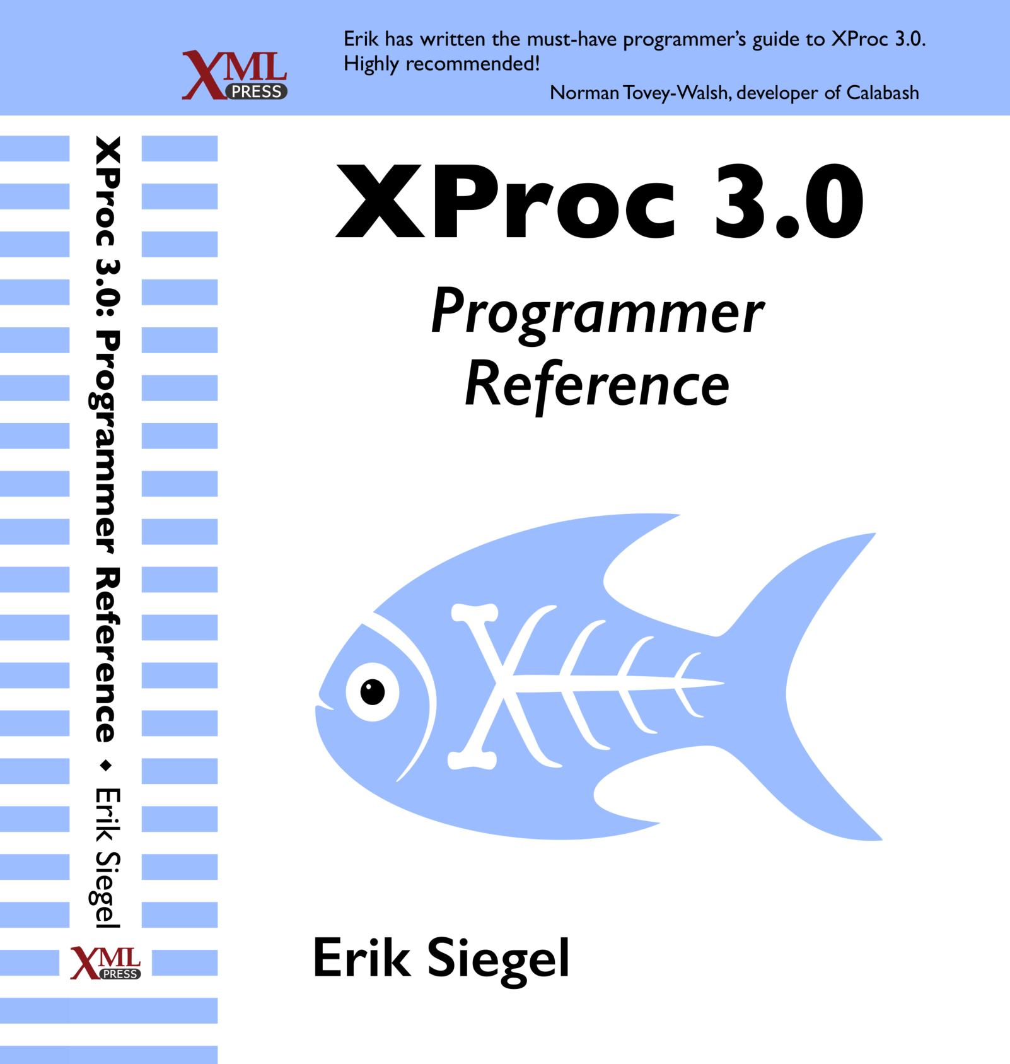
Who Am I?
Erik Siegel
Content Engineer, XML Specialist, Technical Writer
Company: Xatapult
Groningen, The Netherlands
Customers mostly in publishing and standardization
Part of the XProc 3.0 editing committee
Writer of the XProc 3.0 Programmer Reference
Contact:
erik@xatapult.nl www.xatapult.com www.linkedin.com/in/esiegel/ +31 6 53260792

