Slide 1


Working with zip files in XProc 3.0
Now you’ll see what I’m capable of!
GIT for this webinar: https://github.com/xatapult/markupuk-2020

Slide 2
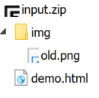
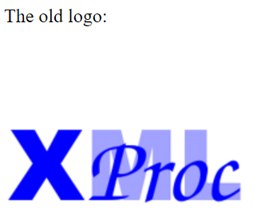
What’s the input?
<html xmlns="http://www.w3.org/1999/xhtml"> <head> <title>XProc demo file</title> </head> <body> <p>The old logo:</p> <p> <img src="img/old.png" alt="Old XProc logo"/> </p> </body> </html>
Shows in the browser as…

Slide 3
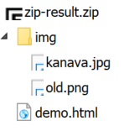
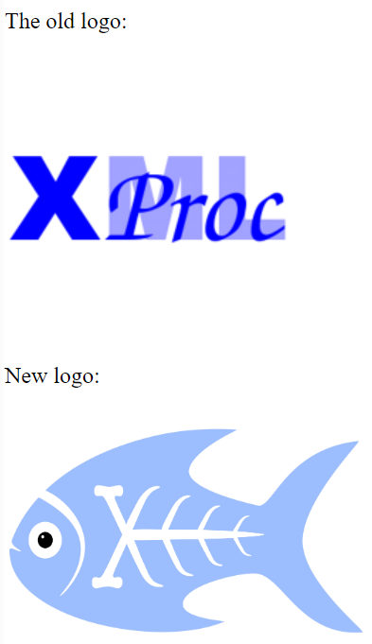
What’s the desired output?
<html xmlns="http://www.w3.org/1999/xhtml">
<head>
<title>XProc demo file</title>
</head>
<body>
<p>The old logo:</p>
<p>
<img src="img/old.png" alt="Old XProc logo" />
</p>
<p>New logo:</p>
<p>
<img src="img/kanava.jpg" alt="New XProc logo" width="10%"/>
</p>
</body>
</html>
Shows in the browser as…
Of course using an XProc 3.0 pipeline…

Slide 4
URI of zip file
URI of file in zip
<c:archive xmlns:c="http://www.w3.org/ns/xproc-step">
<c:entry name="demo.html"
href="file:///.../input/input.zip/demo.html"
method="deflated"
size="219"
compressed-size="150"
time="2020-02-06T08:19:06+01:00"/>
<c:entry name="img/old.png"
href="file:///.../input/input.zip/img/old.png"
method="deflated"
size="7522"
compressed-size="7043"
time="2019-03-14T15:22:48+01:00"/>
</c:archive>
Get manifest:
<p:archive-manifest>
See: markupuk-2020/zip-handling/example/zip-add-new-logo-1.xpl

Slide 5
<c:archive xmlns:c="http://www.w3.org/ns/xproc-step">
<c:entry name="demo.html"
href="file:///.../input/input.zip/demo.html"
method="deflated"
size="219"
compressed-size="150"
time="2020-02-06T08:19:06+01:00"/>
<c:entry name="img/old.png"
href="file:///.../input/input.zip/img/old.png"
method="deflated"
size="7522"
compressed-size="7043"
time="2019-03-14T15:22:48+01:00"/>
<c:entry name="img/kanava.jpg"
href="file:/.../additional-images/kanava.jpg"/>
</c:archive>
Get manifest
Add reference to new logo to manifest
URI of file on disk
See: markupuk-2020/zip-handling/example/zip-add-new-logo-2.xpl

Slide 6
base-uri = file:///.../input/input.zip/demo.html
Unarchive zip file
demo.html
base-uri = file:///.../input/input.zip/img/old.png
img/ old.png
All 2 documents in the archive with property base-uri same as @href in the manifest!
See: markupuk-2020/zip-handling/example/zip-add-new-logo-3.xpl

Slide 7
<html xmlns="http://www.w3.org/1999/xhtml">
<head>
<title>XProc demo file</title>
</head>
<body>
<p>The old logo:</p>
<p>
<img src="img/old.png" alt="Old XProc logo" />
</p>
<p>New logo:</p>
<p>
<img src="img/kanava.jpg" alt="New XProc logo" width="10%"/>
</p>
</body>
</html>
Unarchive zip file
demo.html
img/ old.png
No changes in base-uri properties!
Change demo.html
demo.html (changed)
img/ old.png
See: markupuk-2020/zip-handling/example/zip-add-new-logo-4.xpl

Slide 8
<c:archive xmlns:c="http://www.w3.org/ns/xproc-step">
<c:entry name="demo.html"
href="file:///.../input/input.zip/demo.html"
method="deflated"
size="219"
compressed-size="150"
time="2020-02-06T08:19:06+01:00"/>
<c:entry name="img/old.png"
href="file:///.../input/input.zip/img/old.png"
method="deflated"
size="7522"
compressed-size="7043"
time="2019-03-14T15:22:48+01:00"/>
<c:entry name="img/kanava.jpg"
href="file:/.../additional-images/kanava.jpg"/>
</c:archive>
Unarchive zip file
Get manifest
demo.html
img/ old.png
Add reference to new logo to manifest
Change demo.html
demo.html (changed)
img/ old.png
Match documents in the manifest with documents on the source port, by base-uri property
If not, try to load from URI in manifest @href
Archive
zip
Store
See: markupuk-2020/zip-handling/example/zip-add-new-logo-5.xpl

Slide 9
Wrap up:
There are 3 steps for workin g with archives
<p:archive-manifest>
<p:unarchive>
<p:archive>
Archive manifest:
For finding out what's in an archive
For creating an archive
Select files for the archiving using document's base-uri values
Either from documents on the source port or on disk

Slide 10
Goodbye and thank the fish, again!
Your guide today: Erik Siegel – erik@xatapult.nl
Specification: https://spec.xproc.org/
Processors:
Morgana: https://www.xml-project.com/
Calabash: https://xmlcalabash.com/
Articles on XProc: https://www.xml.com
Book: https://xmlpress.net/publications/xproc-3-0/
See you!
And remember, Kanava says:
XProc rocks…

Slide 11


Who Am I?
Erik Siegel
Content Engineer, XML Specialist, Technical Writer
Company: Xatapult
Groningen, The Netherlands
Customers mostly in publishing and standardization
Part of the XProc 3.0 editing committee
Writer of the XProc 3.0 Programmer Reference
Contact:
erik@xatapult.nl www.xatapult.com www.linkedin.com/in/esiegel/ +31 6 53260792

