Slide 1
Visual studio 2008
Lab0

Slide 2
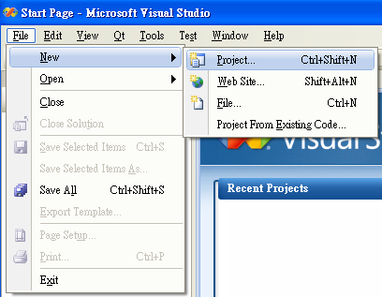
New Project

Slide 3
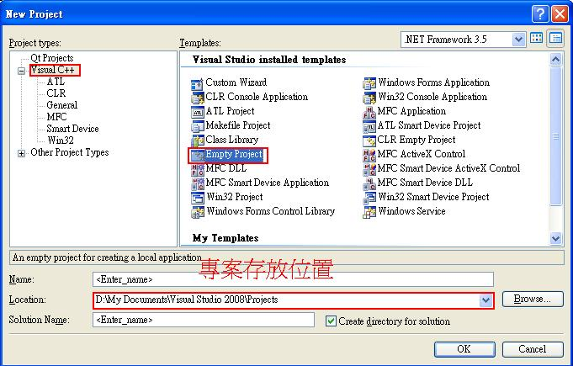
設定專案類型

Slide 4

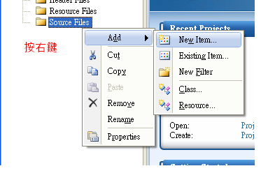
專案欄

Slide 5
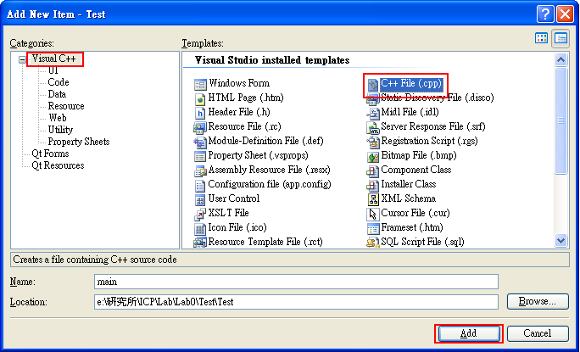
新增cpp檔

Slide 6
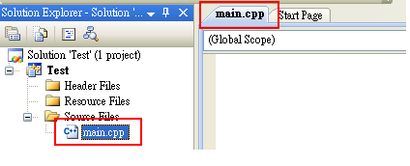
可以開始編輯了

Slide 7
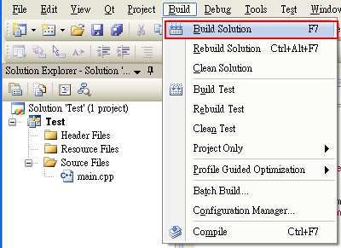
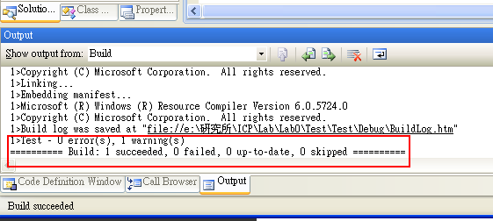
建置方案
  Build Solution(first time)
  Rebuild Solution(Advice)

Slide 8
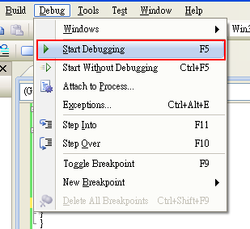
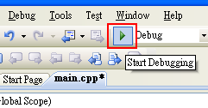
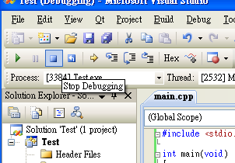
執行with(advice) and without Debugging

Slide 9
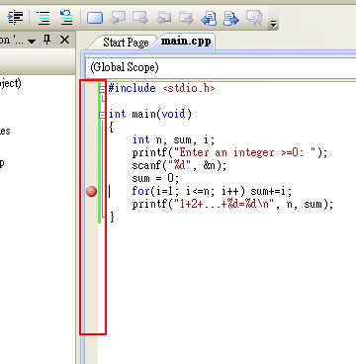
增加breakpoint

Slide 10
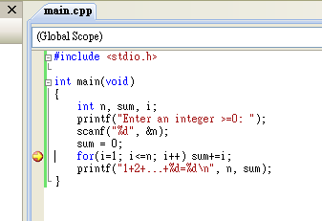

Start with Debugging

Slide 11
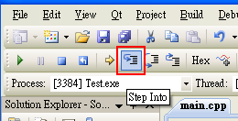
Step Into
  Step by step
Step Over
  Skip function
Step out
  Out of function

Slide 12
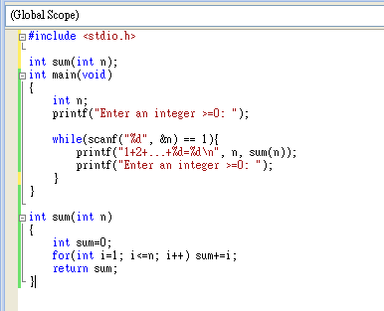
Finish Example

