Slide 1
Introduction to Operation System Homework 4
Concurrency Control
by Hong-Wei Li

Slide 2
Outline
Summary
Requirement
Input(1 files)
Output(2 files)
Score
Demo
Contact Information

Slide 3
Summary
Implement a simple banking system
Create account
Money transfer
Check balance
No restriction on the type of programming language for implementing the banking system
Techniques to attain concurrency
Multithreading & Lock
Actor model
Transactional memory

Slide 4
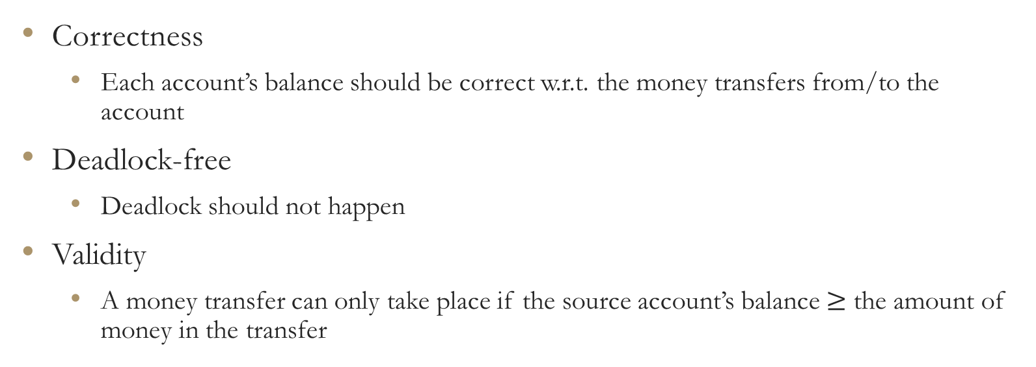
Conditions for a sound banking system
Correctness
Each account’s balance should be correct w.r.t. the money transfers from/to the account
Deadlock-free
Deadlock should not happen
Validity
A money transfer can only take place if the source account’s balance $≥$ the amount of money in the transfer

Slide 5
Input transactions.txt - format
The first line begins with an integer indicating the number of account records
Each account record begins with a description line of the account’s ID (an alphanumeric string), the account’s initial balance (an integer value) and the number of transactions initiated by the account (an integer value)
The range of the number of account records is 1~1000000
The range of the total number of transactions(not provided in transactions.txt) is 1~1500000
Each of the transactions initiated by the account is listed right below the description line (one transaction per line)
Each account’s transactions follow a serial order according to their line numbers.
T1 happens before T2 if T1’s line number < T2’s line number in transaction.txt
There is no ordering requirement for T1 and T2 if they each belongs to a different account.
There are two types of transaction, TRANSFER(T) and BALANCE(B)

Slide 6
Input transactions.txt – format (cont.)
A TRANSFER(T) type transaction is indicated by a line of four terms delimited by whitespaces:
The first term is a string, which represents the transaction’s ID
The second term is the constant string ‘T, representing the transaction’s type
The third term is a string, which represents the receiving account’s ID
The last term is an integer(>0), which represents the amount of money to be transferred
A BALANCE(B) type transaction is indicated by a line of two terms delimited by whitespaces
The first part is a string, which represents the transaction’s ID
The second part is a constant string ‘B’, representing the transaction’s type

Slide 7
Input transactions.txt - example
------------file start---------------
3
John 1000 1
T1 T Brown 500
Brown 500 2
T2 T Merry 1000
T3 B
Merry 700 3
T4 T John 100
T5 B
T6 T Brown 200
------------file end-----------------

Slide 8
Input transactions.txt - reminders
The Transaction’s IDs are meant for distinguishing each transaction. It does not imply any ordering.
Logically, the transactions imitated by an account follow the serial order according to their line numbers in transactions.txt
Transactions from distinct accounts are regarded as concurrent. There is no restriction as to which transaction should go first.
It is guaranteed that balance is always within the value range of a 32-bit signed integer. You don’t need to worry about integer overflow.
There is no self-transfer (i.e. a person transfers money to his / her own account)
It is guaranteed that transactions can be serialized into a sequence and be executed one by one following the sequence without violating the conditions for a sound banking system
Postpone a transaction which may cause violations instead of rejecting it

Slide 9
Output final_state.txt - format
Each line is a account record, which contains the account’s ID and its balance separated by a whitespace
The order of the accounts in the output does not need to follow the order as in transactions.txt

Slide 10
Output final_state.txt - example
------------file start----------------
John 600
Brown 200
Merry 1400
------------file end-----------------

Slide 11
Output transaction_log.txt - format
Each line is a transaction log entry that contains the transaction’s ID and the transaction’s timestamp (a positive integer) separated by a whitespace
The order of log entries does not need to follow transactions.txt
All transactions in transactions.txt have to be included (no less and no more !)
If the type of transaction is BALANCE(B), you need to print the balance of the account at that time
TA will order the transactions according to the timestamps (in ascending order) and execute the transactions serially
The account balances from executing the transactions should be identical to those in final_state.txt
The serial execution has to meet the conditions for a sound banking system

Slide 12

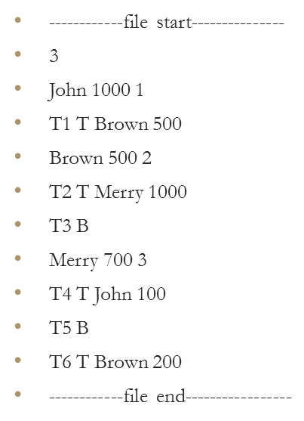
Output transaction_log.txt - example
------------file start----------------
T1 1
T2 2
T3 3 0
T4 4
T5 5 1600
T6 6
------------file end-----------------

Slide 13
Output transaction_log.txt – another possible answer
------------file start----------------
T1 2
T2 4
T3 5 200
T4 1
T5 2 600
T6 3
------------file end-----------------

Slide 14
Output transaction_log.txt - invalid answer
------------file start----------------
T1 2
T2 1 <= Invalid
T3 3 0
T4 4
T5 5 1600
T6 6
------------file end-----------------
Because Brown has only 500 at that time, he cannot transfer 1000 to Merry

Slide 15
Output transaction_log.txt - invalid answer(2)
------------file start----------------
T1 1
T2 2
T3 3 0
T4 5
T5 4 1700 <= Invalid
T6 6
------------file end-----------------
Because it cannot meet Merry’s transaction order(T4 < T5 < T6)

Slide 16
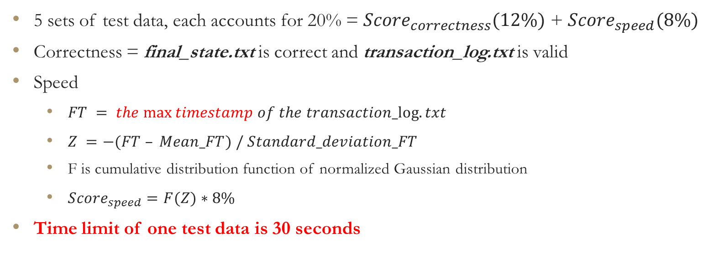
Score
5 sets of test data, each accounts for 20% = ${Score}_{correctness}(12\%)$ + ${Score}_{speed}(8\%)$
Correctness = final_state.txt is correct and transaction_log.txt is valid
Speed
$FT = the max⁡timestamp of the transaction_log.txt$
$Z =−(FT – Mean_FT) / Standard_deviation_FT$
F is cumulative distribution function of normalized Gaussian distribution
${Score}_{speed}=F(Z)∗8\%$
Time limit of one test data is 30 seconds

Slide 17
Demo
Make sure your program can run on CS workstation (linux1.cs.nctu.edu.tw)
If you don’t have the account of CS workstation, contact TA by 12/19
Demo location: EC618
Please choose a demo time and fill the following form with your student id by 12/19
https://docs.google.com/spreadsheet/ccc?key=0ArKw4Ufw9XEgdHpNOHRjamkxenRVRzdKejV1akw5cmc&usp=sharing

Slide 18
Contact Information
TA’s email: NCTUCS_OS_homework_4@hotmail.com
Subject format: homework_4(your_student_ID + your_name)

