Slide 1
Rally Automation Tool
presentation by Aidela Karamyan

Slide 2
Purpose
Purpose of this project is automation of Rally related updates based on TestNG functional test results.

Slide 3
How To Use
To start using this tool simple steps are needed
Set test result listener for test suite
Add rally_automation.properties file to project root with user credentials
Set annotations for functional tests

Slide 4
Setting Listener
<listeners>
...
<listener class-name=
"com.vmware.rally.automation.listener.RTestListener" />
...
</listeners>

Slide 5
Setting Properties
# Rally credentials
apiKey=_OhYE7czYRo2y2tR6il3lyJQsoJGhP0T1gM8JqCFZMlg
userEmail=bobbrown@dispostable.com

Slide 6
Setting Annotation
@TestCase annotation for functional test corresponding Rally test cases
Targets methods only
Retained runtime
All fields are mandatory
Example: @TestCase(id = "TC1", buildNumber = "2244", testSetId = "TS1")

Slide 7
Demo

Slide 8
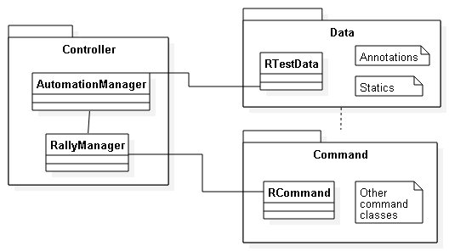
High Level Structure

Slide 9
Project Packages
com.vmware.rally.automation.controller
com.vmware.rally.automation.command
com.vmware.rally.automation.data
com.vmware.rally.automation.data.annotation
com.vmware.rally.automation.data.enums
com.vmware.rally.automation.exception
com.vmware.rally.automation.listener
com.vmware.rally.automation.utils

Slide 10
Thank You!

