Slide 1
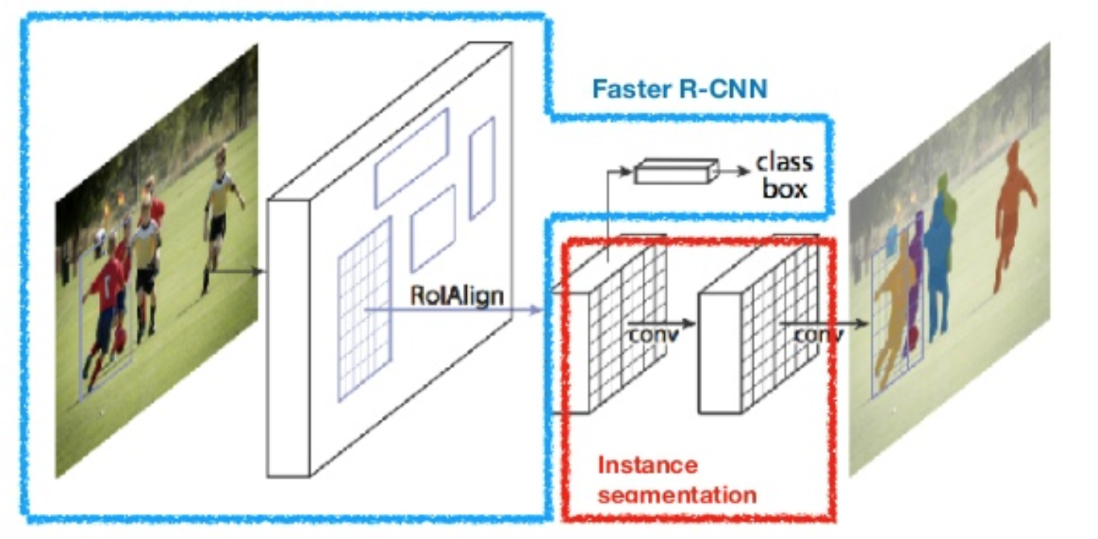
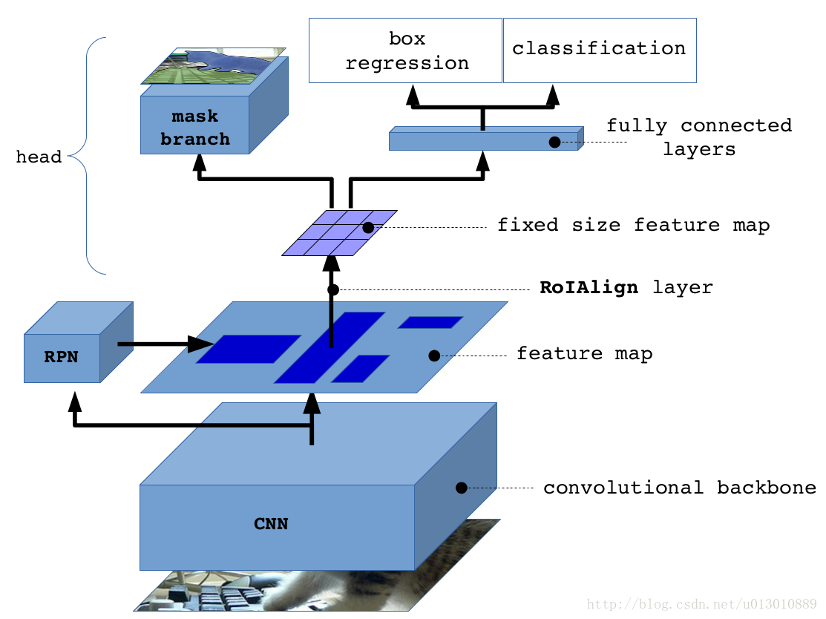
Detectron Models
RPN: (another Convnet)
1. Assume feature map dimension from CNN is M x N x 256
2. Assume each point (256 dim) on feature map has 9 anchors.
4. Each anchor is pre-define in original image frame
3. Output of RPN is :
M x N x (2*9) 对应每个anchor是否有object的prob
M x N x (4*9) 对应每个anchor的调节量
Fixed Size feature map:
1. usually 7 * 7 * 256 (CNN feature is M x N x 256)

Slide 2
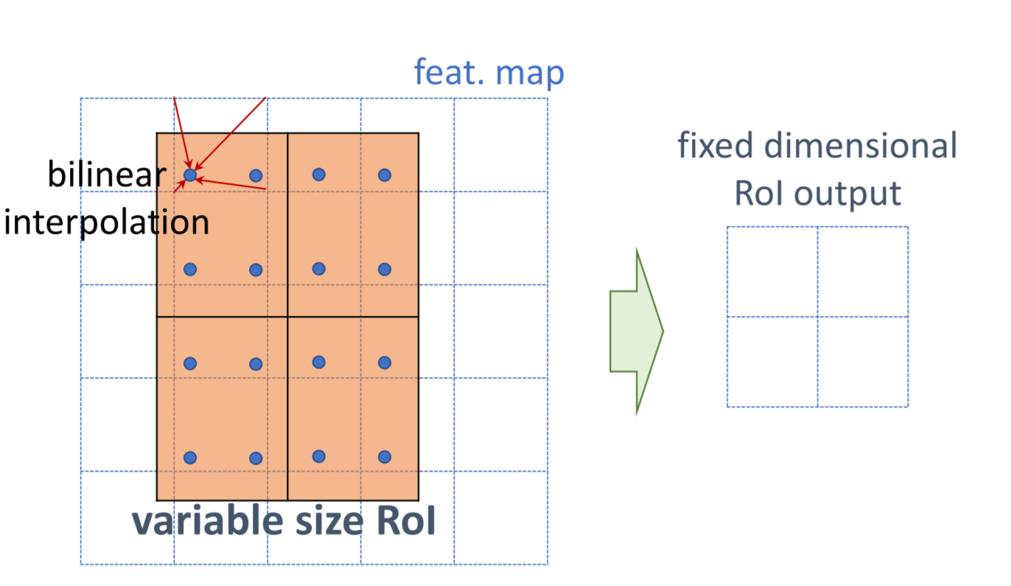
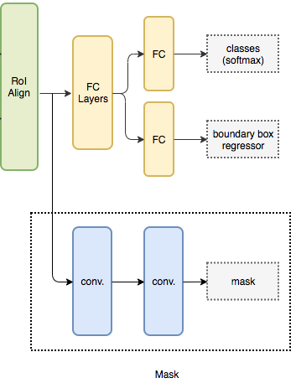
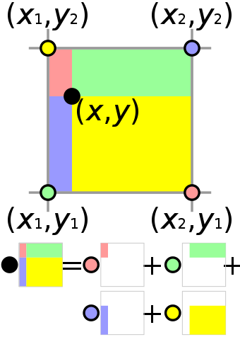
Roi Align
Classifier head
Assume nb_classes is 80
80
4 * 80
Up sampling, then sigmoid
7*7 *256 -> -> 28*28*80
In this geometric visualization, the value at the black spot multiplied by the total area is the sum of the value at each colored spot multiplied by the area of the white colored rectangle, divided by the total area of all four rectangles.

Slide 3
Tensor Operation
CPU Operation
1. CNN Feature extraction
2. RPN getting confidence and bbox modification value
3. Pooling
4. Mask head getting feature map
5. Classification head, class score and bbox modification value
1. Regressing bbox in origin image frame using bbox modification value and predefine anchor
2. sorting and selecting regressed bbox using confidence from RPN
3. NMS operation
4. scaling each bbox to feature map frame for next step
5. ROI Align for each above scaled bbox
6. Another bbox regressing for each above unscaled bbox in classification head to get final bbox

Slide 4
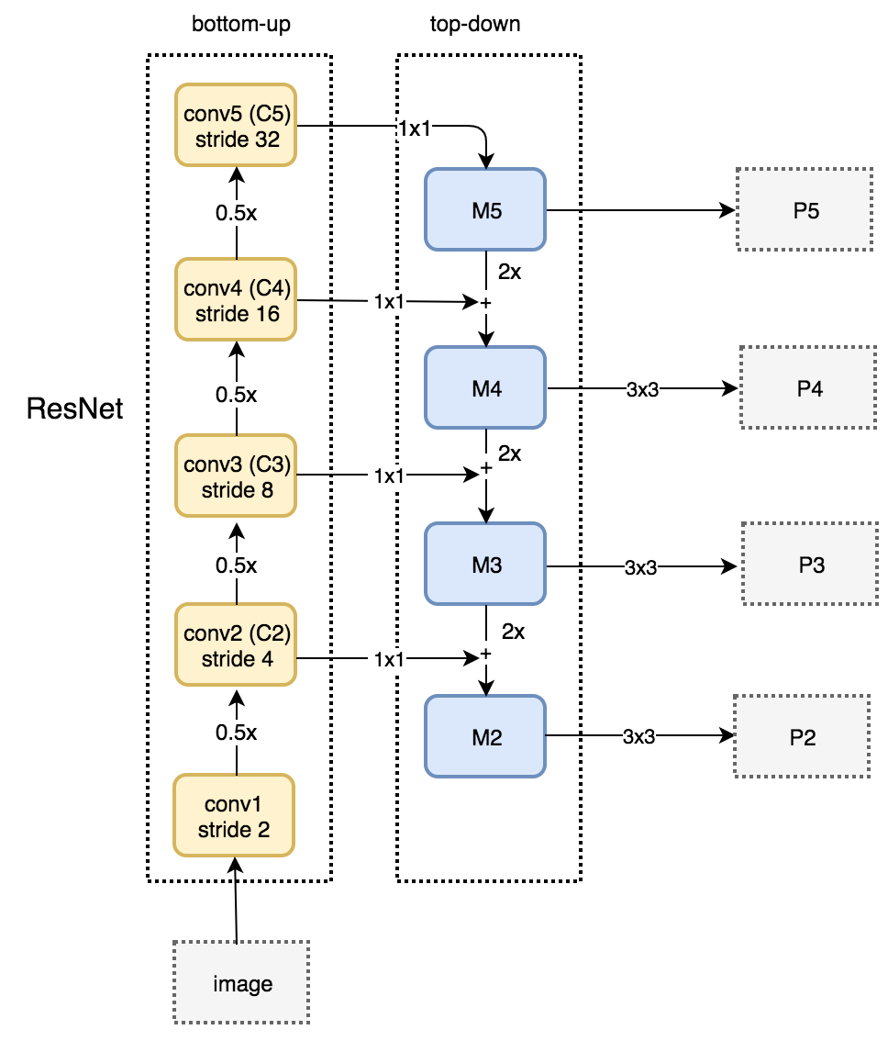

FPN with mask faster rcnn
1. Do ROI Pooling in each prediction Layer
2. Scoring each prediction layer by confidence,
keep top 12000 ROIS for each prediction layer
3. Do NMS for all ROIS with Threshold 0.7, usually keep 2000 total ROIS
4. For each ROI with its w and h, find its corresponding feature map

Slide 5
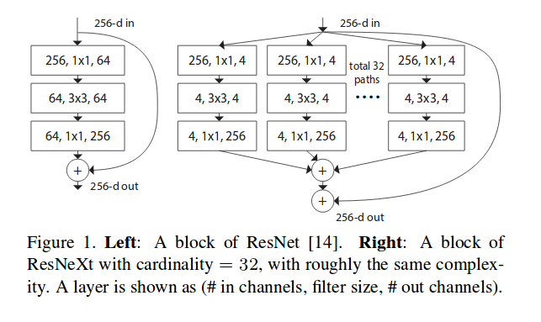
Resnet and Resnext

Slide 6
