Slide 1
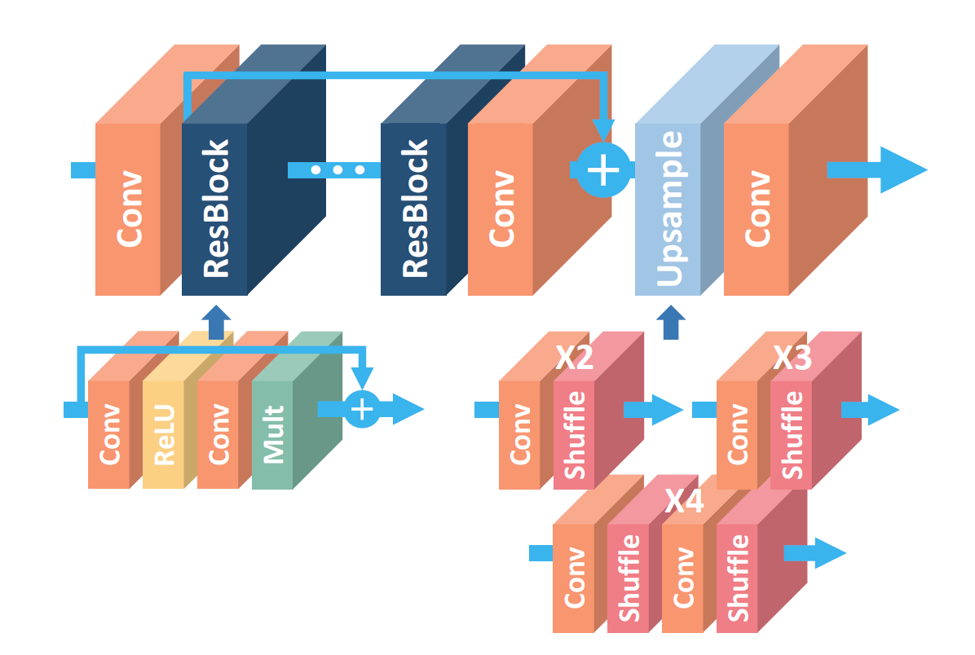
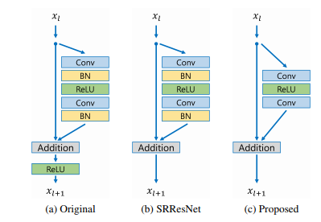
Super Resolution - EDSR

Slide 2
Super Resolution - EDSR
Lambda: Input Normalization
(Image – RGB_MEAN)/127.5
Lambda: Output DeNormalization
Image * 127.5 + RGB_MEAN
Lambda: tf.Depth_to_Space(factor)
Note: 1. Apply factor on conv first to enlarge channel
2. Use this lambda function to do upsampling

Slide 3
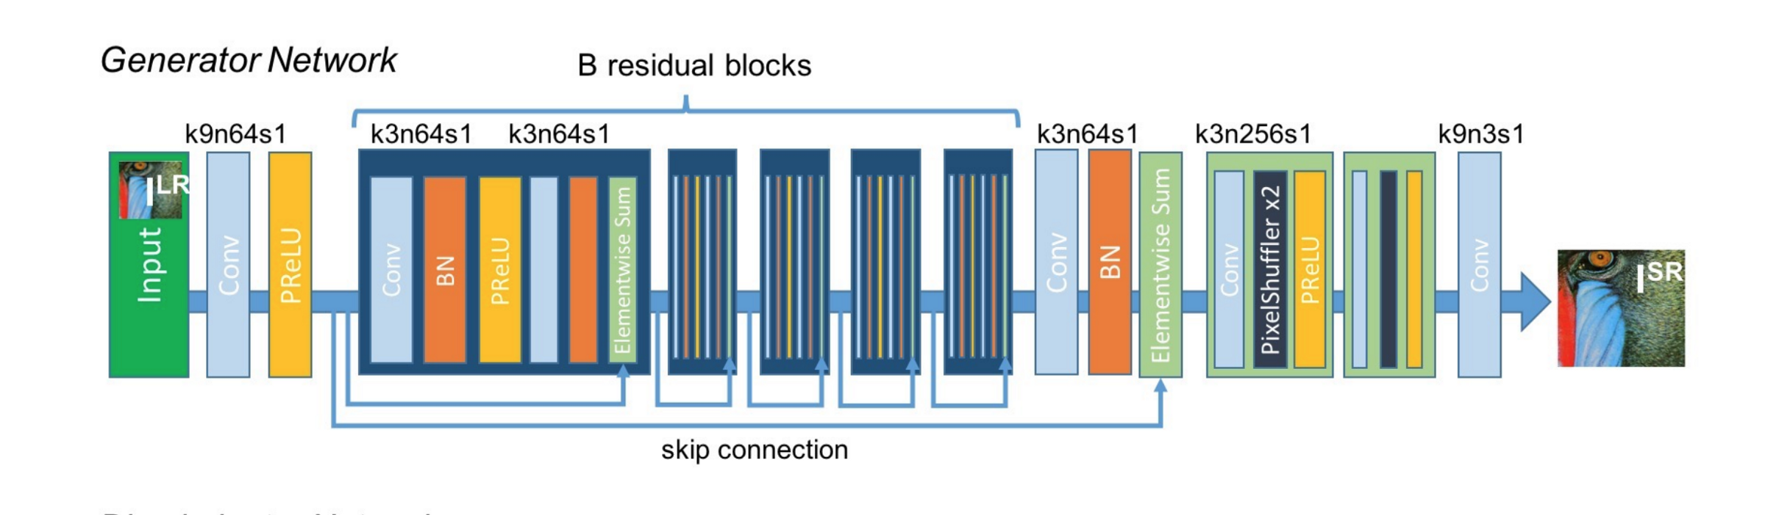
Super Resolution - SRGAN
Lambda: Input Normalization
Image / 255
Lambda: Output DeNormalization
(Image + 1) * 127.5
Lambda: tf.Depth_to_Space(factor)
Note: 1. Apply factor 2 on conv first to enlarge channel
2. Use this lambda function to do upsampling

Slide 4
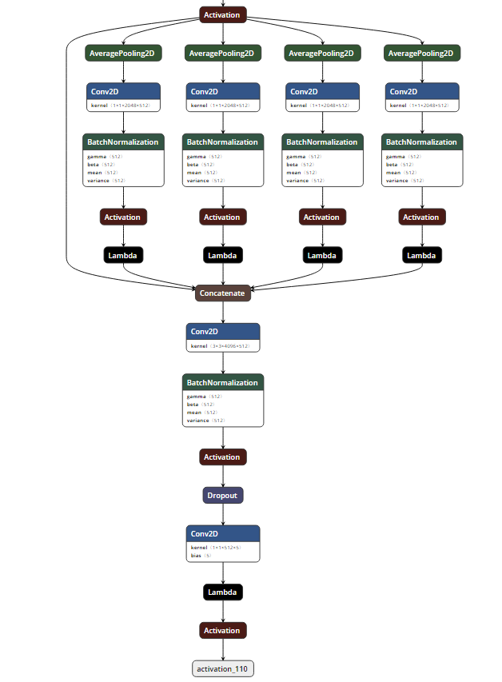
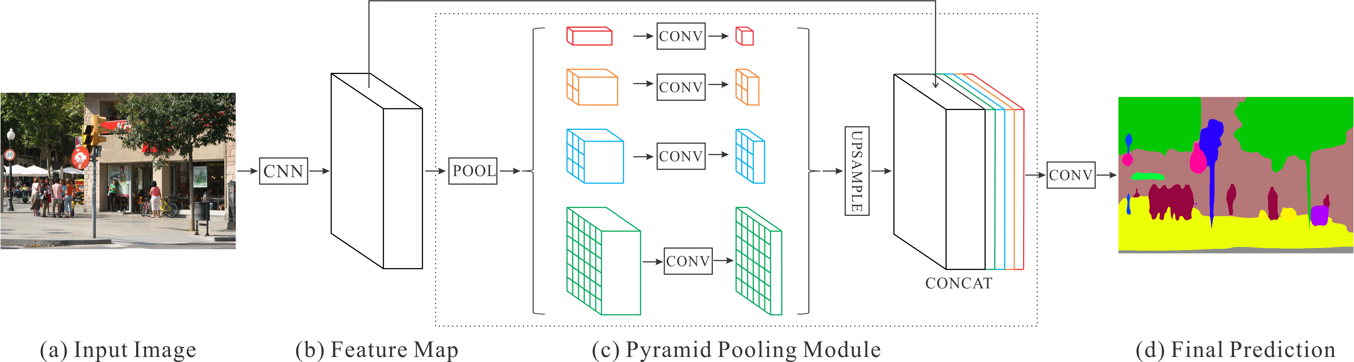
Image Segmentation - PSPNet
Lambda: tf.image.resize
Note: Use resize (bilinear interpolation) here in order to make sure each pooling level has the same output feature shape before concatenating them.
Source: https://googl/zondfq

Slide 5
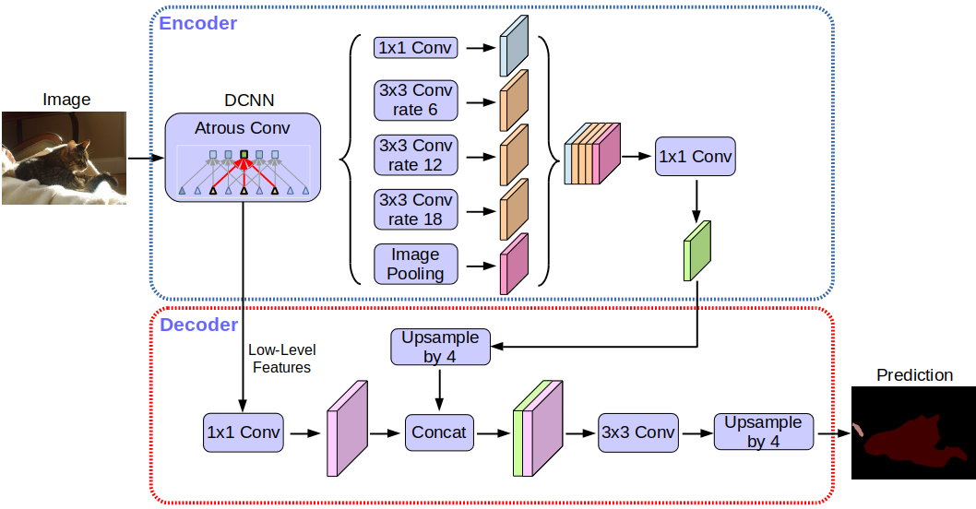
Image Segmentation - Deeplabv3_plus
Special OP: Dialted Conv, Upsampling

Slide 6
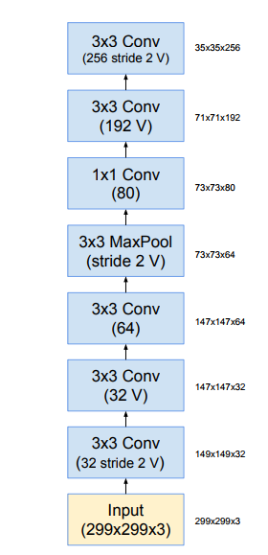
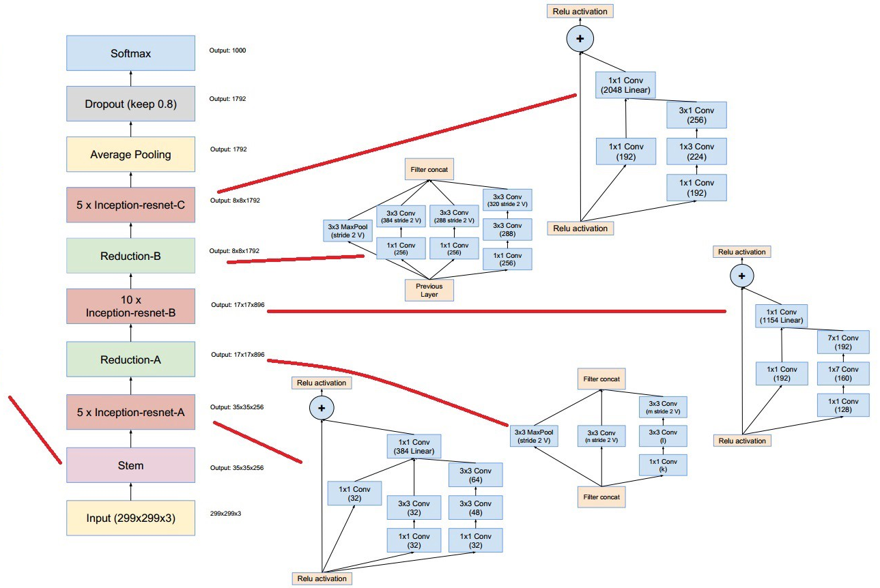
Face Recognition - Facenet (Inception-resnet-v1)
Special OP: 1x1, 1x3, 3x1, 1x7, 7x1 Conv

Slide 7
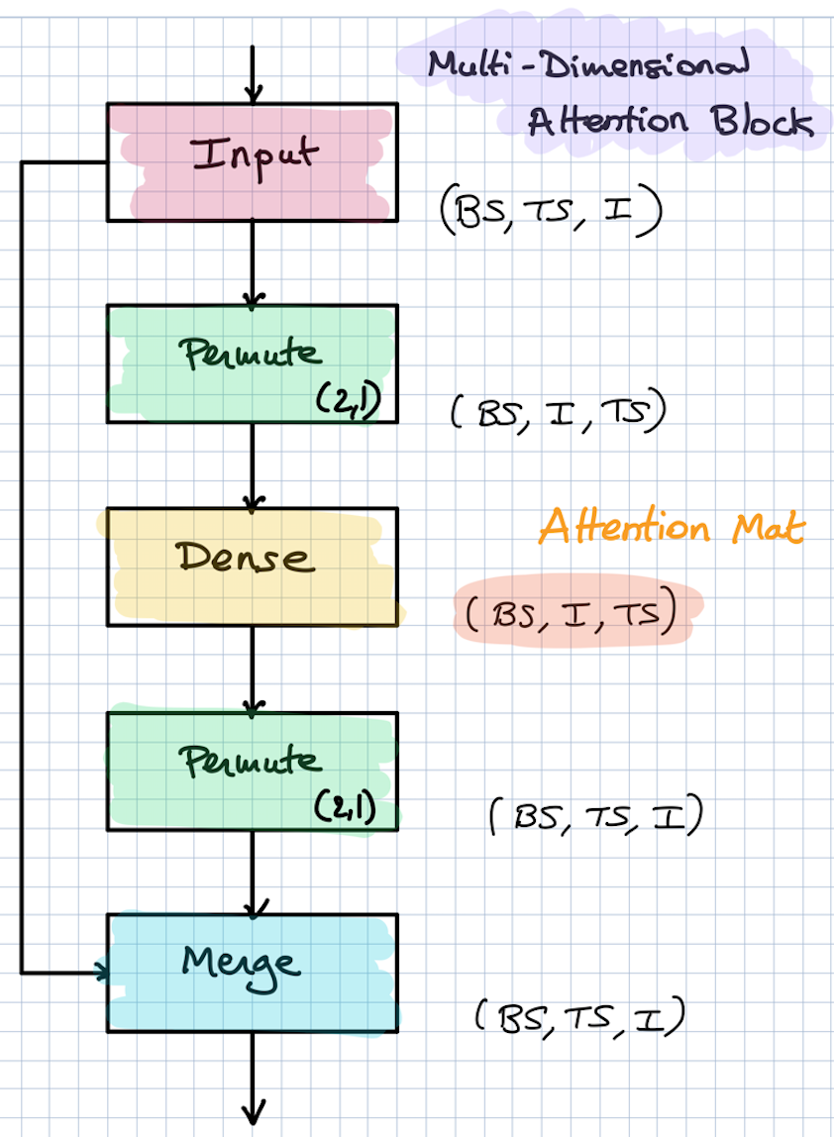
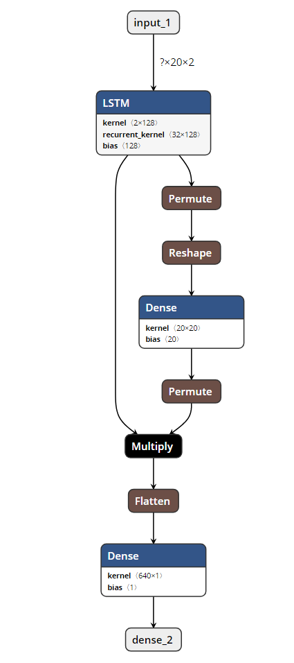
Attention + LSTM
Attention defined per time series
(each TS has its own attention)

