Slide 1
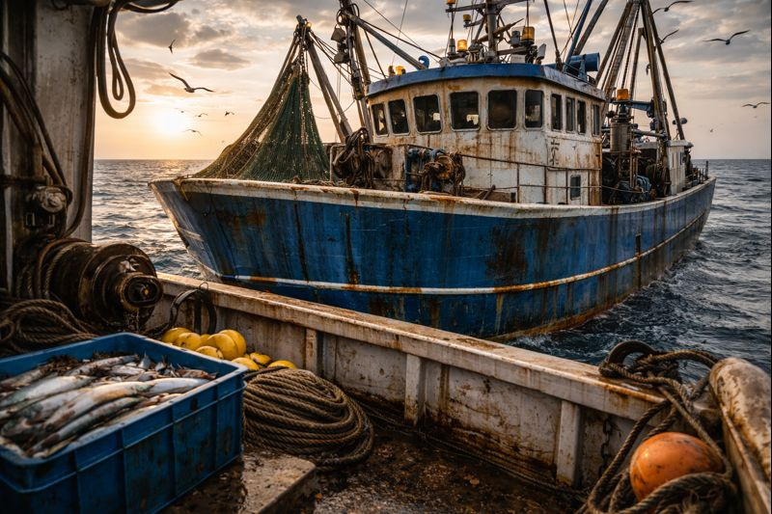
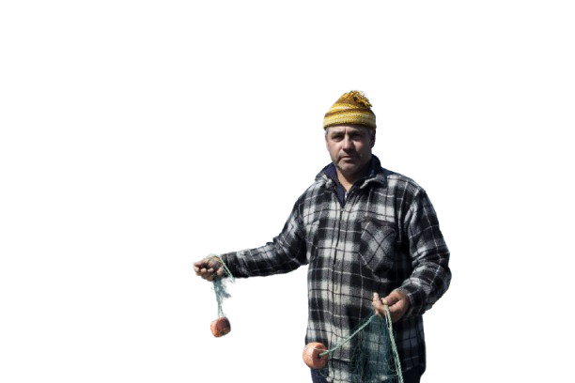
Hey! What are you doing here!?!?

Slide 2
This is our illigal fishing area.

Slide 3
So buzz off, would you?

Slide 4
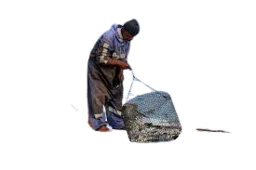

Slide 5
Hey, what is going on here?

Slide 6
Boss, this scavengers are fishing in our area.

Slide 7
I that so, hum...

Slide 8
Look mate.(adressing to the players)

Slide 9
I don’t want any trouble...

Slide 10
And I think you won’t it to.

Slide 11
So how about we make a deal, hum?

Slide 12
You must know about the European Sturgeon, ya?

Slide 13
Because this fish is on the verge of extinction...

Slide 14
It is very VERY rare to find.

Slide 15
If you bring me the fish meat...

Slide 16
I’ll let you fish here.

Slide 17
So have we a deal.

Slide 18

New objective:
Go to the storm to find the the European Sturgeon
go here

