Slide 1
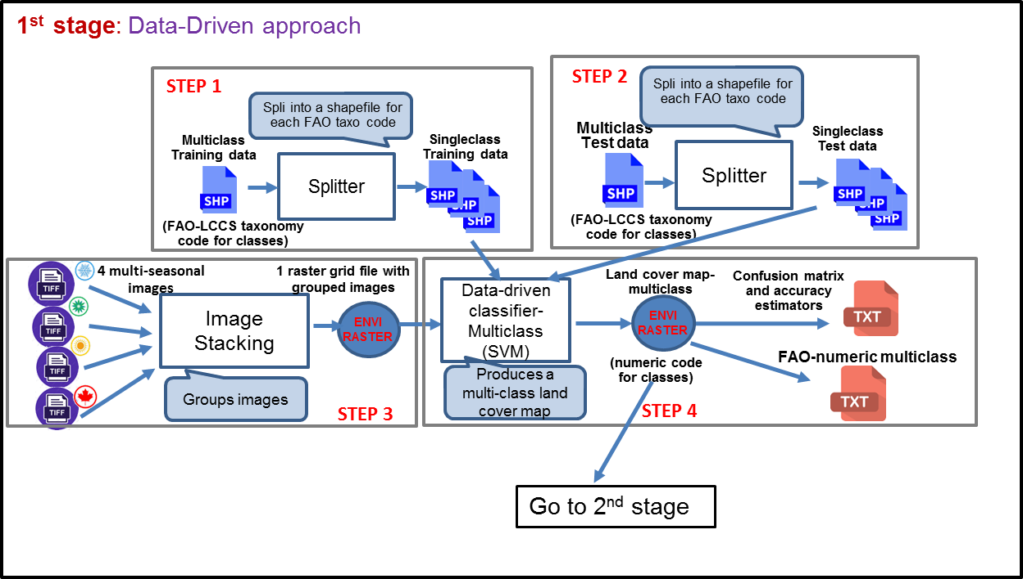

Slide 2






Step 1a
Step 3
LUCAS-Core
LUCAS-Core 2009
Data cleaning
Step 2
PCA
Points Selection
Variables Selection
LUCAS- Topsoil
LUCAS-Topsoil 2018
Data cleaning
ANOVA
Summary Tables
Step 1b
Step 4

Slide 3

Step 1
Step 3
LUCAS-Core
LUCAS-Core 2009
Step 2a
Step 2b
Data cleaning
PCA
Points Selection (stable LU)
Points Selection (AoS)
Variables Selection
LUCAS- Topsoil
LUCAS-Topsoil 2018
Data cleaning
Summary Tables
ANOVA
Step 4

