Slide 1
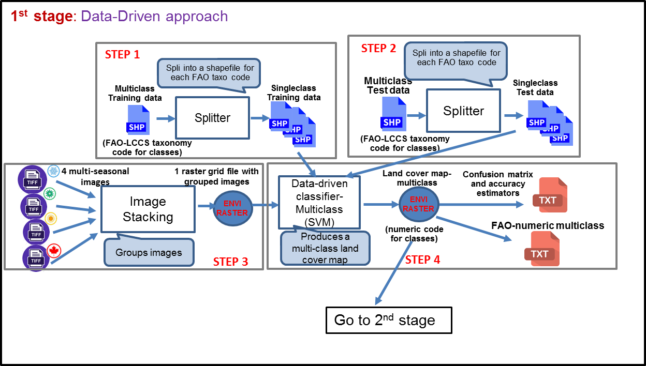

Slide 2






Step 1a
Step 3
LUCAS-Core
LUCAS-Core 2009
Data cleaning
Step 2
PCA
Points Selection
Variables Selection
LUCAS- Topsoil
LUCAS-Topsoil 2018
Data cleaning
ANOVA
Summary Tables
Step 1b
Step 4

Slide 3

Step 1
Step 2
LUCAS-Core
LUCAS-Core 2009/2018
Data cleaning
Points Selection (AoS)
Variables Selection
PCA
Points Selection (stable LU)
LUCAS- Topsoil
LUCAS-Topsoil 2009/2018
Data cleaning
Summary Statistics
Points Selection (AoS)
Variables Selection
ANOVA
Step 3

