Slide 1
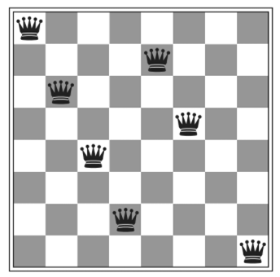


Slide 2
7
6
…
2
1
0
rows
0 1 3 4 ….. 7
cols

Slide 3
Diagonal 10
Diagonal 7
Diagonal 14
7
6
…
2
1
0
Diagonal 1 index = row + column
Example
Diagonal 4
Diagonal index = 1 + 3 = 4
rows
Diagonal 1
Example
Diagonal 0
Diagonal index = 6 + 4 = 10
N diagonals = Nrows + Ncols – 1 = 15
Indices in [ 0, 14]
0 1 3 4 ….. 7
cols

Slide 4
Diagonal 9
7
6
…
2
1
0
Diagonal 2 index = (row + abs( column-7) )
Example
Diagonal 5
Diagonal index = 1 + |3-7| = 5
rows
Example
Diagonal index = 1 + |4-7| = 4
Diagonal 0
N diagonals = Nrows + Ncols – 1
0 1 3 4 ….. 7
cols

Slide 5
[5, 4, 3, 7, 2, 0, 6, 1]

