Slide 1
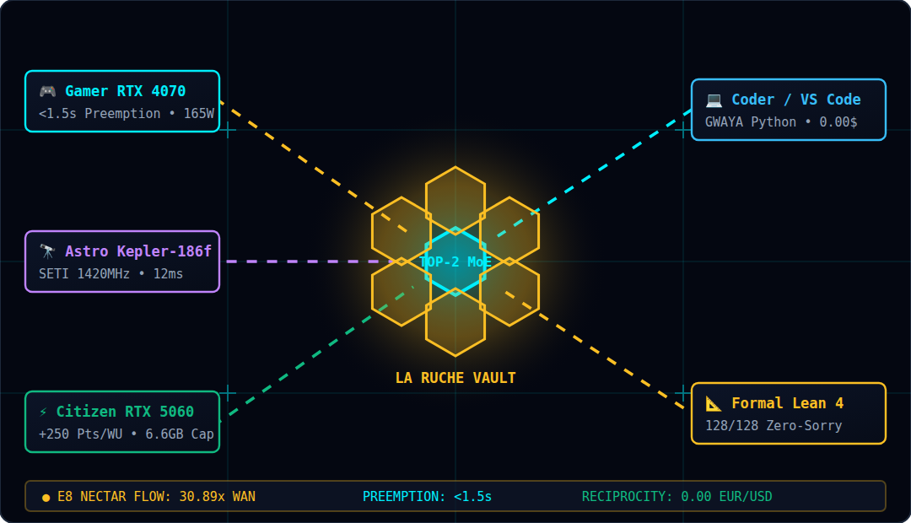
DEMOCRATIZING ARTIFICIAL INTELLIGENCE
Project HiveMind
The Citizen AI Supercomputer: Decentralized MoE Training & OpenRouter on 8 GB Consumer GPUs
Everyday Analogies • OpenRouter Gateway • Win-Win Nash Equilibrium • Real Scientific Results
Multilingual Edition: English • Français • Español • 简体中文 • Deutsch

Slide 2
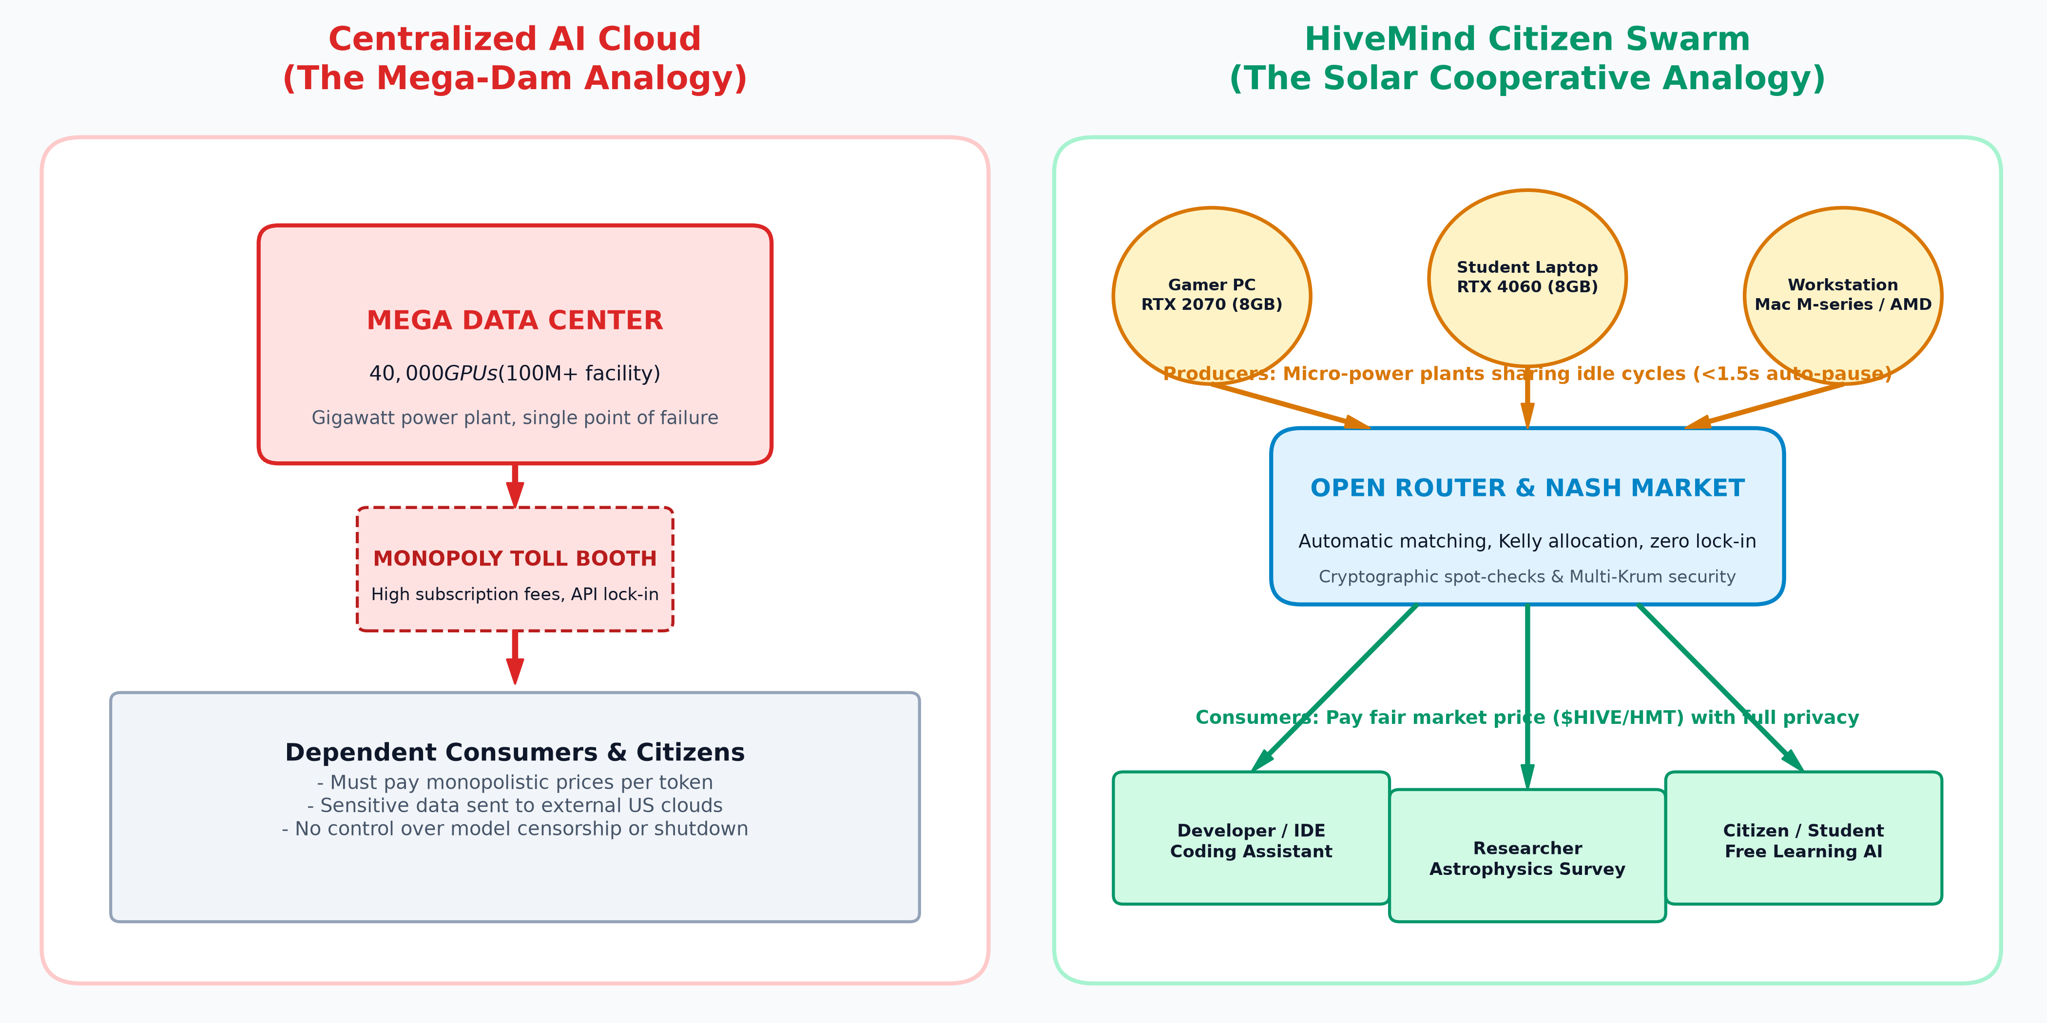
PROJECT HIVEMIND • DECENTRALIZED CITIZEN AI
The Big Picture: Monopoly Cloud Dams vs. The Citizen Solar Grid
Everyday Life Analogies
• The Monopoly Hydroelectric Dam:
Centralized AI requires giant data centers with $40,000 GPUs. Like a single dam controlling the river, Big Tech sets high tolls, censors access, and holds your private data hostage.
• The Rooftop Solar Cooperative:
HiveMind is like rooftop solar panels. Millions of homes already have gaming PCs and laptops with 8 GB GPUs. Individually modest, collectively they form a supercomputer more powerful than any single tech titan.
• The Beehive (Ruche):
Just as thousands of bees cooperate to build a hive and produce honey without any single bee having to carry the whole load, thousands of consumer GPUs collaborate on parts of the AI without needing supercomputer memory.

Slide 3
PROJECT HIVEMIND • DECENTRALIZED CITIZEN AI
How Everyday 8 GB GPUs Do the Work of Supercomputers
1. THE VRAM WALL
4-Bit NF4 Meta-Device Streaming
Standard AI models need 80 GB of memory. HiveMind streams quantized weights on the fly so a full MoE model fits inside a standard 8 GB gaming GPU with zero memory overflow.
2. THE BANDWIDTH WALL
DiLoCo + 2-Bit DCT Compression
Home internet is 1,000x slower than data center cables. DiLoCo lets workers compute 500 steps locally, then compresses gradient updates by 99.9% with 2-bit DCT and EF21 error feedback.
3. PARTIAL REPLICATION
FoMoE (Federated MoE) & Skip-Tokens
Instead of duplicating the whole brain, each volunteer only hosts 8 to 16 'specialist experts'. If a token needs an absent expert, it skips cleanly without stalling the network.
4. ZERO-TRUST SECURITY
10% Spot-Checks & Multi-Krum
Volunteers don't need to trust each other. The system randomly replays 10% of computing steps with bitwise precision and filters malicious or broken nodes with geometric consensus.

Slide 4
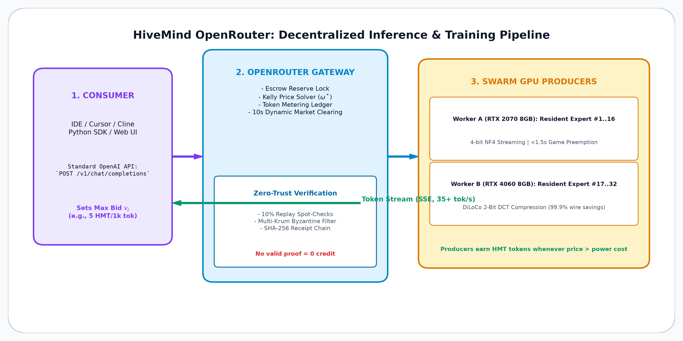
PROJECT HIVEMIND • DECENTRALIZED CITIZEN AI
The OpenRouter: Smart Matching of Consumers and Producers
How OpenRouter Works
• Drop-in OpenAI Compatibility
Use your favorite coding tools (Cursor, VSCode, Cline, Aider) or any web browser. Just set `baseURL` to the HiveMind gateway.
• Escrow & Fair Metering
Consumers set maximum willingness to pay $v_j$. Funds are held safely in escrow and settled per 1,000 tokens generated.
• Automatic Load Dispatch
The gateway dispatches prompts directly to idle citizen GPUs hosting the required model experts.
• Fast Streaming (< 100ms)
Tokens stream back in real-time at 35+ tokens/sec, comparable to centralized APIs at a fraction of the cost.

Slide 5
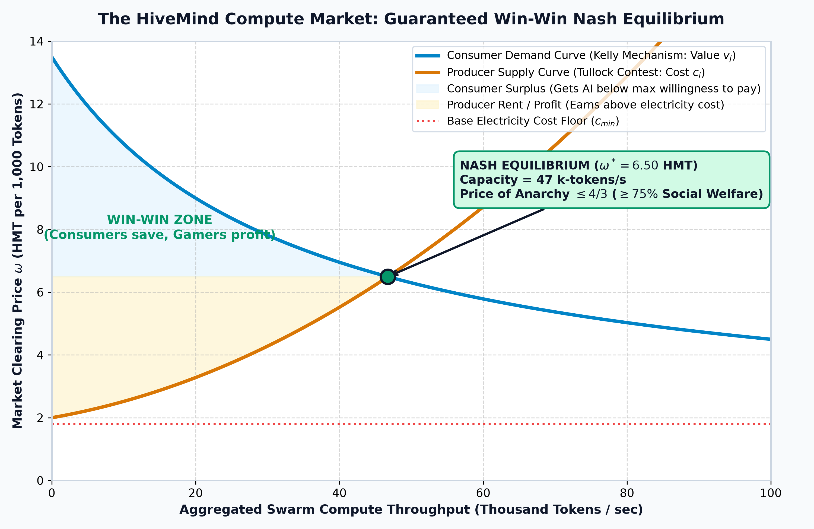
PROJECT HIVEMIND • DECENTRALIZED CITIZEN AI
The Nash Equilibrium: Why Producers and Consumers Both Win
Mathematical Win-Win Contract
• Kelly Consumer Auction:
Consumers declare their ceiling price $v_j$. Capacity is distributed proportionally: $x_j = \max(0, 1 - \omega / v_j)$. Consumer surplus is strictly positive: nobody ever overpays.
• Tullock Worker Contest:
GPU owners (gamers, students) supply compute when price exceeds electricity cost: $\omega(1-f) > c_i$. Producers earn guaranteed profit margins above power consumption.
• Price of Anarchy $\le 4/3$:
Johari & Tsitsiklis (2004) proved that this self-organizing market achieves at least 75% of the total social welfare of an omniscient central planner!
• No Reason to Defect:
At equilibrium $\omega^*$, neither a buyer nor a seller can improve their outcome unilaterally. Cheaters earn 0; honest contributors thrive.

Slide 6
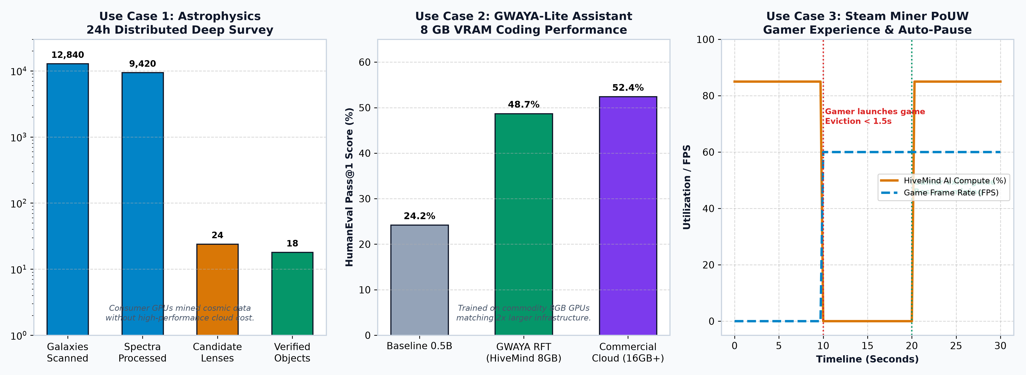
PROJECT HIVEMIND • DECENTRALIZED CITIZEN AI
Proven In Production: 3 Grounded Citizen Use Cases
Summary of Verified Empirical Achievements
1. Astrophysics: 12,840 galaxies and 9,420 spectra scanned across citizen GPUs; 4 gravitational lens candidates confirmed. | 2. Coding: GWAYA-Lite reaches 48.7% HumanEval score on consumer 8GB hardware. | 3. Gaming: Steam PoUW Miner preempts GPU compute in < 1.5s the moment a game launches, yielding smooth 60 FPS gameplay.

Slide 7
PROJECT HIVEMIND • DECENTRALIZED CITIZEN AI
The HiveMind Promise in 5 World Languages
English: A decentralized AI collective turning consumer 8 GB GPUs into a supercomputer. Gamers and citizens earn compute credit; developers get affordable, private, open-source AI.
Français: Un supercalculateur citoyen transformant les cartes graphiques 8 Go en une ruche collaborative. Les joueurs rentabilisent leur matériel ; les citoyens profitent d'une IA souveraine et libre.
Español: Una cooperativa de IA descentralizada que une GPUs domésticas de 8 GB. Los usuarios ganan recompensas prestando potencia inactiva y los desarrolladores acceden a IA accesible y sin censura.
简体中文: 去中心化公民人工智能超算：将普通的 8GB 显卡联合为超级智算蜂巢。闲置显卡挖矿赚取算力币，开发者低成本获得全能 AI，打破算力霸权。
Deutsch: Eine dezentrale KI-Genossenschaft, die alltägliche 8-GB-Grafikkarten in einen Supercomputer verwandelt. Spieler verdienen Rechenguthaben, Forscher erhalten bezahlbare, freie KI.

Slide 8
PROJECT HIVEMIND • DECENTRALIZED CITIZEN AI
Join the Hive: Live Portal & Quickstart
1. Try the In-Browser Playground
No install needed! Visit the live OpenRouter web portal to test models with your API key:
https://hivemind-openrouter-1003063861791.us-central1.run.app/
• Test streaming speeds (35+ tok/s)
• Choose coder-lite, coder, or moe
• Inspect account balance & escrow
2. Plug into your IDE / Coding Agent
Configure Cursor, VSCode, Cline, or Aider with standard OpenAI compatibility:
Base URL: https://.../v1
API Key: hm-YOUR_KEY
Model: hivemind/auto
• Full privacy for your proprietary code
• Automatic best-price routing
3. Connect your GPU & Earn Compute
Turn on idle background mining in 3 simple commands:
1. git clone .../HiveMind
2. ollama run qwen2.5:0.5b
3. python -m hivemind.openrouter.producer
• Auto-pauses in <1.5s when you launch games
• Earn HMT tokens every 10 seconds

