Slide 1
Newark Medical Associates System
Prepared By:-
Nishaben Patel
Xavier Garay

Slide 2
Table of Contents
Introduction
Objectives
Concepts & Fundamentals
Project Platform
E-R Diagrams
Hardware & Software Requirements

Slide 3
Introduction
Project Definition:-
The purpose of online employee account portal helps administrator honor their professional commitments by following a tailored version of the organization’s standard process. This application is supported by a database consisting of employee’s salary details and their leave allowances. Based on these details at the end of every month the application automatically calculates their salary. The amount of salary calculated into employees account is a variant of their leave allowances .This Payroll Processing application also considers employee’s income tax regulations. Based on these considerations the salary of each employee is deducted at the source. This application also includes generation of salary slips to every employee.

Slide 4
Objective
The Purpose of the project :-
It’s help to maintain the information regarding the employee and generates the pay slip.
It attempts to integrate all departments and functions across a company onto a single computer system that can serve all those different departments' particular needs. This will help to identify the loose ends in the system & there will be a chance to improve upon it.
The management will have the right to see the actual working of the different teams whether all the teams are achieving their deadlines or not.

Slide 5
Concepts & Fundamentals
Clinic Employee Data
Payroll Records
Rates
Ledger
Hours Worked
Net Pay
Gross Pay
Deductions
Taxes
Pay slip
Year-To-Date Total

Slide 6
Project Scope
Features of this Project :-
    It Supports Desktop and Laptop Systems
    It also supports the wireless infrastructure
Its main focus is on the generation of reports at any time Its is Platform Independent

Slide 7
Project Platform
Operating system: | window XP , windows 7 or later
Front End: | Java
Back End: | MySQL

Slide 8
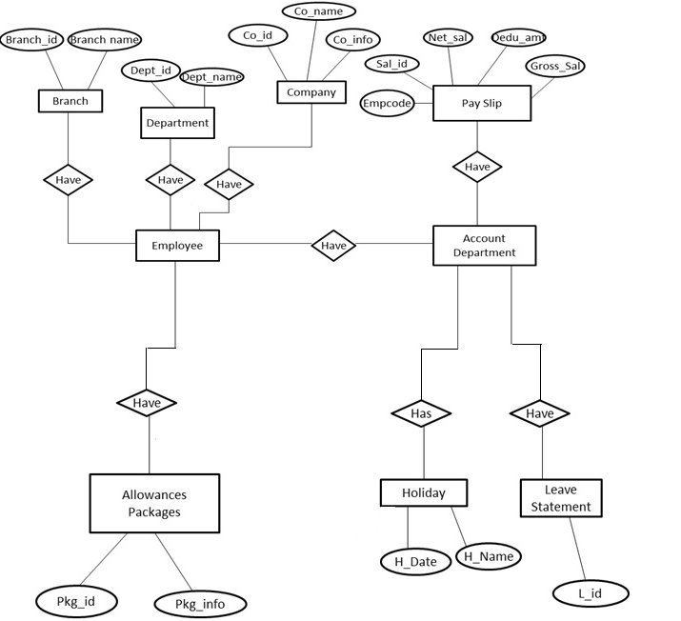
E-R Diagram

Slide 9
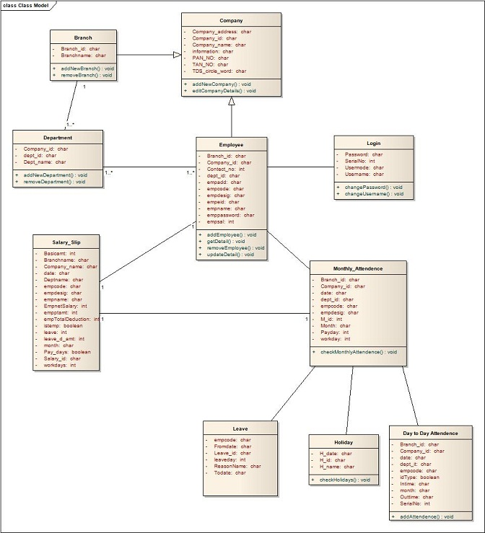
Class Diagram

Slide 10
Hardware & Software Requirements
Software Requirements
    Java Development Kit
    MySQL Database
    MS DOS
Hardware Requirements
    CPU – all
    RAM – 1 GB (MIN)
    Hard disk – 160 GB
    Operating System – All

Slide 11
Screen Shots

Slide 12
Screen Shots

Slide 13
Screen Shots

Slide 14
Screen Shots

Slide 15
Project Summary
This Project will include:-
      Generation of Attendance
      Calculation of the Salary
      Calculation of Taxes
      Generation of Pay Slip
      Generation of MIS Reports

Slide 16
References
Horton, Ivor Java 2 SDK 1.4 Edition Wiley Publishing Inc., Indianapolis 2003
Odinma, Augustine Software Engineering I SEN 261 Lecture Notes April/Spring 2007 ABTI-American University of Nigeria
Palmer, Daniel W. and Daniel H. Steinberg Extreme Software Engineering A hands-on approach Pearson – Prentice Hall, New Jersey 2004

Slide 17
Questions?

Slide 18
Thank You

