Slide 1
CI & CD
Continuous integration
and
Continuous deployment
with Jenkins

Slide 2
What is Continuous integration
A development methodology
Of daily developer integrations
Verified by automated builds
Every commit triggers a build
  As soon as you have completed an independent functionality
  A full build on another, empty machine

Slide 3
Self-testing build
Directly go from source to running build
  No manual copying
  No click on dialog boxes
  No configuration file editing
Test with
  Unit tests
  Functional tests (web tests)
  Performance tests
Responsible persons should be notified when anything fails
Tests web in more browsers

Slide 4
What is it not
Nightly builds
Developer branches
Scheduled integration points
Building via IDEs

Slide 5
Why use continuous integration
Automate the build
Make the build self testing
Keep the build fast
Test in a clone of the production environment
Everyone can see what's happening
Automate deployment

Slide 6
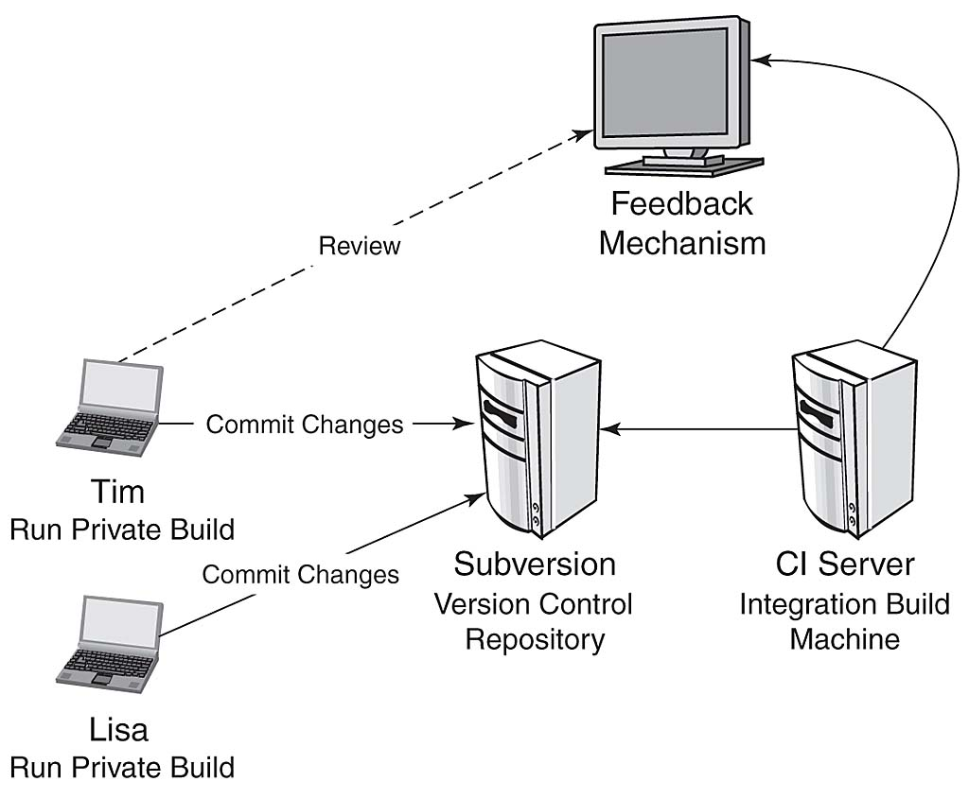

Slide 7
Continuous Delivery
Continuous delivery/Continuous deployment
Continuous, successful and repeatable methodology to deploying code
Automated the steps of taking checked in code and making it run on production servers, used by customers

Slide 8
8 Principles of Continuous Delivery
The process for releasing/deploying software MUST be repeatable and reliable
Automate everything
If somethings difficult or painful, do it more often
Keep everything in source control
Done means “released”
Build quality in
Everybody has responsibility for the release process
Improve continuously

Slide 9
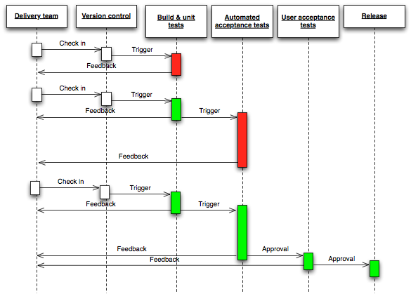

Slide 10
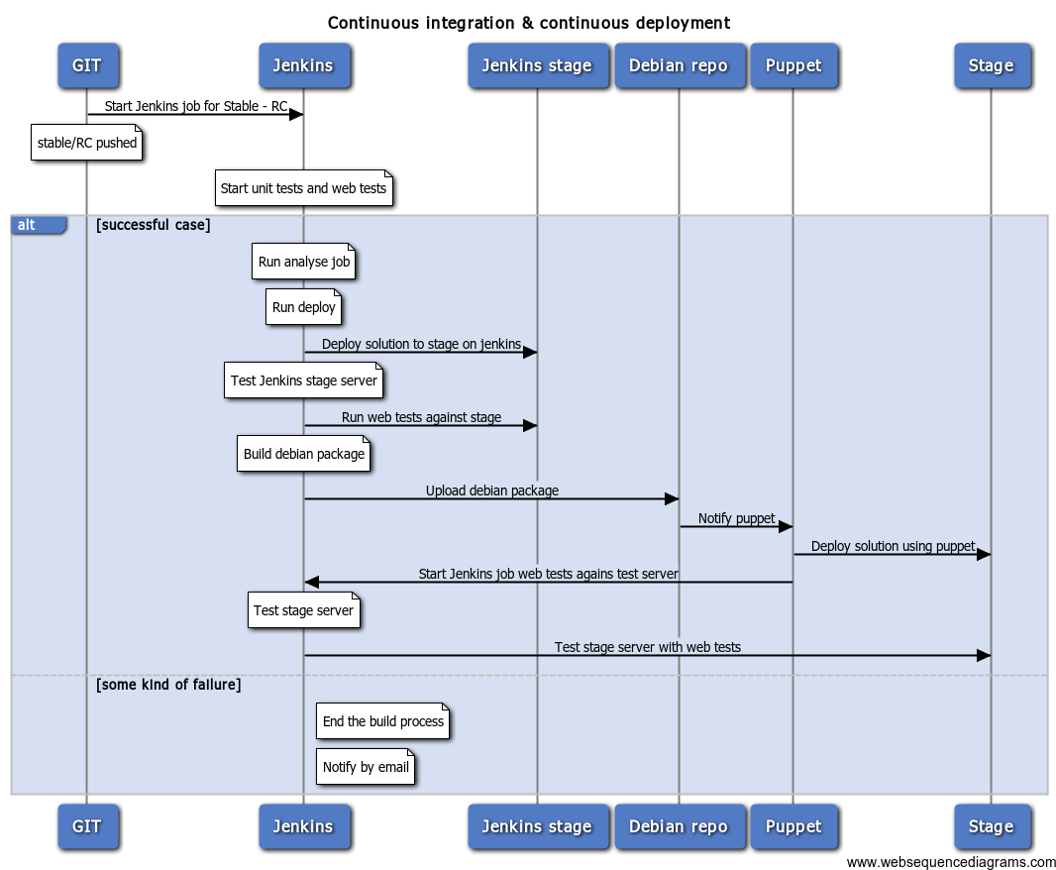

Slide 11
