Slide 1
XAVIER GOH
MID TERM PRESENTATION — MY NOC EXPERIENCE

Slide 2
MY NOC EXPERIENCE
INTERNSHIP
CoverHound & CyberPolicy
My Responsibilities
My Day-to-Day Duties
Projects/Milestones
ENTREPRENEURIAL DEVELOPMENT
Pitch Globally Shark Tank Style @ Reed Smith, Palo Alto
ProductTank Conference @ Thumbtack, San Francisco
Fireside Chat with Carousell Co-founder(s) @ BLOCK71, San Francisco
REFLECTION

Slide 3
INTERNSHIP EXPERIENCE

Slide 4

COVERHOUND
CoverHound was Founded in 2010 by Basil Enan
The company started as an online auto insurance marketplace aimed at providing customers with auto insurance quotes.
CoverHound is now a recognised insurance technology leader in Property & Casualty (P&C) Insurance.
CoverHound services two product lines — Personal Lines, for individuals and Commercial Lines, for Small and Medium Business (SMB) owners.

Slide 5
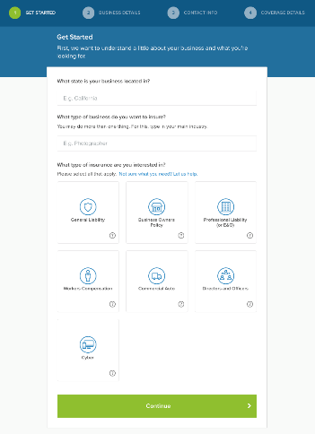
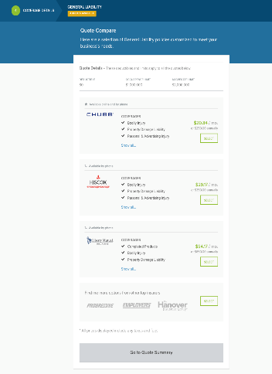
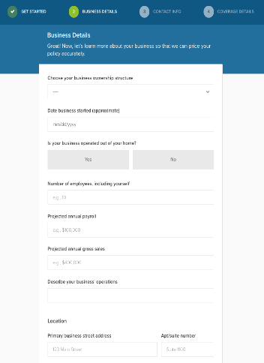
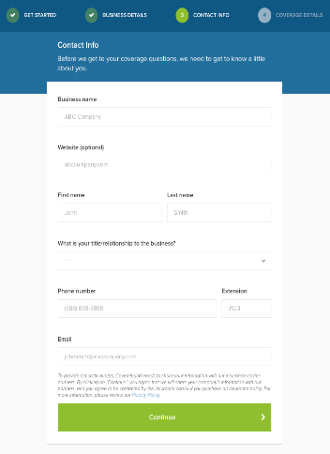
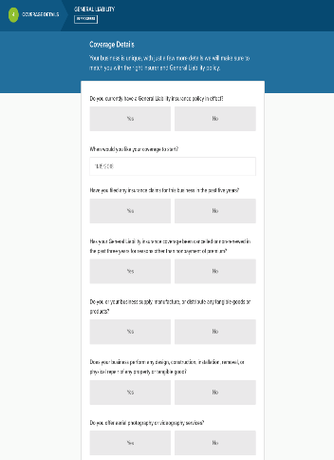
WEB APPLICATION
Online Bind via Web Application
Offline Purchase via Agency

Slide 6

VALUE PROPOSITION
Fast, Accurate & Actionable To meet the demands of today’s digital savvy shoppers
Trusted Advisor for Curated Choice To meet the complex demands of today’s insurance shoppers
High Net Promoter Score (NPS) CoverHound's #1 KPI

Slide 7

CYBERPOLICY
CyberPolicy was founded in 2016 by Keith Moore, current CEO of CoverHound and CyberPolicy
Cyberpolicy is a subsidiary company that leverages on CoverHound’s digital marketplace platform to provide SMBs with cybersecurity options (Cyber Lines)
Cyberpolicy is a pioneer in providing bundled cybersecurity options to SMBs online
CyberPolicy has been helping SMBs obtain comprehensive information on protecting against cybersecurity risks and advocating cyber insurance.

Slide 8
PRODUCT INTERN
MY RESPONSIBILITIES
1
Support product development for small business areas in research, designing specifications, developing and testing, etc.
2
Assist in developing, designing and implementing key performance indicators for the product.
3
Create reports to analyse the overall effectiveness of the company’s sales process.

Slide 9
WHAT IS REQUIRED OF MY JOB
TECHNICAL SKILLSET
PRODUCT KNOWLEWDGE
PRODUCT INTERN AT COVERHOUND
COMMUNICATION

Slide 10





DAY-TO-DAY TASKS
HANDLING REPORTING REQUESTS
Receive & Understand Report Request
Identify what Information is Required and where it is stored
Utilise Existing/Build New Dataset or Dataflow
Build Report
Review & Make Changes (if necessary)

Slide 11
WHAT I’VE DONE – AN OVERVIEW
Built/Updated/Reviewed
300+
Report Cards
Handled
150+
reporting requests
Maintained & Updated
100+ Datasets/Dataflows
Built
50+ Datasets/Dataflows
Found/Ticketed
30+ Bugs

Slide 12
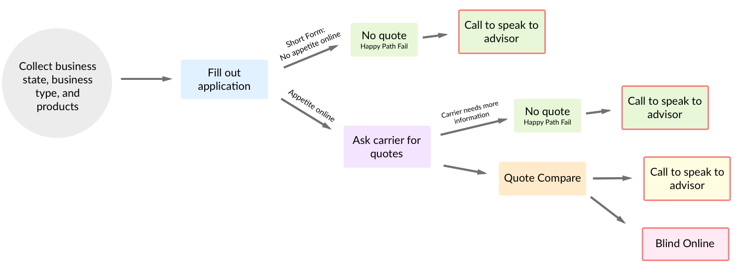
REQUIRED WORKING KNOWLEDGE
Understanding Consumer Journey
MARKETING
(e.g. Advertisement Campaigns)
LANDING PAGE
IN-APPLICATION FLOW
SELECTION/PURCHASE
RETENTION
Economic Analysis of Advertising Efforts
User Flow Tracking
Source/Brand?
Bounce Rate?
# of Commercial Hits? Hit-to-Lead Conversion? Ad Spend?
Simplified Consumer Decision Tree
Lead Time Value (LTV) / Customer Acquisition Cost (CAC)

Slide 13

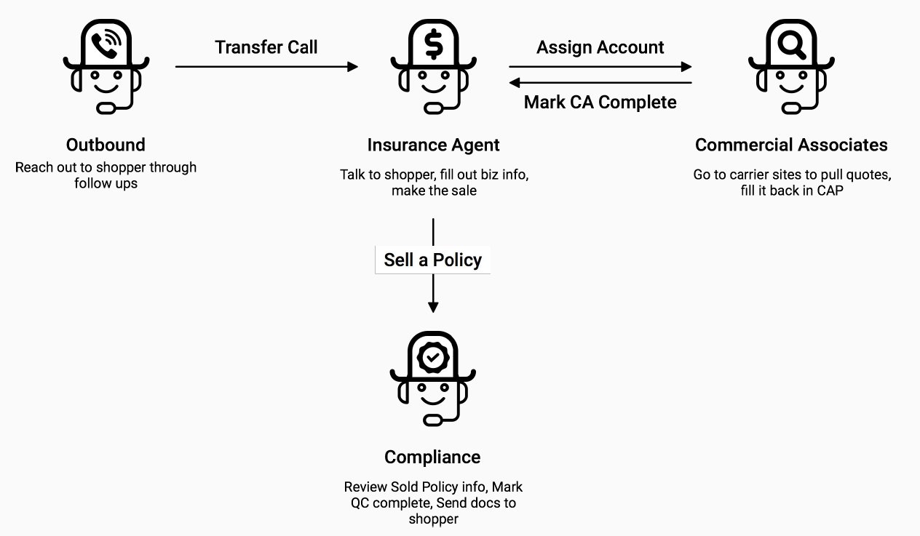
REQUIRED WORKING KNOWLEDGE
Understanding Product Operations
Online Application Flow
Offline Agency Workflow
Customer Profile
Agency Performance
Application Performance
Client Status
Consumer Selection Behaviour
Work Force Management

Slide 14
WHAT I WORK WITH
Data Source/Extraction
Languages
SequelPro (Commercial, Cyber, Personal Lines)
Postico (Segment Data — Online Hit Information)
Google Sheets
MySQL (Structured Query Language)
PostGreSQL
Visual Basic (VB)
Data Cleaning
Data Visualisation/Reporting/Analysis
Progress Tracking
In-Query
Microsoft Excel
DOMO (4,000+ Cards, 700+ Datasets/Dataflows)
Microsoft Excel
Google Sheets
PivotalTracker

Slide 15
KEY SKILLS & CHALLENGES
Be Extremely Familiar with Database and Data Entity Relationships (one-to-one / one-to-many / many-to-many)
Be Familiar with Existing Dataset/Dataflows
Be Familiar with Data Warehouse Processes (ETL)
Be Meticulous in Reporting Data
Understand Request (Need to clarify – the right questions to ask)
Understand Metric & Expected Outcome
Understand Operations & Product
Make Sense of Data

Slide 16


PROJECTS & MILESTONES
Centralising lead management to Commercial Agency Portal (CAP) to allow agency to manage all leads (CoverHound & CyberPolicy) on a centralised platform and to aid reporting efficiency.
[SEP – OCT 2018] CYBER-COMMERCIAL AGENCY PORTAL INTEGRATION
Context
CoverHound and CyberPolicy have separate CRM portals and databases (with different data structure). Changes in resource flow, logic and data structure were made to accommodate this integration.
My Involvement
Understand and remember changes made as indicated in changelog.
Make changes to existing datasets/dataflow in DOMO and update cards affected by change.
Identify bugs that surface as a result of the integration.
Key Challenges
Understand code logic of original dataset/dataflow and purpose of card and build similar dataset/dataflow with different logic.
Check for data integrity (i.e. numbers are accurate)
Explain and communicate differences in report cards pre-integration and post-integration
Cyber DB
CAP DB
Cyber Leads
Commercial Leads
Personal Lines Leads

Slide 17
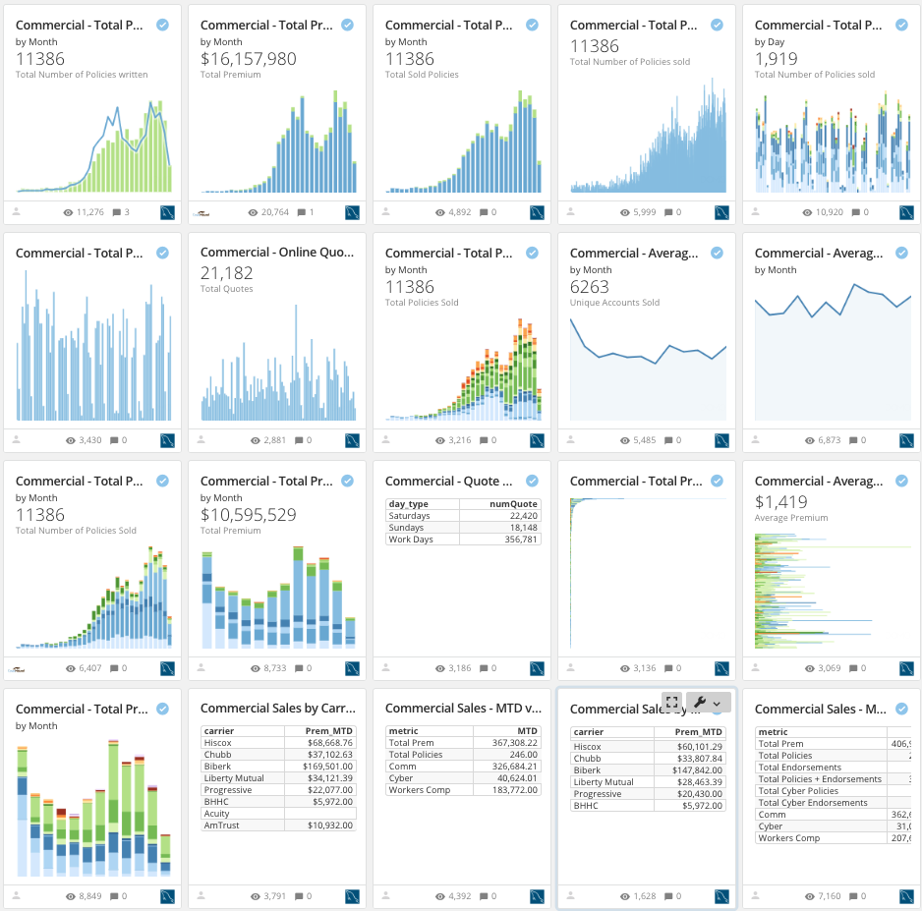
PROJECTS & MILESTONES
Providing greater confidence to reported numbers on certified cards by conducting rigorous data integrity checks.
This is critical due to the data-driven decision making culture of my company.
[OCT 2018 - Ongoing] DOMO CARD CERTIFICATION EXERCISE
Context
The company has a lot of report cards (4,000+). Not all cards are reporting accurate data. DOMO introduced a certification feature that helps indicate that a report card has been rigorously checked for data integrity.
My Involvement
Remember changes/enhancements to DB made and check that cards are updated with new requirements.
Rigorously check for data integrity by writing a separate query for each card (90+ written so far)
Key Challenges
Understand the meaning and calculation of performance metric being tracked
Communicate and explain why an existing dataset/card is resulting in inaccuracies
Report and log potential bugs found in process

Slide 18

PROJECTS & MILESTONES
Assigning a “score” to shoppers based on their priority (how likely to convert to sale, estimated premium, etc). This helps to guide resource allocation when providing services.
[NOV 2018 – Ongoing] SHOPPER SCORE V2.0
Context
The company has three product lines with each product line offering many products. The company services diverse customer profiles, each with differing preferences and consumption behaviour.
My Involvement
Pull data to help determine shopper buckets (e.g. by revenue, number of employees, etc.)
Present findings in a clear and concise manner
More tasks
Key Challenges
Aggregate data at specific levels (by product selection combination, revenue brackets, etc.)
Explain potential oddities, errors and outliers
500

Slide 19
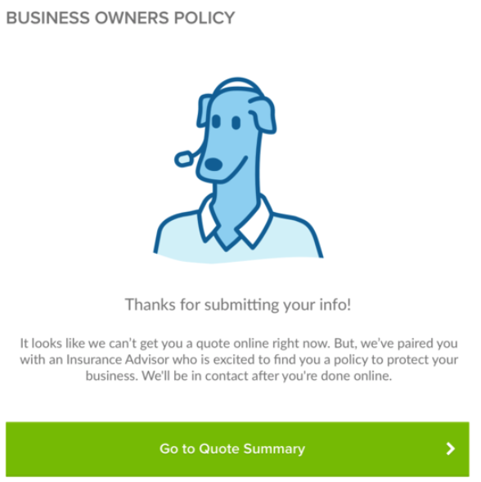
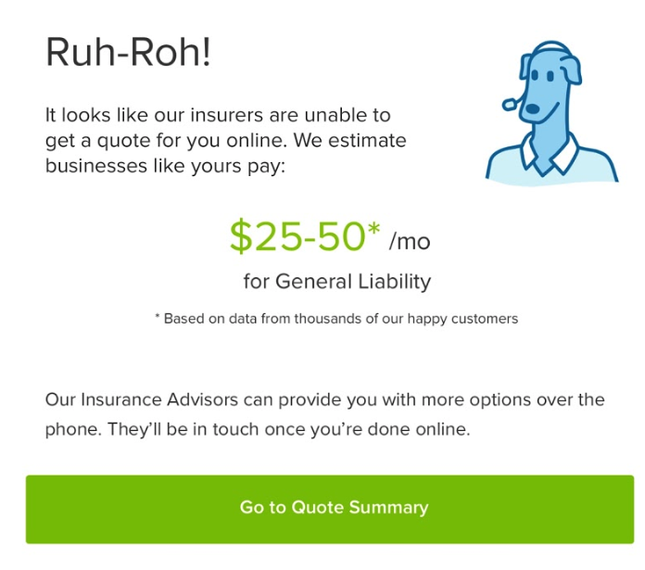
PROJECTS & MILESTONES
Providing value to customers who receive no quotes by giving them a quick estimate of the insurance premium. Gives customer greater control and increase trust in brand.
[NOV 2018 – Ongoing] IN-FLOW PRICE ESTIMATOR
Context
The company is unable to provide instant insurance quotes for some businesses/shoppers. Rather than show a ”fail page”, the company hopes to give shoppers a good estimate of what they can expect to pay.
My Involvement
Preparing training dataset
Test & analyse accuracy of prediction model
More tasks
Key Challenges
Understand and ensure integrity of metrics being used to train data (unique on product selection)
Understand how the prediction model works to reliably report and improve accuracy

Slide 20

PROJECTS & MILESTONES
Improving efficiency of agency by prioritizing shoppers more likely to buy higher premium/multiple policies and by
routing shoppers to specialized IAs to improve conversion & NPS
[NOV 2018 – Ongoing] INTELLIGENT ROUTING PROJECT
Context
The company is unable to provide instant insurance quotes for some businesses/shoppers. Rather than show a ”fail page”, the company hopes to give shoppers a good estimate of what they can expect to pay.
My Involvement
Preparing training dataset
Test & analyse accuracy of prediction model
More tasks
Key Challenges
Understand the Shopper Score v2.0 Project and how it ties with Intelligent Routing implementation
Understand the In-Flow Price Estimator Project and how it ties with Intelligent Routing implementation
Understand the decision tree and routing paths

Slide 21
OTHER INVOLVEMENT
BEING INVESTED IN THE COMPANY
Offering suggestions
More Data Validation
Less Datasets, More Dataflows
Performance Tuning Options
Standardized Nomenclature
OTHER LEARNING EXPERIENCES
UI/UX Webinar: Invision’s Research Series
UI/UX Brainstorming: Happy Path Fail
UI/UX Brainstorming: CAP Activity Feed Redesign
Product Feature Testing
Operations, Work Force Management and Partnership Success Presentation
Fuzzy Matching Tasks

Slide 22
THANK YOU

