Slide 1
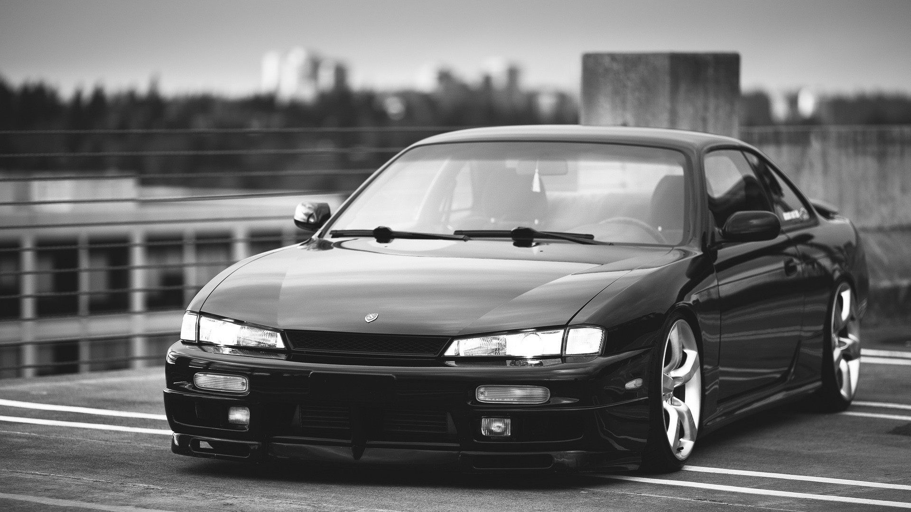
Car Curing
徐嘉澤
By Kazuo , 2023-12-22

Slide 2
Motivation & Include function
Motivation
For players who love old cars, the condition of the car must be paid attention to at all times. Compared with new cars, the maintenance of old cars requires more attention.
Include function
Maintenance data
Fuel consumption calculation
cost calculation
Maintenance cycle
Favorite store
Whether old or new, vehicles carry the safety of their passengers. Therefore, it becomes the owner's responsibility to track and maintain the condition of the vehicle.

Slide 3
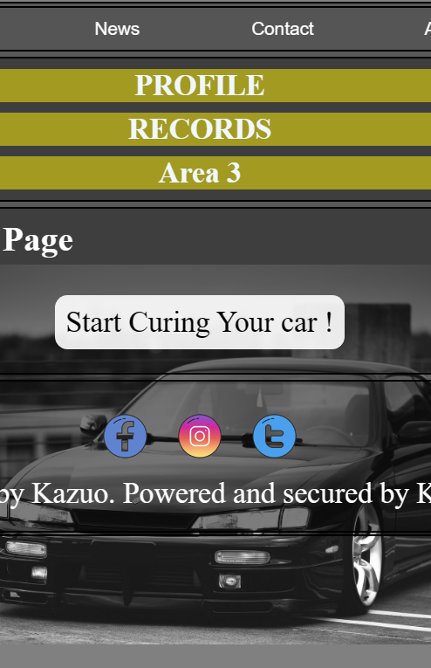
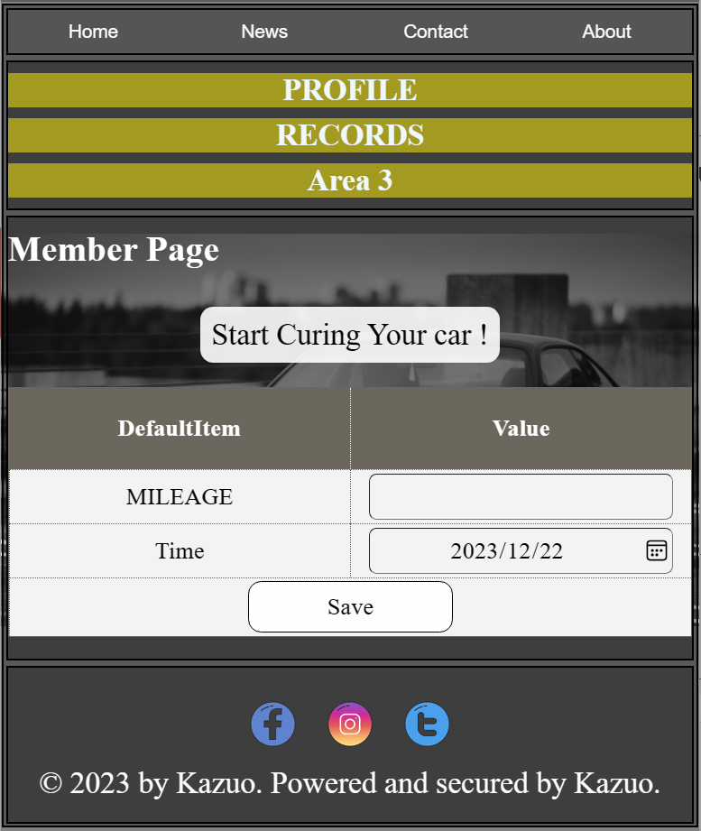
Introduction (1/5, prework)
Add your 1st data into the web for starting with your using:
MILEAGE
Key the car mileage for now.
TIME
Key latest maintenance check time to be the system baseline.

Slide 4
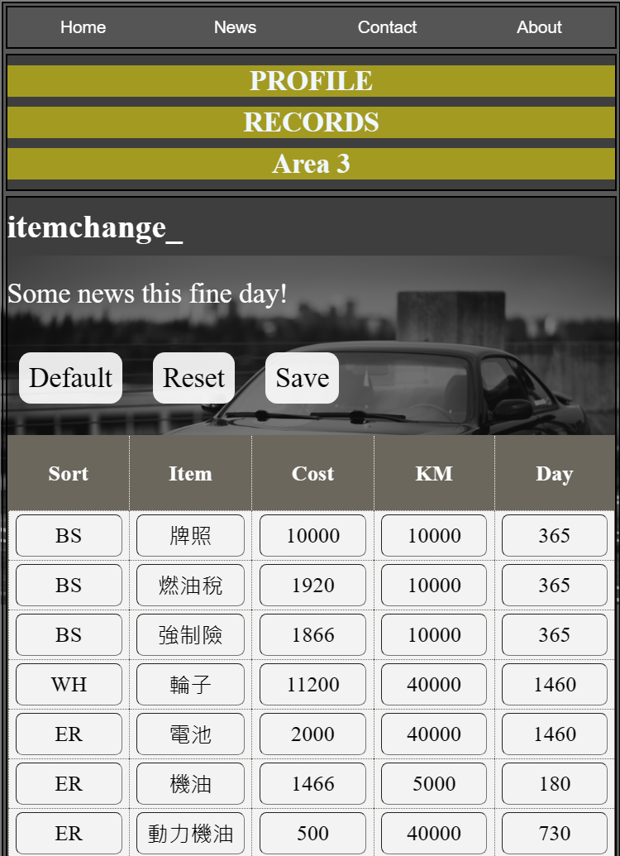
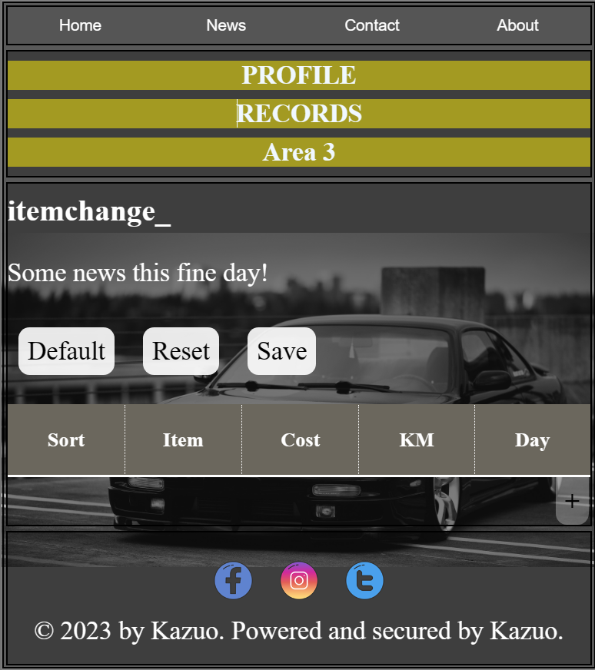
Introduction (2/5), prework
Edit your Maintain cycle for each parts in different sort:
Sort
Key the sort.
Item
Key the maintain item name.
Cost
Key the item cost.
KM
Key the km least need to be change .
Day
Key the day least need to be change .
All these data will be save & use without the database.

Slide 5
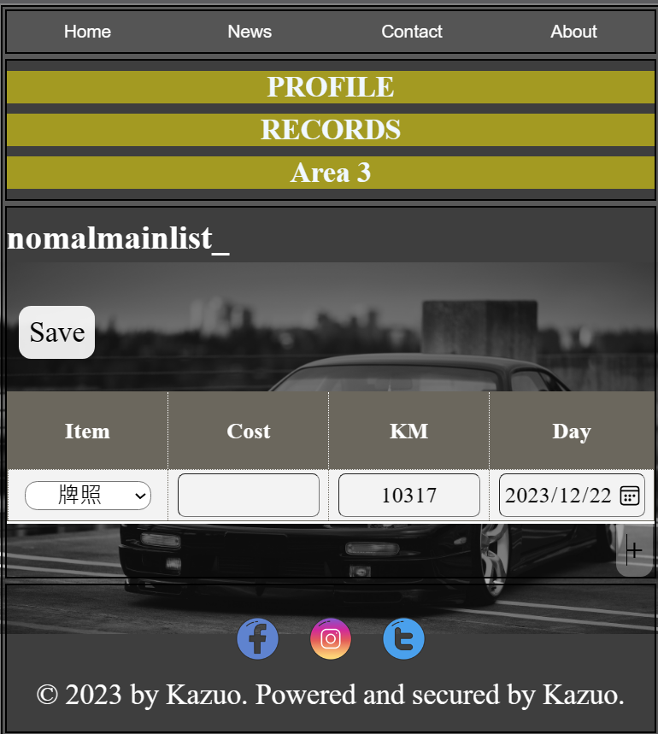
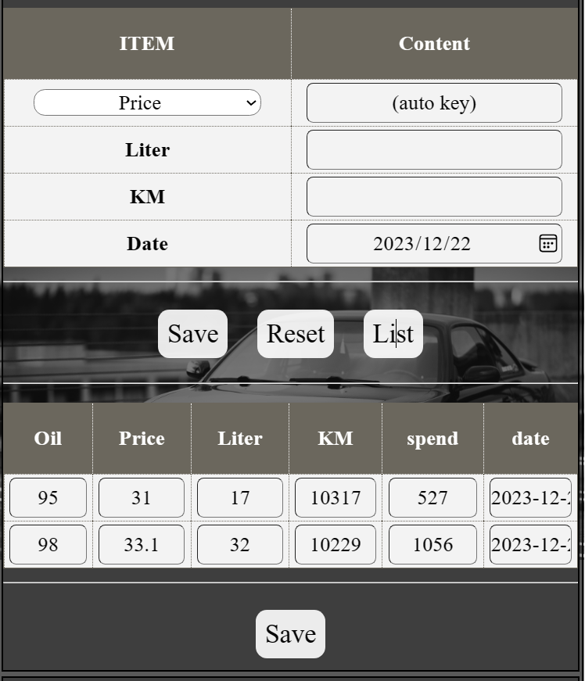
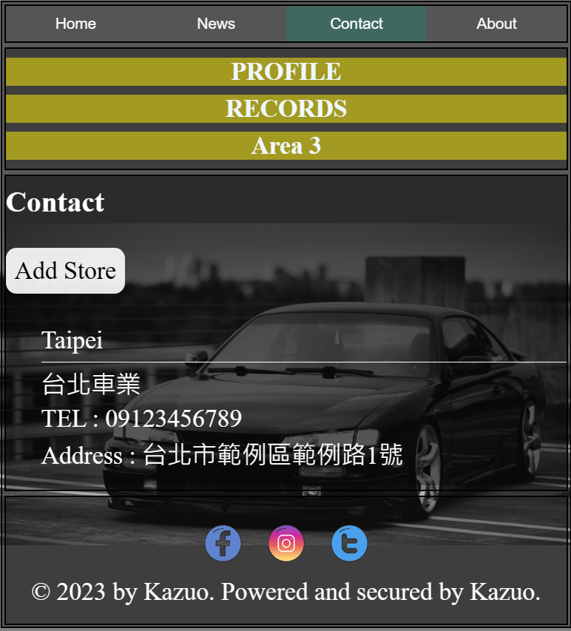
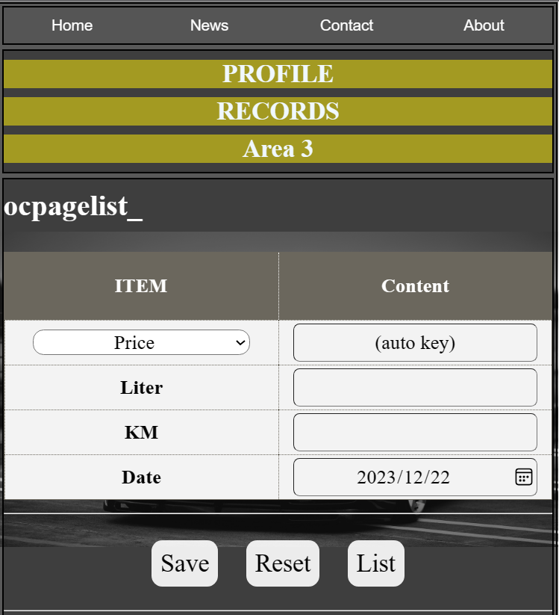
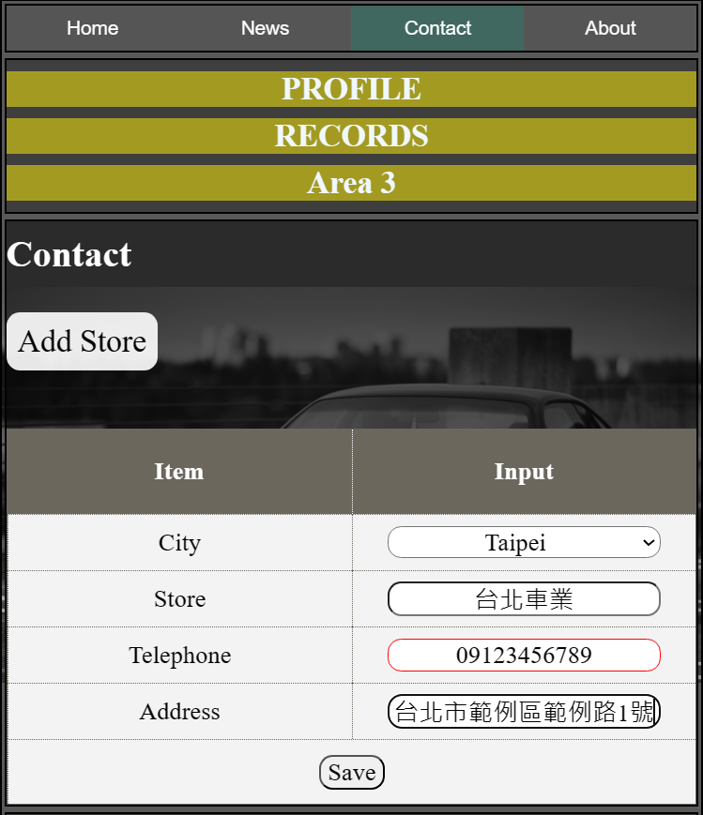
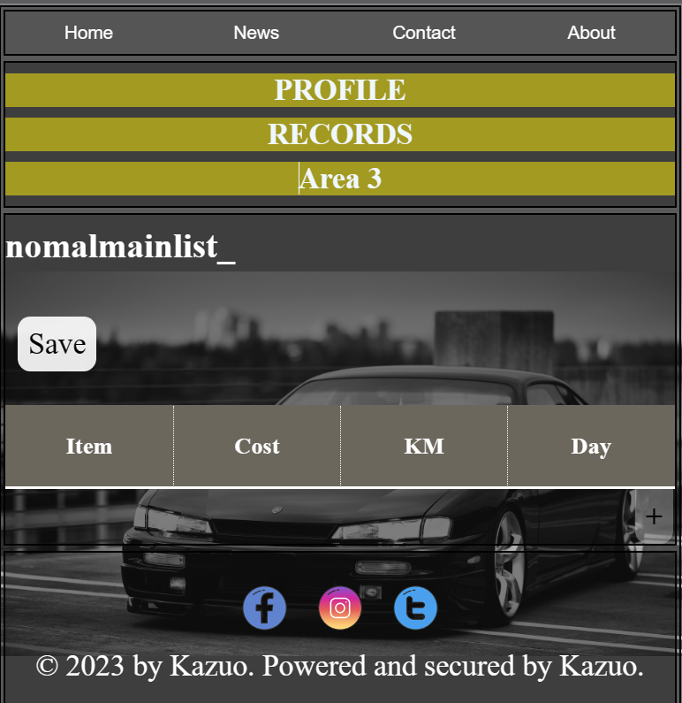
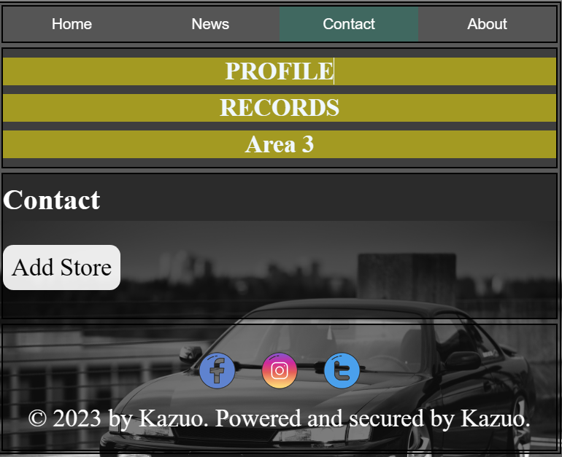
Introduction (3/5, using)
Add oil information:
Oil Consumption
Key the oil price、mileage、liter.
Normal/un-Normal Maintain
Key the maintenance items.
Contact person
Key your favorite store

Slide 6
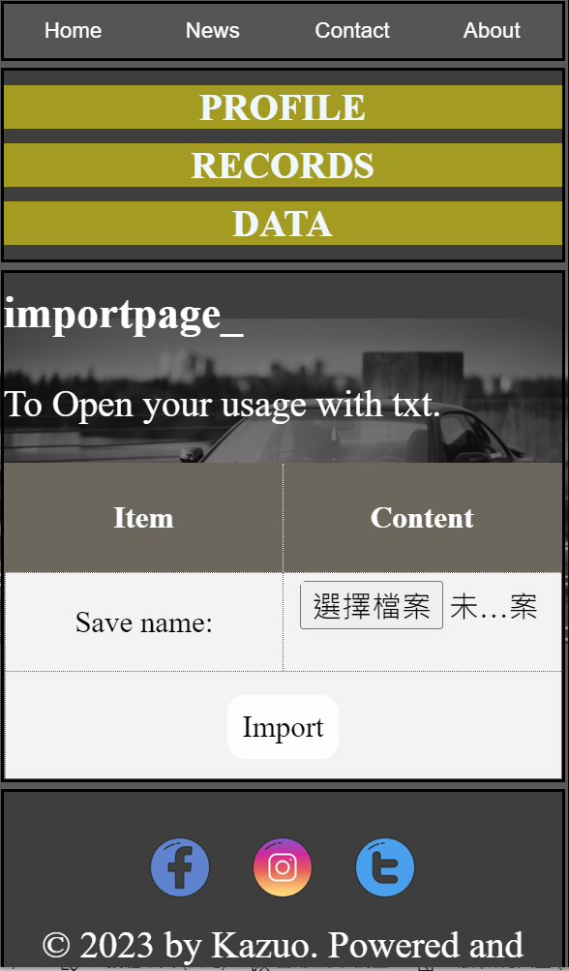
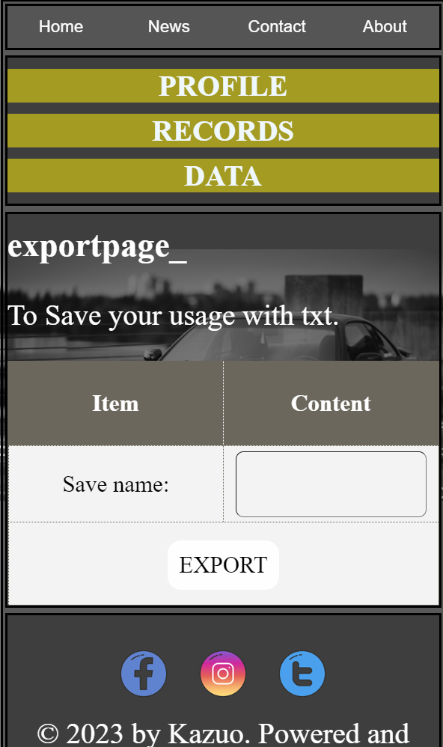
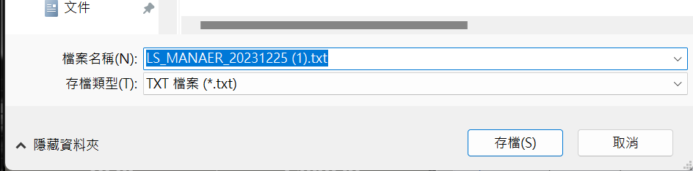
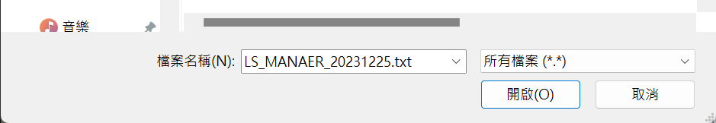
Introduction (4/5, data)
Export / import:
Export
Key the oil price、mileage、liter.
import
Key the maintenance items.

Slide 7
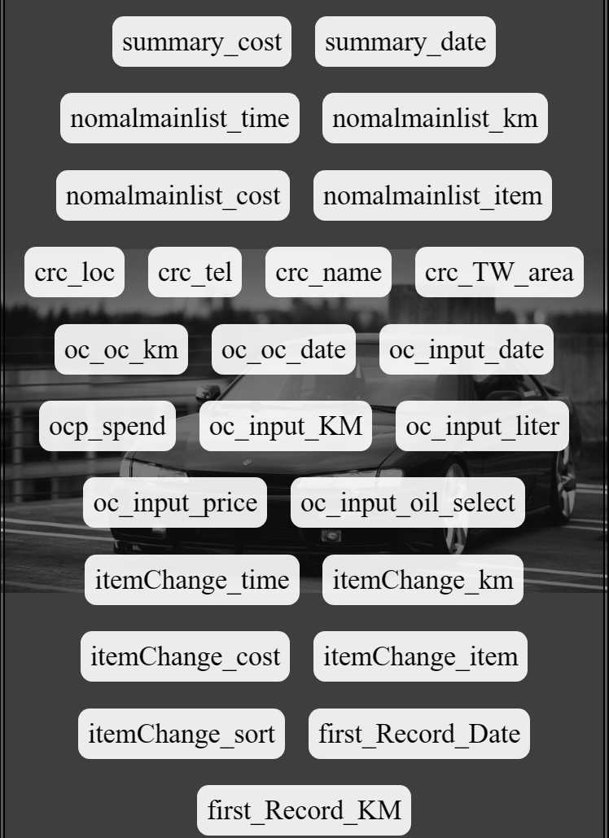
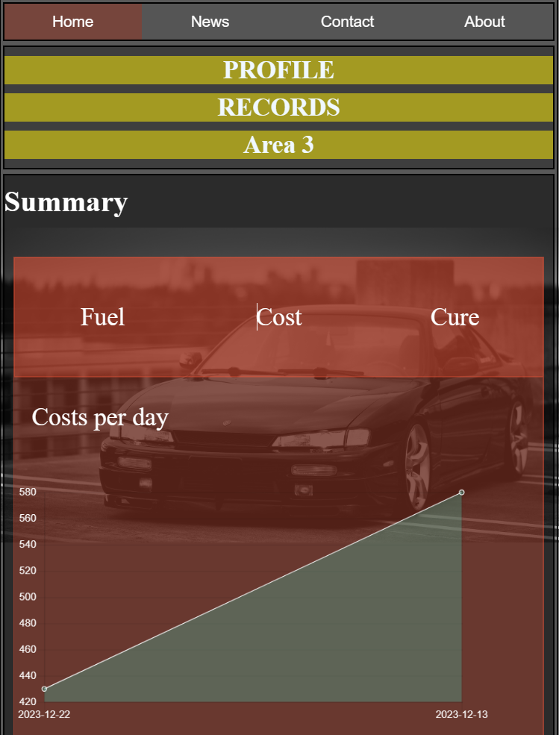
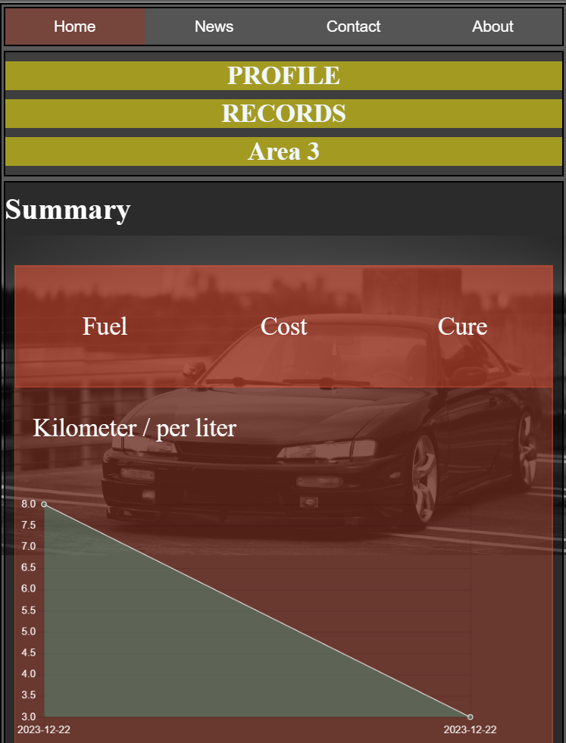
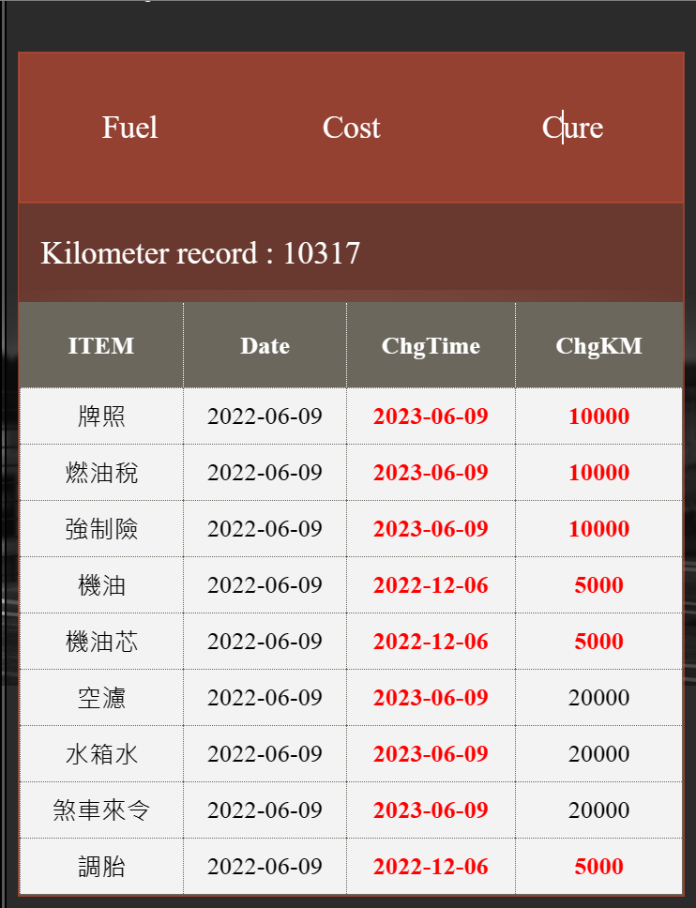
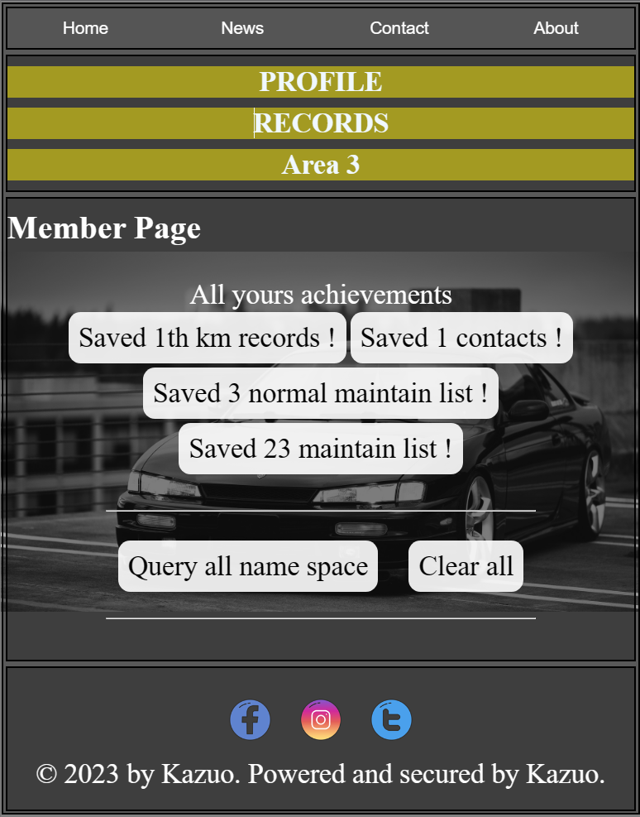
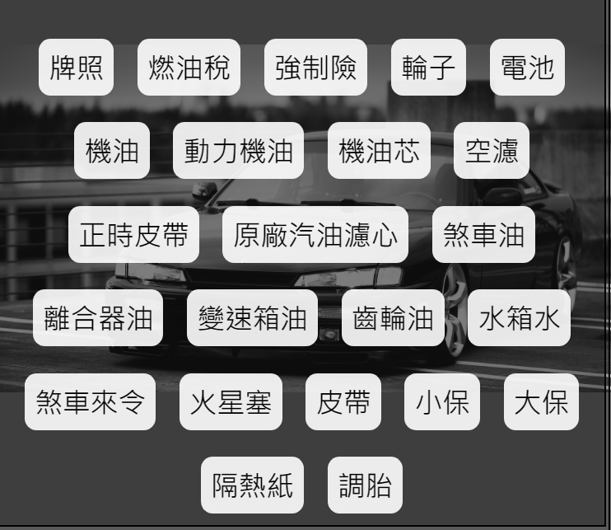
Introduction (5/5), summary
Summary page
Fuel consumption / Cost by day / need maintain items
Store space
Show all the data you save.

Slide 8

Thanks for your listening
By Kazuo , 2023-12-22

