Slide 1
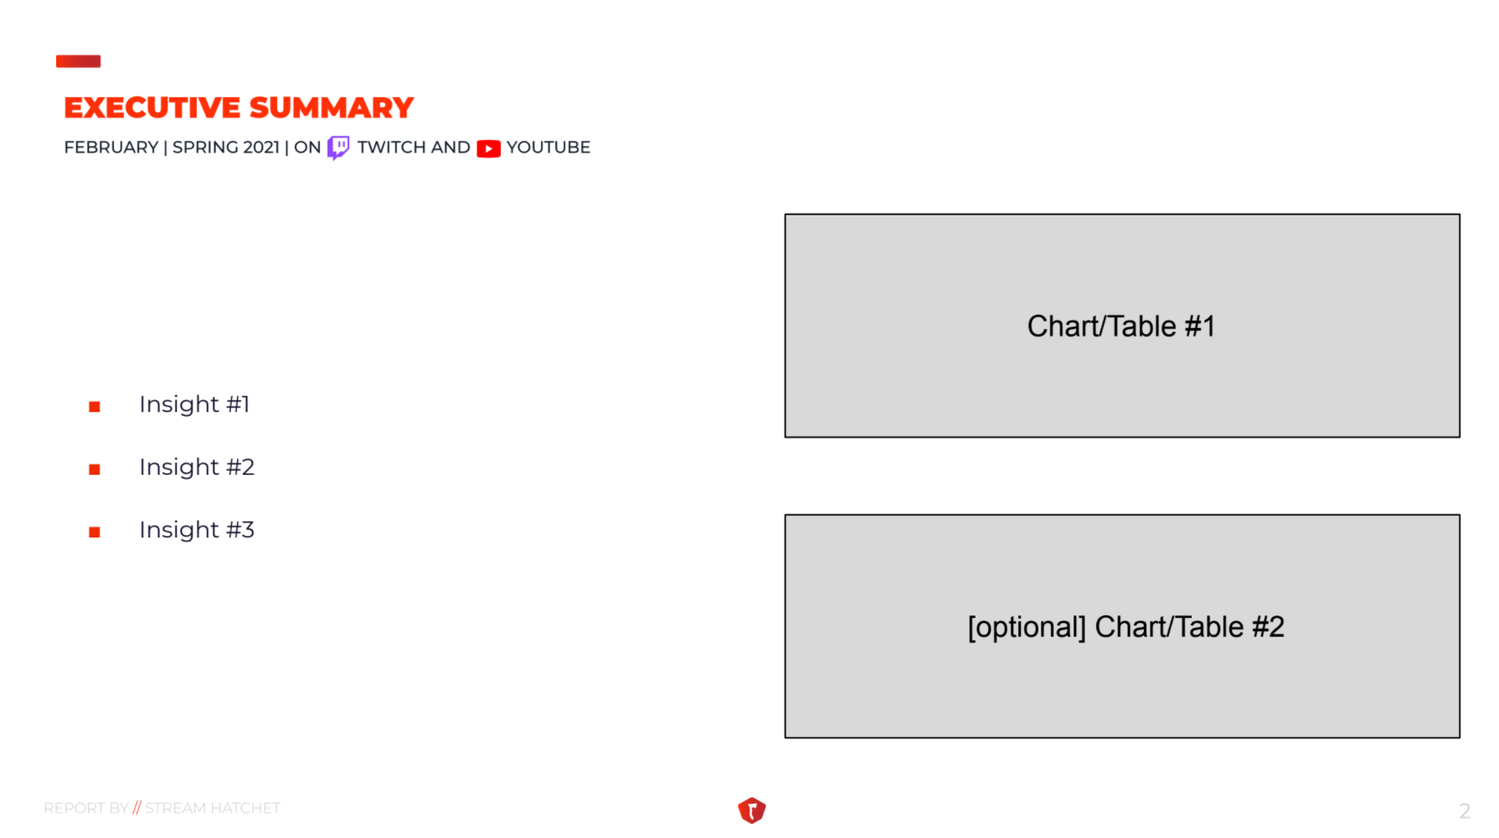


AMA PEAK (K)
TSM & C9 take the higher AMA PEAK at 250k in their most watched match with 119k hours.
Week 2 is the week with the most hours watched of 3k over the total of the 9k hours of the month.
Grubhub Mentions
Grubhub mentions perform very well at week 1 and week 4 and really underperform at week 2 where the hours watched is the max. of the month. (Week 3 has small Grubhub mentiosn but is due to the small hour sreamed as well)
Week 2
Hours watched

