Slide 1

Project Overview
October 13th 2016
Created by: Dakota Fang, Nick Liu, Carlos Rado and Xavier Mercado

Slide 2
Agenda
Project Description
Functional Users
WireFrame Examples
Technical Specifications
Use Case Model
ERD Diagram
Login Page
Admin Profile Page
Renters Page
Reservations Page
Q&A

Slide 3
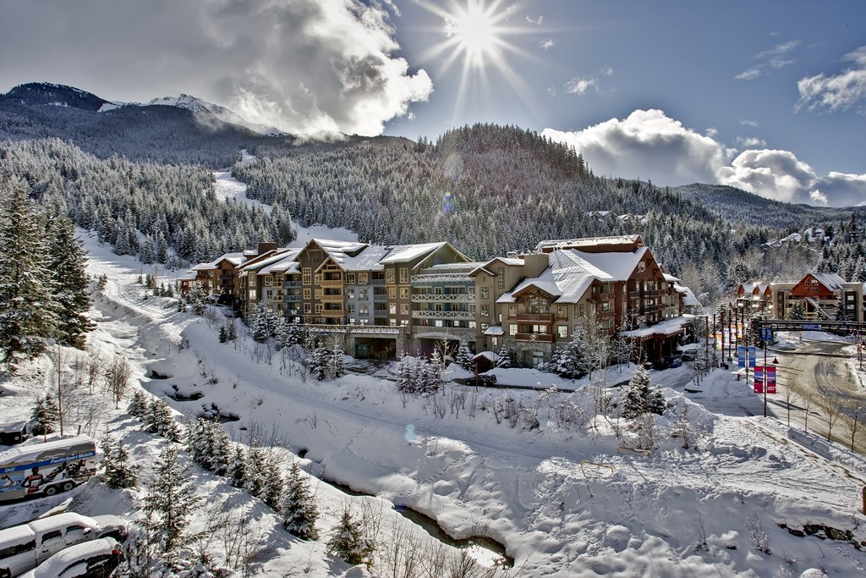
Project Description
WhisCabins.CA is the next Accomodation Marketplace application for people who is willing to have a great time on a lovely Cabin in Whistler,British Columbia.

Slide 4
Functional Users
Office Manager
Owner
Renter
WhisCabins is his/her main Work Application.
Is the person who owns the property.
Is the person who wants to rent a property.
IT Administrator
Makes sure the application is working correctly.

Slide 5
Technical Specifications
Use Case Diagram

Slide 6
Technical Specifications
ERD Diagram

Slide 7
¿Q&A? THANKS A LOT FOR YOUR TIME!!!

