Slide 1
Aligning the three vertices of course design
Delivery (How to teach)
Class activities
link and align the three vertices
Curriculum (what to teach)
Assessment (How do we know if it works)

Slide 2
Aligning the three vertices of your learning objectives
Class activities
Learning Objectives must be always met
Home practice
Summative assessment (exams)

Slide 3
Optimizing the summative assessment
Transparency:
Available to students beforehand
Summative assessment (exams)
Specifications or standard-based grading
A/C/F scale
Badges
Competencies
Cumulative Allows chunking and connections

Slide 4
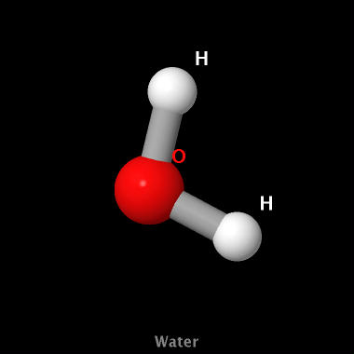
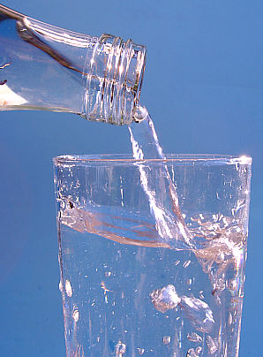
Helping students connect the three different representations in chemistry. Water can be ”represented” in 3 ways.
H₂O
Symbolic
Representations in Chemistry
Submicroscopic Pictures of the abstract atomic world
Macroscopic Experienced with our senses Measurable

Slide 5
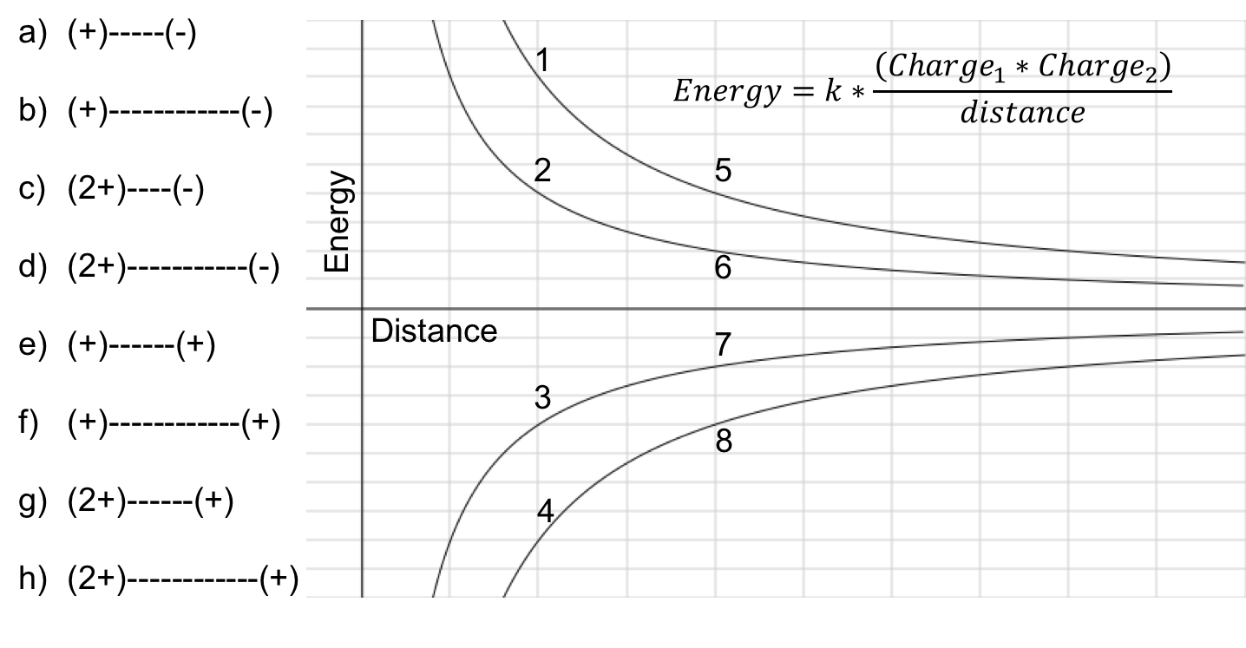
Draw
Represent/Plot
Languages to learn Chemistry D-R-E-C
Explain
Calculate
The electric potential energy depends on the nuclear charge and the distance to the electrons…

Slide 6
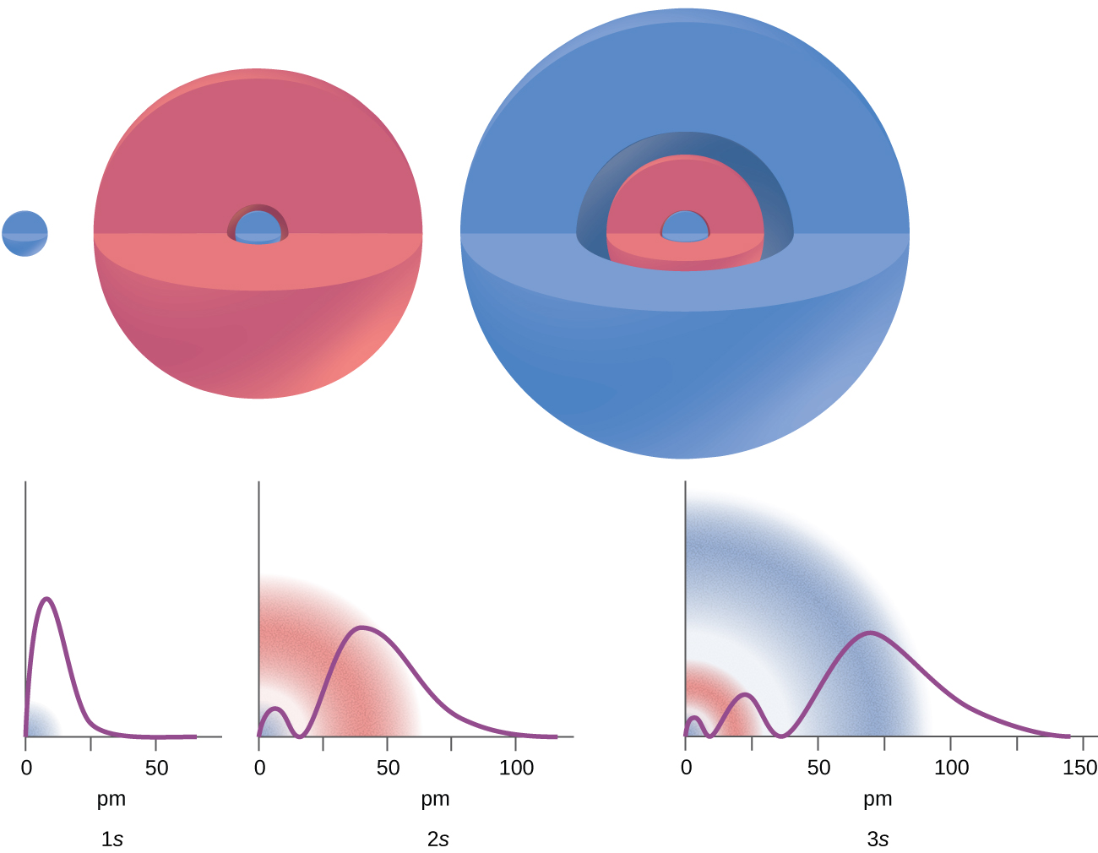
Draw
Represent/Plot
Languages to learn Chemistry D-R-E-C
Explain
Calculate
The electronic density of the hydrogenoid atomic orbital is represented by the square of the wavefunction and has n-1 number of nodes…
P_{nl}(r) = 4πR²R_{nl}(r)

