Slide 1


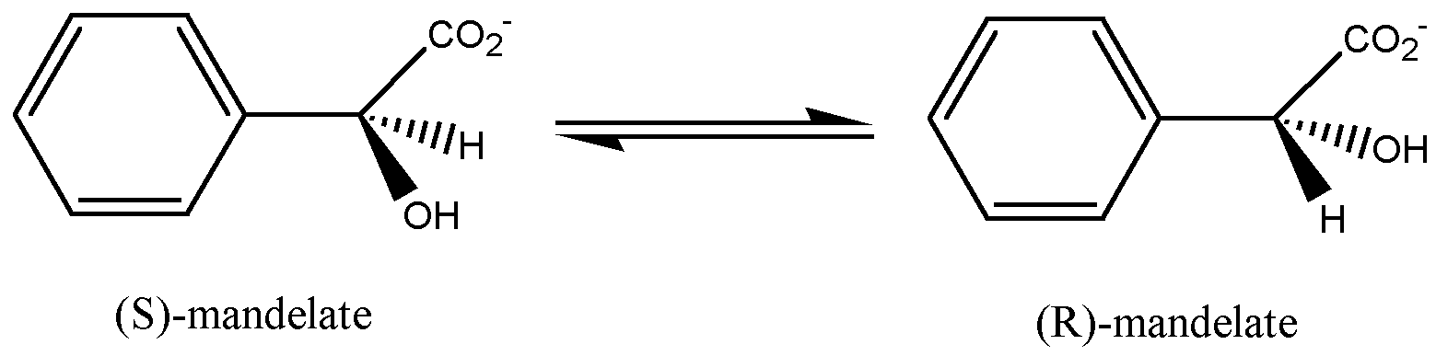
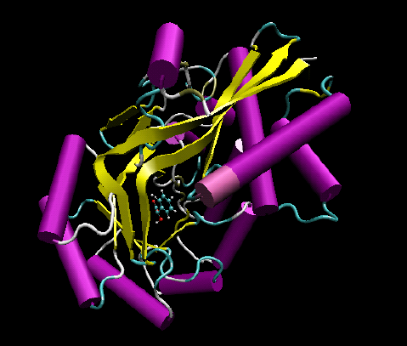
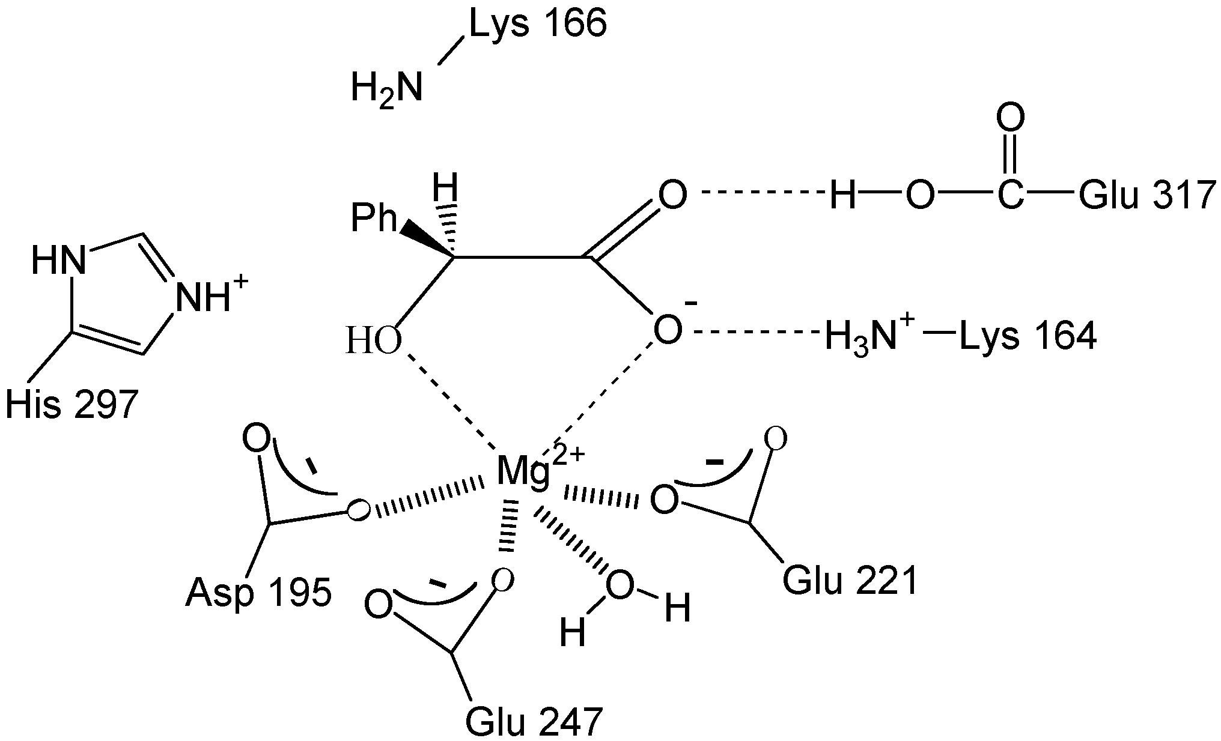
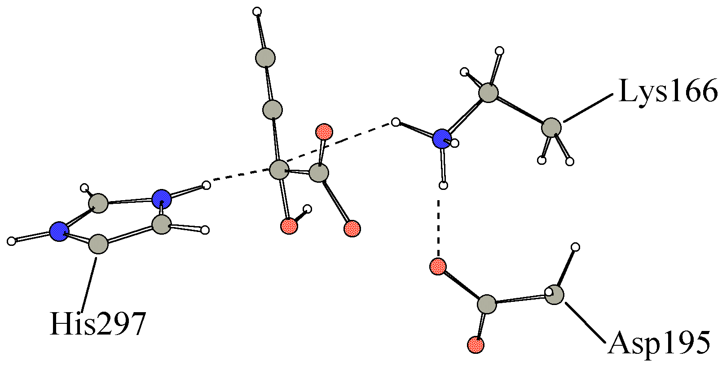
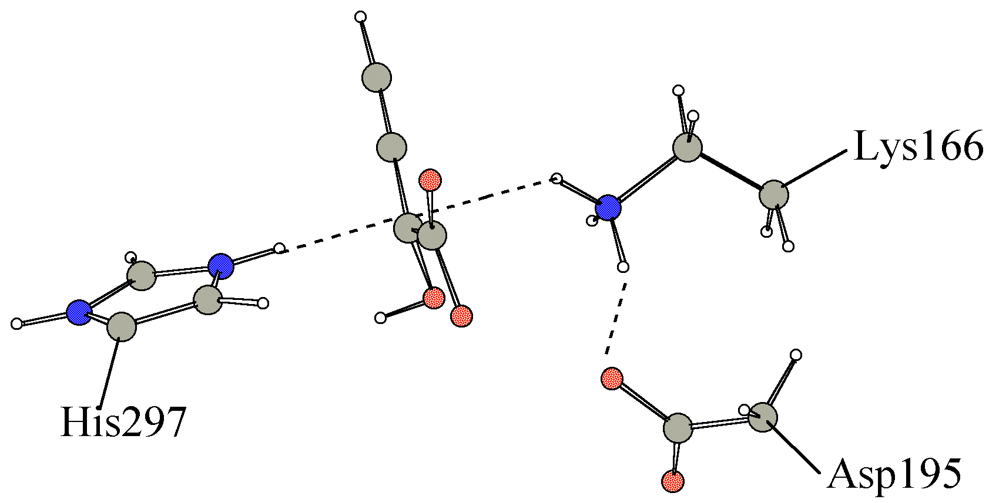
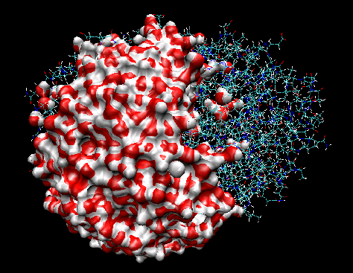
Exploring Mandelate Racemase
Reactivity with QM/MM methods
Xavier PRAT-RESINA, Àngels GONZÁLEZ-LAFONT and José Maria LLUCH
Departament de Química, Universitat Autònoma de Barcelona
08193 Bellaterra (Barcelona) - SPAIN
Abstract
Mandelate racemase is the enzyme which catalyzes the reversible interconversion of the (S) and (R) enantiomers of mandelic acid. It has been studied as a paradigm for enzymes that catalyze rapid carbon-hydrogen bond cleavage of carbon acids with relatively high pKa values. This racemization occurs in a stepwise manner, through abstraction of the α-proton (the one adjacent to the carboxylate group) from either enantiomer of mandelate, followed by stereorandom reprotonation of an anionic intermediate. Isotope exchange and site-directed mutagenesis experiments suggest the participation of different residues playing an important role in the catalytic reaction. Experimental works have dealt with mutants N197A, K166R, H297N and E317Q of the natural enzyme.
The main goal of this work is to shed some light to this problem using Quantum Mechanics and Quantum Mechanics/Molecular mechanics (QM/MM) theoretical methods to investigate the mechanistic aspects of the enzymatic reaction. In particular, we have explored the potential energy surface using minimization and transition state search with a method developed recently in our group. Molecular dynamics simulations have been used to calculate the free energy profile along an appropriate reaction coordinate. In addition, calculations with the mutant enzyme structures will be useful to identify the importance of the different residues in the catalytic reaction.
Mandelate Racemase Enzyme:
The Reaction
Three possible reaction mechanisms (ref. 1)
Two stepwise mechanisms are possible when Lys164 or Glu317 protonate the carboxylic group before the R-S interconversion. (MecI and MecII respectively)
A direct mechanism can take place by only the deprotonation by Lys166 and the immediately protonation by His297 (MecIII)
Three main aspects help to increase the acidity of the α-carbon and to stabilize the negative charge of the intermediates.
1) the proximity to the substrate of Lys166 and His297 for a rapid reprotonation
2) the acid-base catalysis carried out by Glu317 and Lys164
3)The magnesium cation will contribute to the electron charge withdraw needed for the reaction
Mandelate racemase catalyzes the racemization of (R) and (S)-mandelate enantiomers
Important Residues in the Active Site
Experimental results show that the conjugate acids of Lys166 and His297 serve as the proton donors in the formation of (S) and (R)-mandelate respectively.
Moreover other substrates (vinylglycolate and propargyl-glycolate) undergo racemization as well.
The QM/MM model
88 atoms corresponding to the active site are selected to be calculated by PM3 semiempirical Hamiltonian (the magnesium parameters are AM1-SRP). The rest of enzyme is modelled by AMBER forcefield with TIP3P for water molecules.
Exploring the Surface with Optimization methods:
The Algorithm to Find Stationary Points in Big Systems (ref. 2,3)
Results in Mandelate Racemase
A micro-iterative method has been designed. It is based on performing a Newton-like search in a small core zone while an environment is minimized until self-consistency.
We have shown(ref. 2) how important is the refinement of TS location in enzymes and how useful is this kind of exploration before a free energy computation.
The three possible mechanisms have been studied (ref. 1) for two substrates. mandelate and propargylglycolate. A coordinate scan is performed between the intermediates to obtain a discrete energy profile. We can compare the highest point of the energy profile with the refined TS obtained by the micro-iterative algorithm. The energy in kcal/mol is shown in the next table. In brackets the energy corresponding to the refined TS structure.
Testing the Core Size
Several core and environment sizes have been tested in madelate racemase mechaisms. The results show that depending on the reaction type the optimal core size may be very different. For example, in a proton transfer reaction only a few atoms in the core zone are needed. On the other hand when heavy atoms are implicated in the reaction step the core size must be bigger.
 | Substrate: mandelate |  |  |  | Substrate: propargylglycolate
Structures | Mec I stepwise | Mec II stepwise | MecIII synchron |  | MecI stepwise | MecII stepwise | MecIII synchron
S | 0.00 | 0.0 | 0.0 |  | 0.0 | 0.0 | 0.0
TS1 | 17.8 (18.2) | 17.7 (17.8) |  |  | 15.9 (19.7) | 11.8 (11.2)
I1 | 7.8 | 4.7 |  |  | 6.0 | 0.5
TS2 | 19.5 (19.7) | 14.8 (14.5) |  |  | 19.9 (19.9) | 15.3 (15.3)
I2 | 18.3 | 12.3 |  |  | 19.7 | 15.3
TS3 | 20.0 (20.1) | 14.6 (15.0) |  |  | 22.2 (22.2) | 17.0 (17.0)
I3 | 19.1 | 7.9 |  |  | 20.2 | 15.9
TS4 | 22.5 (22.6) |  | 20.2 (19.5) |  | 30.1 (22.2) | 28.1 (20.7) | 22.1 (22.0)
I4 | 22.3 |  |  |  | 21.2 | 15.4
TS5 | 25.2 (25.8) | 23.6 (23.8) |  |  | 23.2 (22.6) | 19.2 (20.1)
I5 | 18.6 | 18.3 |  |  | 15.7 | 15.5
TS6 | 27.2 (27.3) | 28.1 (28.2) |  |  | 23.9 (24.4) | 26.5 (24.6)
R | 6.7 | 6.7 | 6.7 |  | 3.3 | 3.3 | 3.3
MM
QM
core
environment
Initial geometry with a core and an environment
Accelerating the Environment Minimization
Some strategies to save CPU time during the environment minimization have been implemented and tested (ref. 3). These stratetegies are based on the simplification of the QM/MM expression while only MM atoms are moved.
1st: 1SCF/MM
The density matrix is kept frozen. Moreover since the QM part does not move most of integrals are not recomputed
2nd: ESP/MM
The QM calculation is avoided associating fixed ESP charges to the quantum atoms
The 1SCF/MM is the most suitable approximation since it is able to reproduce the pure QM/MM results and it diminishes remarkably the computational cost for the energy evaluation.
environment minimization
L-BFGS until |g_{env}|<crit
looking for TS in core
RFO until |g_{cor}|<crit
NO
is environment minimized?
YES
Transition state found
with |g_{TOT}|<crit
Minimization frequency
We tested how often the minimization of the environment must be performed during the TS search.
A full TS search in the core zone is recomended before a new environment minimization
Important differences may appear between the structures found with the coordinate scan and with the more accurate micro-iterative method. Mainly when the reaction coordinate cannot be directly associated to a geometric parameter. This information is also valuable for the posterior molecular dynamics simulations.
Structures found with coordinate scan (up) and with the micro-iterative method (down) in TS4 (Mec II for propargylglycolate)
Exploring the Surface with Molecular Dynamics:(work in progress)
Several QM/MM models are adopted
Potential of Mean Force
CHARMM program package is used,
PM3 semiempirical Hamiltonian for the QM part with the GHO method to treat the QM/MM frontier
SRP: Some DFT calculations have shown that Glu317 forms a possible LBHB that PM3 is not able to reproduce. Modifying the PM3 parameters for this bond will adequately reproduce the interaction
Magnesium cation and its sphere of ligands can be included in the QM part, if they are not included the Van der Waals parameters can be optimized in order to modulate the charge polarization in the substrate.
By means of umbrella sampling along a reaction coordinate for the wild type enzyme and for the E317Q mutant the free energy for the direct mechanism will be obtained.
Stochastic Boundary Molecular Dynamics is a solution to reduce the high number of the degrees of freedom of the enzymatic system
References:
Xavier Prat-Resina, Mireia Garcia-Viloca, Angels González-Lafont, and José Maria Lluch. On the modulation of the substrate activity for the racemization catalyzed by mandelate racemase enzyme. a qm/mm study. Phys.Chem.Chem.Phys., 4:5365:5371, 2002
2) Xavier Prat-Resina, Angels González-Lafont, and José Maria Lluch. How important is the refinement of transition state structures in enzymatic reactions? J. Mol. Struct (Theochem). in press 2003
3) Xavier Prat-Resina, Josep Maria Bofill, Angels González-Lafont, and José Maria Lluch. Geometry optimization and transition state search in enzymes: Different options in the micro-iterative method. Submitted for publication

