Slide 1

Heart Disease Prediction
Xavier Santos
xavier@ua.pt

Slide 2

Dataset

Slide 3
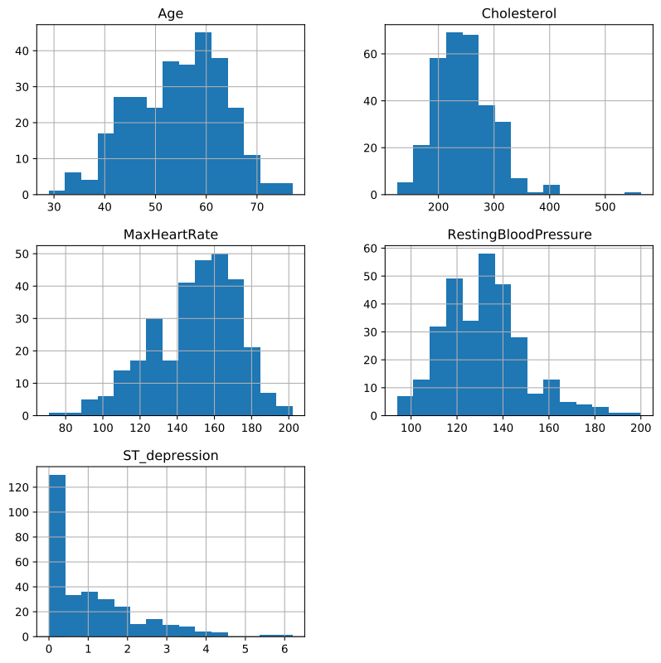
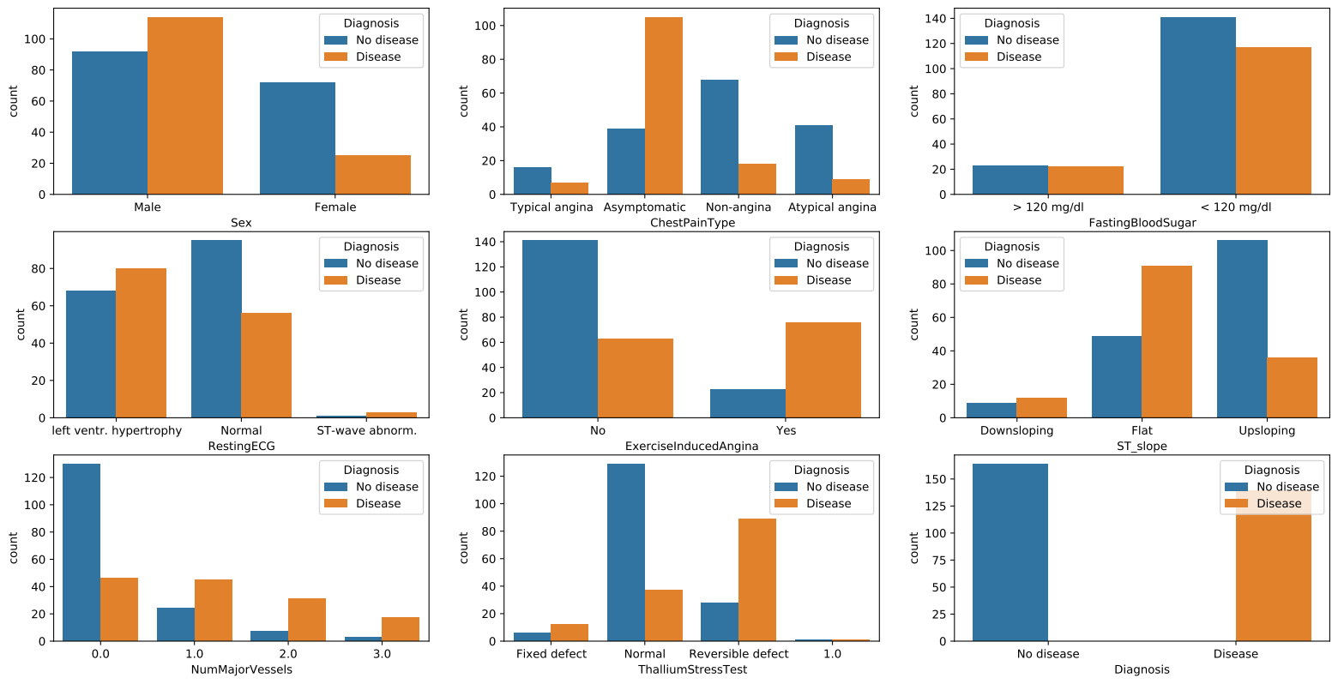
Data Analysis

Slide 4
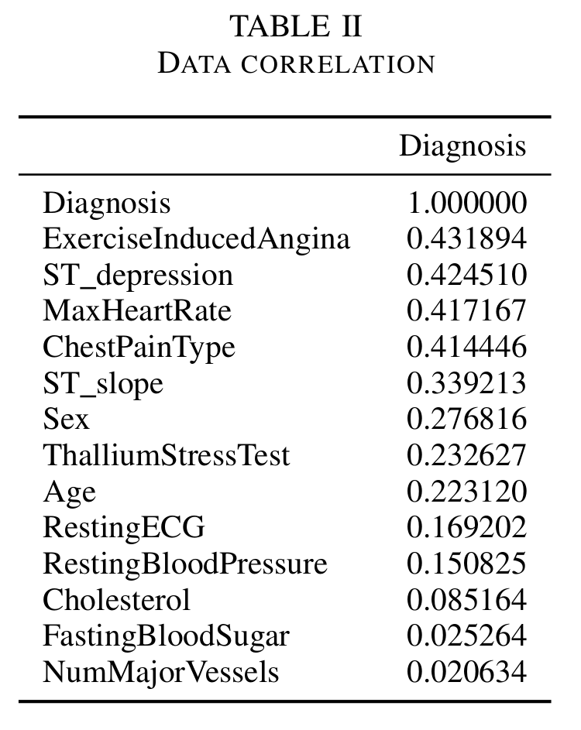
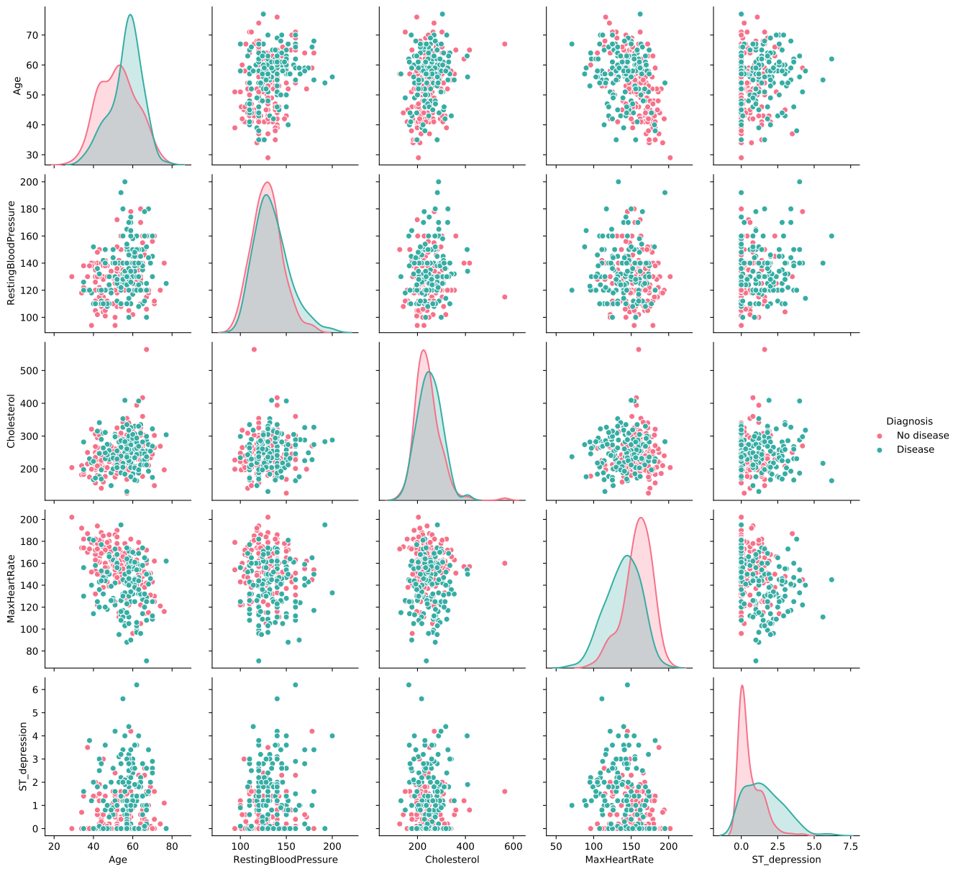
Data Analysis

Slide 5
Data Preprocessing
Parse CSV
Changing the target from 4 categories of heart disease to a binary value (has / doesn’t have)
Fill the missing values (mean or most frequent)
Splitting dataset into training (80%) and test (20%)

Slide 6
Model training
5 models used
  Logistic Regression
  Naive Bayes
  K Nearest Neighbors
  Decision Tree
  Random forest

Slide 7
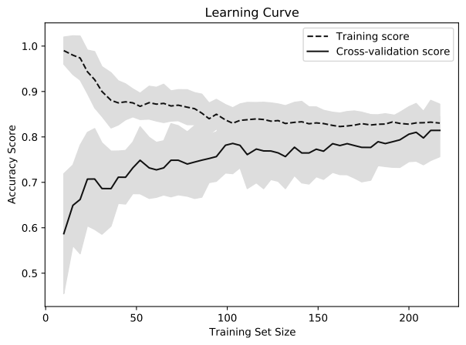
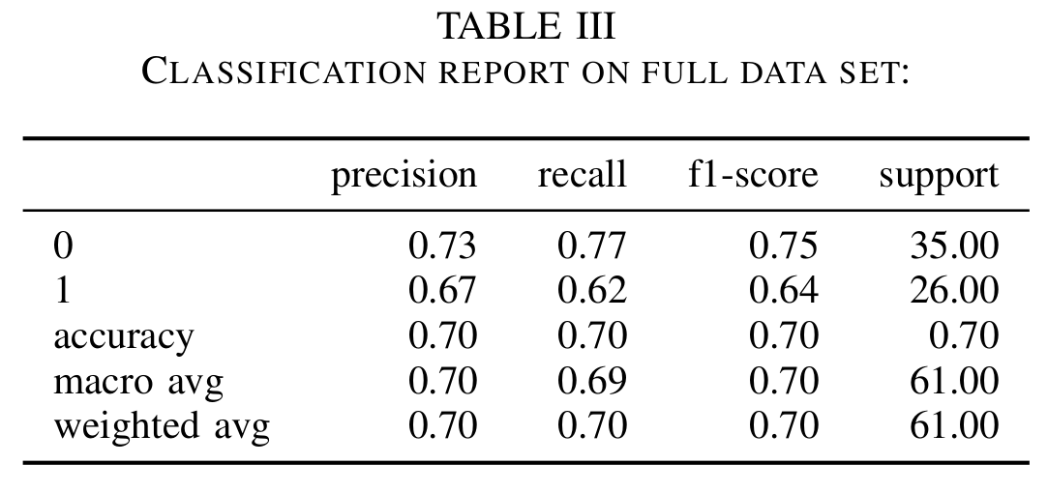
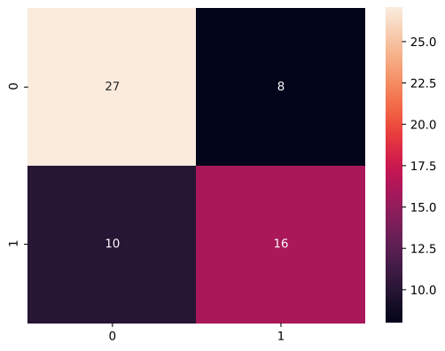
Logistic Regression

Slide 8
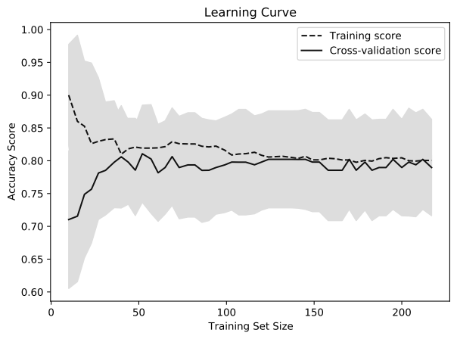
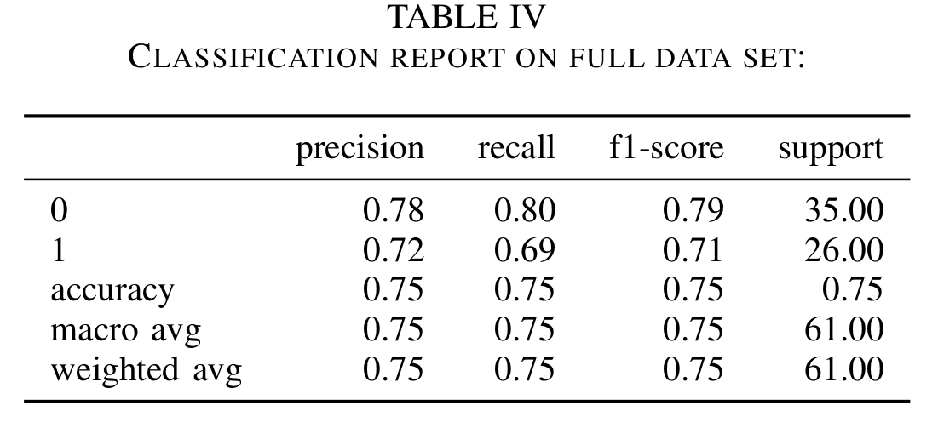
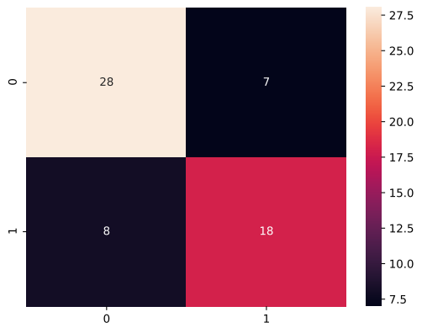
Naive Bayes

Slide 9
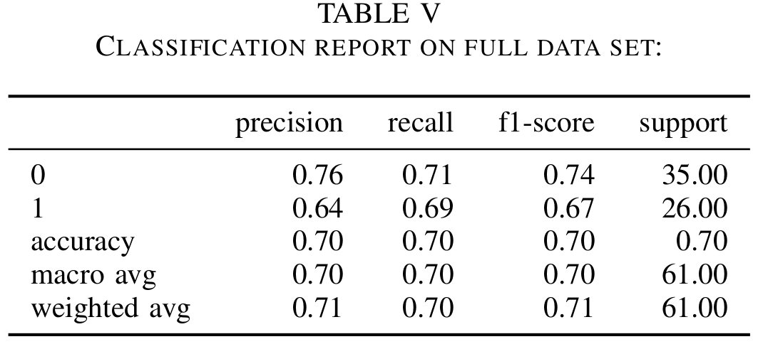
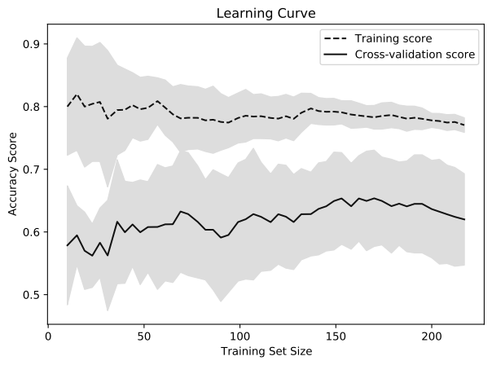
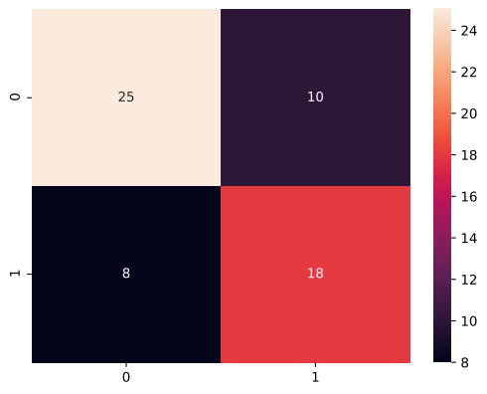
K Nearest Neighbors

Slide 10
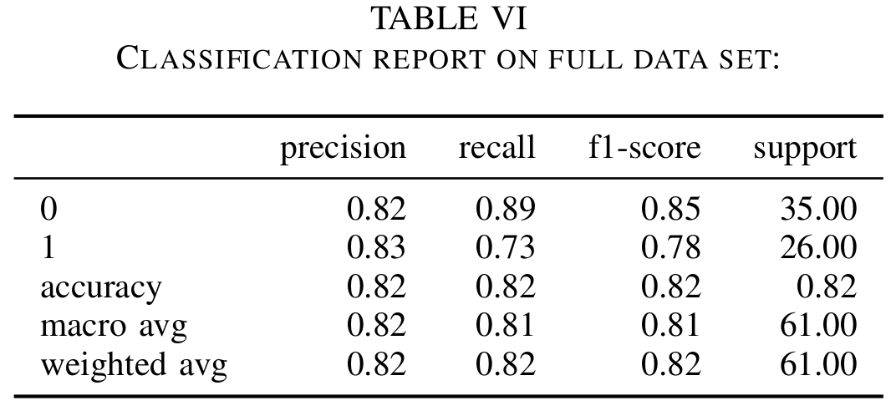
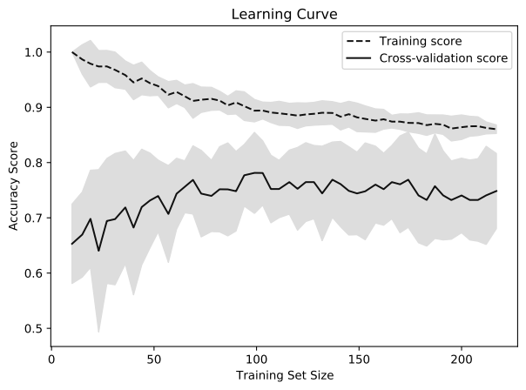
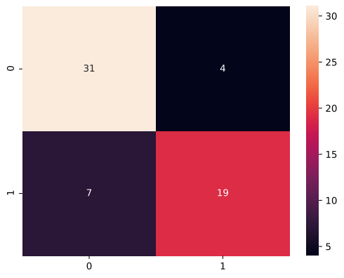
Decision Tree

Slide 11
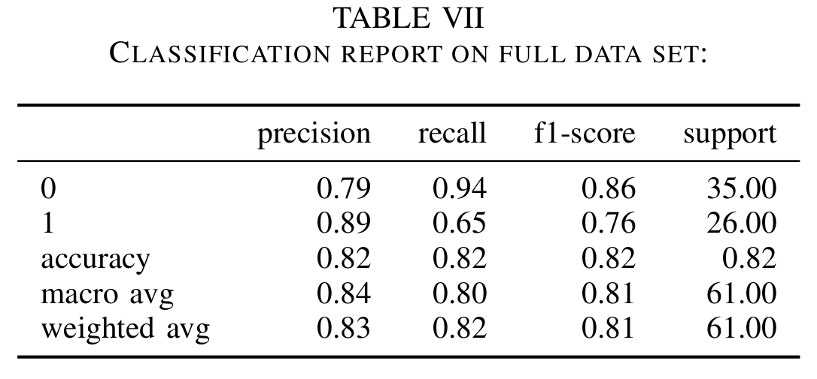
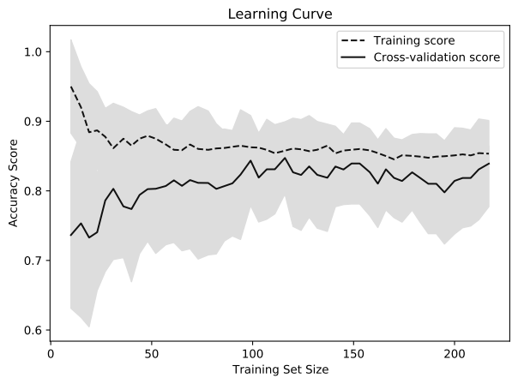
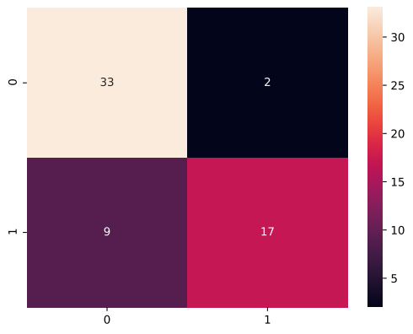
Random Forest

Slide 12
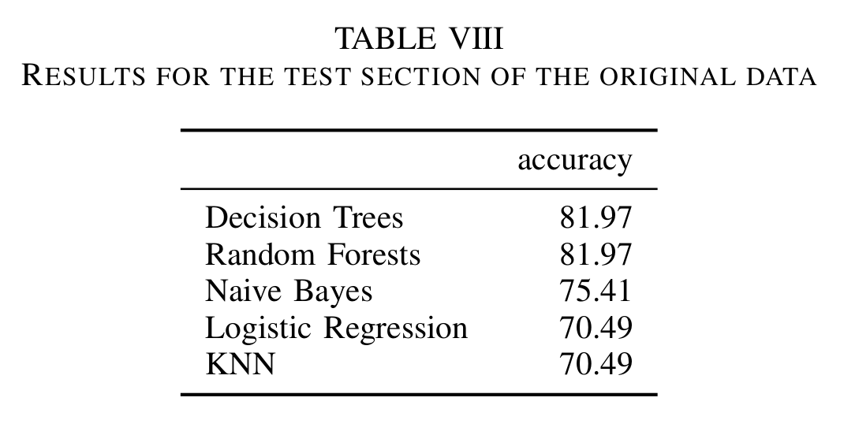
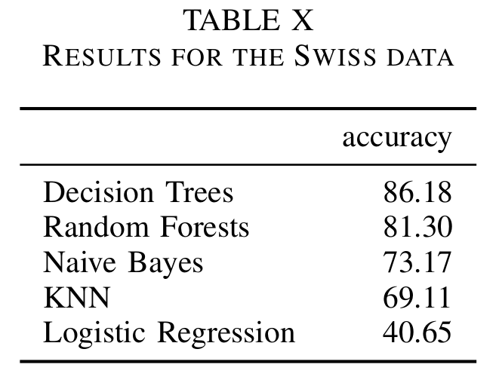
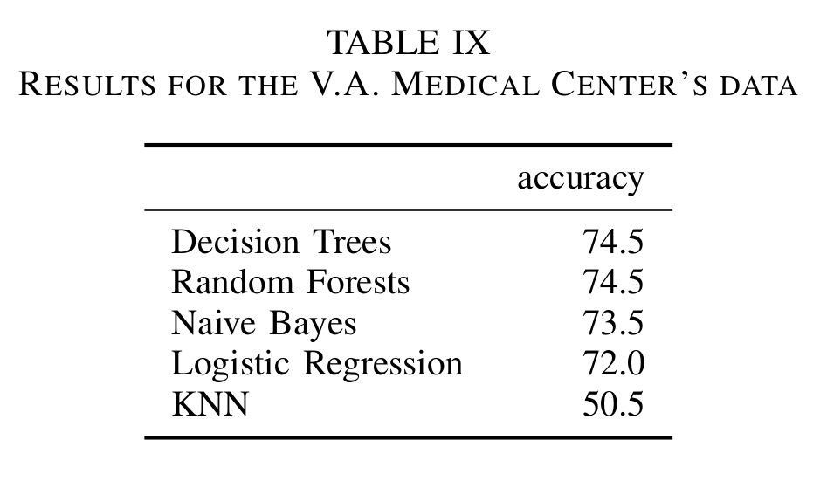
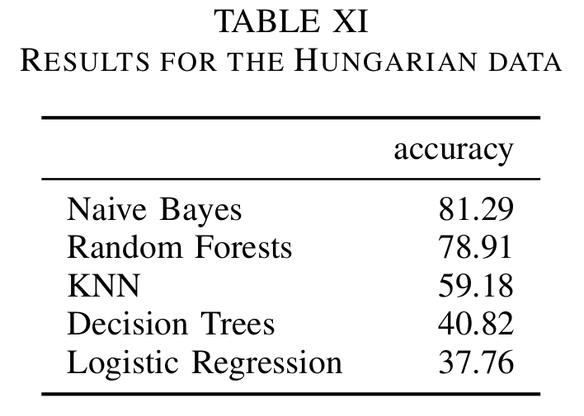
Results

Slide 13
Conclusions
Naive Bayes: consistently accurate, fast and easy to implement
Data used for the tests had many missing values, which might have influenced the results

