Slide 1

Activity Recognition Using Wearable Physiological Measurements: Selection of Features from a Comprehensive Literature Study
Ludovico Dolcini
Rodrigo Ferreira
Xavier Santos

Slide 2
The paper
The paper is centered around the process of feature selection.
The data comes from an experimente regarding activity recognition.
It uses a genetic algorithm to select the most relevant features for each set of data, with different constraints.
Then, it uses several classifiers to compare results.

Slide 3
The data
The data comes from an experiment where subjects do several different activities while being monitored in diferente ways.
Monitoring:
  Heart activity (Electrocardiogram);
  Lung activity (Thoracic Electrical Bioimpedance);
  Hand activity (Electrodermal Activity);
  Arm activity (Electrodermal Activity);

Slide 4
The data
The goal is to predict the current activity from the subject’s stats.
The data contains 4480 instances and 533 attributes, 174 from the ECG, 151 from TEB, 104 from arm EDA and 104 from hand EDA.
The activity can be:
  Neutral;
  Emotional;
  Mental;
  Physical;

Slide 5
The data
To ensure these activities, they were induced in different ways.
  Neutral: induced by watching documentaries;
  Emotional: induced by watching carefully picked movies;
  Mental: induced using mental arithmetic games and tetris;
  Physical: induced by having the subjects go up and down the stairs;

Slide 6
Exploratory work
We decided to replicate the some of the paper’s work to compare results.
Using a genetic algorithm to select from each set, with a max of 5,10,20,40 and 80 features, the best.
Then we ran them through different classifiers.

Slide 7
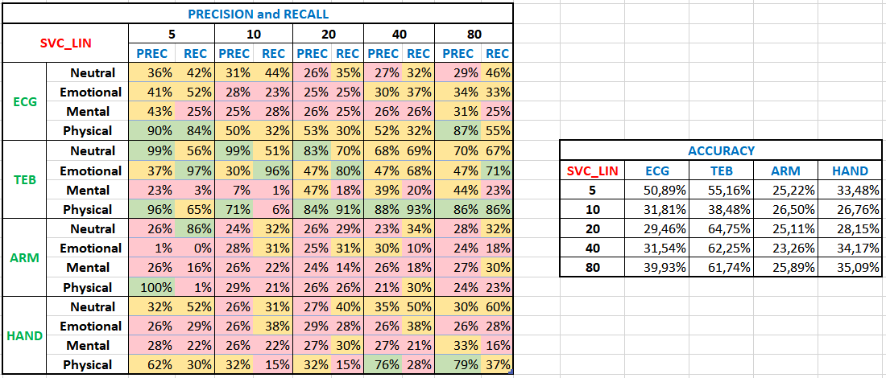
Linear SVC

Slide 8
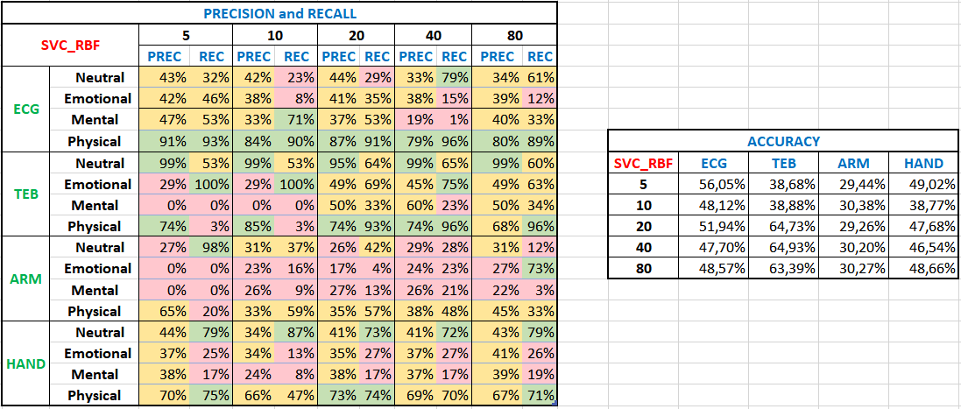

Slide 9
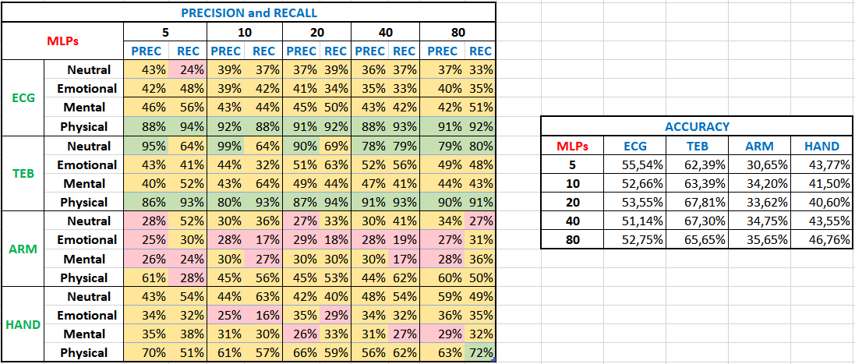

Slide 10
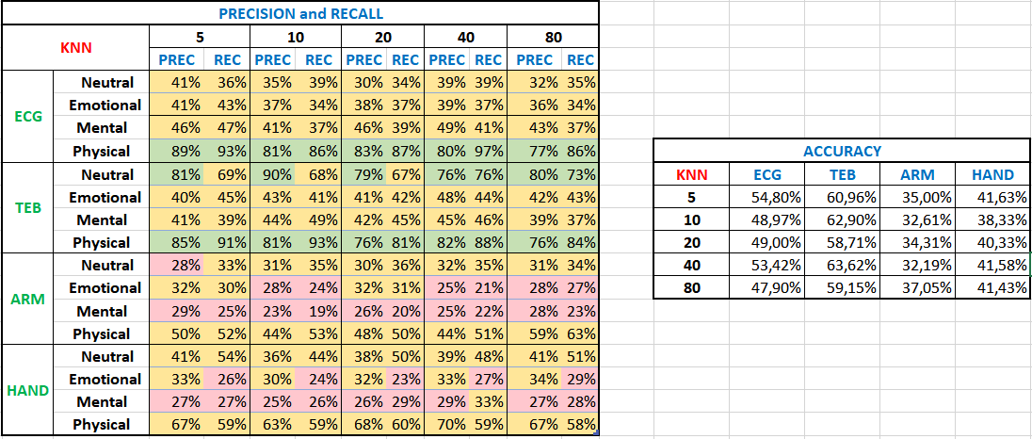

Slide 11
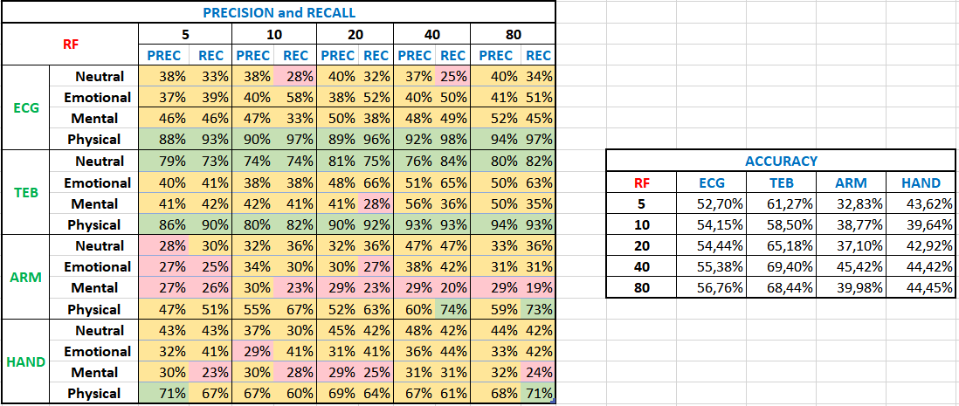

Slide 12
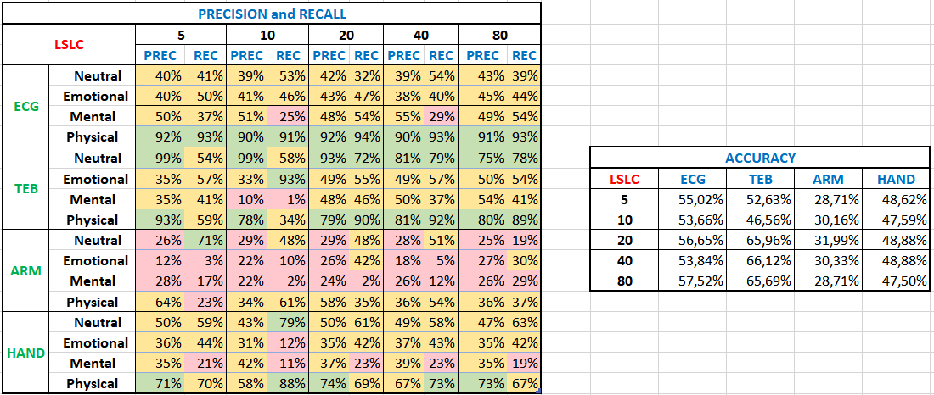

Slide 13
