Slide 1
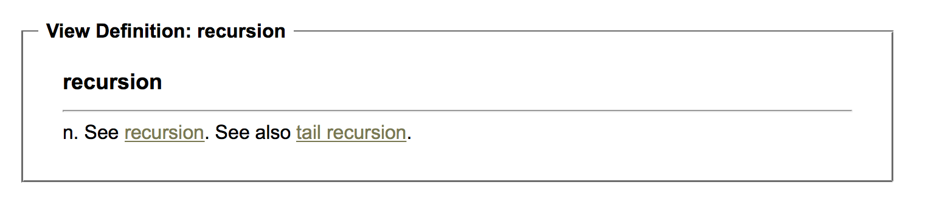
Introduction to Recursion
@source - Hacker Dictionary
Intro to CS Bootcamp Recursion Videos #1
Alexander Z. Wu

Slide 2

Announcements
We are going to talk about recursion.
Yay!
This is the first video. It will give you the basic idea of recursion + an example.

Slide 3
(Useless) Definition
A recursive function/method is a function/method that explicitly or implicitly calls itself.
Yes, it can implicitly call itself. Don’t ask.

Slide 4
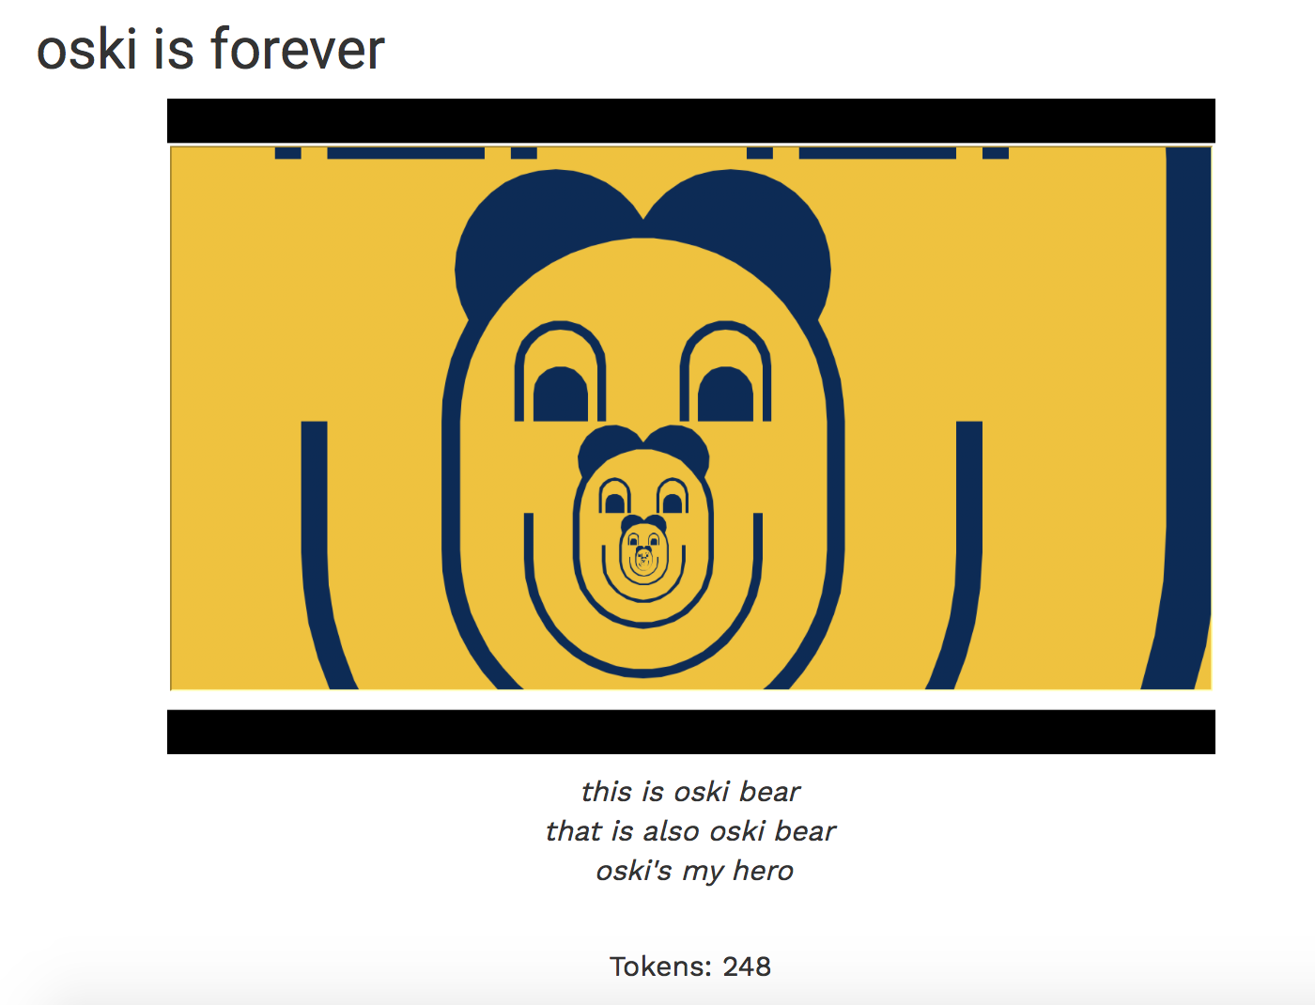
@source - fall 2017 scheme contest

Slide 5
But…
It must stop. At some point.
This is called a base case.
Example:
@source - UCBMFET (Don’t ask)

Slide 6
Waiting in Line
Example:
What number are you in line?

Slide 7
Waiting in Line
Example:
I don’t know. Hey, what number are you?

Slide 8
Waiting in Line
Example:
What number are you?

Slide 9
Waiting in Line
Example:
What number are you?

Slide 10
Waiting in Line
Example:
What number are you?

Slide 11
Waiting in Line
Example:
What number are you?

Slide 12
Waiting in Line
Example:
Hmm… I’m number one.

Slide 13
Waiting in Line
Example:
Then I must be second in line.

Slide 14
Waiting in Line
Example:
Then I am #3.

Slide 15
Waiting in Line
Example:
I’m number 4.

Slide 16
Waiting in Line
Example:
I’m fifth.

Slide 17
Waiting in Line
Example:
I’m 6th.

Slide 18
Waiting in Line
Another example: https://youtu.be/ly60Vkiak4E
I am seventh in line. Great!

Slide 19
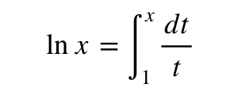

An example that actually uses code
Find a power
power(3, 2) -> 9
power(4, 0) -> 1
power(2, 5) -> 32
@source - medium.com

Slide 20
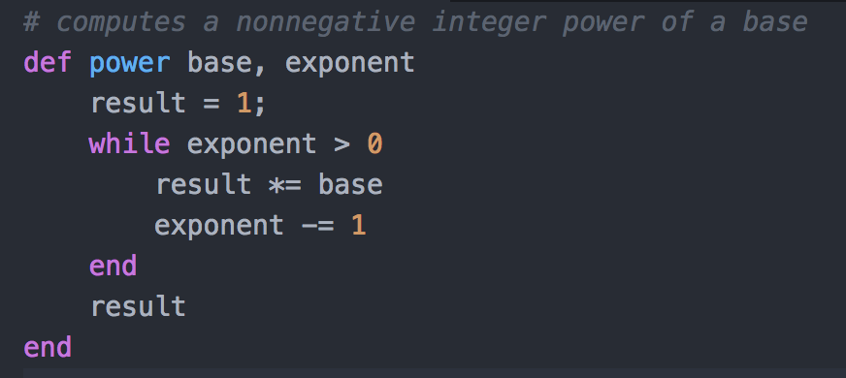
How it works (iteration)
power(2, 3)

Slide 21
How it works (iteration)
power(2, 3)
base = 2
exponent = 3
result = 1

Slide 22
How it works (iteration)
power(2, 3)
result = 1
base = 2
exponent = 3
result = 2

Slide 23
How it works (iteration)
power(2, 3)
base = 2
exponent = 2
result = 2

Slide 24
How it works (iteration)
power(2, 3)
base = 2
exponent = 1
result = 4

Slide 25
How it works (iteration)
power(2, 3)
base = 2
exponent = 0
result = 8

Slide 26
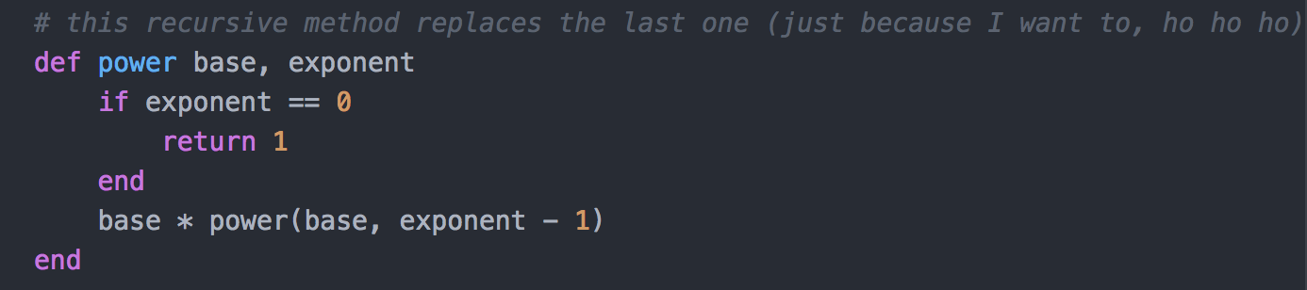
How it works (recursion)
power(2, 3)

Slide 27
How it works (recursion)
power(2, 3)

Slide 28
How it works (recursion)
power(2, 3)
2 * power(2, 2)

Slide 29
How it works (recursion)
power(2, 3)
2 * power(2, 2)
2 * power(2, 1)

Slide 30
How it works (recursion)
power(2, 3)
2 * power(2, 2)
2 * power(2, 1)
2 * power(2, 0)

Slide 31
How it works (recursion)
power(2, 3)
2 * power(2, 2)
2 * power(2, 1)
2 * power(2, 0)
1

Slide 32
How it works (recursion)
power(2, 3)
2 * power(2, 2)
2 * power(2, 1)
2 * 1
1

Slide 33
How it works (recursion)
power(2, 3)
2 * power(2, 2)
2 * 2
2 * 1
1

Slide 34
How it works (recursion)
power(2, 3)
2 * 4
2 * 2
2 * 1
1

Slide 35
How it works (recursion)
8
2 * 4
2 * 2
2 * 1
1

Slide 36

The Call Stack
This is called a call stack because it is a stack.
power(2, 3)

Slide 37
The Call Stack
This is called a call stack because it is a stack.
power(2, 2)
power(2, 3)

Slide 38
The Call Stack
This is called a call stack because it is a stack.
power(2, 1)
power(2, 2)
power(2, 3)

Slide 39
The Call Stack
This is called a call stack because it is a stack.
power(2, 0)
power(2, 1)
power(2, 2)
power(2, 3)

Slide 40
The Call Stack
This is called a call stack because it is a stack.
power(2, 0)
1
power(2, 1)
power(2, 2)
power(2, 3)

Slide 41
The Call Stack
This is called a call stack because it is a stack.
power(2, 1)
2
power(2, 2)
power(2, 3)

Slide 42
The Call Stack
This is called a call stack because it is a stack.
power(2, 2)
4
power(2, 3)

Slide 43
The Call Stack
This is called a call stack because it is a stack.
power(2, 3)
8

Slide 44
The End!
Next video:
The recursive leap of faith
Recursion vs. iteration

