Slide 1
The Recursive Leap of Faith & Recursion Vs. Iteration
If you already know what recursion is, just remember the answer. Otherwise, find someone who is standing closer to Douglas Hofstadter than you are; then ask him or her what recursion is. —Andrew Plotkin
Intro to CS Bootcamp Recursion Videos #2
Alexander Z. Wu

Slide 2

Announcements
Um, no announcements
Sorry, it was terribly wrong of me to use tabs instead of double spaces in all my demo code so far. Please accept my apology.

Slide 3
How Do You Write Recursive Methods?
It’s not magic!
Explain why recursion works, even though you are calling a method that has not yet been defined, in haiku if possible.
Ruby does not care
About a method’s body
Until it is called.

Slide 4
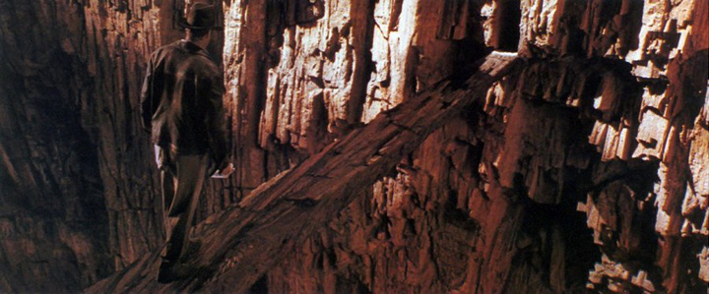
The Recursive Leap of Faith
Two things:
The base case is correct.
The recursive case is correct, assuming the smaller case works.
@source - Indiana Jones Wiki

Slide 5
The Recursive Leap of Faith
Two things:
power(a, 0) is correct.
power(a, b) is correct assuming that power(a, b - 1) works.
@source - Indiana Jones Wiki

Slide 6
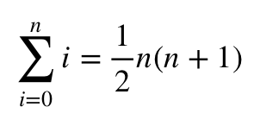
The Mathematical Leap of Faith
Two things:
for n = 0.
for n assuming it works for n - 1.
@source - Indiana Jones Wiki

Slide 7
The Recursive Stubbornness of Faith
Infinitely many things:
power(a, b) will call power(a, b - 1) and multiply that by a, which will call power(a, b - 2) and multiply that, which will keep calling b times… or b - 1 times? Or b + 1 times?

Slide 8
What about iteration?
base =
exponent =
result =
Iteration:
2
3 2 1 0
1 2 4 8
Recursion:
power(2, 3)
8
power(2, 2)
4
power(2, 1)
2
power(2, 0)
1

Slide 9
Iteration Is Better!
Iteration is faster! (usually)
Iteration doesn’t use more memory!
Even when it’s infinite! (Although infinite loops are still bad)

Slide 10
Recursion Is Better!
It sometimes makes more sense!
Some problems can only be solved with recursion! (kind of)
Why? Next video.

Slide 11
The End!
Next video:
A more complicated example of recursion.
TREE RECURSION.

