Slide 1
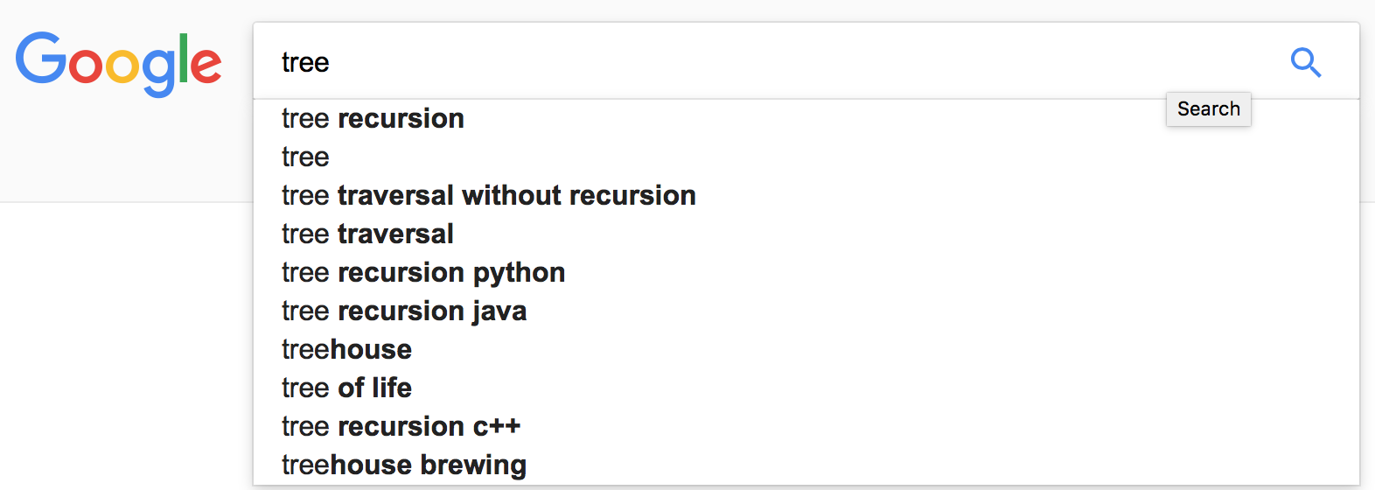
Tree Recursion
Intro to CS Bootcamp Recursion Videos #3
Alexander Z. Wu

Slide 2

Get Familiar with Recursion
Stuff you learn in 61A:
Things you need to learn in order to do recursion
Recursion
Really hard recursion
Data structures with recursion
Data structures with really hard recursion
A language that relies exclusively on recursion
A language that hardly ever uses recursion but you need to do recursion with it anyway

Slide 3
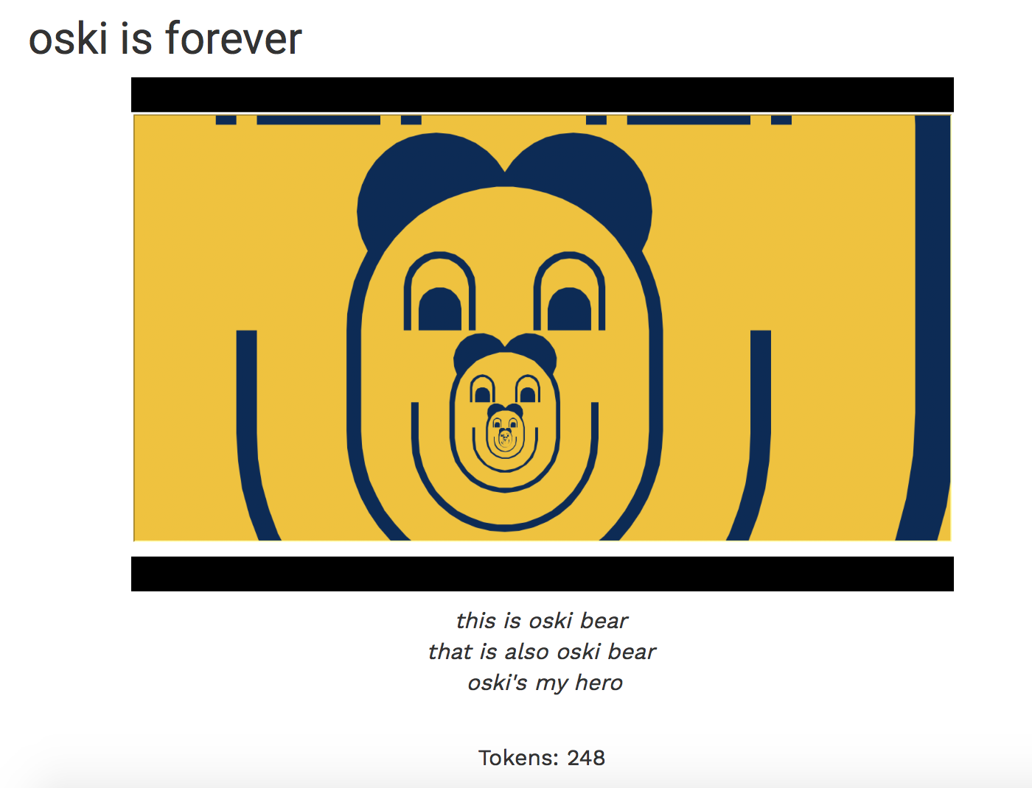
“Regular Recursion”
Recursion that is linear:

Slide 4
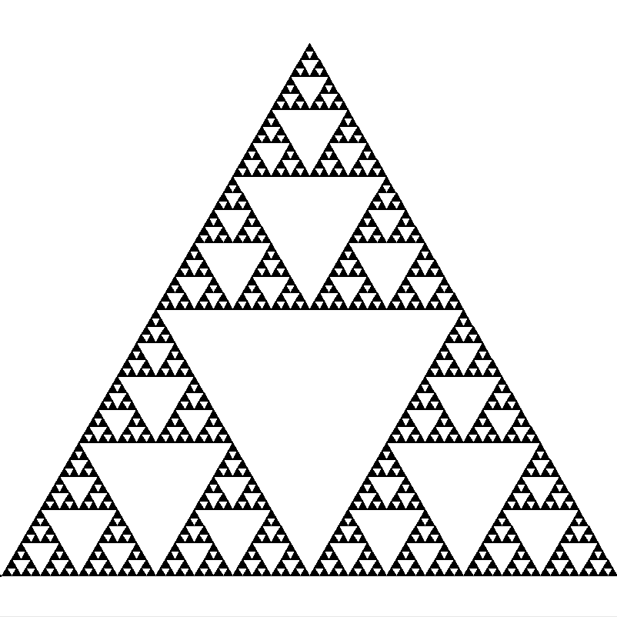
More Complicated Recursion

Slide 5
More Complicated Recursion

Slide 6
More Complicated Recursion

Slide 7
More Complicated Recursion

Slide 8
More Complicated Recursion

Slide 9
More Complicated Recursion

Slide 10
It’s a Tree!
vs.
………………………………
……

Slide 11
TREE RECURSION
When there’s more than one recursive call, it’s tree recursion (usually).
def be_happy(times)
if times == 0
return
end
puts “I’m happy!”
be_happy(times - 1)
end
Not tree recursion:
def be_really_happy(times)
if times == 0
return
end
be_really_happy(times - 1)
puts “I’m really happy!”
be_really_happy(times - 1)
end
Tree recursion:

Slide 12
The Complicated Example I Promised
Deep sum a nested list of numbers.
For example:
1
(empty)
deep_sum([1, [2], [[3], 4], []])
returns 1 + 2 + 3 + 4 = 10
2
4
3

Slide 13
Without Using the Leap of Faith
Recursion tree
deep_sum([1, [2], [[3], 4], []])
deep_sum(1)
deep_sum([2])
deep_sum([[3], 4])
deep_sum([])
1
deep_sum(2)
deep_sum([3])
deep_sum(4)
0
2
deep_sum(3)
4
3

Slide 14
Without Using the Leap of Faith
Another (slightly simpler) recursion tree
deep_sum([1, [2, 3], [[]]])

Slide 15
Without Using the Leap of Faith
Another (slightly simpler) recursion tree
deep_sum([1, [2, 3], [[]]])
deep_sum(1)

Slide 16
Without Using the Leap of Faith
Another (slightly simpler) recursion tree
deep_sum([1, [2, 3], [[]]])
deep_sum(1)
1

Slide 17
Without Using the Leap of Faith
Another (slightly simpler) recursion tree
deep_sum([1, [2, 3], [[]]])
deep_sum(1)
deep_sum([2, 3])
1

Slide 18
Without Using the Leap of Faith
Another (slightly simpler) recursion tree
deep_sum([1, [2, 3], [[]]])
deep_sum(1)
deep_sum([2, 3])
1
deep_sum(2)

Slide 19
Without Using the Leap of Faith
Another (slightly simpler) recursion tree
deep_sum([1, [2, 3], [[]]])
deep_sum(1)
deep_sum([2, 3])
1
deep_sum(2)
2

Slide 20
Without Using the Leap of Faith
Another (slightly simpler) recursion tree
deep_sum([1, [2, 3], [[]]])
deep_sum(1)
deep_sum([2, 3])
1
deep_sum(2)
deep_sum(3)
2

Slide 21
Without Using the Leap of Faith
Another (slightly simpler) recursion tree
deep_sum([1, [2, 3], [[]]])
deep_sum(1)
deep_sum([2, 3])
1
deep_sum(2)
deep_sum(3)
2
3

Slide 22
Without Using the Leap of Faith
Another (slightly simpler) recursion tree
deep_sum([1, [2, 3], [[]]])
deep_sum(1)
deep_sum([2, 3])
1
5

Slide 23
Without Using the Leap of Faith
Another (slightly simpler) recursion tree
deep_sum([1, [2, 3], [[]]])
deep_sum(1)
deep_sum([2, 3])
deep_sum([[]])
1
5

Slide 24
Without Using the Leap of Faith
Another (slightly simpler) recursion tree
deep_sum([1, [2, 3], [[]]])
deep_sum(1)
deep_sum([2, 3])
deep_sum([[]])
1
5
deep_sum([])

Slide 25
Without Using the Leap of Faith
Another (slightly simpler) recursion tree
deep_sum([1, [2, 3], [[]]])
deep_sum(1)
deep_sum([2, 3])
deep_sum([[]])
1
5
deep_sum([])
0

Slide 26
Without Using the Leap of Faith
Another (slightly simpler) recursion tree
deep_sum([1, [2, 3], [[]]])
deep_sum(1)
deep_sum([2, 3])
deep_sum([[]])
1
5
0

Slide 27
Without Using the Leap of Faith
Another (slightly simpler) recursion tree
deep_sum([1, [2, 3], [[]]])
6

Slide 28
Without Using the Leap of Faith
Another (slightly simpler) recursion tree
deep_sum([1, [2, 3], [[]]])
deep_sum(1)
deep_sum([2, 3])
deep_sum([[]])
1
deep_sum(2)
deep_sum(3)
deep_sum([])
2
3
0

Slide 29

It’s Technically Still A Call Stack
It’s just that the stack grows and shrinks a lot more.
deep_sum([1, [2, 3], [[]]])

Slide 30

It’s Technically Still A Call Stack
It’s just that the stack grows and shrinks a lot more.
deep_sum(1)
deep_sum([1, [2, 3], [[]]])

Slide 31
It’s Technically Still A Call Stack
It’s just that the stack grows and shrinks a lot more.
deep_sum(1)
1
deep_sum([1, [2, 3], [[]]])

Slide 32
It’s Technically Still A Call Stack
It’s just that the stack grows and shrinks a lot more.
deep_sum([1, [2, 3], [[]]])

Slide 33

It’s Technically Still A Call Stack
It’s just that the stack grows and shrinks a lot more.
deep_sum([2, 3])
deep_sum([1, [2, 3], [[]]])

Slide 34

It’s Technically Still A Call Stack
It’s just that the stack grows and shrinks a lot more.
deep_sum(2)
deep_sum([2, 3])
deep_sum([1, [2, 3], [[]]])

Slide 35
It’s Technically Still A Call Stack
It’s just that the stack grows and shrinks a lot more.
deep_sum(2)
2
deep_sum([2, 3])
deep_sum([1, [2, 3], [[]]])

Slide 36
It’s Technically Still A Call Stack
It’s just that the stack grows and shrinks a lot more.
deep_sum([2, 3])
deep_sum([1, [2, 3], [[]]])

Slide 37
It’s Technically Still A Call Stack
It’s just that the stack grows and shrinks a lot more.
deep_sum(3)
deep_sum([2, 3])
deep_sum([1, [2, 3], [[]]])

Slide 38
It’s Technically Still A Call Stack
It’s just that the stack grows and shrinks a lot more.
deep_sum(3)
3
deep_sum([2, 3])
deep_sum([1, [2, 3], [[]]])

Slide 39
It’s Technically Still A Call Stack
It’s just that the stack grows and shrinks a lot more.
deep_sum([2, 3])
deep_sum([1, [2, 3], [[]]])

Slide 40
It’s Technically Still A Call Stack
It’s just that the stack grows and shrinks a lot more.
deep_sum([2, 3])
5
deep_sum([1, [2, 3], [[]]])

Slide 41
It’s Technically Still A Call Stack
It’s just that the stack grows and shrinks a lot more.
deep_sum([1, [2, 3], [[]]])

Slide 42

It’s Technically Still A Call Stack
It’s just that the stack grows and shrinks a lot more.
deep_sum([[]])
deep_sum([1, [2, 3], [[]]])

Slide 43
It’s Technically Still A Call Stack
It’s just that the stack grows and shrinks a lot more.
deep_sum([])
deep_sum([[]])
deep_sum([1, [2, 3], [[]]])

Slide 44
It’s Technically Still A Call Stack
It’s just that the stack grows and shrinks a lot more.
deep_sum([])
0
deep_sum([[]])
deep_sum([1, [2, 3], [[]]])

Slide 45
It’s Technically Still A Call Stack
It’s just that the stack grows and shrinks a lot more.
deep_sum([[]])
deep_sum([1, [2, 3], [[]]])

Slide 46
It’s Technically Still A Call Stack
It’s just that the stack grows and shrinks a lot more.
deep_sum([[]])
0
deep_sum([1, [2, 3], [[]]])

Slide 47
It’s Technically Still A Call Stack
It’s just that the stack grows and shrinks a lot more.
deep_sum([1, [2, 3], [[]]])

Slide 48
It’s Technically Still A Call Stack
It’s just that the stack grows and shrinks a lot more.
deep_sum([1, [2, 3], [[]]])
6

Slide 49
Why Recursion Is Cool
While “regular recursion” might not be too hard to convert to iteration, tree recursion forms a tree, so it is much harder (if possible) to convert to iteration.
So recursion is still pretty useful.
vs.

Slide 50
The End!
The recursion series is done!
Until 61A! To remind you,
Stuff you learn in 61A:
Things you need to learn in order to do recursion
Recursion
Really hard recursion
Data structures with recursion
Data structures with really hard recursion
A language that relies exclusively on recursion
A language that hardly ever uses recursion but you need to do recursion with it anyway

