Slide 1
ECE 18-649
Final Project Report Starting Point
December 07, 2015
Group # 03
Shuai Wang
Jiyu Shi
Xiao Guo
Xiaoyu Wang
Shuai Wang

Slide 2
Overview
Project statistics
Design of Dispatcher
Logic of Dispatcher
Lessons learned
Suggestions to future students
Shuai Wang

Slide 3
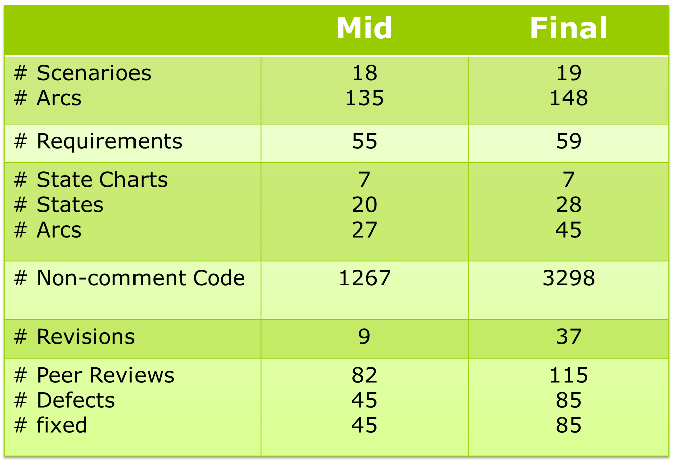
Project Statics
Shuai Wang

Slide 4
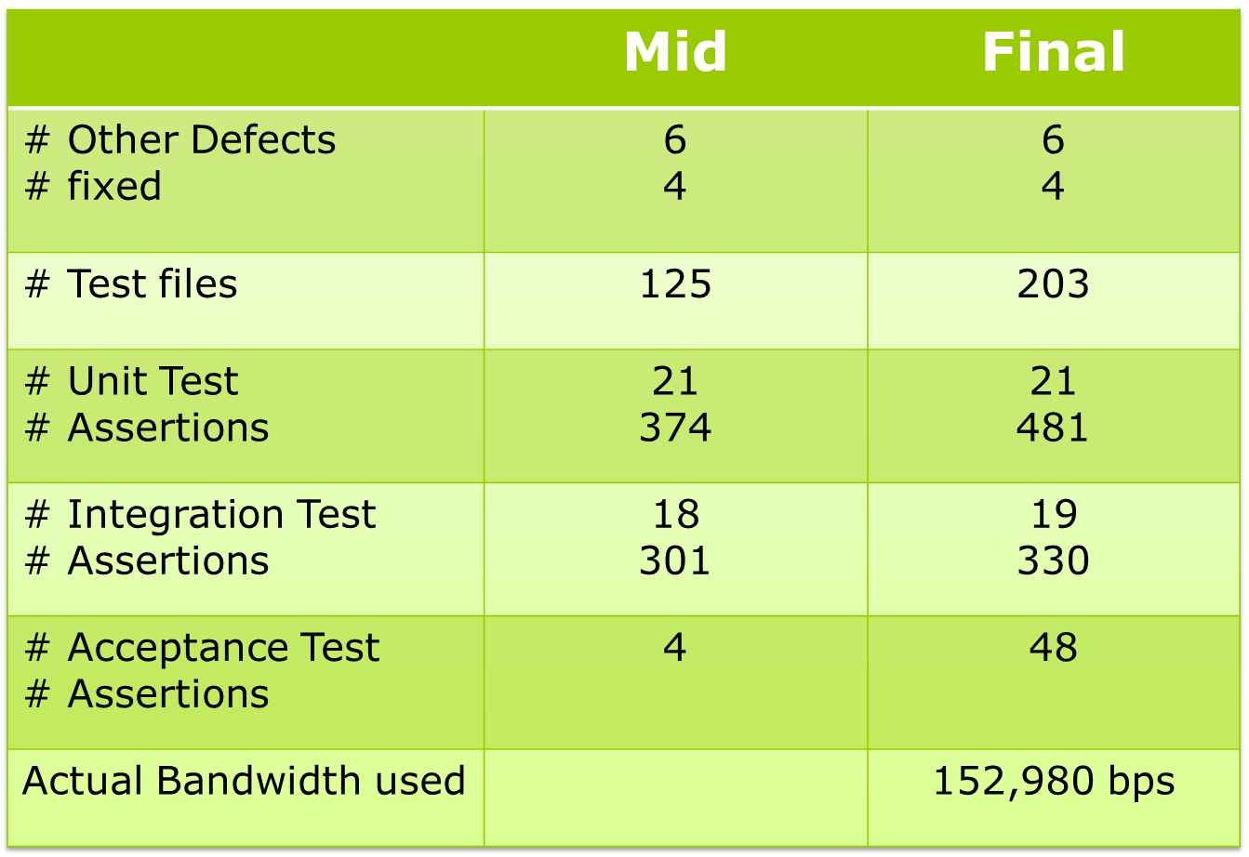
Project Statics
Shuai Wang

Slide 5
Project Statics
Mainly changes from mid
  1.Speed : Slow –> Fast
  2.CarPositionControl: Commit Point calculation
  3.Dispatcher implementation
  4.Network Scheduling
  5.Runtime Monitor finished
  6.Passed all acceptance tests(including proj13)
Shuai Wang

Slide 6
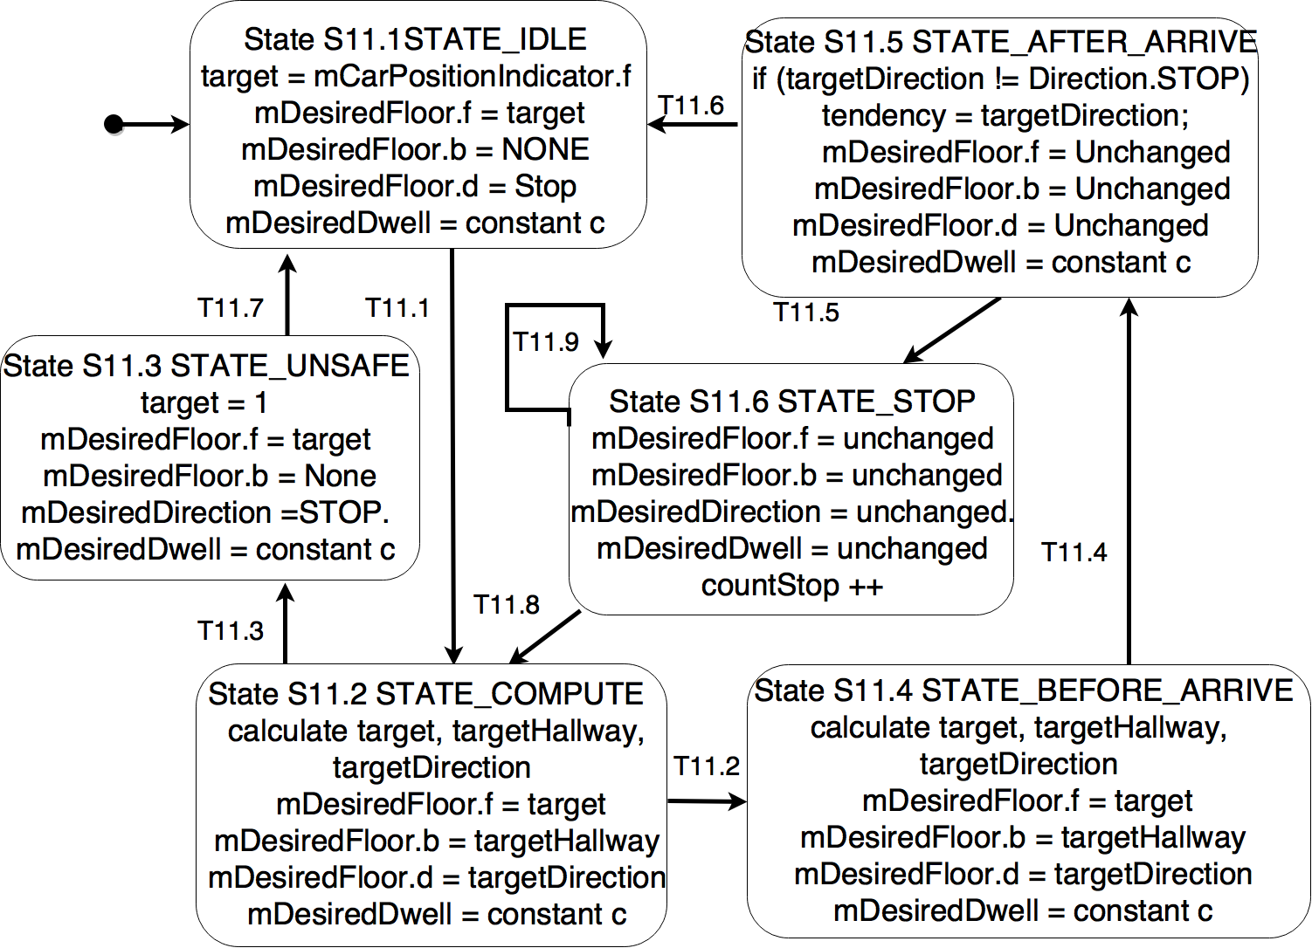
Design of Dispatcher - SC
16pt！
Jiyu Shi

Slide 7
Design of Dispatcher - SC
Transitions:
[T11.1] any mCarCall [f, b] ==True || any mHallCall[f, b,d] ==True
[T11.2] mCarPositionIndicator[f] == target
[T11.3] any mDoorClosed [b, r] ==False && all mAtFloor[f, b]==False
[T11.4]mAtFloor[f,b] == target && any mDoorClosed[b,r] == false
[T11.5] all mDoorClosed[b,r] == true &&
(any mCarCall [f, b] ==True || any mHallCall[f, b,d] ==True)
Jiyu Shi

Slide 8
Design of Dispatcher - SC
Transitions(cont.):
[T11.6] all mDoorClosed[b,r] == true && all mCarCall[f,b] == false && all mHallCall[f,b,d] == false
[T11.7]mAtFloor[1,b] == true
&& all mDoorClosed[b,r]== true
[T11.8] countStop >= totalStop
[T11.9] countStop <totalStop
Jiyu Shi

Slide 9
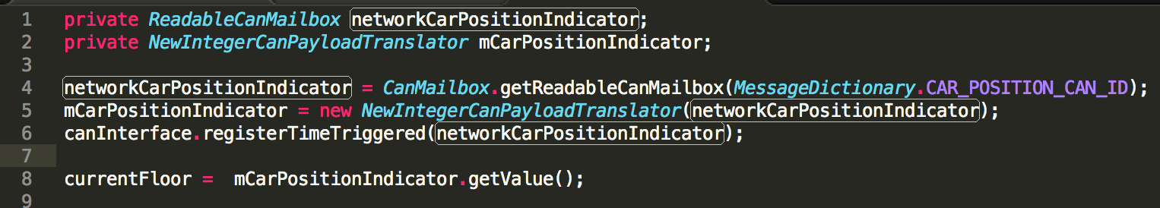
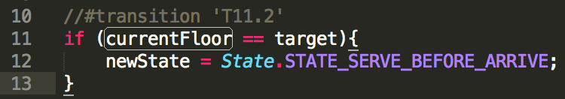
Interaction
CarPosition Indicator(input):
Where and How we use this message?
1.In the function to calculate the next desired floor.
2.State Transition.
Jiyu Shi

Slide 10
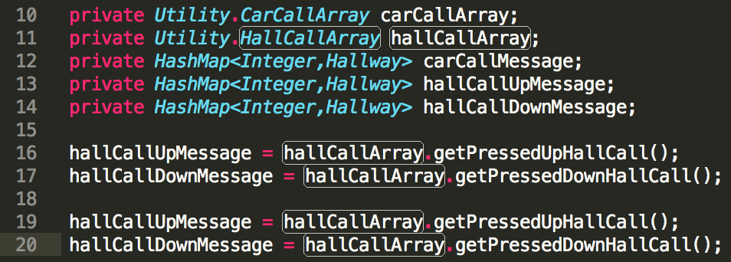
Interaction
Carbutton and Hallbutton control(input):
Jiyu Shi

Slide 11
Interaction
Other module(output):
DriveControl: floor of mDesiredFloor
DoorControl: Hallway of mDesiredFloor + mDesiredDwell
LanternControl: Direction of mDesiredFloor
Jiyu Shi

Slide 12
Logic of Dispatcher
HallCall up
CarCall
HallCall down
null
7 ↑
6 ↑
5 ↑
4 ↑
3 ↑
2 ↑
1 ↑
8
7
6
5
4
3
2
1
8↓
7↓
6↓
5↓
4↓
3↓
2↓
null
Xiao Guo

Slide 13
Logic of Dispatcher
HallCall up
CarCall
HallCall down
null
7 ↑
6 ↑
5 ↑
4 ↑
3 ↑
2 ↑
1 ↑
8
7
6
5
4
3
2
1
8↓
7↓
6↓
5↓
4↓
3↓
2↓
null
served
Tendency
Least Direction Change Method
Xiao Guo

Slide 14
Logic of Dispatcher
1st Priority
2nd Priority
HallCall up
CarCall
HallCall down
null
7 ↑
6 ↑
5 ↑
4 ↑
3 ↑
2 ↑
1 ↑
Low
8
7
6
5
4
3
2
1
8↓
7↓
6↓
5↓
4↓
3↓
2↓
null
High
served
Tendency
4th
Priority
3rd
Priority
Xiao Guo

Slide 15
Logic of Dispatcher
3rd
Priority
4th
Priority
HallCall up
CarCall
HallCall down
null
7 ↑
6 ↑
5 ↑
4 ↑
3 ↑
2 ↑
1 ↑
8
7
6
5
4
3
2
1
8↓
7↓
6↓
5↓
4↓
3↓
2↓
null
served
High
Tendency
Low
2nd Priority
1st Priority
Priority for four arrays changed.
Xiao Guo

Slide 16
Logic of Dispatcher
Calculate Period
User-friendly design
HallCall ↓ 50s
8
7
6
5
4
3
2
1
4
AtFloor
Car at here 50s
Tendency
HallCall ↑ 0s
Commit Point
Arrive
Nothing changes
BeforeArrive
Desired Direction can change
Hallway can change
Destination floor can’t change
Xiao Guo

Slide 17
Lessons Learned
Problems solved
  Change of requirements
  Redo V process. Good documentation helps reduce workload.
  How to decide commit point
  Make CarpositionController do all the math work.
  Race conditions
  Use DMA for CAN scheduling.
  Enough time delay should be taken into account.
Weak strategy
Version control based on Google Drive.
Xiaoyu Wang

Slide 18
Suggestions to future students
Start each project ASAP.
Get familiar with the framework first.
One step ahead, do final tests earlier.
Passing tests does not mean bug free.
Design before coding.
When in doubt, observe the real elevator.
Xiaoyu Wang

