Slide 1
Grails Project: Employee Record
Anmol Shrestha
Dipesh Poudel
Saroj Shrestha
Shrijak Shrestha

Slide 2
Introduction to Employee Record
This Application allows us to:
Keep and update the record of employees.
Create
Delete
Update
2. Keep the track of work hour of employee and calculate the salary

Slide 3
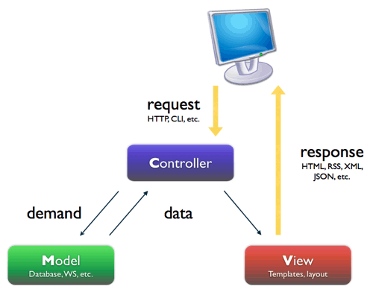
Use of MVC in Employee Record

Slide 4
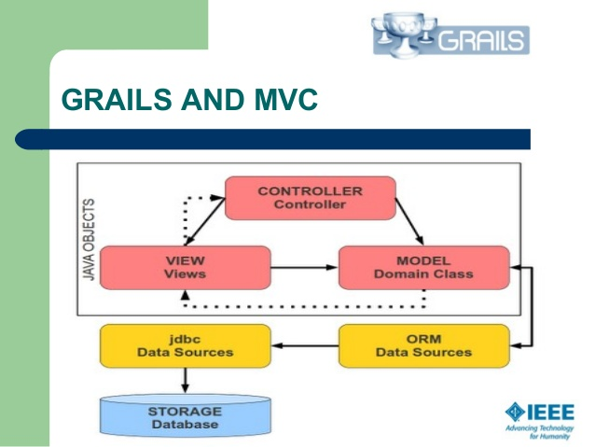

Slide 5
Domains of Employee Record
User
Employee
UserRole
Role

Slide 6
Plugin: Spring Security
A plugin is a software add-on that is installed onto a program, enabling it to perform additional features.
In the Project Employee Record the Spring Security Plugin is used for
Handling login/logout
Session handling

Slide 7
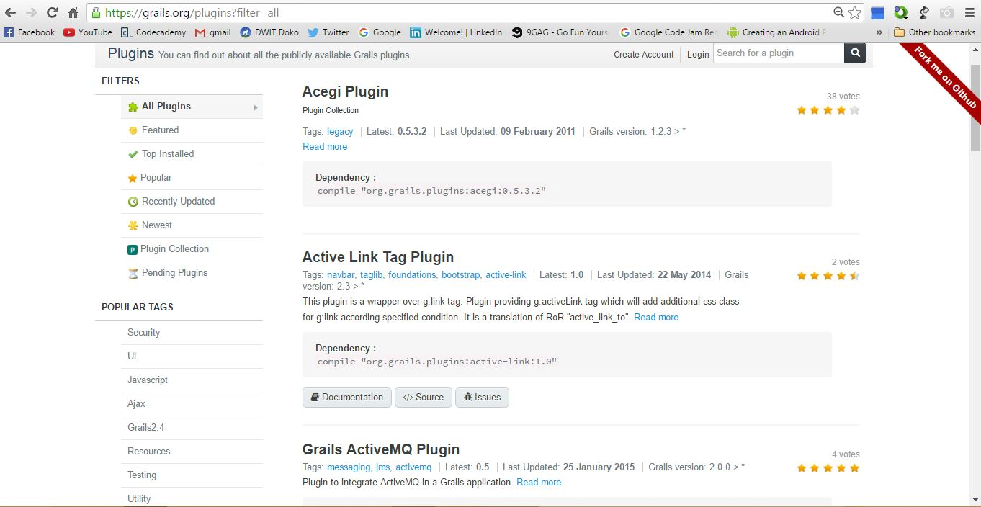

Slide 8
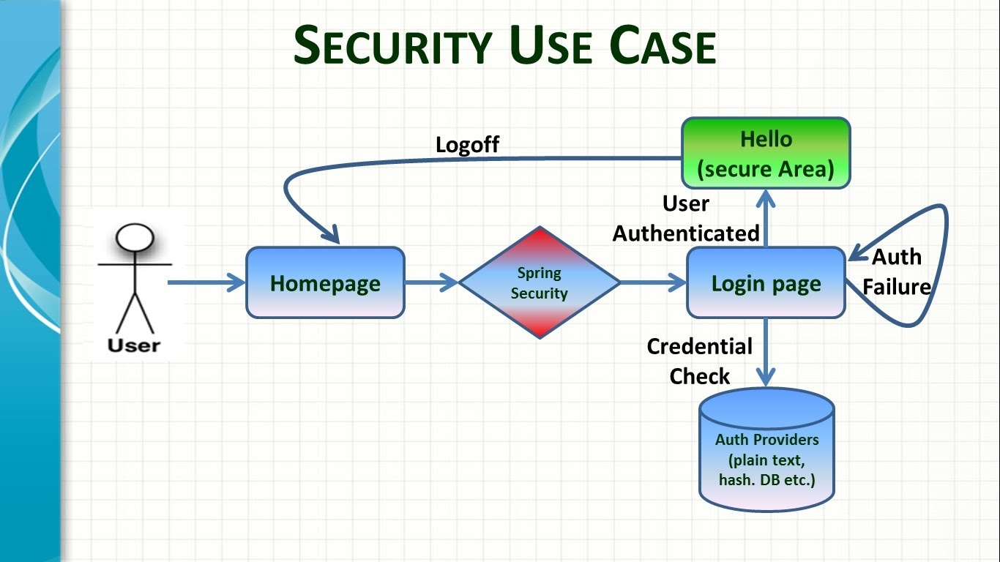

Slide 9
Benefits of Using Grails
Easy integration with other tools like bootstrap
Convention over Configuration
Easy to set-up and get started
Good documentation, serious support and a large community of contributors.

Slide 10
Disadvantages of Using Grails
Integration process is complicated.
Interpreted languages increase weight and that directly affects the run time.
You have to buy IntelliJ Idea because other IDE’s either don’t have or provide limited support.

Slide 11
Thankyou.

