Slide 1
Kruskal’s Minimum Spanning Tree Algorithm
Ksawery Kochanowicz – Final project presentation

Slide 2
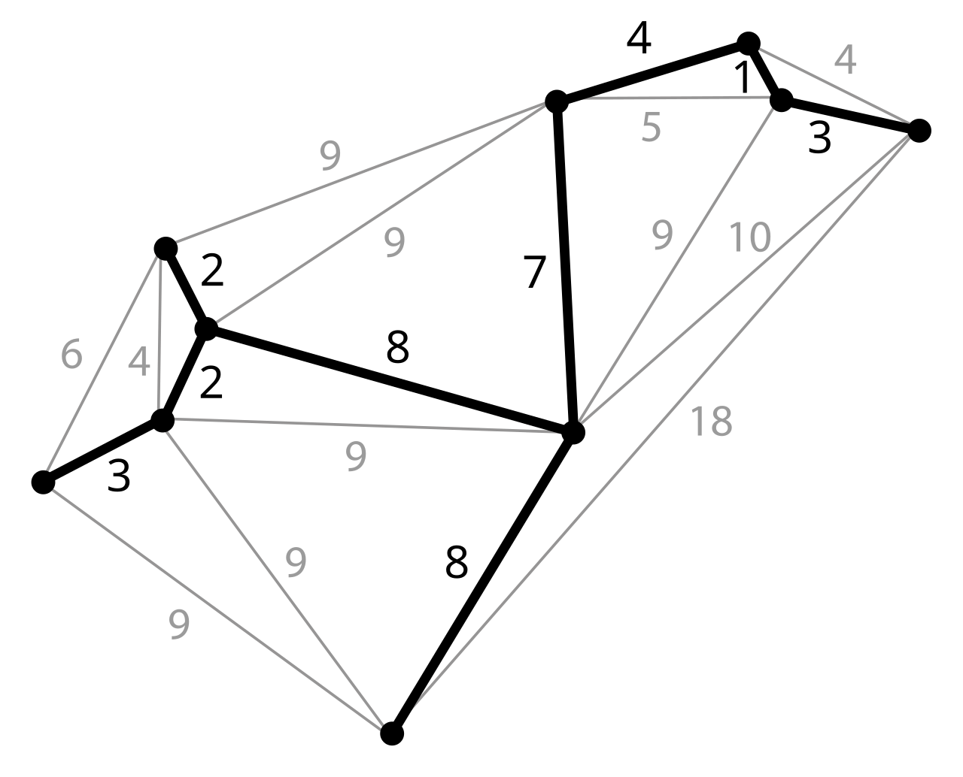
Introduction to the problem
MST – a connected subgraph without cycles, which the sum of the weights of all the edges is minimal

Slide 3
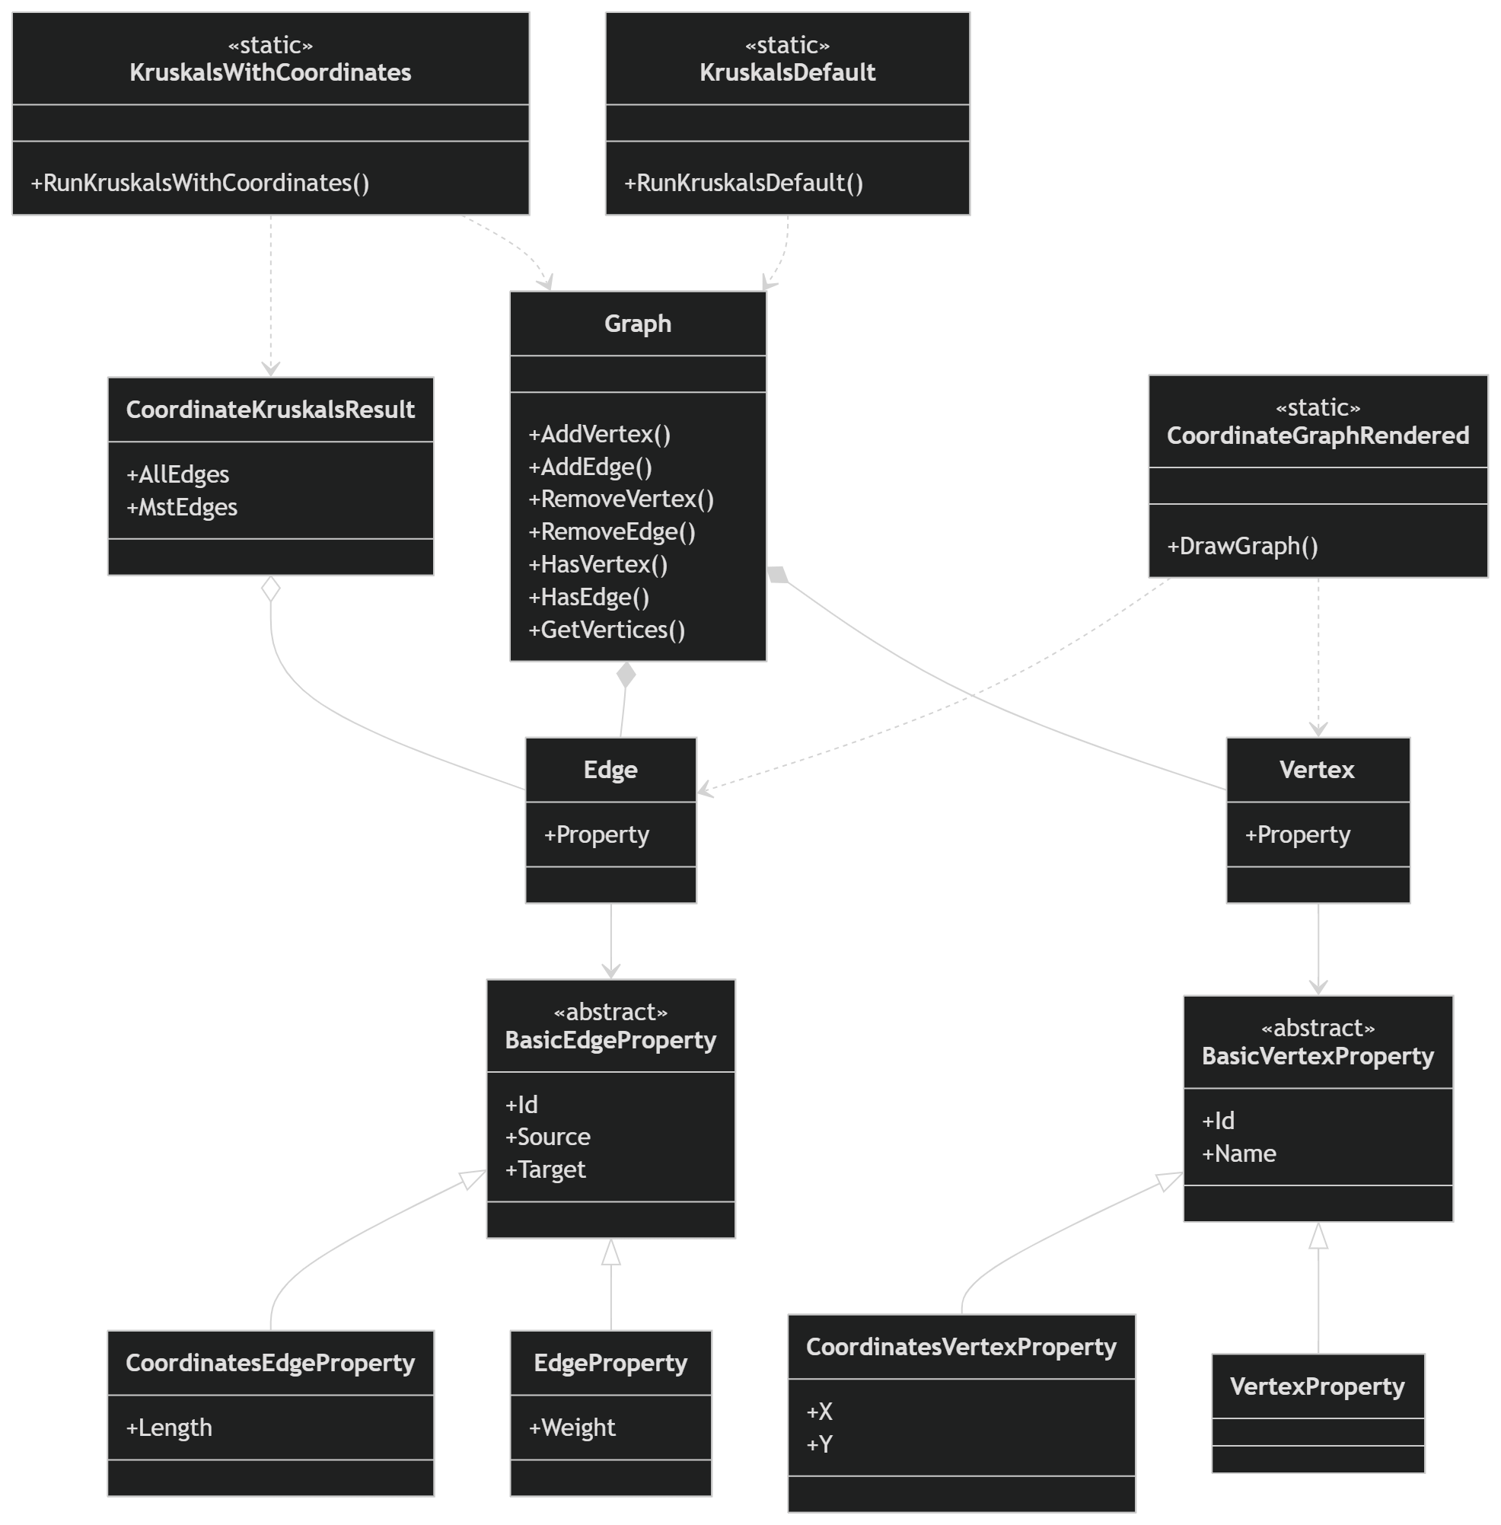
Implementation
Changes to DataSctructureLibrary
Kruskal’s Default solution
Kruskal’s Coordinates solution & Graph generation
Practical application

Slide 4
Challenges & solves
Understanding the algorithm and coding it, choosing correct data structure to store the disjoint set
Understanding the DS library from lectures, and tuning it to my project

Slide 5
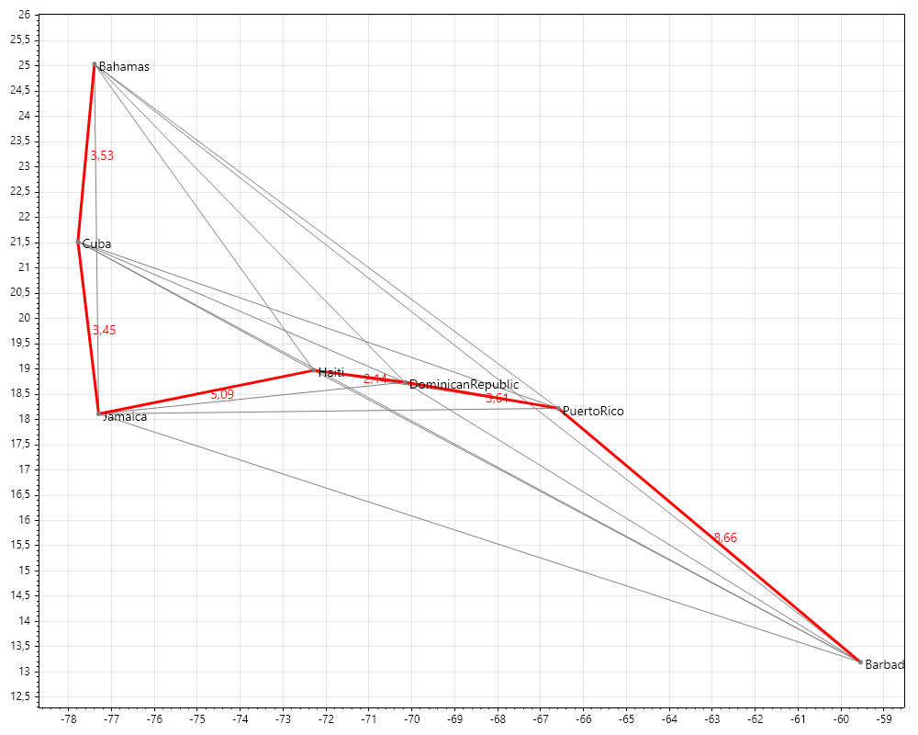
Reflection
I enjoyed the project a lot, especially the freedom I've got to implement a practical solution of my choosing.
Working on the implementation required me to do plenty of additional research, which I feel like improved my knowledge a lot, and also got me hooked on researching different graph traversal algorithms.

