Slide 1
AIRLINE RESERVATION SYSTEM
Airline Reservation System
A practical walkthrough: user input → stored data → results.
Python console application + SQLite database
Manage flights, passengers and tickets.
Book seats, search records, update details and cancel tickets.
Calculate revenue and occupancy. Export results.txt.
01
Notes:
We will demonstrate the app in the terminal and explain the exact source code behind its actions.

Slide 2
AIRLINE RESERVATION SYSTEM
Three modules, one workflow
The menu collects input; booking rules validate it; SQLite stores it.
main.py
airline.py
database.py
Batyrlan
Input and output
Menus and errors
→
Alibek
Booking and search
Statistics and export
→
Batyr
Tables and SQL
Persistent data
Example: enter a seat → check availability → save a ticket → show its ID.
02
Notes:
main.py handles input and output. AirlineSystem handles application rules. Database handles storage.

Slide 3
AIRLINE RESERVATION SYSTEM
How the tables are connected
A ticket links one passenger to one flight.
flights
tickets
passengers
id [primary key]
route and departure
capacity and price
1:N
flight_id [foreign key]
passenger_id [foreign key]
seat and booking price
N:1
id [primary key]
name
unique email
One flight → many tickets. One passenger → tickets on different flights.
03
Notes:
Flights and passengers each have many tickets. Tickets implement the many-to-many relationship between them.

Slide 4
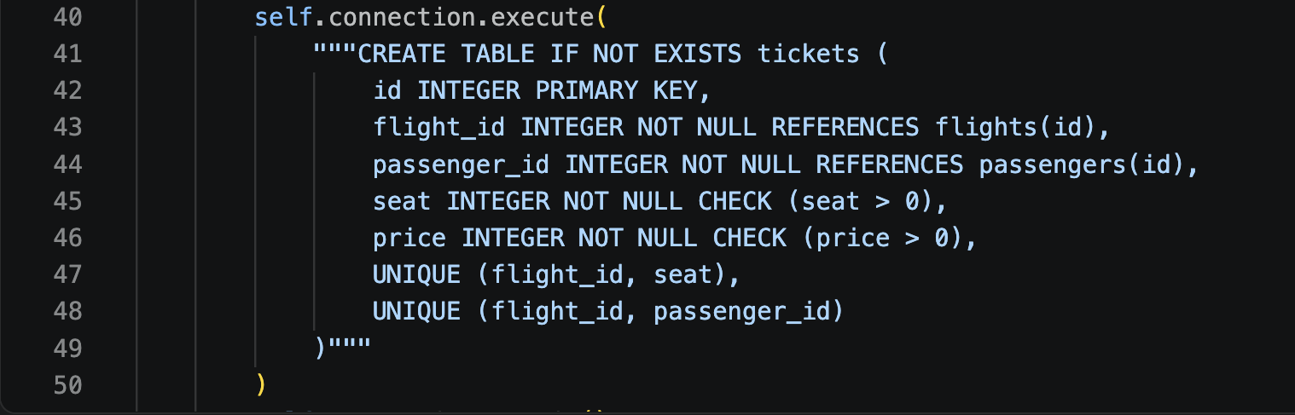
AIRLINE RESERVATION SYSTEM
Database: protect booking relationships
database.py • VS Code screenshot
Foreign keys require an existing flight and passenger. UNIQUE prevents duplicate seats and
duplicate passenger bookings on the same flight.
04
Notes:
Foreign keys require an existing flight and passenger. UNIQUE prevents duplicate seats and duplicate passenger bookings on the same flight.

Slide 5
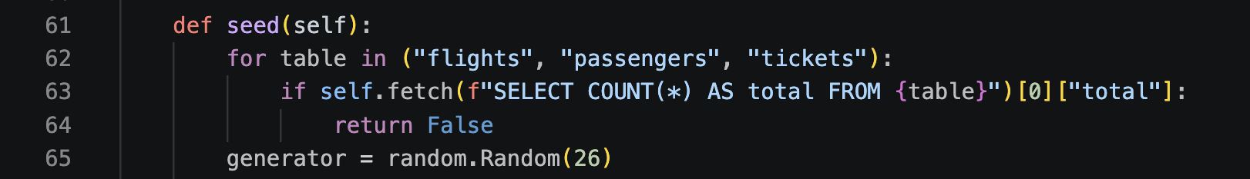
AIRLINE RESERVATION SYSTEM
Initial data: created only once
database.py • VS Code screenshot
seed() stops if any table contains records. A fully empty database receives 20 flights, 50
passengers and 40 tickets; random uses a fixed seed.
05
Notes:
seed() stops if any table contains records. A fully empty database receives 20 flights, 50 passengers and 40 tickets; random uses a fixed seed.

Slide 6
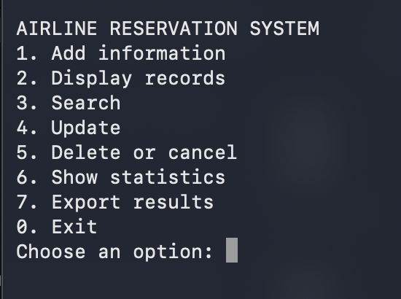
AIRLINE RESERVATION SYSTEM
Start with the main menu
Run: python3 main.py
Choose an operation from 1 to 7. The menu repeats after each action; 0 exits the program.
06
Notes:
Choose an operation from 1 to 7. The menu repeats after each action; 0 exits the program.

Slide 7
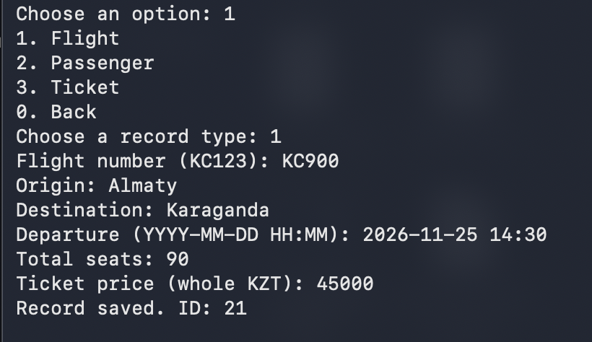
AIRLINE RESERVATION SYSTEM
1. Add a flight
Result: flight 21 • KC900 • 90 seats • 45,000 KZT
Add information → Flight. The user enters the route, departure, capacity and price. The
program confirms the new flight ID.
07
Notes:
Add information → Flight. The user enters the route, departure, capacity and price. The program confirms the new flight ID.

Slide 8
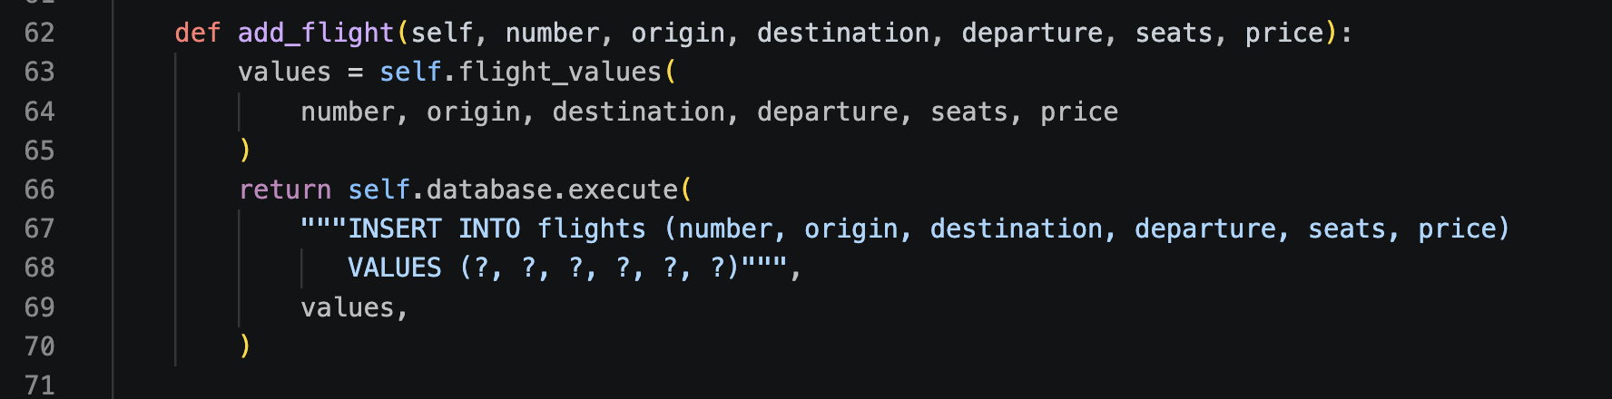
AIRLINE RESERVATION SYSTEM
Code: validate and save the flight
airline.py • VS Code screenshot
add_flight() validates the supplied fields, then inserts them. The question marks receive
values separately; execute() commits and returns the new ID.
08
Notes:
add_flight() validates the supplied fields, then inserts them. The question marks receive values separately; execute() commits and returns the new ID.

Slide 9
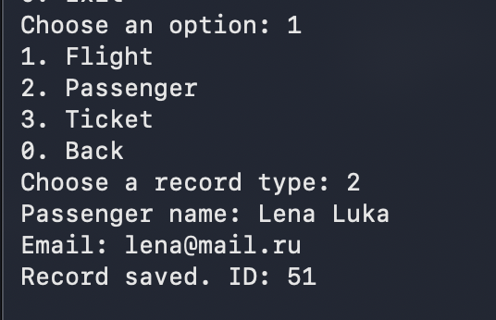
AIRLINE RESERVATION SYSTEM
2. Add a passenger
Result: passenger 51 • Lena Luka
Add information → Passenger. The name and email are saved as a passenger record. The
generated ID is used when booking tickets.
09
Notes:
Add information → Passenger. The name and email are saved as a passenger record. The generated ID is used when booking tickets.

Slide 10
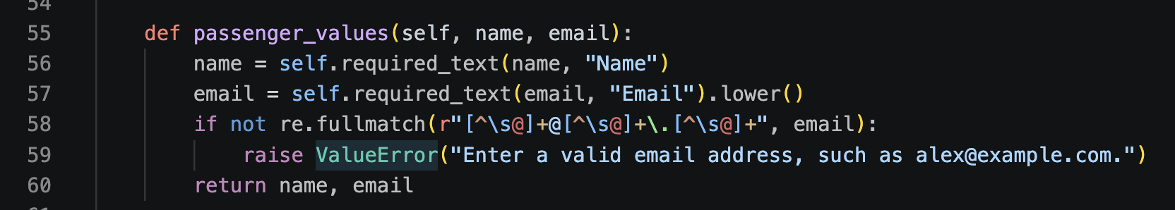
AIRLINE RESERVATION SYSTEM
Code: validate passenger details
airline.py • VS Code screenshot
required_text() rejects empty input. Email is converted to lowercase; re.fullmatch() checks
its format. add_passenger() then saves the validated values.
10
Notes:
required_text() rejects empty input. Email is converted to lowercase; re.fullmatch() checks its format. add_passenger() then saves the validated values.

Slide 11
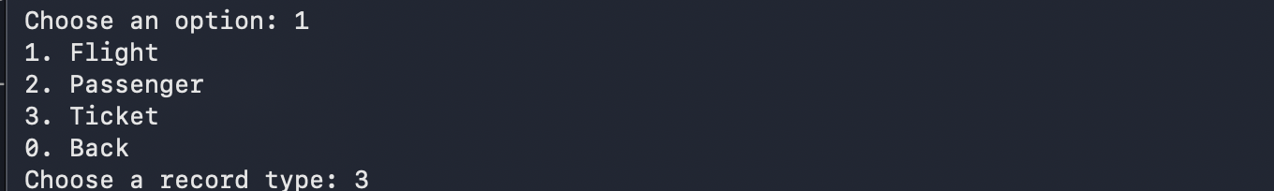
AIRLINE RESERVATION SYSTEM
3. Book a ticket: open the form
Choose 1 — Add information, then 3 — Ticket.
STEP 1 / Select the operation
STEP 2 / Find the flight in the displayed table
Flight KC900 has ID 21 → enter 21 at the Flight ID prompt.
11
Notes:
The user selects Add information and Ticket. The program displays saved flights and passengers before asking for their IDs. These screenshots were taken after the earlier successful booking; they explain where the IDs come from.

Slide 12

AIRLINE RESERVATION SYSTEM
3. Book a ticket: choose the passenger
Use the ID column, not the passenger name or the row position.
STEP 3 / Find the passenger in the displayed table
Passenger ID = 51
Next: enter Flight ID 21, Passenger ID 51 and an available seat.
The name is Lena Nika after the update; the passenger ID stays 51.
12
Notes:
The passenger table is displayed after the flights. Passenger 51 is Lena Nika in this later screenshot because the name has already been updated. The ID remains 51, and that ID is used in the booking example.

Slide 13
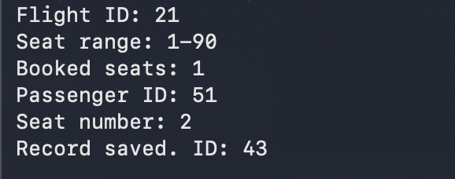
AIRLINE RESERVATION SYSTEM
3. Book a ticket: save the booking
Result: ticket 43 • flight 21 • passenger 51 • seat 2
Seat 1 is already booked. Passenger 51 selects available seat 2 on flight 21. The program
saves the booking and returns ticket ID 43.
13
Notes:
Seat 1 is already booked. Passenger 51 selects available seat 2 on flight 21. The program saves the booking and returns ticket ID 43.

Slide 14
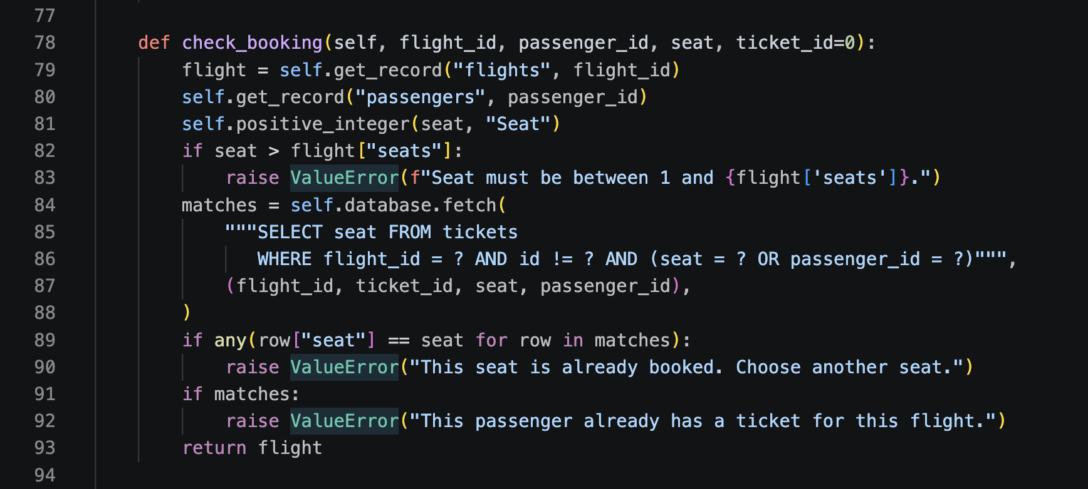
AIRLINE RESERVATION SYSTEM
Code: check the seat before saving
airline.py • VS Code screenshot
check_booking() checks IDs, the seat range, occupied seats and repeat passenger bookings. A
conflict raises ValueError; otherwise the flight is returned.
14
Notes:
check_booking() checks IDs, the seat range, occupied seats and repeat passenger bookings. A conflict raises ValueError; otherwise the flight is returned.

Slide 15
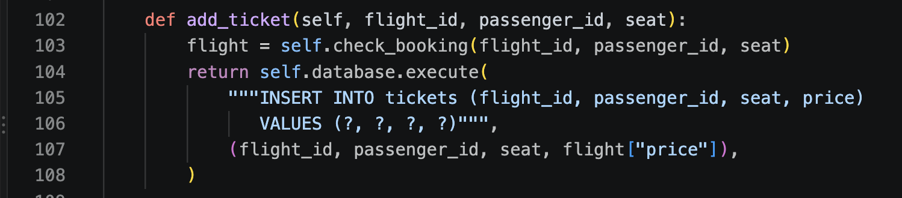
AIRLINE RESERVATION SYSTEM
Code: save the ticket and its price
airline.py • VS Code screenshot
add_ticket() runs the checks, then stores the flight, passenger, seat and current price.
Later changes to the flight price do not alter this ticket price.
15
Notes:
add_ticket() runs the checks, then stores the flight, passenger, seat and current price. Later changes to the flight price do not alter this ticket price.

Slide 16
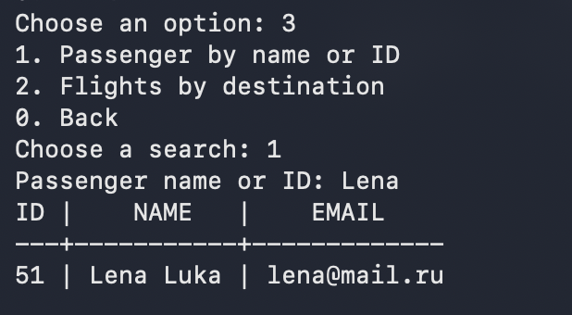
AIRLINE RESERVATION SYSTEM
4. Search for a passenger
Query: Lena → passenger 51, Lena Luka
Search → Passenger by name or ID. A partial name is enough; matching is case-insensitive.
The result displays ID, name and email.
16
Notes:
Search → Passenger by name or ID. A partial name is enough; matching is case-insensitive. The result displays ID, name and email.

Slide 17
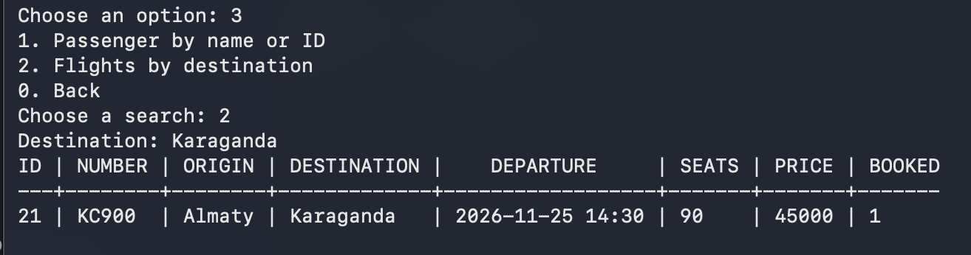
AIRLINE RESERVATION SYSTEM
5. Search flights by destination
Query: Karaganda → flight KC900, one booked seat
Search → Flights by destination. The result shows the route, departure, capacity, price and
number of booked tickets.
17
Notes:
Search → Flights by destination. The result shows the route, departure, capacity, price and number of booked tickets.

Slide 18
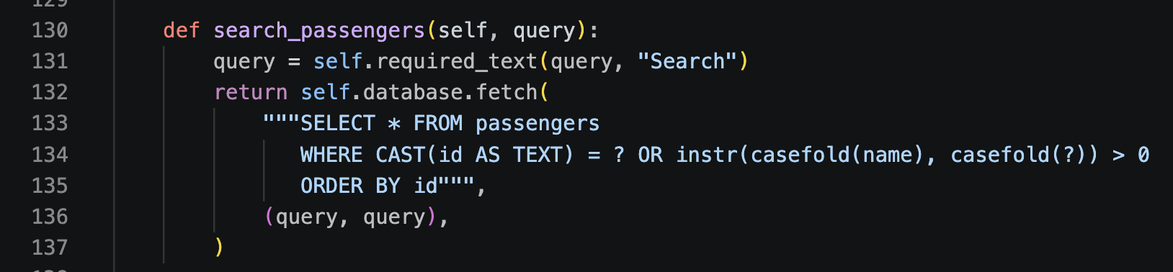
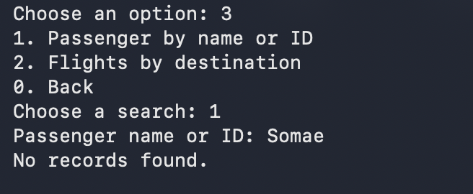
AIRLINE RESERVATION SYSTEM
Code: search and handle missing records
Passenger search uses SQL; the display function handles an empty result.
CAST compares ID as text.
casefold ignores letter case.
instr finds part of a name.
Empty rows → No records found.
18
Notes:
The SQL matches either an exact ID or part of a name. An empty result is shown as No records found.

Slide 19
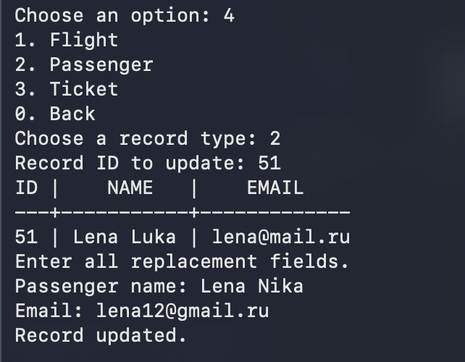
AIRLINE RESERVATION SYSTEM
6. Update a passenger
Passenger 51: Lena Luka → Lena Nika
Update → Passenger. The program shows the old record, accepts replacement fields and
confirms the update. airline.py: update_passenger() runs UPDATE.
19
Notes:
Update → Passenger. The program shows the old record, accepts replacement fields and confirms the update. airline.py: update_passenger() runs UPDATE.

Slide 20
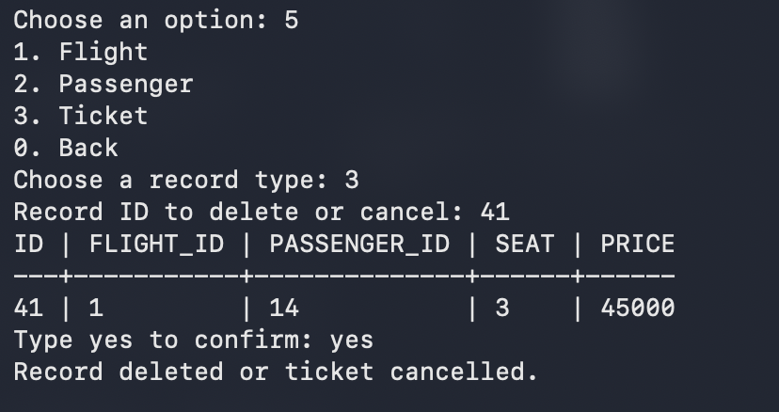
AIRLINE RESERVATION SYSTEM
7. Cancel a ticket
Result: ticket 41 deleted after confirmation
Delete or cancel → Ticket → ID 41 → yes. This is a separate ticket on flight 1, not ticket
43 from the booking example. delete_record() removes it.
20
Notes:
Delete or cancel → Ticket → ID 41 → yes. This is a separate ticket on flight 1, not ticket 43 from the booking example. delete_record() removes it.

Slide 21
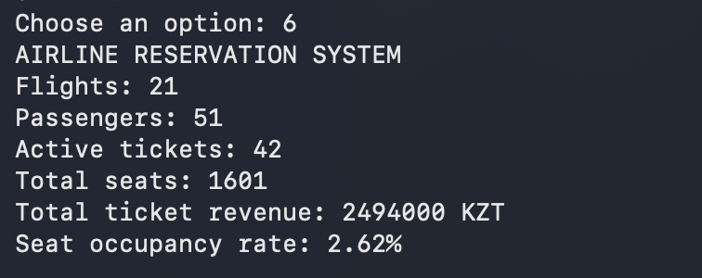
AIRLINE RESERVATION SYSTEM
8. Calculate results and export
Recorded session: statistics before cancellation, then export through option 7.
Revenue = SUM(ticket prices)
2,494,000 KZT
Occupancy = 42 / 1601 × 100
2.62%
statistics() calculates metrics; export_results() saves records and results.txt.
21
Notes:
Revenue sums active ticket prices. Occupancy is ticket count divided by total capacity. The captured statistics precede cancellation. Export writes all records and metrics to results.txt.

Slide 22
AIRLINE RESERVATION SYSTEM
Our contributions and what we learned
Two classes • three related tables • CRUD • search • calculations • file export
Kushekbayev Batyrlan
main.py
Menu, input, tables and error messages
Aben Batyr
database.py
SQLite, relationships and random data
Abduldinov Alibek
airline.py
Booking, re validation, search and results
Next: live demonstration and questions.
22
Notes:
Batyrlan presents the console interface; Batyr presents storage and generated data; Alibek presents booking rules, validation, calculations and export. Additional features are re and random.

