Slide 1
Spring Security http://projects.spring.io/spring-security/
Abdus Mondal
Software Engineer

Slide 2
Spring Security:Agenda
History of Spring Security
Why Spring Security? What Problem it solves?
Core Concept?
Configuration
Development with Spring security
Method Level Security
JSP Tag Library.

Slide 3
Spring Security:Histroy
Originally was the ACEGI project
Configuration was “death by XML”
Project lead liked it that way
ACEGI was rebranded as “Spring Security” around the Spring 2.0 release
With the Security Namespace and as additional modules became available, death by XML gave way to Configuration By Convention
Notes:
Spring Security was originally the ACEGI project in 2003, but had one particular problem: death by XML. The ACEGI forum was filled with people begging to simplify the configuration, but at that time, the project lead refused due to his perception of the power given by the XML schema. (The military term is “shut up and color”).
ACEGI was adopted by the overall Spring project in 2007 and renamed Spring Security with the Spring 2.0 release. The new security namespace was supplemented with annotation-based configuration, and the older Death By XML gave way to Configuration by Convention.

Slide 4
Spring Security
Spring Security is a powerful and highly customizable authentication and access-control framework. It is the de-facto standard for securing Spring-based applications.
Spring Security is a framework that focuses on providing both authentication and authorization to Java applications.

Slide 5
Spring Security
Spring Security solves
"authentication" and
"authorization“
Authentication – establishing a principal to validate ‘ claim’
Authorization – refers to the process of deciding whether a principal is allowed to perform an action within your application.
--Authorization also called "access-control"

Slide 6
Spring Security - Authentication
Support different Authentication model including third party modules
HTTP BASIC authentication headers (an IETF RFC-based standard)
HTTP Digest authentication headers (an IETF RFC-based standard)
HTTP X.509 client certificate exchange (an IETF RFC-based standard)
LDAP (a very common approach to cross-platform authentication needs, especially in large environments)
Form-based authentication (for simple user interface needs)
OpenID authentication

Slide 7
Spring Security - Authentication
Support different Authentication model including third party modules
Kerberos
Mule ESB
Java Authentication and Authorization Service (JAAS)

Slide 8
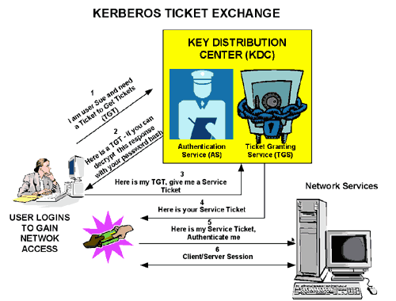
Kerberos authentication architechture

Slide 9
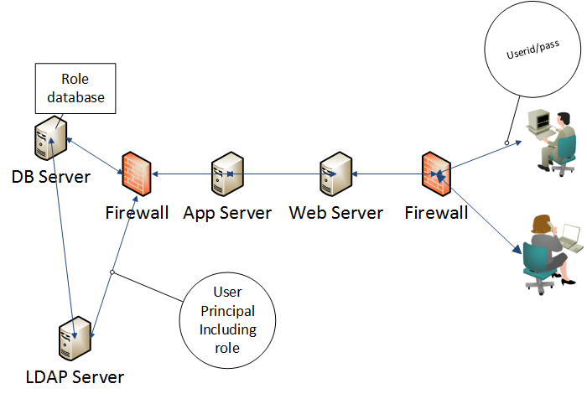
LDAP Authentication architechture
Authorization is maintained by user role

Slide 10
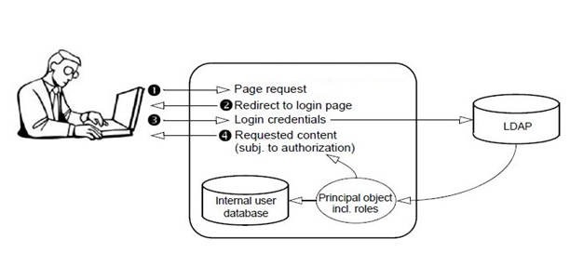
LDAP

Slide 11
Single Sign on (SSO)
Single sign-on (SSO) is a property of access control of multiple related, but independent software systems. Ex- Google app store (gmail,drive,doc,youtube etc.)
Conversely, single sign-off is the property whereby a single action of signing out terminates access to multiple software systems.

Slide 12
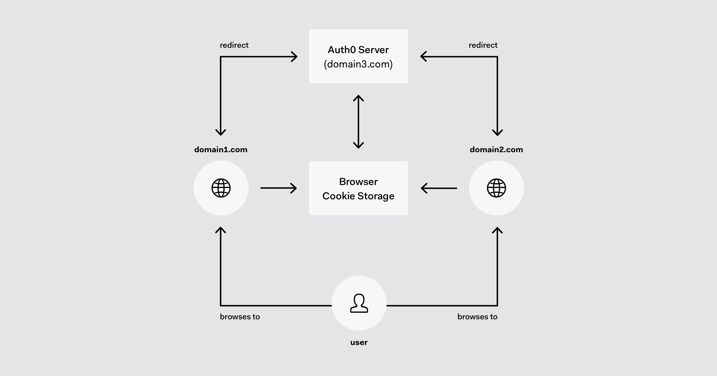
SSO Architecture

Slide 13
Single Sign on (SSO)-Benefits
Mitigate risk for access to 3rd-party sites (user passwords not stored or managed externally)
Reducing password fatigue from different user name and password combinations
Reducing time spent re-entering passwords for the same identity
Reducing IT costs due to lower number of IT help desk calls about passwords[3]
SSO shares centralized authentication servers that all other applications and systems use for authentication purposes and combines this with techniques to ensure that users do not have to actively enter their credentials more than once.

Slide 14
SSO Implementation
List of single sign-on implementations
https://en.wikipedia.org/wiki/List_of_single_sign-on_implementations
Siteminder (CA SSO)
CAS / Central Authentication Service
Facebook Connect
IBM Enterprise Identity Mapping
Kerberos
SAML(Security Assertion Markup Language)

Slide 15
Spring Security-Modules
org.springframework.security.core
org.springframework.security.access
org.springframework.security.authentication
org.springframework.security.provisioning
Web - spring-security-web.jar
Config - spring-security-config.jar
LDAP - spring-security-ldap.jar

Slide 16
Reference
What is LDAP
http://www.nexpert.com.au/23
SSO
https://docs.oracle.com/cd/A97336_01/portal.102/a86782/concepts.htm
https://hellokoding.com/hello-single-sign-on-sso-with-json-web-token-jwt-spring-boot/
https://spring.io/guides/tutorials/spring-boot-oauth2/

Slide 17
Reference
JAAS
https://docs.oracle.com/javase/8/docs/technotes/guides/security/jaas/JAASRefGuide.html

