Slide 1


Slide 2

Reproducible Builds
Robots recreate Electric Sheep
Brett Smith
xbcsmith@gmail.com
20240405

Slide 3
Introduction to Secure Supply Chain
Define a Secure Supply Chain:
A secure supply chain, in the context of software, encompasses the end-to-end process through which software is developed, tested, and delivered to end-users or customers. It includes all the steps from initial code development to distribution and maintenance.
Importance of Supply Chain Security:
The security of the software supply chain is vital because it directly impacts the safety and reliability of the software products that we use daily. A breach or vulnerability in the supply chain can have far-reaching consequences, from data breaches to system failures.
The Role of Software in Supply Chains:
It's crucial to understand that software is not only a component within the supply chain; it often controls and orchestrates the entire process. From managing inventory in manufacturing to coordinating logistics in transportation, software is an integral part of modern supply chains.

Slide 4
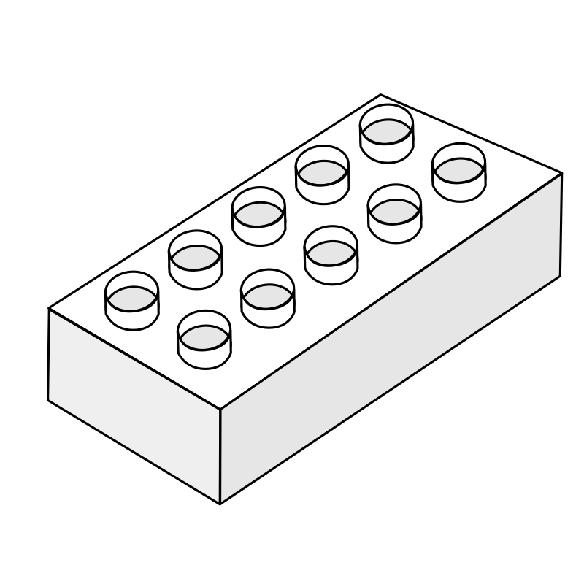

What are Reproducible Builds?
Lego X-Wing fighter
Process:
Setup the place to build the kit
Use the parts from the kit
Follow the assembly instructions from the kit
Results:
You get the exact same X-Wing fighter Lego intended you to get.
Notes:
So lego x-wing
I know where I am going to build my lego X-wing - The kitchen table. It is the same table I build all my models on. I sit in the same seat with the same mat in front of me.
The box is sealed so I know everything in it is what I need to build the model
I take out the instructions. They were sealed in the box so I know they are the right instructions.
I take out the bag of parts. Again sealed in the box. The bag has the signature from Quality Assurance tech #12. I know the parts are right because I trust QA tech #12 and I know it is their signature because I have seen it before.
I follow the instructions and build the model.
When I am done I disassemble the model put all the parts and instructions back in the box… a week later I pull the box off the shelf to build it again. I am at the table in my same seat with my same mat and dump the contents of the box on the table.
I have no QA tech signature because the bag was thrown out. My sibling needed some parts for their build so they nabbed a few bricks. And in the process they switched the series 9 instructions and put the series 7 in the box.
Now I have to snag some parts from my Death Star and wing the build because I don’t have instructions…

Slide 5
When is a build reproducible?
The Debian definition of “reproducible builds” in reproducible-builds.org initiative 2:
A build is reproducible if given the same source code, build environment, and build instructions, any party can recreate bit-by-bit identical copies of all specified artifacts.
The relevant attributes of the build environment, the build instructions, and the source code as well as the expected reproducible artifacts are defined by the authors or distributors. The artifacts of a build are the parts of the build results that are the desired primary output.
Notes:
The Debian definition of “reproducible builds” in reproducible-builds.org initiative 2:
A build is reproducible if given the same source code, build environment, and build instructions, any party can recreate bit-by-bit identical copies of all specified artifacts.
The relevant attributes of the build environment, the build instructions, and the source code as well as the expected reproducible artifacts are defined by the authors or distributors.
The artifacts of a build are the parts of the build results that are the desired primary output.

Slide 6
How do Reproducible Builds Ensure Integrity?
Determinism
Build Process that is Predictable and Consistent
Difficult to introduce changes or vulnerabilities to the process
Unauthorized modifications are immediately apparent
Notes:
Reproducible builds ensure the integrity of software by focusing on determinism.
Determinism means that every aspect of the build process is predictable and consistent.
When software builds are deterministic, it becomes exceedingly difficult for attackers to introduce subtle changes or vulnerabilities during the compilation and distribution process.
Any unauthorized modifications would be immediately apparent because the binaries would differ from the expected, legitimate ones.

Slide 7
Levels of Deterministic Builds
Deterministic builds produces exactly the same output every time.
Basic determinism:
full build
same source code
same directory
same machine
Incremental determinism:
partial rebuild
same source code
same directory
same machine
Local determinism:
full build
same source code
any directory
same machine
Universal determinism:
full build
same source code
any directory
any machine the build runs on.
Notes:
Basic determinism: Doing a full build of the same source code in the same directory on the same machine produces exactly the same output every time, in the sense that a content hash of the final build artifacts and of all intermediate files does not change.
Incremental basic determinism: Like basic determinism, but the output binaries also don’t change in partial rebuilds. In build systems that track file modification times to decide when to rebuild, this means for example that updating the modification time on a C++ source file (without doing any actual changes) and rebuilding will produce the same output as a full build.
Local determinism: Like incremental basic determinism, but builds are also independent of the name of the build directory. Builds of the same source code on the same machine produce exactly the same output every time, independent of the location of the source checkout directory or the build directory
Universal determinism: Like 3, but builds are also independent of the machine the build runs on. Everybody that checks out the project at a given revision into any directory and builds it following the build instructions ends up with exactly the same bits in the build output.

Slide 8
Things that wreck reproducible builds
Build Environment
Timestamps
Files Networks
Locale
Dependencies
Randomness
Packaging
Notes:
The build environment itself.
Variations in toolchain versions
Variations in dynamic linked libraries
Variations in configurations enabled/disabled
Timestamps.
Injected during the build
Injected after the build
Generated during the build
Files.
Encoding, ordering, permissions
Locale
Build environments with different Locale settings
Dependencies
Getting latest is not conducive to reproducibility
Randomness
Unsorted data structures
Find
Never trust python sorting… etc.
Packaging
Timestamps
Host info
Locale

Slide 9
Pillars of Reproducible Builds
Repeatable builds
Immutable environments
Source availability
Notes:
Are your builds repeatable?
Are your environments immutable?
Is your source available and verifiable?

Slide 10
Deterministic Build System
Define the Build Environment
Distribute the Build Environment
Provide the Comparison Protocol
Notes:
Define the Build Environment:
It's crucial to have a clear definition of the build environment. Users should be capable of reconstructing the build environment as closely as possible to the original setup, ensuring that the output matches the original. This definition can be established in advance or documented during the build process.
Distribute the Build Environment:
Users need access to information about the build environment to successfully replicate the build. Ideally, this description should be easily understood by both humans and automated systems, and it should be stored in a version control system like Git for easy retrieval and sharing.
Provide the Comparison Protocol:
To ensure the reproducibility of builds, users should have a straightforward method for recreating the build environment, obtaining the source code, conducting the build, and comparing the outcomes. The comparison protocol should be user-friendly and ideally involve simple methods like comparing bytes or cryptographic hash values, making it both easy to perform and comprehend.

Slide 11
Things we can do to make builds reproducible
Infrastructure as Code and gitOps
Containerize the toolchains, immutable is good.
Pin your versions
Record the build environment
Checksums and Cryptographic Signatures
Hermetic builds
Remove randomness from the resulting binary.
Notes:
Infrastructure as Code and gitOps, using manifests checked into an SCM system to ensure deployments can be reproduced.
Containerize the toolchains, immutable is good. Have known good containers. Dockerfiles are not enough.
Pin your versions. For everything. Tools, OS, compiler, source, etc…
Record versions, types, variables for your build environment, tools, inputs, processes, and results. SHA512 and Cryptographic Signatures are your friends.
Hermetic builds, don’t rely on the network during builds. Vendor your dependencies.
Remove randomness from the resulting binary. Do not inject timestamps, signatures, or random data into the binaries during or after the build process. Sometimes it is unavoidable as transitive dependencies do not play by your rules.

Slide 12
Build Systems
That try to meet the definition of reproducible build:
Debian buildd system
That can never meet the definition of reproducible build:
Fedora Buildsystem
Notes:
In Debian’s buildd system binaries are built twice and compared against each other.
Build environment is well defined
Build instructions are part of the packaging tools
Build environment information is captured in a .buildinfo file that is cryptographically signed and stored separate from the binary.
Archived source tar balls are available at http://snapshot.debian.org/ (and other locations).
Fedora can’t do reproducible builds by the Debian definition because the technology makes it impossible.
Signatures are embedded in the rpm.
Resulting rebuilds outside of the original build system (where the signing key is present) are always missing the signature.
Timestamps are injected in several places during the builds
Another issue that prevents reproducible builds by the definition I gave earlier is the presence of BUILDTIME and BUILDHOST in the rpm header. Both are pulled from the build environment when they are built. BUILDTIME is almost always guaranteed to be different.
Another field that can be affected is SOURCEPACKAGEID is different because BUILDTIME and other fields were different in the rebuilt srpm
Debian goes through a lot of work to make their builds reproducible. The .buildinfo allows rebuilders to use the exact toolchain versions that were used during the initial build. They try and remove the randomness from the built binary.
Debian introduced a fix for the timestamp injection issue during rebuilds. The SOURCE_DATE_EPOCH for a package can be set during build time so that any timestamps in the build process match the original timestamp.
Fedora’s packaging technology definitely throws a monkey wrench in the ability to do reproducible builds.

Slide 13
The Debate
Is the Debian definition of reproducible builds the only way?
Notes:
Fedora rpms are built in a well-defined environment.
The Koji build system uses a tool called mock to build rpms.
As part of the process mock uses systemd-nspawn to start a build in an isolated container, that in turn installs packages using dnf.
Koji records the build environment during the build.
Koji can provide that list using the getBuildrootListing() call.
Fedora build bits are stored in git repos and have tools like fedpkg that make retrieving the source for a build easy. You still need a lot of build environment context to do a reproducible build.
Outside of fedpkg RPMs have Source RPMs that provide the source code, build instructions, and dependent list one would need as the input to reproduce the build
If we exclude the known fields in an RPM that will differ from the original we could do a pretty fair comparison of the payload that should be the same.
So with a looser definition of reproducible Fedora maybe has a case for reproducibility.
Debian has had struggles with their own definition lately.
Recently Debian announced that kernel modules will be signed with an ephemeral key
Makes reproducible builds by the Debian definition impossible
No better solution exists but they have some plans (if you want to contribute)
## Kernel modules will be signed with an ephemeral key
The modules will not longer be signed using the Secure Boot CA like the
EFI kernel image itself. Instead a key will be created during the build
and thrown away after.
Yes, this will make the build unreproducible, but no better solution
currently exists. There are some plans, but no-one is working on them.
If a suitable replacement shows up, we can always switch to that
solution.

Slide 14
The Ideal Reproducible Build
More than one pipeline build the same source
Notes:
Ideally we would have multiple pipelines build the same source code. We would then compare the results and they match.
This covers several scenarios.
The source are not compromised.
The inputs are not compromised.
The instructions are not compromised.
The environment is not compromised.

Slide 15
Wrap up
Are the toolchains containerized?
Are the build environments immutable?
Are the build inputs always available?
Are the sources verifiable?
Are the builds instructions repeatable?

Slide 16
AMA

Slide 17
I am Smitty and I am afraid of Robots
Brett Smith
xbcsmith@gmail.com
20240405

Slide 18
Resources
Web Articles
https://reproducible-builds.org
https://lists.debian.org/debian-release/2023/09/msg00625.html
https://lists.reproducible-builds.org/pipermail/rb-general/2023-September/003076.html
https://buildinfos.debian.net/ftp-master.debian.org/buildinfo/2023/09/16/
https://fossa.com/blog/three-pillars-reproducible-builds/
https://blog.llvm.org/2019/11/deterministic-builds-with-clang-and-lld.html
https://discussion.fedoraproject.org/t/report-from-the-reproducible-builds-hackfest-during-flock-2023/87469
Interesting tools
https://diffoscope.org/
https://salsa.debian.org/reproducible-builds/debian-verification-build-experiment

Slide 19


