Slide 1

Event Driven CI/CD Pipelines with an Audit Trail
NOTE: This is the Ignite Auto-Advancing Template
Enable Asynchronous CD without Skynet happening
Brett Smith
xbcsmith@gmail.com
Notes:
Continuous Integration, Continuous Testing, Continuous Deployments, Continuous Delivery...
I am going to need an army of robots.
And I hope they don't run amuck

Slide 2
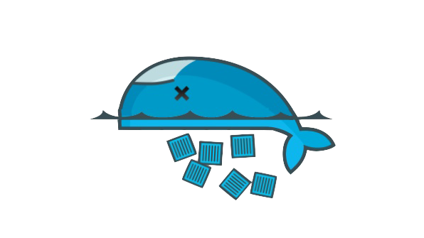
Strategy
Hope is not a strategy.
-- The SRE --
Notes:
Hope is not a strategy.
We cannot hope the robots do the right thing.
We can not hope the robots don't chase my Electric Sheep
We need a strategy.
Why?

Slide 3
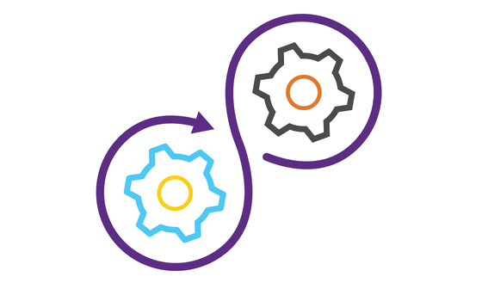
Truth
Continuous Delivery at scale is Hard
Notes:
Because Continuous Delivery at scale is hard.
Continuous anything at large companies is going to be difficult.
What do we do about this new world?

Slide 4
Truth
The Future is Automatic
Notes:
The future is automatic.
Automation will not be enough.
I need the developers to check out code.
Make their changes.
Submit their pull requests.

Slide 5

gitOps
#JustCommit
Notes:
Just Commit.
And the robots do the work.
How can we accomplish this?
I have a few ideas.

Slide 6
Idea
Create receipts for Actions
Notes:
What if we create receipts for the actions we automate?
What if receipts payloads follow a spec?
What if the receipts have all the metadata collected from the actions?

Slide 7
Idea
Dev (Build/Unit test)
Component Test
System Integration
Regression test
Staging
Notes:
We create receipts for Builds, Unit tests, Component Test, System Integration, Regression Tests, Staging.
Everything gets a receipt.
What do we do with all these receipts?

Slide 8
Idea
Collect Receipts for Actions
Notes:
We collect all the receipts.
We tie them to gates.
We collect, validate and store the receipts.
What do all these receipts do?

Slide 9
Idea
Receipts satisfy Gates
Notes:
Receipts check the box.
The box is the gate.

Slide 10
Idea
Gates produce Events
Notes:
What if we use the receipts to satisfy gates and trigger the next steps in the pipeline?
The receipts satisfy the gates.
The gates enable flow through the pipeline.

Slide 11
Idea
Query the Gates for Receipts
Notes:
The watchers are listening for events.
We emit a message to the watchers.
The watcher hears the message it queries the gates for the receipts.
It validates the gate is satisfied.

Slide 12
Idea
Automatic not just Automated
Notes:
The robots promote the unit.
We ship by readiness.
This is my letter to Deckard
Automatic not just Automated. Because automation is not enough.

Slide 13
Value
Reduce Engineering Forensics
Notes:
What value do we get from all the receipts and gates?
I can trace the lifecycle of source to a binary running in production.

Slide 14
Value
Map Dev Source to Prod Binary
Notes:
So, when they find a bug I can trace how it got there. Once I trace how it got there...

Slide 15
Value
Reproduce Actions with a Receipt
Notes:
I can reproduce the actions for the things the automation did with the receipts...

Slide 16
Future
Machine Learning to Optimize
Notes:
We use machine learning to Optimize.
We make our tests better, we make our deployments better, we make everything faster.

Slide 17
Future
Predictive Test Selection
Notes:
We do predictive test selection so when a Developer changes the README I don’t run six hours of regression tests.
I run the README test.

Slide 18
Future
Deployment Risk Prediction
Notes:
We do Deployment Risk Prediction.
Automation does 40,000 deployments a year.
10,000 of them fail.
We use that data to flag source that is risky for deployments and come up with another plan.

Slide 19
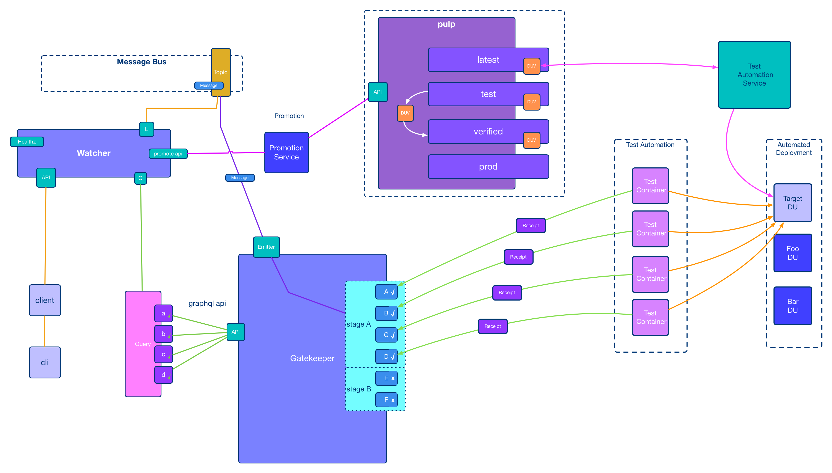
Notes:
This is the event driven asynchronous pipeline.
I like to refer to It is a series of bad decisions wrapped in go.

Slide 20
I am Smitty and I am afraid of Robots
Brett Smith
xbcsmith@gmail.com
Notes:
I am Smitty and I am afraid of robots.

