Slide 1
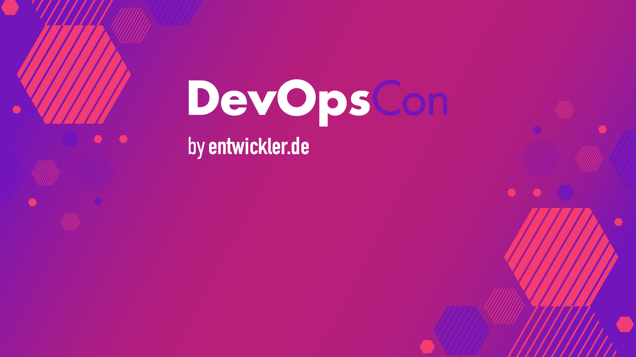

Brett Smith
xbcsmith@gmail.com
20240405

Slide 2
Building an Event-Driven CI/CD Provenance System
Brett Smith
xbcsmith@gmail.com
20240405

Slide 3
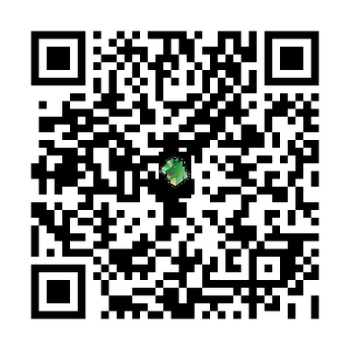
Event Driven CI/CD Workshop
View the workshop:
https://github.com/xbcsmith/epr-workshop
Clone the workshop:
git clone git@github.com:xbcsmith/epr-workshop.git

Slide 4
Introduction to Event Driven Microservice Architectures
Asynchronous
Allows for scalability and modularity
Provides an audit trail
Services are specialized
Independent SDLC
Creeping system complexity
Eventual consistency
Increased maintenance
Downstream flooding
Dead Letters

Slide 5
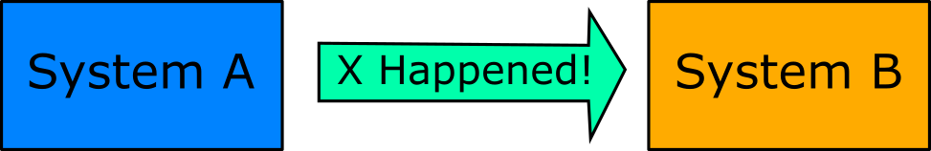
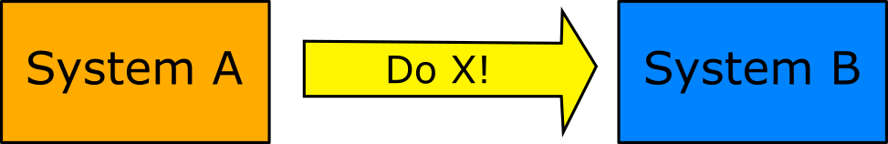
Declarative and Imperative Events

Slide 6

Cloud Events
Interoperability
Producer Consumer Independence
Asynchronous Communication
Standard Data Model
Dynamic Event Interest Expression
Flexible Event Consumption
Consumer Evolution

Slide 7

CDEvents
Common Vocabulary
Normalized Form
System Agnostic
Declarative events
Simplified Integration
Targeted Notifications

Slide 8
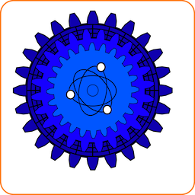
Event Provenance Registry (EPR)
Events
Event Receivers
Event Receiver Groups
Gating
Auditing
Provenance
Messages
CloudEvents Spec
Declarative events
Imperative events
Watchers

Slide 9


Slide 10
Setting Up the Environment
Docker – https://docs.docker.com/get-docker
Docker Compose – https://docs.docker.com/compose/install
Golang – https://go.dev/doc/install
Python – https://www.python.org/downloads
Git – https://git-scm.com/downloads

Slide 11

Redpanda (Kafka): Message Queue Overview
Redpanda is a Kafka-compatible event streaming platform.
It provides a message bus for our event-driven architecture.
Simple. Kafka® API-compatible. ZooKeeper® free. JVM free.
Redpanda Nodes - Self contained service
Redpanda Keeper - CLI for managing clusters
Redpanda Console - UI for managing clusters

Slide 12
Redpanda (Kafka): Message Queue Overview
Terminal 1 : run the command to consume the message
docker compose -f ./compose/docker-compose.yaml up
Terminal 2 : run the commands create a topic and produce the message
docker exec -it redpanda rpk topic create epr.dev.events --brokers=localhost:9092
docker exec -it redpanda rpk topic produce epr.dev.events --brokers=localhost:9092
Terminal 3 : run the command to consume the message
docker exec -it redpanda rpk topic consume epr.dev.events --brokers=localhost:9092

Slide 13
EPR Concepts
Gating
Auditing
Provenance
Events
Event Receivers
Event Receiver Groups
N - Name
V - Version
R - Release
P - Platform ID
P - Package
Messages
CloudEvents Spec
Declarative events
Imperative events
Watchers

Slide 14
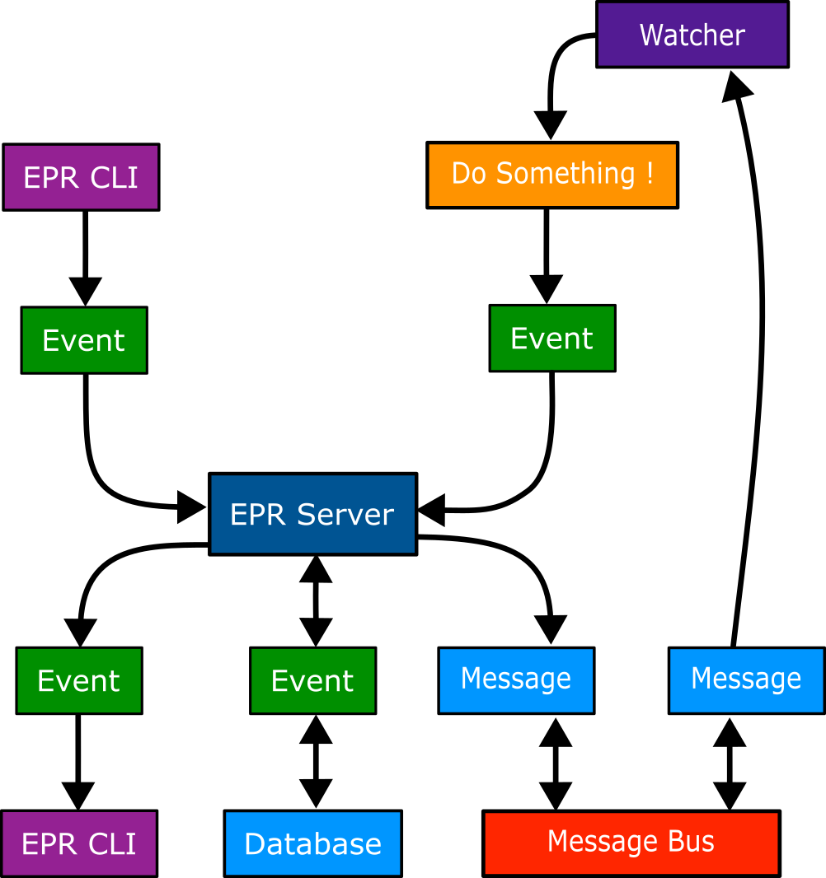
EPR Workflow

Slide 15
Exploring EPR: Codebase Overview
Use the following command to clone the EPR project repository:
git clone git@github.com:sassoftware/event-provenance-registry.git

Slide 16
Exploring EPR: Start the Backend
Open a new terminal and cd to the event-provenance-registry repository.
cd event-provenance-registry
Use the following command to start the backend services for EPR:
docker compose -f ./docker-compose.services.yaml up

Slide 17
Building EPR: Service
Open a new terminal and cd to the event-provenance-registry repository.
cd event-provenance-registry
Export the following environment variables:
export EPR_TOPIC=epr.dev.events
export EPR_BROKERS=localhost:19092
export EPR_DB=postgres://localhost:5432
Then we can start the EPR server with the following command:
go run main.go
The server will be available on localhost:8042

Slide 18
Setup EPR: Workflow
EPR workflow to setup the server to produce events is as follows:
Create an Event Receiver.
Post an Event to the Event Receiver.
EPR produces message on topic.
To leverage Event Receiver Groups we would follow this workflow:
Create several Event Receivers
Create an Event Receiver Group with all the Event Receivers.
Create an Event with identical NVRPP for each Event Receiver in the Group.
EPR produces a message for each Event on the topic.
When the last Event is sent EPR produces a message for the Event Receiver Group on the topic.

Slide 19
Curl EPR: Create an Event Receiver
curl --location --request POST 'http://localhost:8042/api/v1/receivers' \
--header 'Content-Type: application/json' \
--data-raw '{
"name": "foobar",
"type": "foo.bar",
"version": "1.1.3",
"description": "The event receiver of Brixton",
"schema": {
"type": "object",
"properties": {
"name": {
"type": "string"
}
}
}
}'

Slide 20
Curl EPR: Create an Event
curl --location --request POST 'http://localhost:8042/api/v1/events' \
--header 'Content-Type: application/json' \
--data-raw '{
"name": "magnificent",
"version": "7.0.1",
"release": "2023.11.16",
"platform_id": "linux",
"package": "docker",
"description": "blah",
"payload": {
"name": "joe"
},
"success": true,
"event_receiver_id": "<PASTE EVENT RECEIVER ID FROM FIRST CURL COMMAND>"
}

Slide 21
Curl EPR: Create an Event Receiver Group
curl --location --request POST 'http://localhost:8042/api/v1/groups' \
--header 'Content-Type: application/json' \
--data-raw '{
"name": "the_clash",
"type": "foo.bar",
"version": "3.3.3",
"description": "The only event receiver group that matters",
"enabled": true,
"event_receiver_ids": [
"PASTE EVENT RECEIVER ID FROM FIRST CURL COMMAND"
]
}

Slide 22
Using EPR: GraphQL
The GraphQL Playground is a tool that allows you to test your GraphQL queries in
a browser.
The graphql playground will now be accessible at:
http://localhost:8042/api/v1/graphql

Slide 23
Using EPR: GraphQL
Create an Event Receiver by pasting the mutation into the GraphQL Playground.
mutation {
create_event_receiver(
event_receiver: {
name: "the_clash"
version: "1.0.0"
type: "london.calling"
description: "The only band that matters"
schema: "{\"name\": \"value\"}"
}
)
}

Slide 24
Using EPR: GraphQL
Create an Event Receiver Group by pasting the mutation into the GraphQL Playground. Use the ID from the last command for the event_receivers_ids field.
mutation {
create_event_receiver_group(
event_receiver_group: {
name: "foobar"
version: "1.0.0"
description: "a fake event receiver group"
enabled: true
event_receiver_ids: ["ID_RETURNED_FROM_PREVIOUS_MUTATION"]
type: "test.test.test"
}
)
}

Slide 25
Using EPR: GraphQL
Create an Event by pasting the mutation into the GraphQL Playground.
mutation {
create_event(
event: {
name: "foo"
version: "1.0.0"
release: "20231103"
platform_id: "platformID"
package: "package"
description: "The Foo of Brixton"
payload: "{\"name\": \"value\"}"
event_receiver_id: "ID_RETURNED_FROM_PREVIOUS_MUTATION"
success: true
}
)
}

Slide 26
Building EPR: CLI
Open a new terminal and cd to the cli directory in the event-provenance-registry repository.
cd event-provenance-registry/cli
Build CLI with the following commands:
Linux
make PREFIX=$(go env GOPATH) install
Mac OS X M1
make PREFIX=$(go env GOPATH) install-darwin-arm64
Export the following environment variables:
export EPR_TOPIC=epr.dev.events
export EPR_BROKERS=localhost:19092
export EPR_DB=postgres://localhost:5432

Slide 27
Using EPR: CLI
Export the following environment variables:
export EPR_TOPIC=epr.dev.events
export EPR_BROKERS=localhost:19092
export EPR_DB=postgres://localhost:5432

Slide 28
Using EPR: CLI
Create a pair of Event Receivers
epr-cli receiver create \
--name "foo-cli" \
--version "1.0.0" \
--description "foo cli created foo" \
--type "epr.foo.cli" \
--schema "{}"
epr-cli receiver create \
--name "bar-cli" \
--version "1.0.0" \
--description "bar cli created bar" \
--type "epr.bar.cli" \
--schema "{}"

Slide 29
Using EPR: CLI
Create an Event Receiver Group. Use the IDs from the Event Receivers
epr-cli group create \
--name "foo-group-cli" \
--version "1.0.0" \
--description "foo cli created foo group" \
--type "epr.foo.group.cli" \
--event-receiver-ids "01HKX0J9KS8AASMRYX61458N41 01HKX0KY3B31MR3XKJWTDZ4EQ0"

Slide 30
Using EPR: CLI
Search for objects by ID, or Name and Version, or Type.
epr-cli receiver search --id 01HKX0KY3B31MR3XKJWTDZ4EQ0 --fields all
epr-cli receiver search --type epr.foo.cli --fields all
epr-cli receiver search --name foo-cli --version 1.0.0 --fields all

Slide 31
Extended EPR: Creating a watcher
Use the EPR watcher SDK to craft a watcher, which actively listens for events originating from the EPR server.
Make a new directory for your watcher and create a `main.go` in that directory.
mkdir foo
cd foo
touch main.go

Slide 32
Extended EPR: Creating a watcher
Now open the `main.go` in your favorite editor (Vim).
Add the following code:
package main
import (
"encoding/json"
"log"
"github.com/sassoftware/event-provenance-registry/pkg/message"
"github.com/sassoftware/event-provenance-registry/pkg/watcher"
)
func main() {
seeds := []string{"localhost:19092"}
topics := []string{"epr.dev.events"}
consumerGroup := "watcher-workshop"
watcher, err := watcher.New(seeds, topics, consumerGroup)
if err != nil {
panic(err)
}
defer watcher.Client.Close()
go watcher.StartTaskHandler(customTaskHandler)
watcher.ConsumeRecords(customMatcher)
}

Slide 33
Extended EPR: Creating a watcher
Add:
customMatcher
matching the message type value.
customTaskHandler
prints a message when a match is found.
func customMatcher(msg *message.Message) bool {
return msg.Type == "foo.bar"
}
func customTaskHandler(msg *message.Message) error {
log.Default().Printf("I received a task with value '%v'", msg)
return nil
}
Save the file and run `go mod init` in your terminal.
Run `go mod tidy` to fill in the dependencies.

Slide 34
Extended EPR: Creating a watcher
Start up the watcher and start consuming messages with the following command:
go run main.go
curl --location --request POST 'http://localhost:8042/api/v1/receivers' \
--header 'Content-Type: application/json' \
--data-raw '{
"name": "watcher-workshop",
"type": "foo.bar",
"version": "1.0.0",
"description": "The event receiver of Brixton",
"enabled": true,
"schema": {
"type": "object",
"properties": {
"name": {
"type": "string"
}
}
}
}'
In a second terminal create an Event Receiver where type matches what you put in the customMatcher.

Slide 35
Extended EPR: Creating a watcher
Now create an Event.
curl --location --request POST 'http://localhost:8042/api/v1/events' \
--header 'Content-Type: application/json' \
--data-raw '{
"name": "magnificent",
"version": "7.0.1",
"release": "2023.11.16",
"platform_id": "linux",
"package": "docker",
"description": "blah",
"payload": {"name":"joe"},
"success": true,
"event_receiver_id": "<PASTE EVENT RECEIVER ID FROM FIRST CURL COMMAND>"
}'

Slide 36
Advanced EPR: CDEvents
In this section we will cover the CDEvents and EPR concepts and how to use them.
Event Receiver Schema
Create an Event Receiver with a CDEvent schema
Post an Event without a payload and a CDEvent payload
Create a watcher to trigger on CDEvents types
The commands in this section are long. Please refer to section 07-epr-cdevents

Slide 37
Advanced EPR: SBOMs
In this section of the workshop, we will introduce the SBOMs. We will follow a pattern similar to the previous CDEvents section.
Event Receiver Schema
CycloneDX bom schema
Create a source SBOM event
Create an SBOM for an OCI image
The commands in this section are long. Please refer to section 08-epr-sboms

Slide 38
Advanced EPR: Python
In this section we will walk through the development and usage of the EPR Python client.
EPR Python Client
Overview
Development
Model Example
Client Create Example
Create an event receiver
Create an event receiver group
Create an event
EPR Python CLI
The commands in this section are long. Please refer to section 09-epr-python

Slide 39
Advanced EPR: Workshop Challenge
In this section we will expand on our EPR concepts we have learned in the previous sections. This is a free form exercise to expand on what we have learned.
Suggestions:
Add a watcher to fire a webhook.
Add a watcher to create a CDEvent.
Add a watcher to create a SBOM.
Add a Python watcher to create an Event.

Slide 40
AMA

Slide 41
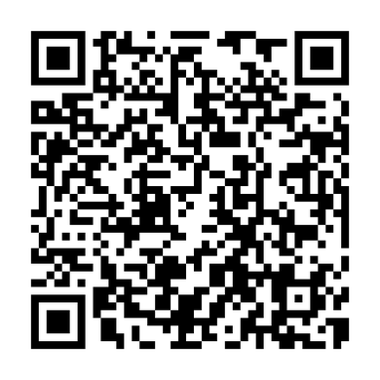
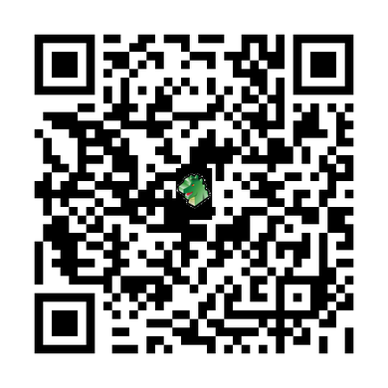
I am Smitty and I am afraid of Robots.
EPR Workshop
EPR
EPR-Python
Brett Smith
xbcsmith@gmail.com
20240405

Slide 42
