Slide 1

Examining Health and Nutrition in South America

Slide 2
Global Look at South America (KP)

Slide 3
Adults of South America (Andrea)

Slide 4
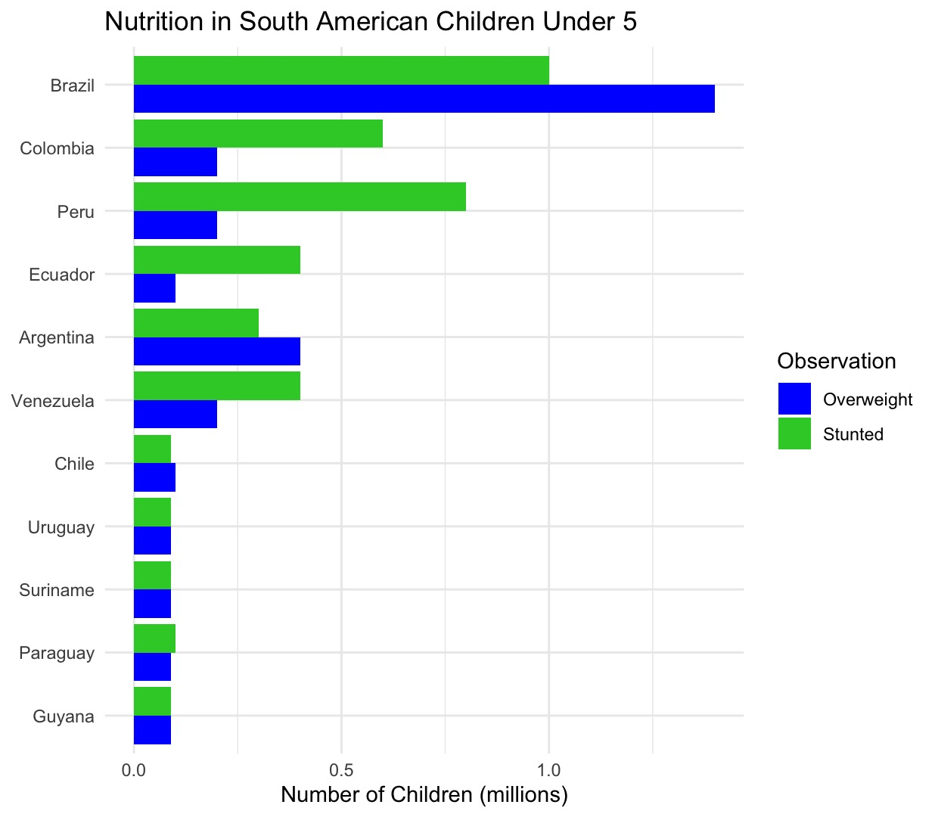
Children of South America (Madison)
Key observations:
  Brazil has the largest numbers of both overweight and stunted children, with overweight children being the highest.
  Peru and Colombia have substantial numbers of stunted children, with overweight children lower in comparison.
  Venezuela, Ecuador, and Argentina show more balanced numbers between stunted and overweight children.
  Smaller countries like Chile, Uruguay, Suriname, Paraguay, and Guyana have much lower absolute numbers of children affected by either condition.
  Across most countries, stunting is more prevalent than overweight in Peru, Ecuador, and Venezuela, while in Brazil, overweight surpasses stunting.

Slide 5
Conclusions

