Slide 1
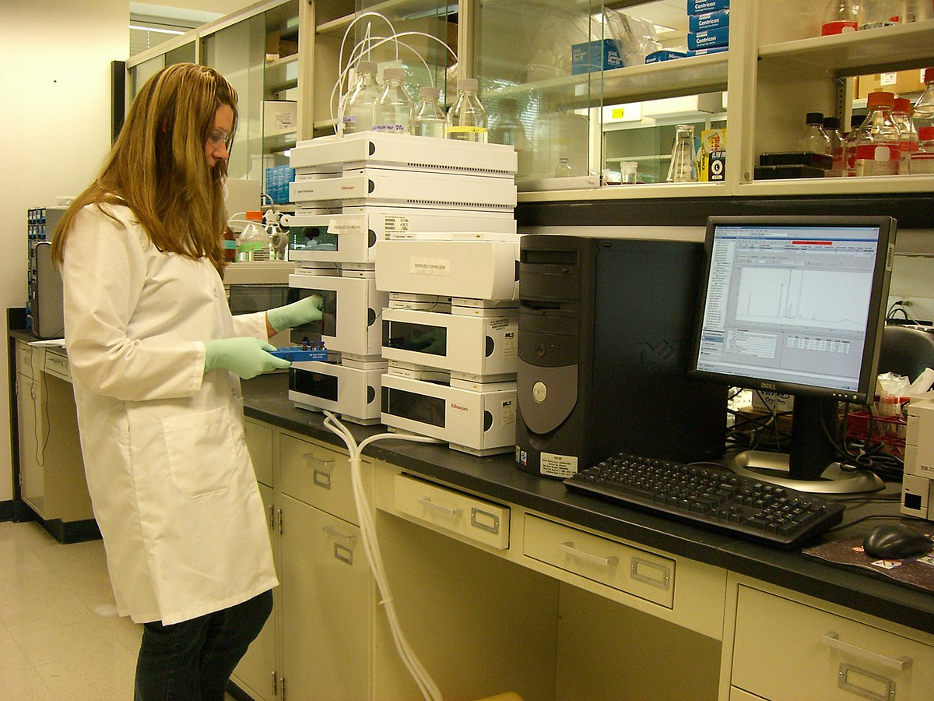

Patient Record Keeping System Presentation
Team 2
Ngoc Nguyen
Kiswendsida Kikone
Jeff Kryszewski
Abhishek Prasad

Slide 2
Agenda
Executive Summary
Business Objective
Current State
Fit-Gap Analysis
Future State
Requirements - Lists
Requirements Forms
Requirements - Reports
Ease of Use

Slide 3
Company owner requested that Team Two present a patient and customer management system that can be used by his small optical business.
Team Two came up with Patient Record Keeping System(PRKS 1.0). The system is intended to displace existing manual business process as the system for Patient Prescription Management for this optical business.
Executive Summary

Slide 4
Business Objective
Optical Company’s owner sought to have a system that would meet the following objectives:
Features and functions made the business a success
Deliver a new platform that extends current capabilities
Deliver a system that enables the next generation of innovations that will keep the optics business competitive in the data-driven business world

Slide 5
Current State
Artifacts
The team analyzed the following artifacts as part of it’s discovery process:
The projectdata.xlsx data extract
SemesterProject.PDF
CurrentProjQuestion.PDF
TeamScore.PDF
Presentation.PDF

Slide 6
Current State Patient Record Keeping
Patient Record Keeping
The current process for managing patients utilizes Microsoft excel for data input.
Data is captured via paper based forms.
.
Current State
Reports are printed from the excel data to provide paper based list to manage the process.
Team 2 has captured the requirements of the current business process and new functionality envisioned and obtained email sign off from the company owner for the functionality requested.

Slide 7
Fit Gap Analysis
Fit-Gap Analysis

Slide 8
Future State

Slide 9
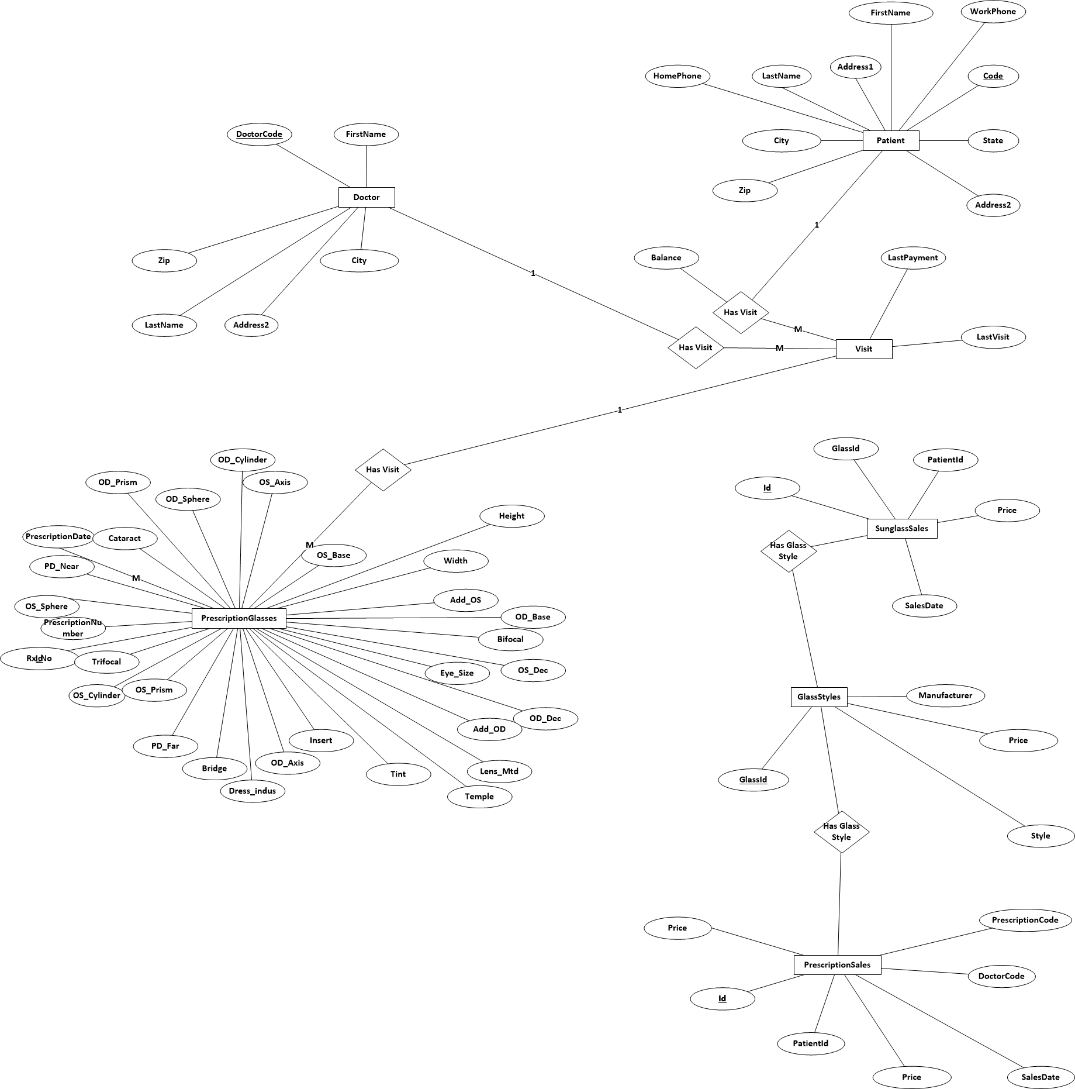
Logical Design

Slide 10
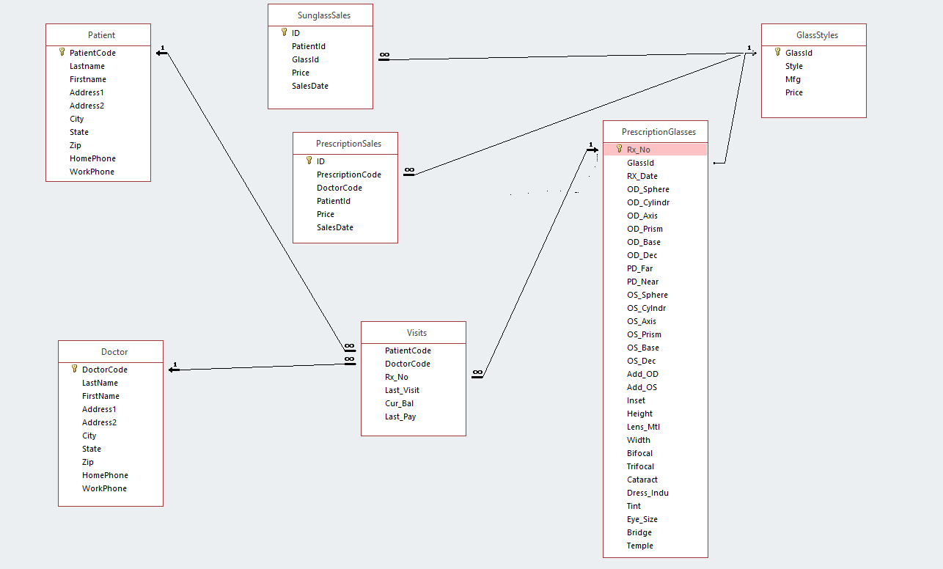
Physical Design

Slide 11
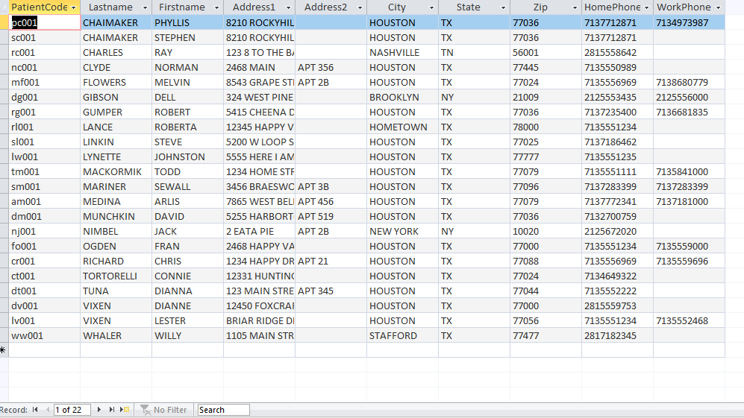
Requirements List Current Patients

Slide 12
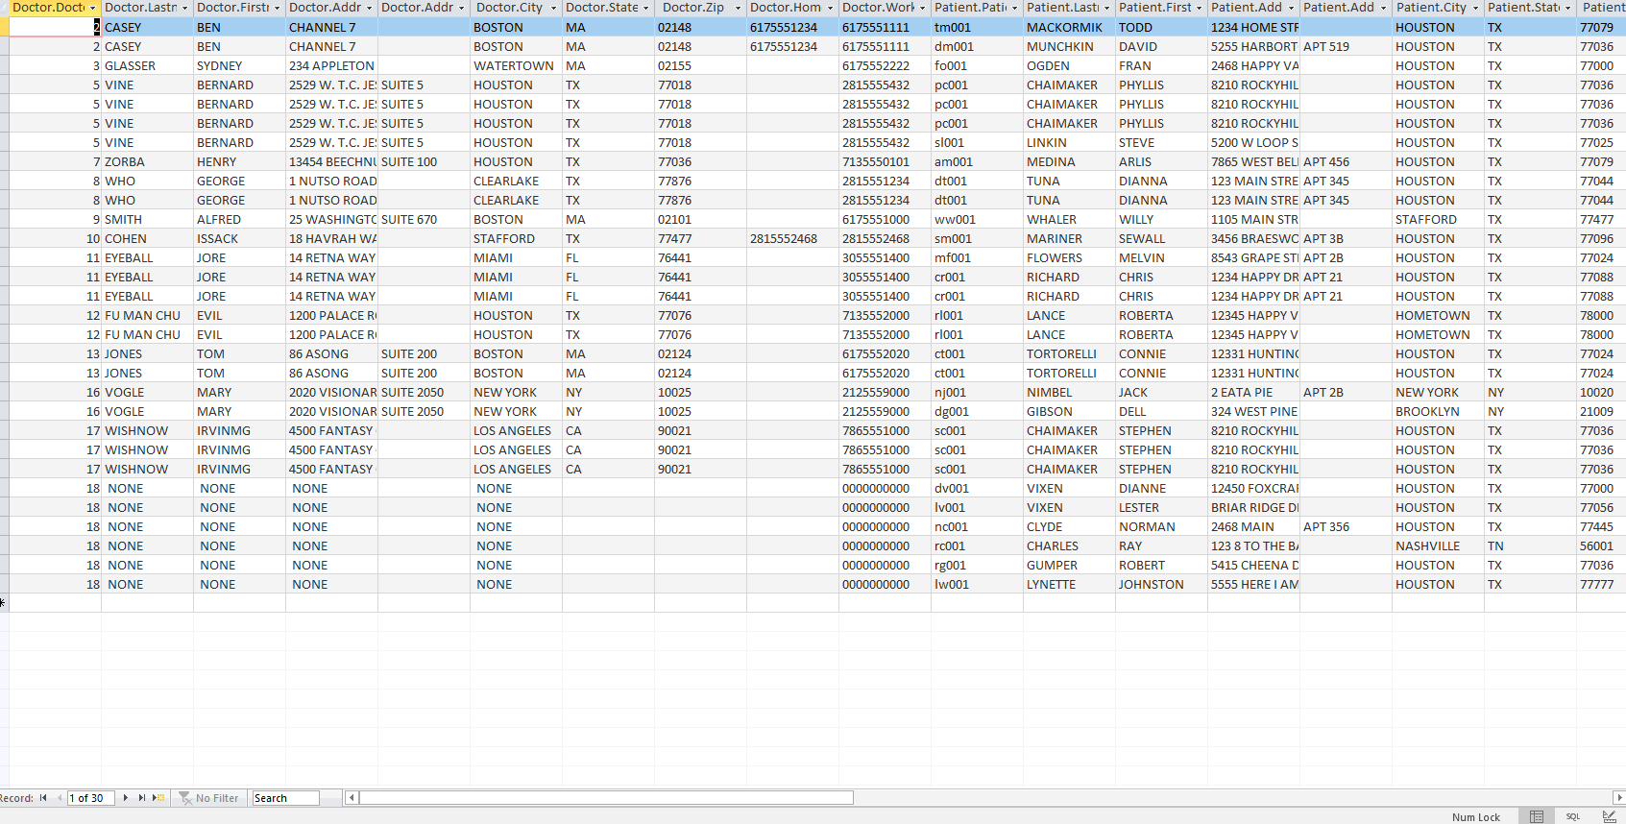
Requirements List Doctors and Their Patients

Slide 13
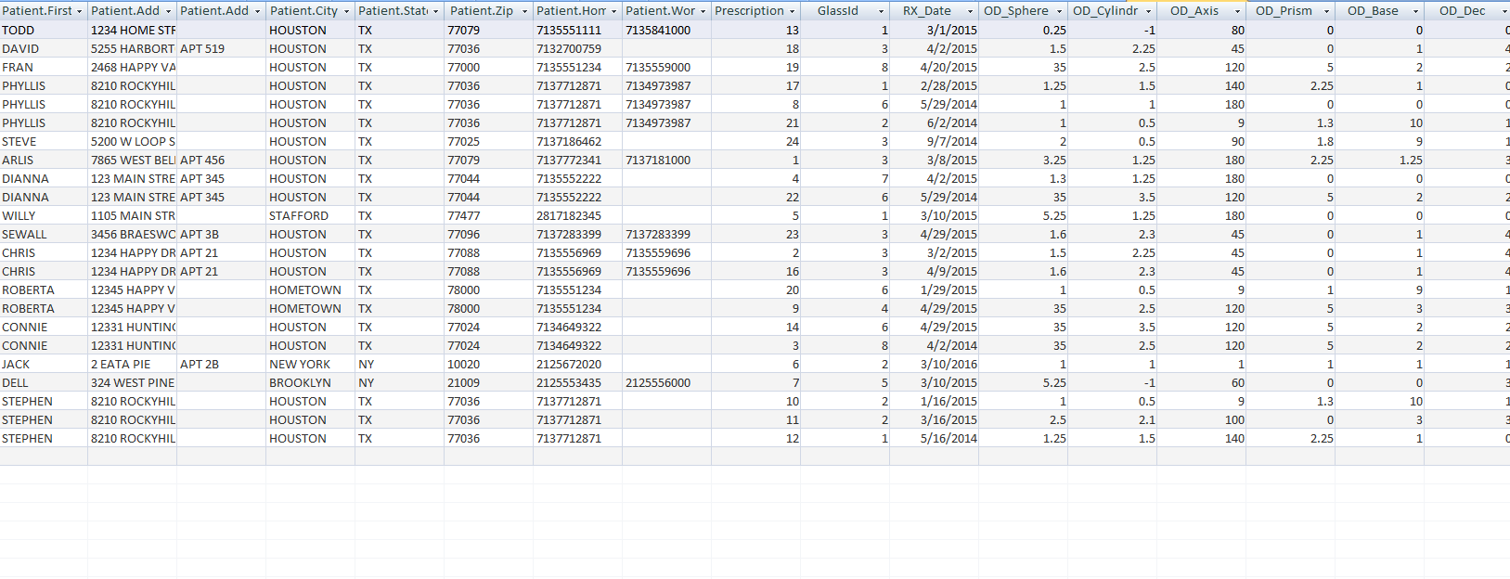
Requirements List Patient Scripts

Slide 14
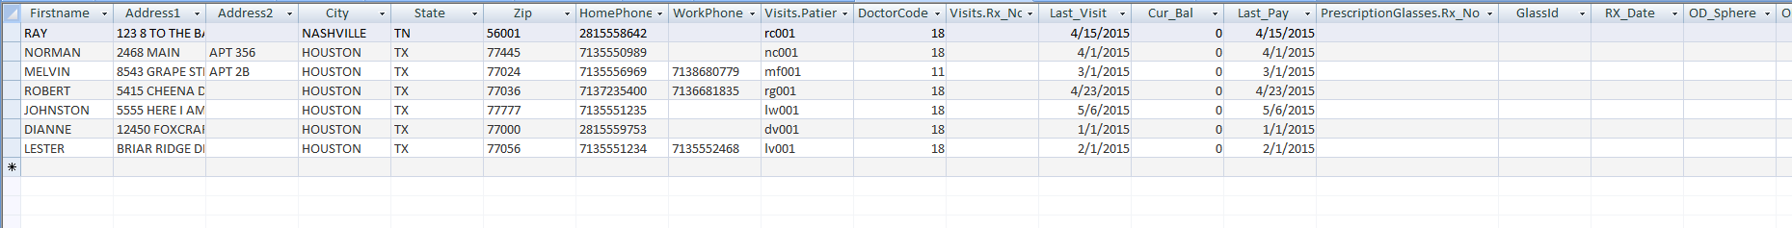
List Retail Customers Only
Requirements List
Retail Customers Only

Slide 15
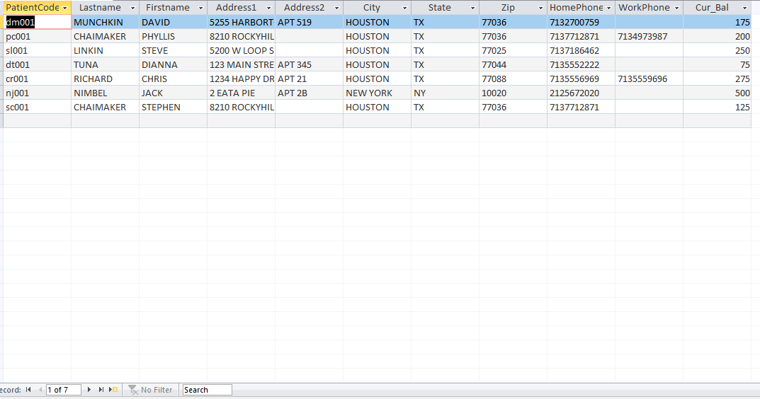
List Open Patient Accounts
Requirements List
Open Patient Accounts

Slide 16
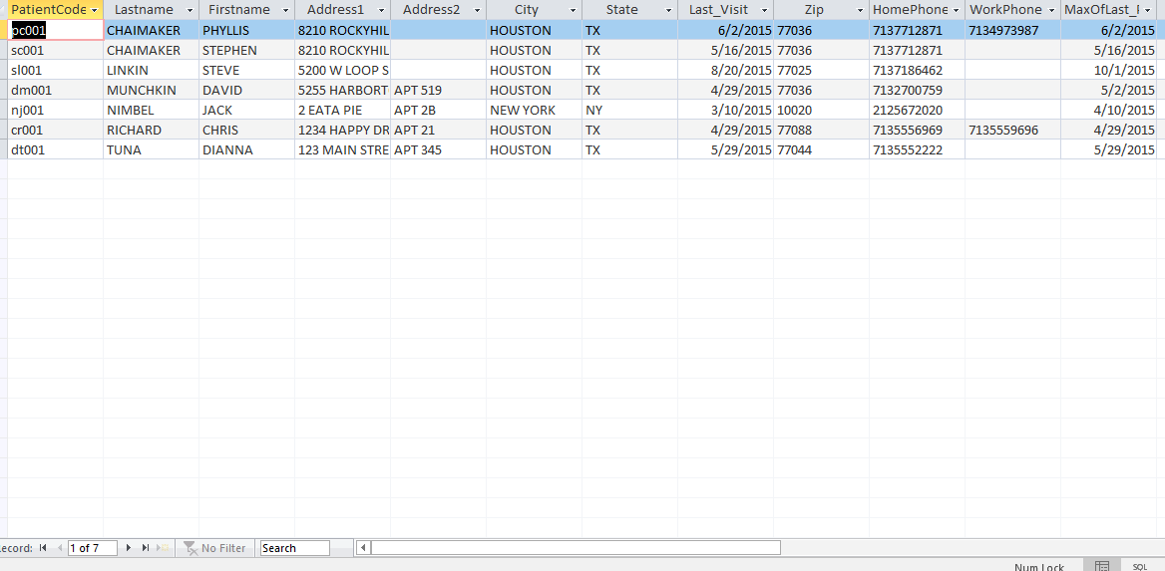
Requirements List
Accounts Past Due

Slide 17
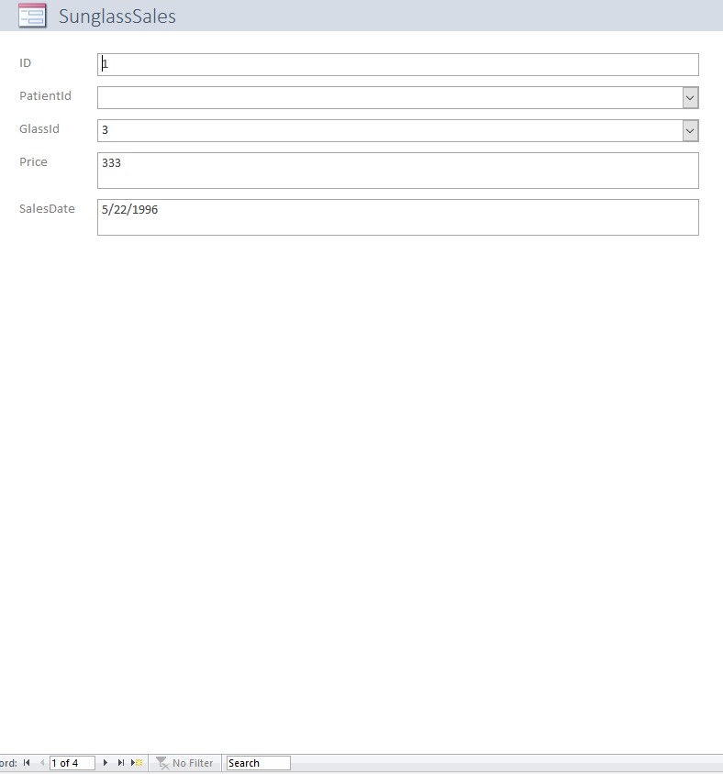
Requirements Forms
Sunglasses Sales

Slide 18
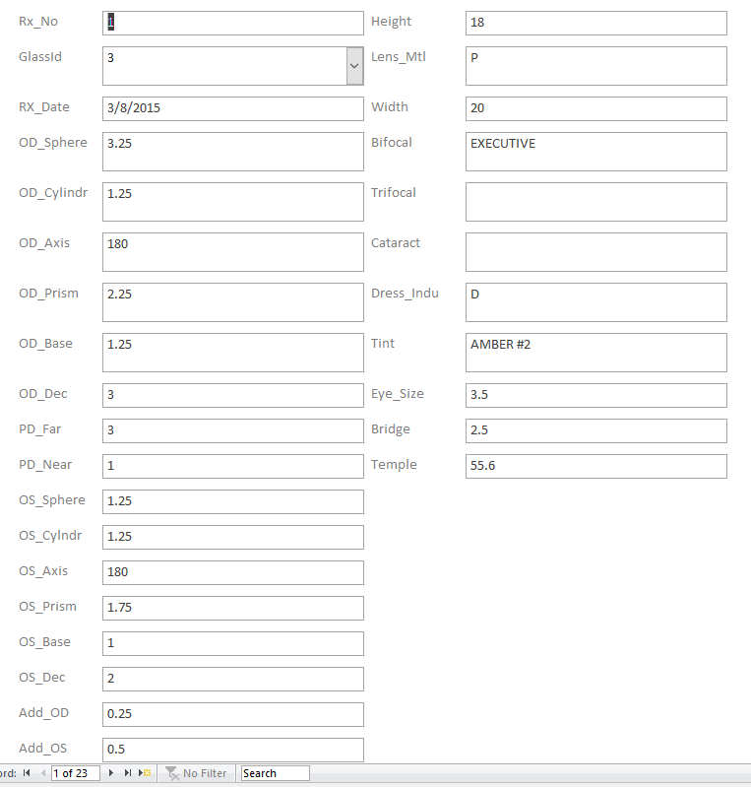
Requirements Forms
Prescription Eyeglasses/Contact Sales

Slide 19
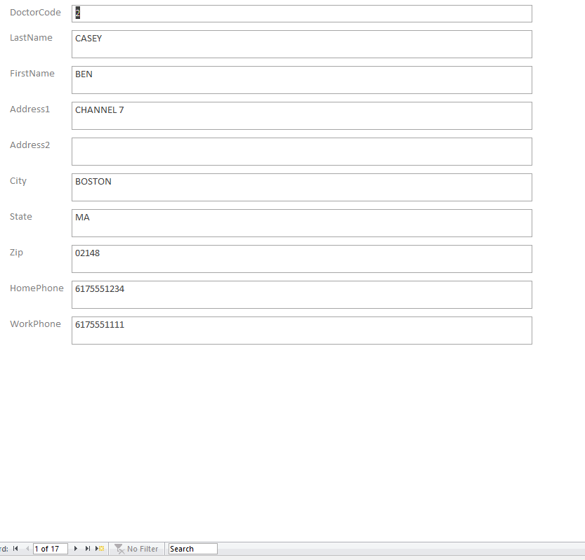
Requirements Forms
New Doctor

Slide 20
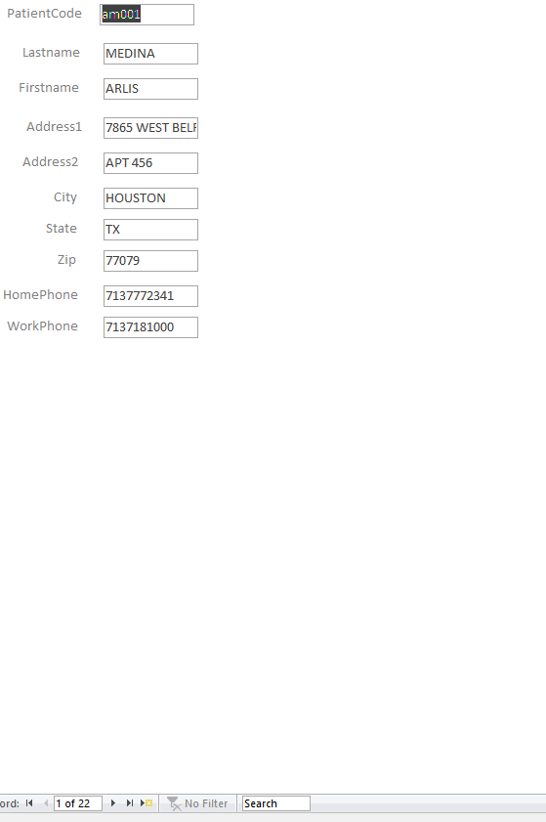
Requirements Forms
New Customer

Slide 21
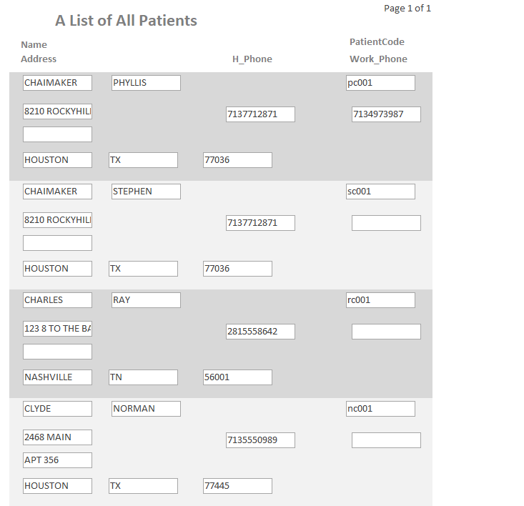
Requirement Reports A List of All Patients
Requirements Reports
A List of All Patients

Slide 22
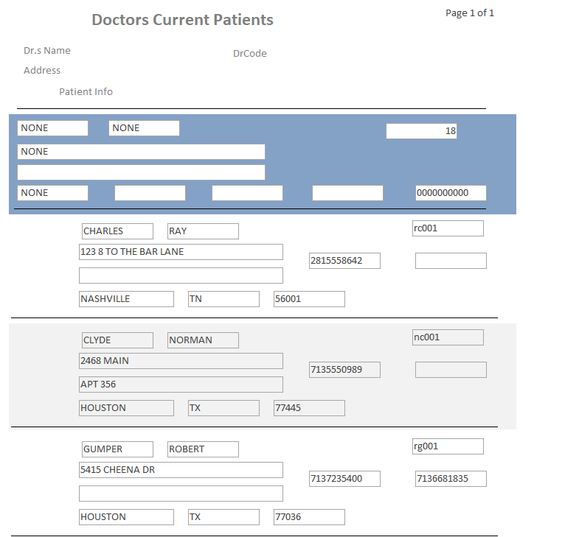
Requirements Reports
Doctors Current Patients

Slide 23
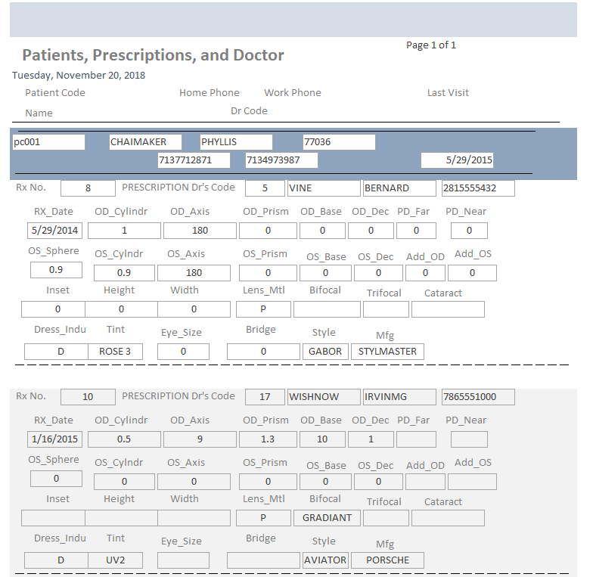
Requirement Reports Patients, Prescriptions and Doctors
Requirements Reports
Patients, Prescriptions, and Doctor

Slide 24
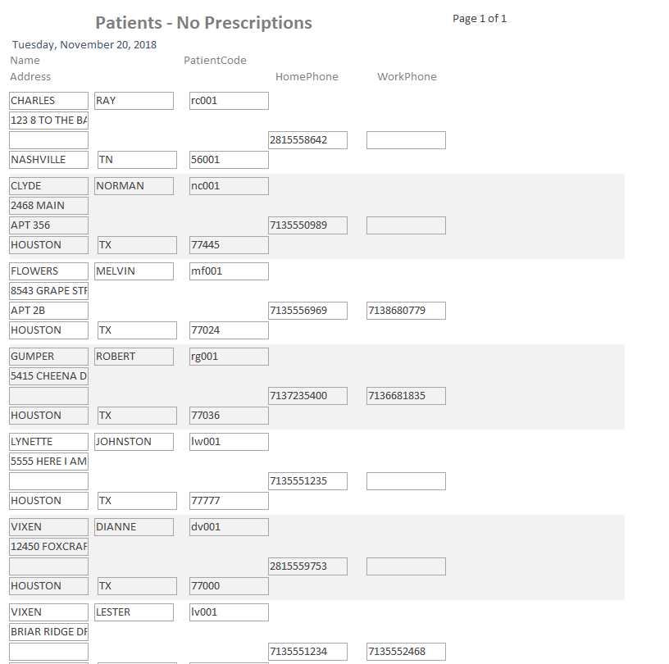
Requirement Reports Patients with No Prescriptions
Requirements Reports
Patients – No Prescriptions

Slide 25
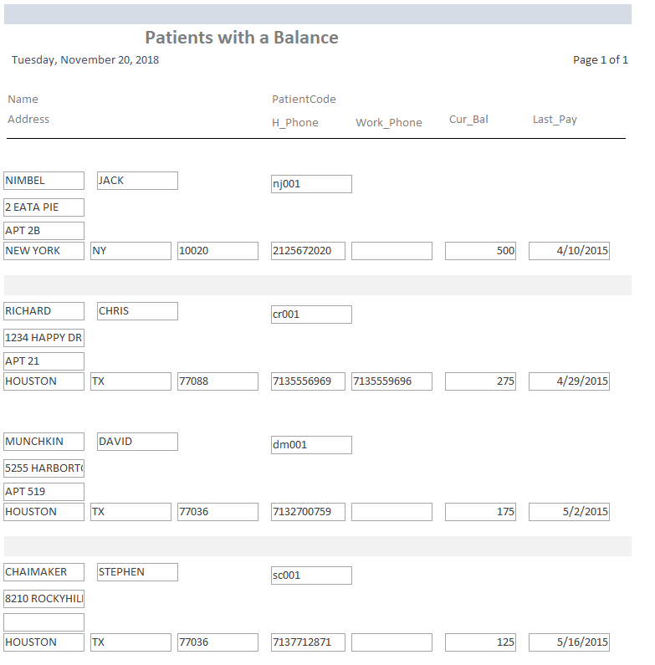
Requirement Reports Patients with a Balance
Requirements Reports
Patients with a Balance

Slide 26
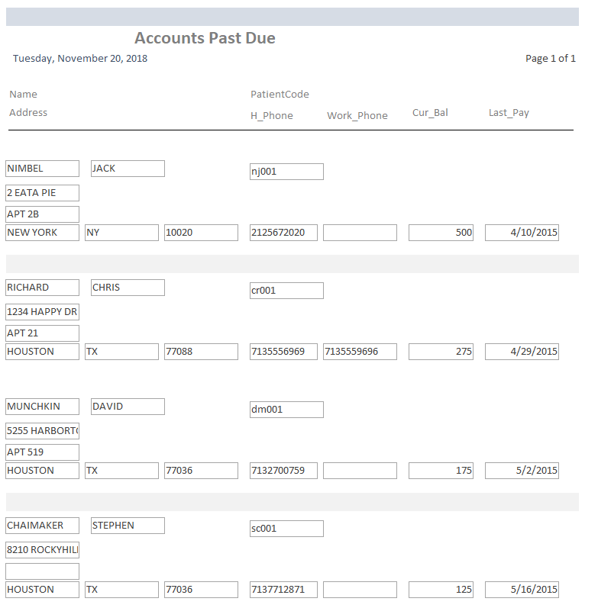
Requirement Reports Accounts Past Due
Requirements Reports
Accounts Past Due

Slide 27
Ease of Use
Forms were created to allow for easy linking to entry tables to allow editing and adding of new records while respecting referential integrity requirements.
Demo

Slide 28


