Slide 1
Basics of Web Design Table+ Form Basics
xbi@eamv

Slide 2
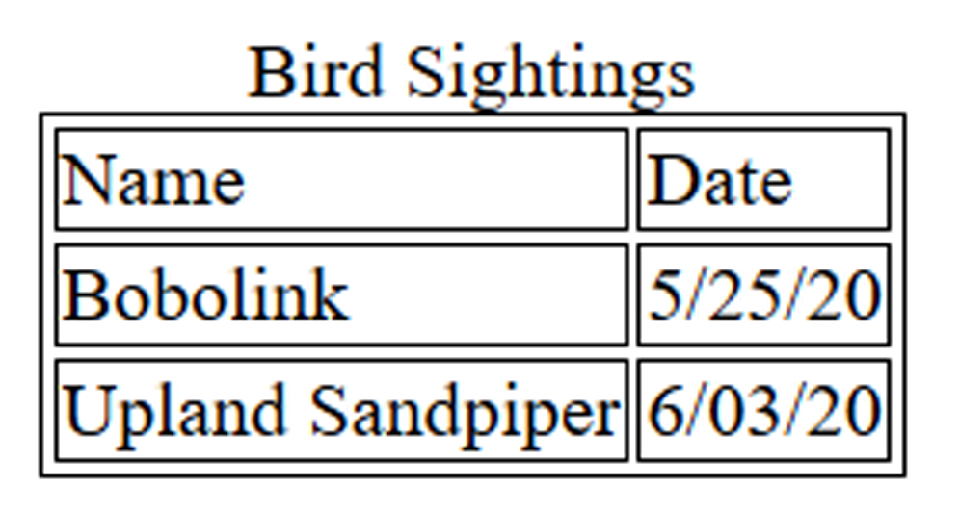
HTML Table Elements
<table> Contains the table
Table Borders
border attribute (deprecated in HTM5) border="1" configures a border
Use CSS instead table, td, th { border: 1px solid #000; }
<tr> Contains a table row
<td> Contains a table cell
<caption> Configures a description of the table

Slide 3
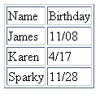
HTML Table Example 1
<table> <caption>Birthday List</caption>
<tr>
<td>Name</td>
<td>Birthday</td>
</tr>
<tr>
<td>James</td>
<td>11/08</td>
</tr>
<tr>
<td>Karen</td>
<td>4/17</td>
</tr>
<tr>
<td>Sparky</td>
<td>11/28</td>
</tr>
</table>
Birthday List

Slide 4
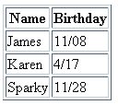
HTML Table Example 2
<table>
<tr>
<th>Name</th>
<th>Birthday</th>
</tr>
<tr>
<td>James</td>
<td>11/08</td>
</tr>
<tr>
<td>Karen</td>
<td>4/17</td>
</tr>
<tr>
<td>Sparky</td>
<td>11/28</td>
</tr>
</table>
Using the <th> Element

Slide 5

HTML colspan Attribute
<table>
<tr>
<td colspan=“2”> Birthday List</td>
</tr>
<tr>
<td>James</td>
<td>11/08</td>
</tr>
<tr>
<td>Karen</td>
<td>4/17</td>
</tr>
</table>

Slide 6
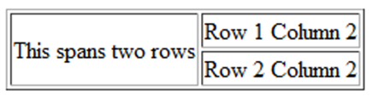
HTML rowspan Attribute
<table <tr> <td rowspan="2">This spans two rows</td> <td>Row 1 Column 2</td> </tr> <tr> <td>Row 2 Column 2</td> </tr> </table>

Slide 7
Accessibility and Tables
Use table header elements (<th> tags) to indicate column or row headings.
Use the caption element to provide the title/caption for the table.
Other attributes that provide for accessibility:
headers & id
scope

Slide 8
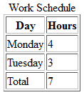
Accessibility: headers & id Attributes
<table>
<caption>Work Schedule</caption>
<tr>
<th id="day">Day</th>
<th id="hours">Hours</th>
</tr>
<tr>
<td headers="day">Monday</td>
<td headers="hours">4</td>
</tr>
<tr>
<td headers="day">Tuesday</td>
<td headers="hours">3</td>
</tr>
<tr>
<td headers="day">Total</td>
<td headers="hours">7</td>
</tr>
</table>

Slide 9
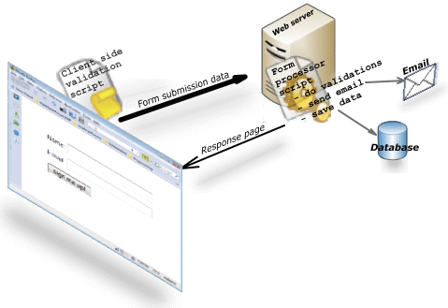
Html forms
used to collect user input. The user input is most often sent to a server for processing.
Demo code
uge 43 php
Source: https://www.javascript-coder.com/html-form/images/web-form-working1.png

Slide 10

Overview of Forms
Forms are used all over the Web to
Accept information
Provide interactivity
Types of forms:
Search form, Order form, Newsletter sign-up form, Survey form, Add to Cart form, and so on…

Slide 11
Two Components of Using Forms
1. The web page form
An HTML element that contains and organizes form controls such as text boxes, check boxes, and buttons that can accept information from website visitors.
and
2. The server-side processing
Server-side processing works with the form data and sends e-mail, writes to a text file, updates a database, or performs some other type of processing on the server.

Slide 12
HTML Forms
<form> tag
Contains the form elements on a web page
Container tag
<input> tag
Configures a variety of form elements including text boxes, radio buttons, check boxes, and buttons
Stand alone tag
<textarea> tag
Configures a scrolling text box
Container tag
<select> tag
Configures a select box (drop down list)
Container tag
<option> tag
Configures an option in the select box
Container tag

Slide 13
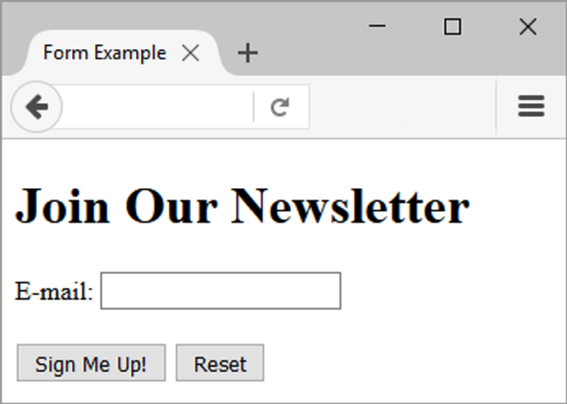
Sample Form HTML
<form>
E-mail: <input type="text" name="email" id="email" >
<br><br>
<input type="submit" value="Sign Me Up!"> <input type="reset">
</form>

Slide 14
The Form Element <form>
Container Tag
The form element attributes:
action
Specifies the server-side program or script that will process your form data
method
get – default value, form data passed in URL
post – more secure, form data passed in HTTP Entity Body
name
Identifies the form
id
Identifies the form

Slide 15

The Input Element Text Box <input>
Accepts text information
Common Attributes:
type="text"
name
id
size
maxlength
value
required
placeholder

Slide 16
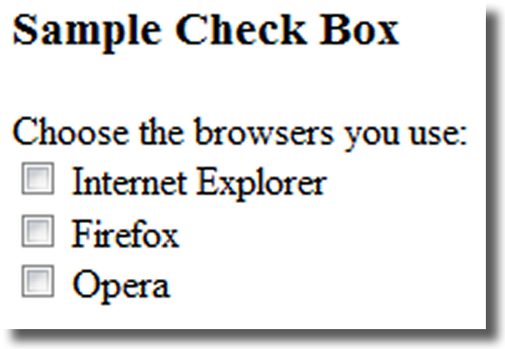
The Input Element Check box <input>
Allows the user to select one or more of a group of predetermined items
Common Attributes:
type="checkbox"
name
id
checked
value

Slide 17
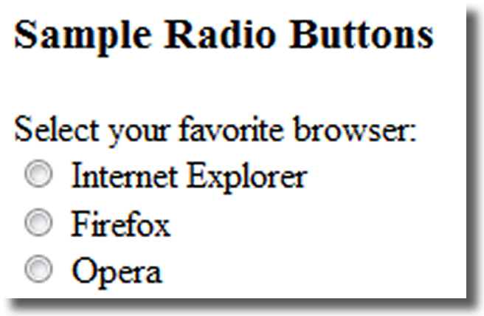
The Input Element Radio Button <input>
Allows the user to select exactly one from a group of predetermined items
Each radio button in a group is given the same name and a unique value
Common Attributes:
type="radio"
name
id
checked
value

Slide 18
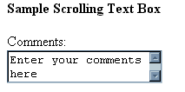
The Textarea Element <textarea>
Configures a scrolling text box
Common Attributes:
name
id
cols
rows
required

Slide 19

The Select Element <select>
Configures a select list (along with <option> tags)
Also known as: Select Box, Drop-Down List, Drop-Down Box, and Option Box.
Allows the user to select one or more items from a list of predetermined choices.
Common Attributes:
name
id
size
multiple

Slide 20
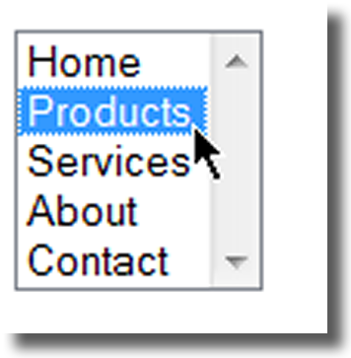
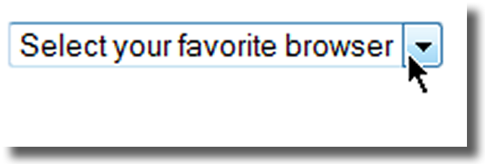
The Option Element <option>
Configures the options in a Select List
Attributes:
value
selected

Slide 21
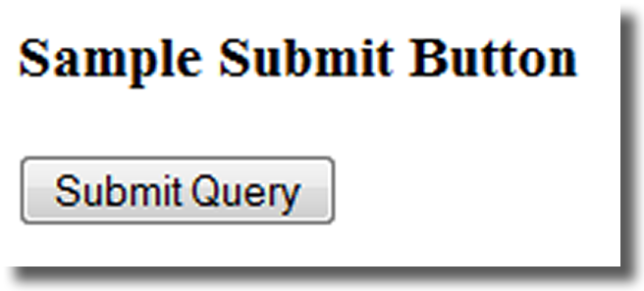
The Input Element Submit Button <input>
Submits the form information
When clicked:
Triggers the action method on the <form> tag
Sends the form data (the name=value pair for each form element) to the web server.
Attributes:
type="submit"
name
id
value

Slide 22
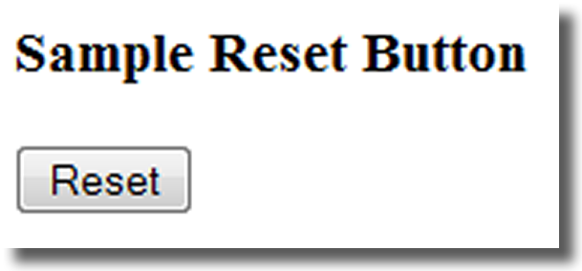
The Input Element Reset Button <input>
Resets the form fields to their initial values
Attributes:
type="reset"
name
id
value

Slide 23

The Input Element Password Box <input>
Accepts text information that needs to be hidden as it is entered
Common Attributes:
type="password"
name
id
size
maxlength
value
required
placeholder

Slide 24
The Label Element <label>
Associates a text label with a form control
Two Different Formats: <label>Email: <input type="text" name="CustEmail"> id ="CustEmail"></label>
OR <label for="email">Email: </label> <input type="text" name="CustEmail" id= "email">

Slide 25

Forms and GDPR

Slide 26
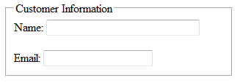
The Fieldset & Legend Elements
The Fieldset Element <fieldset>
Container tag
Creates a visual group of form controls on a web page
The Legend Element <legend>
Container tag
Creates a text label within the fieldset
<fieldset><legend>Customer Information</legend>
<label>Name: <input type="text" name="CName" id="CName" size="30"></label> <br><br >
<label>Email: <input type="text" name="CEmail" id="CEmail"></label>
</fieldset>

Slide 27
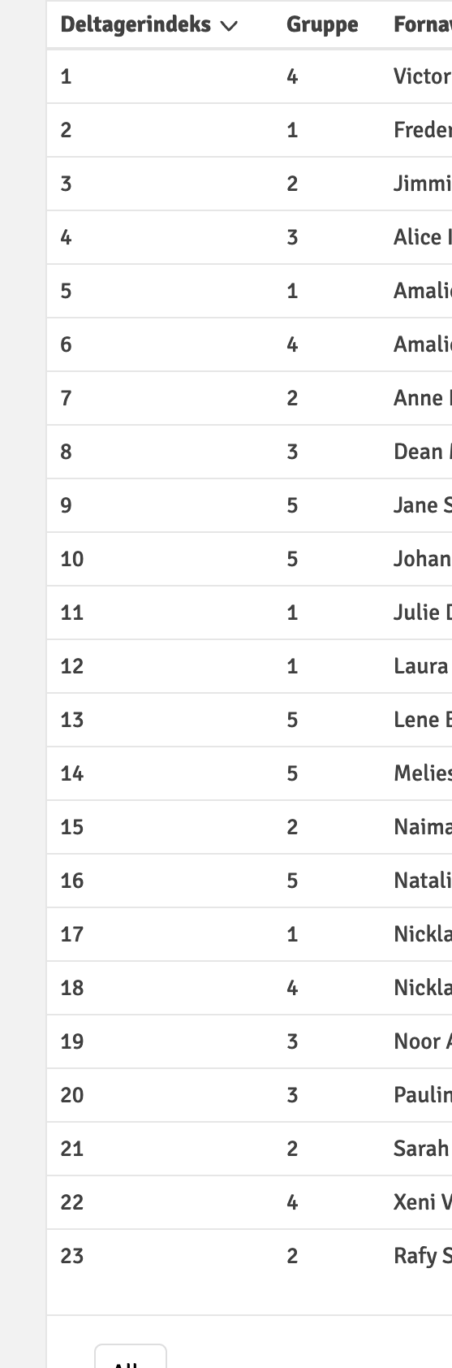
Exercise
Check your
group project and give peer
feedback of how to improve your
Form

Slide 28
HTML test
https://www.w3schools.com/html/html_quiz.asp

Slide 29
Home exercise
Uge 43 opgaver
Og linkedin videos

