Slide 1
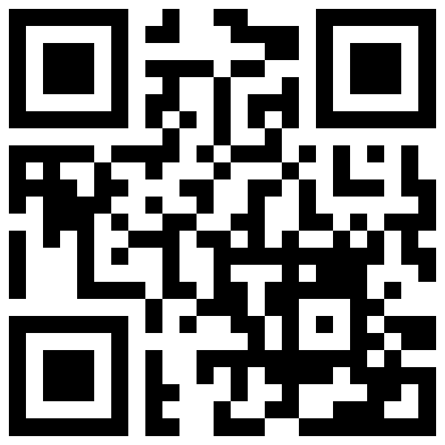
Coding Jam 2026
BulletProof: Resume Optimization Coding Jam
Brooklyn DevFest
Friday, October 30, 2026
GDG Brooklyn
Jam page
William McLean (xbill)
CTO Glitnir Ticketing, GDE Cloud + AI, AWS CB (AI)

Slide 2
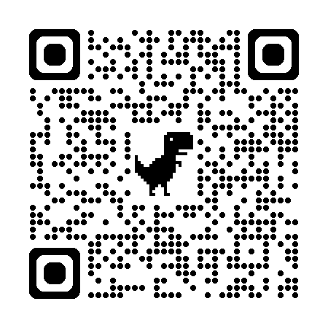
William McLean (xbill)
CTO and co-founder, Glitnir Ticketing
GDE (Google Developer Expert)
Cloud and AI/ML
*** Do NOT Work for Google ***
AWS Community Builder 2026, AI

Slide 3
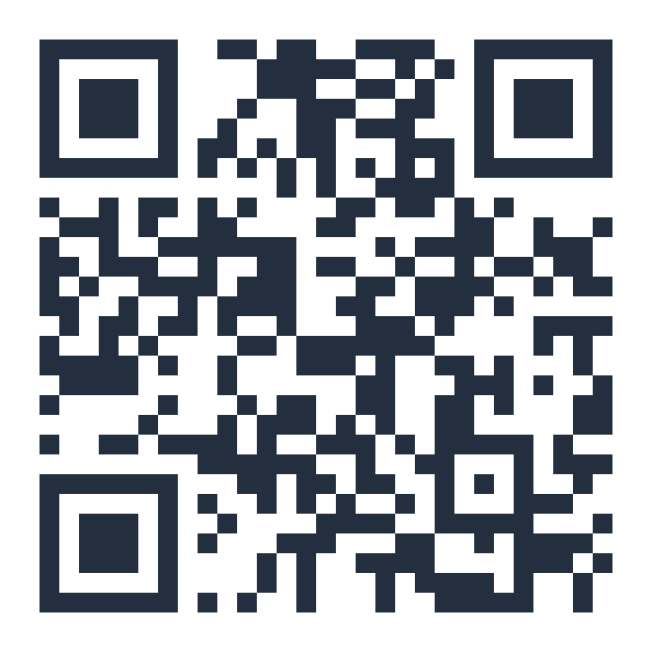
Where to Find Me
LinkedIn linkedin.com/in/xbill
Dev.to dev.to/xbill
Medium medium.com/@xbill999
GitHub github.com/xbill9
Hugging Face huggingface.co/xbill9
AWS Builder Center builder.aws.com/community/@xbill9

Slide 4
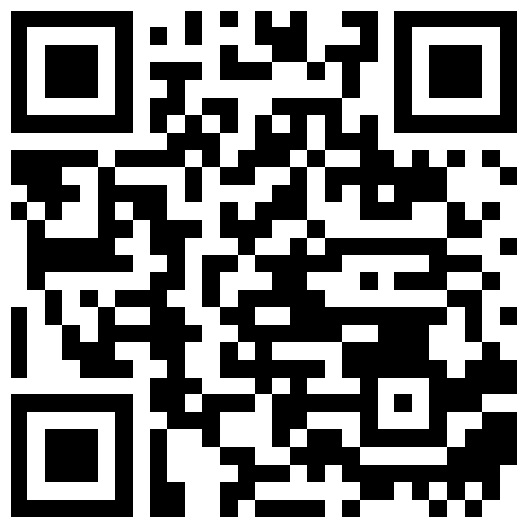
What You're Building: BulletProof
The brief
Paste a resume and a job posting
Click one button
Copy tailored resume bullets
Out of scope today: PDF parsing, cover letters, export
Track brief

Slide 5
Two Hours, Build in the Middle
Agenda
0:00 Check in and meet your neighbors
0:15 Claim credits, run setup, install and sign in
0:30 Build with Antigravity and the codelab
1:35 Two-minute demo, then submit
Jam page

Slide 6
Claim Your Credits Now
Setup
Open the claim link and sign in with your personal Gmail
Join the Google Developer Program, claim the badge
Finish the verification on your phone
Wait 2 to 5 minutes for the billing account to appear
Claim today: credits can't be saved
If it fails
CRED-101: you're on a work or school account. Switch to your @gmail.com.
CRED-103: verification failed. Refresh, retry, or switch your phone to mobile data.

Slide 7
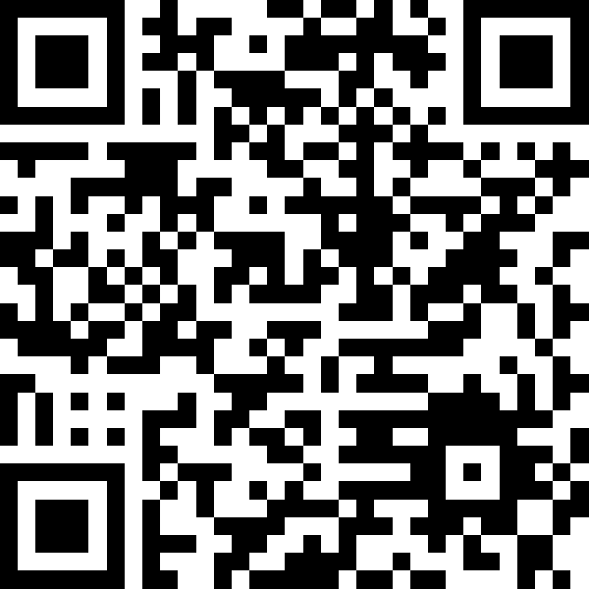
Run the Setup Script
Setup
Open a new window with the same Gmail
Scan the QR, or open github.com/harrisonahn1129/gdg_workshop_skills
Click Open in Cloud Shell, type bash setup.sh
All green: done. Any red: ask a TA
Setup repo

Slide 8
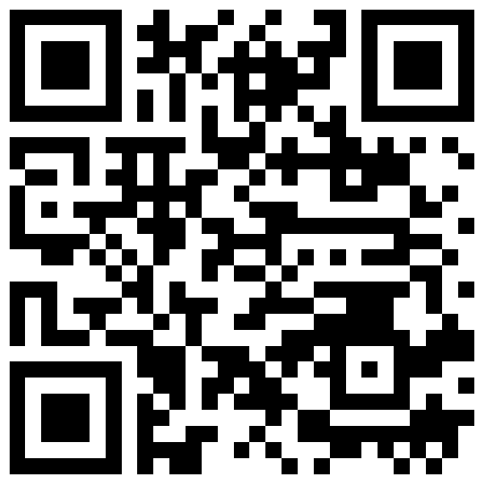
Install Antigravity
Setup
Download from antigravity.google/download
Run the installer with the default settings
Git, and a GitHub account that can clone
Don't click Sign in yet: next slide
Antigravity setup

Slide 9
Sign In With Your Credit
Setup
Open Antigravity and click Sign in
Choose Business account
Continue with Google Cloud, same Gmail
Choose Other: your project ID, location global
Agent stops mid-build? You're on the free plan: sign out, repeat
Free plan
Sign in without Business account. Weekly limit, then the agent stops.
Your credit
Business account and your project ID. Build on this today.

Slide 10
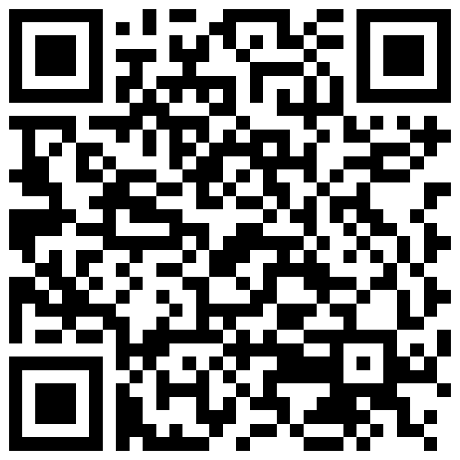
The Codelab
Follow this codelab: your Google Cloud credits work here, not in AI Studio
Ten steps, about 75 minutes
Every step slide has its own QR code
Scan for the codelab
Setup
Plan
Review
Build
API
Verify

Slide 11
Install and Sign In to Antigravity
Step 1
Done in setup: Antigravity installed and signed in with Business account
Check: the welcome screen shows Open Folder and Clone Repository
Codelab step 1

Slide 12
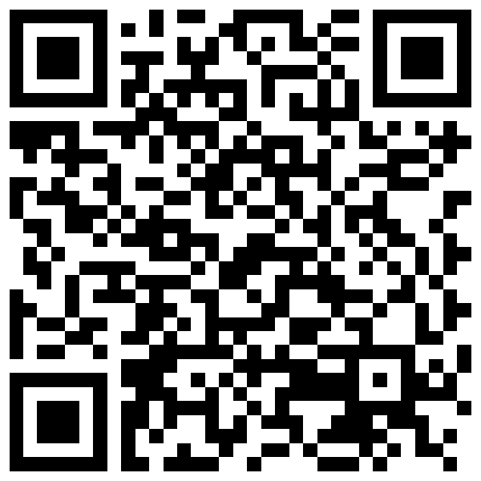
Install uv and Git With the Agent
Step 2
Open an empty folder, such as coding-jam-setup
Prompt: “Install uv and git on my computer if they're not already there.”
Approve each install command; skip Node.js
If it fails, install uv and git by hand, then ask the agent to check
Codelab step 2

Slide 13
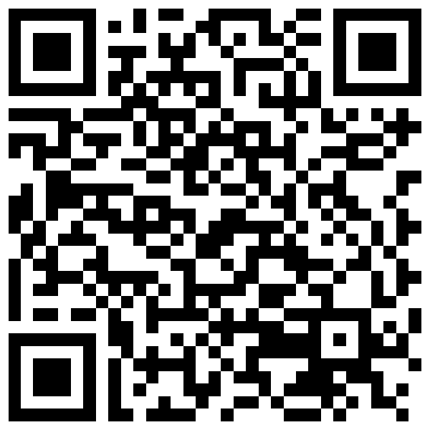
Clone the Starter Repo
Step 3
Repo: gca-americas/codingjam-bulletproof
Use Antigravity's Clone Repository button
Read BRIEF.md and the reference/ folder
Replace PASTE_YOUR_PROJECT and PASTE_YOUR_LOCATION, or .env gets placeholders
Codelab step 3

Slide 14
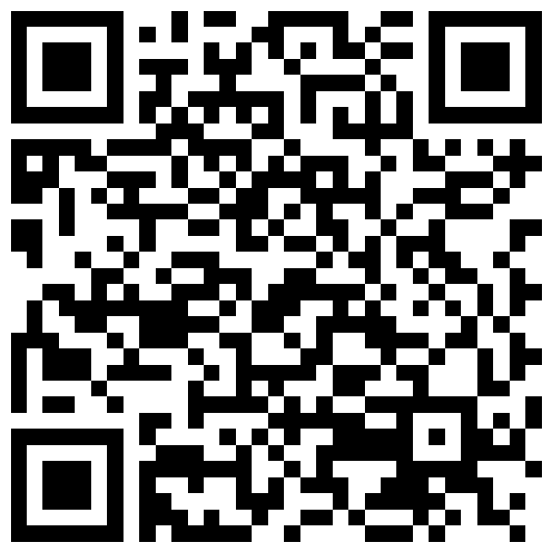
Install the Workshop Skills
Step 4
Ask the agent to clone skills-garden and gemini-skills into .agent/skills/
Click Allow on both git pop-ups
Leave Turbo mode off
Codelab step 4

Slide 15
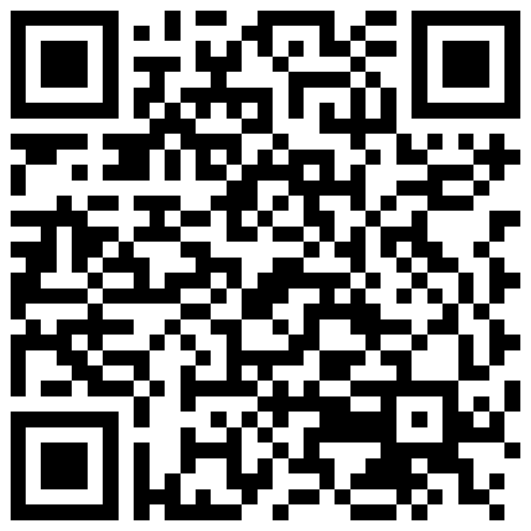
The Spec Talk Takes Two Minutes
Step 5
The agent asks three questions: inputs, the magical moment, out of scope
Answer them; no files get written yet
If product.md appears, ask the agent to delete it
Codelab step 5

Slide 16
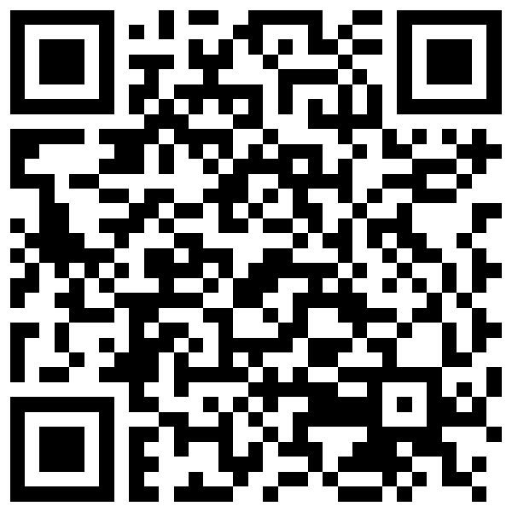
Three Design Docs Before Code
Step 6
Gemini 3.8 - Argon is limited*
One prompt writes product.md, ui.md and engineering.md
engineering.md needs a Testing strategy section
Comment on the docs; fix the doc, not the code
Codelab step 6

Slide 17
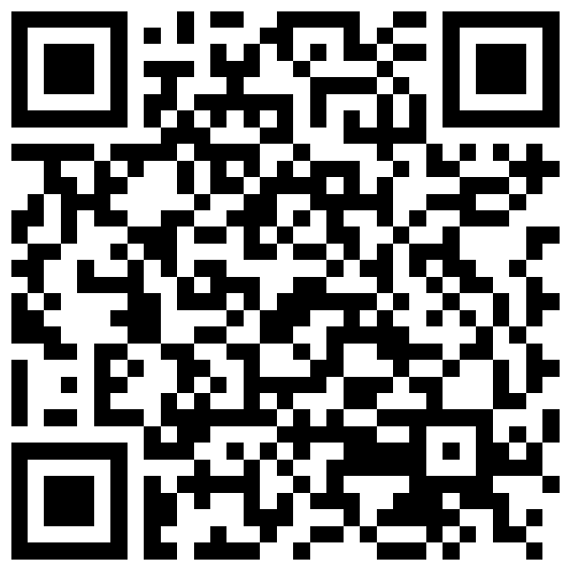
Build It, Make the Tests Pass
Step 7
Gemini 3.8 - Argon Limited
The agent builds from the docs and mocks Gemini in tests
Done: backend/, frontend/ and tests/ exist, all tests pass
Never skip tests; fix the Testing strategy instead
Codelab step 7

Slide 18
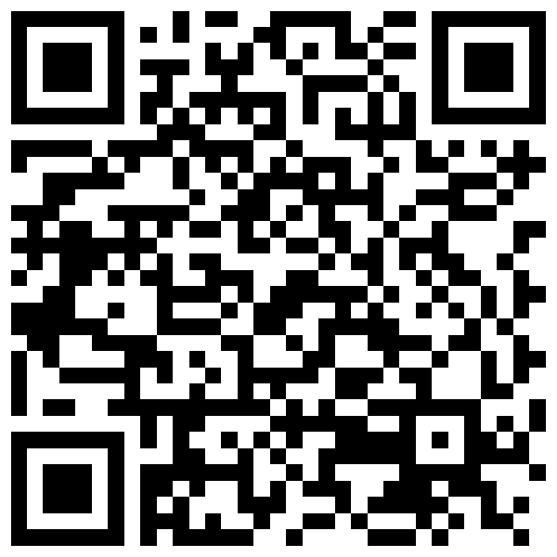
Add Your Gemini API Key
Step 8
Create a key in AI Studio; pick your jam project when it asks
Sign in with your personal @gmail.com, not Workspace
The agent writes backend/.env with GEMINI_API_KEY
Check that .env is in .gitignore
Treat the key like a password; never commit it
Codelab step 8

Slide 19
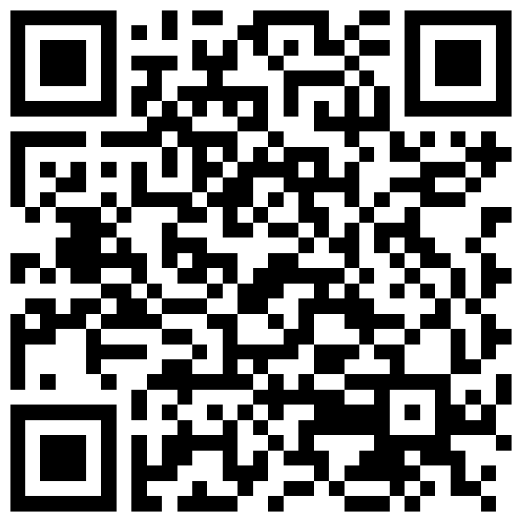
Run It and Check It by Hand
Step 9
Ask the agent to start the dev server; click Allow
Open localhost:8000 or localhost:5173
Paste a real resume and a real job posting
Report problems, then have the agent write the README
Codelab step 9

Slide 20
Tips for Better Bullets
Tips
Paste the full job posting, not just the title
Read the bullets aloud; if you wouldn't say it in an interview, change the prompt
Skip cover letters, PDF parsing and ATS scoring on purpose
Stuck? Ask the room, then a mentor
Track tips

Slide 21
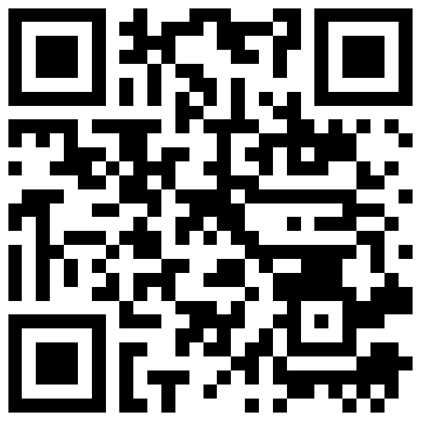
Share and Submit Before You Leave
Step 10
Two-minute screen-share demo
Submit your build: it goes on the showcase
Your name and chapter go with it
Submit your build

Slide 22
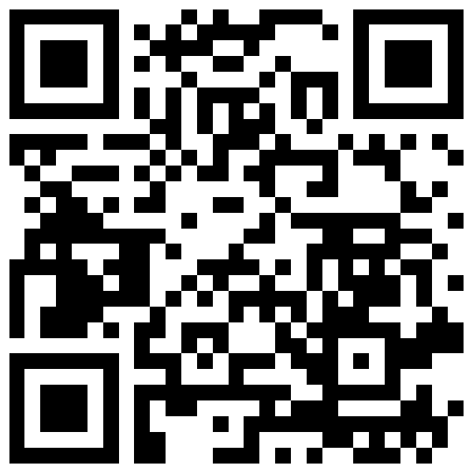
Keep Building at Home
After the jam
Match score and missing keywords
PDF resume parsing
Cover letter generator
Interview question generator
Application tracker
Starter repo

Slide 23
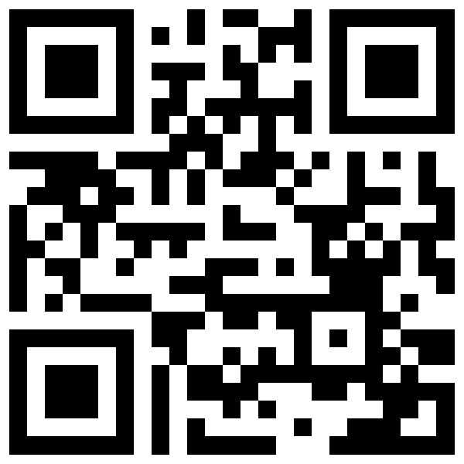
Demo Builds to Fork
Demo repos
codejam: the finished build from the starter repo
codejam-claude: the same app, set up for Claude Code
FastAPI and Gemini backend, plain JavaScript front end
Both at github.com/xbill9, with design docs and tests
My GitHub

