Slide 1
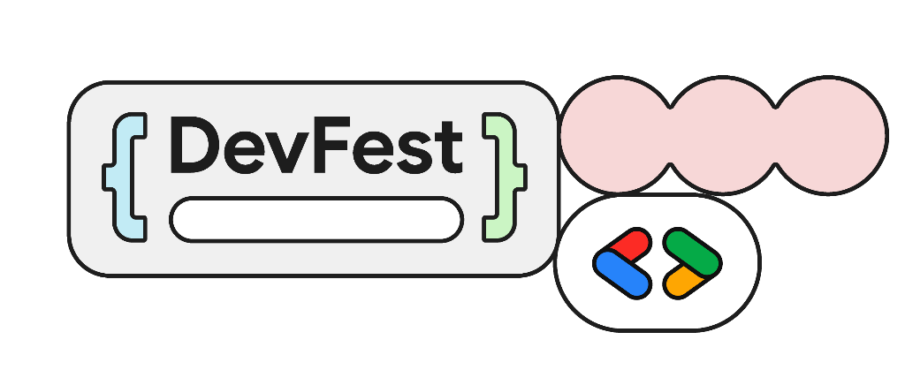
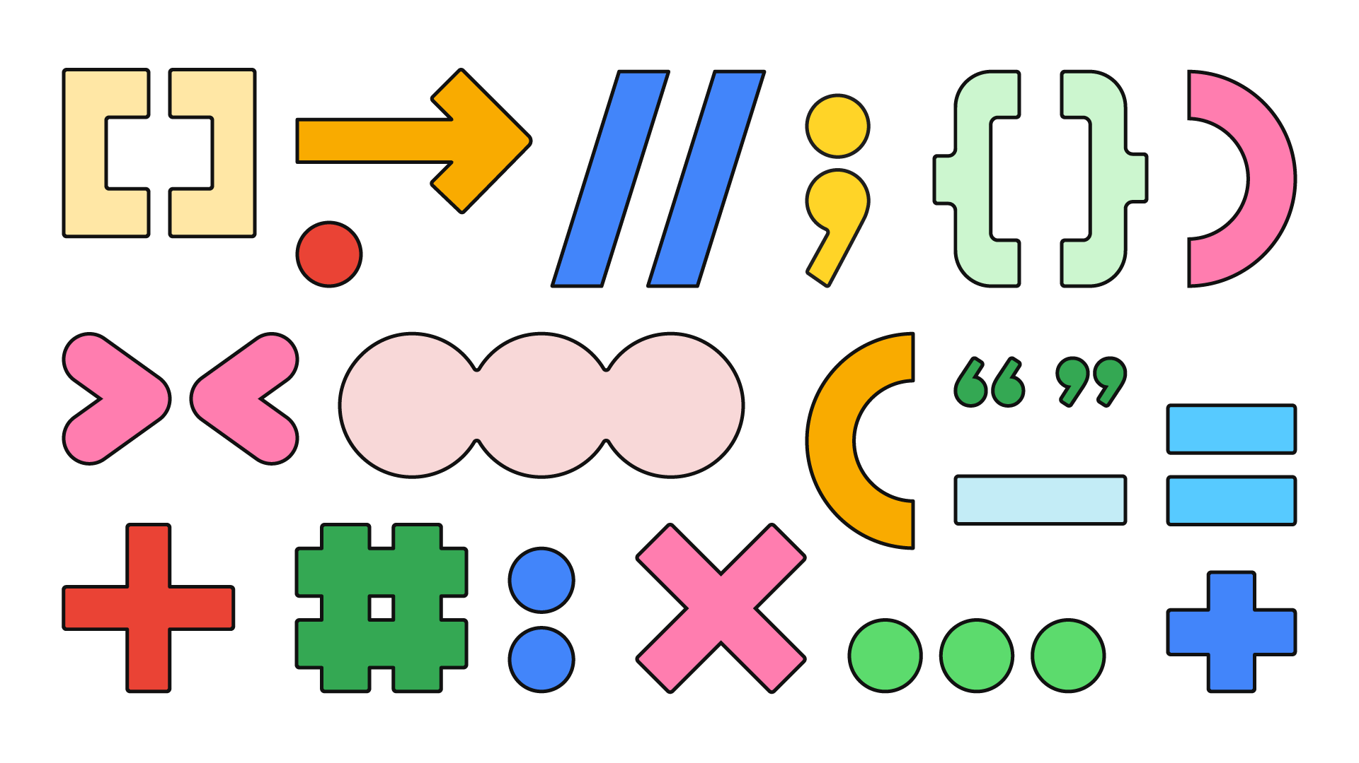




2026
Intro to Cloud TPU
Gemma 4 on a v5e chip, managed over MCP
William McLean (xbill) · GDE Cloud + AI

Slide 2

About Me
William McLean (xbill)
AWS Community Builder 2026, AI
GDE (Google Developer Expert), Cloud and AI/ML
CTO and co-founder, Glitnir Ticketing
2026 goal: multi-cloud agents, tools and models
Where to Find Me
LinkedIn linkedin.com/in/xbill
Dev.to dev.to/xbill
Medium medium.com/@xbill999
GitHub github.com/xbill9
Hugging Face huggingface.co/xbill9

Slide 3
Agenda
01
Ten years of TPUs
02
The chips, and what they compute natively
03
Getting a chip: control planes, quota and price
04
Live demo: Gemma 4 on a v5e-1 over MCP
05
So, which one?

Slide 4
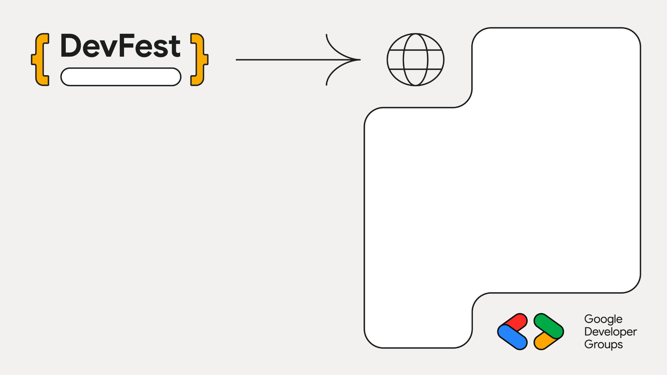
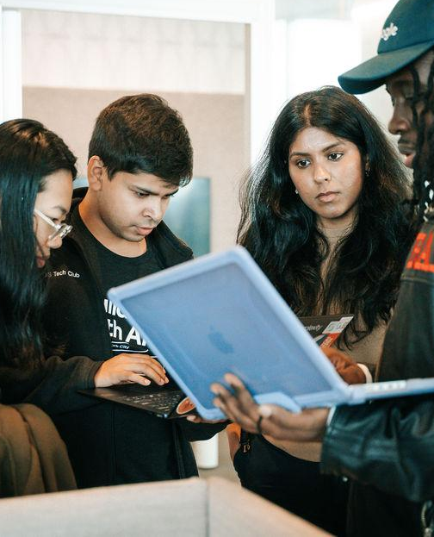

Part 01
Ten Years
of TPUs

Slide 5
The First TPU Was Built for Inference
Year | Chip | What changed
2015 | TPU v1 | Inference only, 8-bit, 92 TOPS; announced 2016
2017 | TPU v2 | bf16 training, 180 TFLOPs per device, first pods
2019 | TPU v3 pods | Liquid cooled, 1,024 chips, public beta
2021 | TPU v4 | Optical circuit switches, 4,096 chips
2023 | v5e and v5p | Cost-optimized v5e; v5p with 95 GiB HBM
2024 | v6e Trillium | 4.7x v5e peak compute
2025 | TPU7x Ironwood | fp8, 192 GiB HBM; “first TPU for the age of inference”; GA March 2026
2026 | TPU 8t and 8i | Announced April 2026; 8i is the inference part
Blue rows: the inference-first chips. Sources: Google Cloud and Google blogs 2016 to 2026; Jouppi et al., arXiv 1704.04760.

Slide 6
vLLM Reaches the TPU Through tpu-inference
Client
OpenAI API
tpu-inference v0.31.0 shipped 2026-10-08; v5e, v6e and v7x recommended, v5p experimental
Gemma 4 E2B, E4B, 26B-A4B and 31B pass its release matrix
XLA compile is 81 to 91% of engine start for E2B on v6e and v5e
Pin an image digest: the nightly tag broke two 4-bit builds on 2026-10-02
vLLM
batching, KV paging
tpu-inference
JAX model code
XLA
one program per shape
TPU VM
1 to 8 chips per host
Sources: github.com/vllm-project/tpu-inference; gemma4-dev tpu-jax-v5e1-2b and tpu-vllm-v5e1-2b reports.

Slide 7
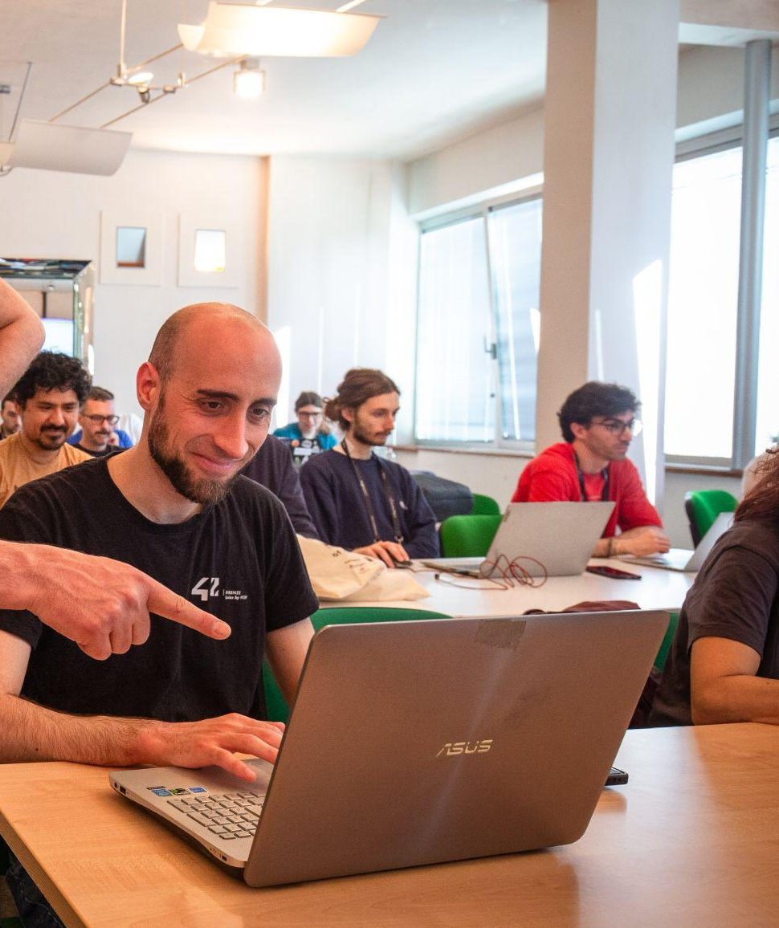

Part 02
The Chips

Slide 8
TPU7x: About 13x v5e's Memory at 10x the Price
Chip | HBM | Peak bf16 | Native low precision | Max pod | On-demand
v5e | 16 GB | 197 TFLOPs | int8, 393 TOPs | 256 | $1.20/hr
v6e Trillium | 32 GB | 918 TFLOPs | int8, 1,836 TOPs | 256 | $2.70/hr
v5p | 95 GiB | 459 TFLOPs | int8; fp8 at bf16 rate | 8,960 | $4.20/hr
TPU7x Ironwood | 192 GiB | 2,307 TFLOPs | fp8, 4,614 TFLOPs | 9,216 | $12.00/hr
Single-host shapes used here: v5litepod-1 and -4, v6e-1, -4 and -8
v6e on-demand varies by region: $2.70 us-east, $2.97 europe-west4
Sources: docs.cloud.google.com/tpu/docs and cloud.google.com/tpu/pricing, read 2026-10-12; regional rates from the Billing Catalog. Blue row: today's demo chip.

Slide 9
One-Stream Decode Follows Memory Bandwidth
Chip | Memory | Bandwidth | E2B bf16 tok/s, 1 stream | tok/s per TB/s
TPU v5e | 16 GB | 859 GB/s¹ | 120 | 140
TPU v6e | 32 GB | 1,638 GB/s | 199 | 121
TPU v5p | 95 GiB | 2,765 GB/s | not measured | —
TPU7x | 192 GiB | 7,380 GB/s | not measured | —
NVIDIA L4 | 24 GB | 300 GB/s | 46 | 153
Each token reads every weight once, so bandwidth sets the ceiling for one request
The three measured chips land at 121 to 153 tok/s per TB/s of bandwidth
¹ Google quotes v5e as 800 GiBps. Different vLLM builds per platform. Sources: gemma4-dev HARDWARE.md, MI300X dollar-hour article; Google TPU docs.

Slide 10
Only int8, and fp8 on TPU7x, Buy Compute
Format | v5e | v6e | v5p | TPU7x
bf16 | native | native | native | native
int8 | 2x bf16 | 2x bf16 | native | native
fp8 | storage | storage | bf16 rate | 2x bf16
int4 | storage | storage | storage | storage
2x bf16: a native matmul path at double the bf16 peak
storage: saves HBM and bandwidth, then widens to bf16 before every matmul
fp8 KV cache on v6e logs fp8 and allocates bf16
Sources: gemma4-dev HARDWARE.md, QUANTIZATION.md; Google TPU7x docs (not measured here).

Slide 11
“v5e-1” Works in Prose, Never in a gcloud Flag
What you mean | What gcloud wants | Where it goes
v5e, one chip | v5litepod-1 | --accelerator-type (Cloud TPU API)
v5e runtime | v2-alpha-tpuv5-lite | --runtime-version (Cloud TPU API)
v5e machine | ct5lp-hightpu-1t | listed in the Compute Engine catalog; create is refused
v6e, one chip | v6e-1 / ct6e-standard-1t | Cloud TPU API / Compute Engine
v6e runtime | v2-alpha-tpuv6e | --runtime-version (Cloud TPU API)

Slide 12
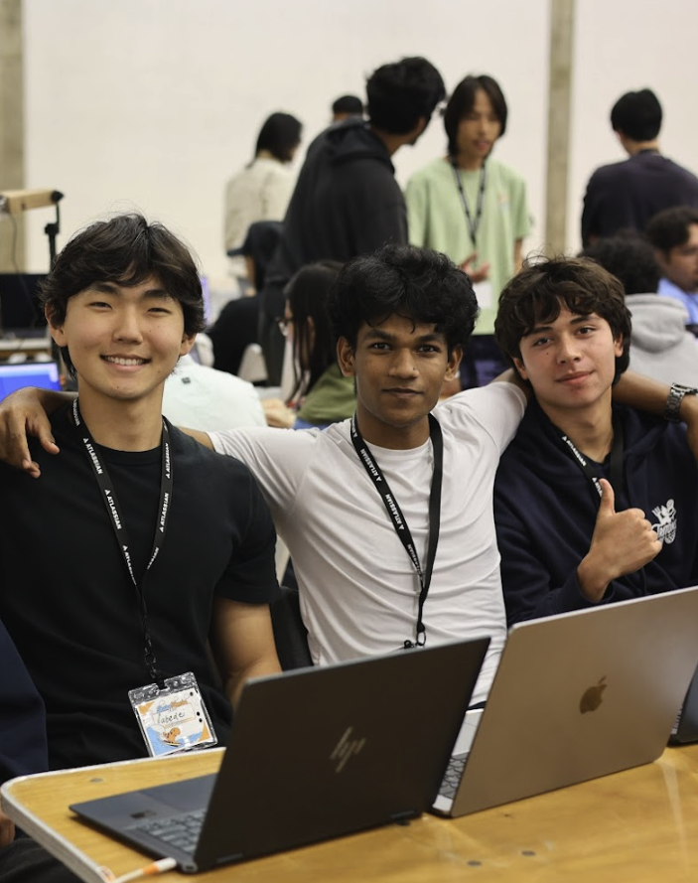

Part 03
Getting
a Chip

Slide 13
Two Control Planes
Cloud TPU API
Queued resources produce a node named <id>-node
gcloud alpha compute tpus queued-resources create
Bug fixes and security updates only
The only path for v5e outside GKE
Compute Engine
The instance is the node: one object to manage
gcloud compute instances create --machine-type=ct6e-standard-1t
Supports TPU7x, v6e and v5p
TPU7x (Ironwood) onward: Compute Engine or GKE only
“The Cloud TPU API is no longer under active development … New hardware generations, starting with TPU7x (Ironwood), are supported only through Compute Engine or Google Kubernetes Engine (GKE).”
Quote: Cloud TPU resources in Compute Engine, Google Cloud docs.

Slide 14
Moving a v6e-1 Across: the Flag Mapping
Cloud TPU API | Compute Engine
--accelerator-type=v6e-1 | --machine-type=ct6e-standard-1t
--runtime-version=v2-alpha-tpuv6e | --image-family=ubuntu-accel-… + --image-project
--valid-until-duration | --request-valid-for-duration
--provisioning-model=flex-start | --provisioning-model=FLEX_START
queued resource produces <id>-node | the instance is the node
gcloud compute tpus tpu-vm list | gcloud compute instances list
gcloud compute tpus tpu-vm ssh | gcloud compute ssh
Same chip, same checkpoint, same serving flags: the KV cache came out at 1,151,744 tokens on both control planes.
Source: The unofficial TPU migration guide, dev.to/gde, 2026-08-11.

Slide 15
v5e Has No Compute Engine Create Path
$ gcloud compute machine-types list --filter="name~ct5lp"
ct5lp-hightpu-1t ct5lp-hightpu-4t ct5lp-hightpu-8t (26 zones)
$ gcloud compute instances create … --machine-type=ct5lp-hightpu-1t
ERROR: This user agent is not allowed to use the machine type [ct5lp-hightpu-1t].
The catalog lists the machine type; GKE uses those names for its v5e node pools
Google's TPU machines page names TPU7x, v6e and v5p for Compute Engine, and no v5e
The v5e page: supported using Google Kubernetes Engine and the Cloud TPU API
To test any chip, try a create in a zone where your quota is zero: a refusal costs nothing
Today's demo runs on a Cloud TPU API queued resource

Slide 16
Four Ways to Ask for a Chip
Model | Capacity | Max run | Ends | Quota spent | v6e, europe-west4
STANDARD | now, if available | unlimited | when you delete it | standard | $2.97 / chip-hr
SPOT | now, if available | unlimited | preempted at any time | preemptible → standard | $1.78 / chip-hr
FLEX_START | queues up to 2h | 10 min – 7 days | at --max-run-duration | preemptible → standard | $1.35 / chip-hr
RESERVATION_BOUND | reserved ahead, if approved | up to 90 days | when the reservation ends | with the reservation | no list rate
Flex-start is the cheapest of the three priced models on v6e, under half of on-demand
On v5e in us-west4: flex-start $0.60, spot $0.607 per chip-hr
The demo uses flex-start: it queues for capacity and deletes itself after 4 hours
Behaviour: Compute Engine provisioning models docs. Prices: Cloud Billing Catalog, read 2026-08-11.

Slide 17
Flex-Start Halves the On-Demand Rate
$ per chip-hour | On-demand | Flex-start | Calendar | 1-yr CUD | 3-yr CUD | Spot read
v5e | $1.20 | $0.60 | $0.84 | $0.84 | $0.54 | $0.58
v6e Trillium | $2.70 | $1.35 | $1.89 | $1.89 | $1.22 | $1.40
v5p | $4.20 | $2.10 | $2.94 | $2.94 | $1.89 | —
TPU7x Ironwood | $12.00 | $6.00 | $8.40 | $8.40 | $5.40 | —
Flex-start can undercut spot: v6e in us-east5 is $1.35 flex-start against $1.40 spot
Flex-start runs 10 min to 7 days and bills until deleted
TPU7x spot, flex-start and calendar are behind an allowlist
List rates: cloud.google.com/tpu/pricing, read 2026-10-12. Spot: Billing Catalog reads, Aug 2026.

Slide 18
Quota Does Not Mean Availability
1. Hardware
in the zone
2. Provisioning
model offered
3. Capacity
right now
37 zones report v6e quota; 18 offer v6e-1 hardware, and Google's docs list 8
3 of 5 zones holding 1,536 chips of quota returned stockout
us-central1-b has hardware, quota and a flex-start price, and rejects flex-start
Probe with spot: it fails fast with “reason: stockout”; flex-start with no quota queues as PENDING, like a stockout
v5e-1 flex-start: accepted in us-west4-a, rejected in europe-west4-a and -b
Source: gemma4-dev tpu_zones_status.md (2026-08-10), TPU.md, request-quota.sh; tpu-vllm-v5e1-2b CLAUDE.md (2026-08-04).

Slide 19
The Control Plane Fails Quietly
Cloud TPU API is frozen
Bug fixes only. TPU7x runs on Compute Engine or GKE.
v5e has no Compute Engine path
Listed in 26 zones; create refused.
Two separate quota pools
us-east5: 512 v6e chips via the TPU API, 0 via Compute Engine.
RUNNING means booted
A GKE node is Ready about 10 min before the model serves.
Boot defaults break vLLM
10 GB disk, no Docker on PATH; a missing scope spins 30 min.
Nothing stops billing
GKE pools and old queued resources bill until deleted.
Sources: Google TPU docs; gemma4-dev TPU.md, request-quota.sh, gke-vllm-v6e1-2b.

Slide 20
Part 04
Live
Demo

Slide 21
What the Agent Drives
MCP client
Claude Code or
Antigravity CLI
server.py
tpu-vllm-v5e1-2b
31 tools, stdio
Queued resource
v5litepod-1
us-west4-a, flex-start
TPU VM node
vllm/vllm-tpu
port 8000
Gemma 4 E2B-it
bf16, one chip
The client talks to server.py over stdio; its tools wrap gcloud to provision, find the node's IP and start the container
Queries go to vLLM's OpenAI-compatible /v1/chat/completions
analyze_cloud_logging sends the TPU's own error logs to the model it hosts
Project, zone, model and provisioning model come from one file, tpu.env

Slide 22
Demo Script
# | Ask the agent | Tool it calls
1 | What's running in the zone? | get_system_status
2 | Which zones have v5e quota? | get_zones_with_available_quota
3 | Create the v5e-1, flex-start | create_tpu_queued_resource
4 | Is it up yet? Show the container log | describe_queued_resource, get_vllm_docker_logs
5 | Is the model healthy? | verify_model_health
6 | Explain a TPU in two sentences, with speed | query_queued_gemma4_with_stats
7 | Any TPU errors in the last hour? | analyze_cloud_logging
8 | Tear it down | destroy_queued_resource
In a shared zone, provision with create_tpu_queued_resource: manage_queued_resource deletes every other queued resource in the zone.

Slide 23
XLA Compile Is Most of a Cold Start: Cache It
Seconds from container start to healthy, Gemma 4 E2B
v6e-1
510 s
v5e-1
986 s
XLA compile is 81 to 91% of engine start
A mounted compile cache cut a v5e restart 42%, 857 to 497 s
31B weights load in 5.6 min from in-region GCS; 60 to 90 min from Hugging Face
GKE from nothing to first token: about 28 min
Each v6e cold start costs $0.19 to $0.24 at flex-start rates
Source: gemma4-dev tpu-jax-v5e1-2b and tpu-vllm-v5e1-2b reports.

Slide 24
On v5e, int8 Serves E2B 1.7x Faster Than bf16
Output tok/s, one stream, v5e-1 (E2B)
bf16
144
Accuracy holds: 0.683 bf16, 0.677 int8 + 4-bit embeddings
fp8 trails int8 at the same file size: 518 against 624 tok/s on 12B
12B int8 (11.31 GiB) is the largest model served on one 16 GB v5e chip
4-bit QAT
150
fp8
182
fp8 + 4-bit emb.
203
int8 W8A8
220
int8 + 4-bit emb.
243
One stream, v5e-1. Source: gemma4-dev QUANTIZATION.md, measured 2026-09-29/30.

Slide 25
Measured on One v5e Chip
Gemma 4 E2B-it, bf16, v5litepod-1 | Result
GSM8K, all 1,319 problems, 2,048-token limit | 0.910
GSM8K, 768-token limit | 0.894
BFCL v3 simple, 400 single-tool calls | 0.928
~1,000-token prompts, output tok/s at 1 / 16 requests | 139 / 1,521
~3,600-token prompts, output tok/s at 1 / 16 requests | 130 / 906
~3,600-token prompts, time to first token at 16 requests | 1.10 s
One chip, 16 requests, ~1,000-token prompts: 1,521 output tok/s
Measured 2026-09-30. GSM8K and BFCL greedy. Each long prompt has its own prefix, so the prefix cache serves none of it. Source: tpu-vllm-v5e1-2b README.

Slide 26
So, Which One?
Workload | Pick | Why
E2B or E4B, cost first | v5e-1, int8, one engine per chip | 1.7x bf16 speed; lowest $/M at spot or flex-start
12B to 31B on one chip | v6e-1, 4-bit QAT W4A16 | 26B at 1,283 tok/s; 31B fits in 21.67 GiB
bf16 26B or 31B, long context | v6e-4, TP=4 | about 2,000 tok/s
fp8 math, 192 GiB per chip | TPU7x | allowlisted; not measured here
Stock software, fast boot | L4, or Cloud Run L4 | 26B 4-bit loads unpatched; 334 s to healthy
Then: probe capacity with spot, ask for the smallest slice, pin the image digest, mount the compile cache.

Slide 27
Takeaways
One v5e chip serves Gemma 4 E2B at about 1,500 output tok/s across 16 requests, for $0.60 an hour on flex-start
int8 serves E2B 1.7x faster than bf16 on v5e, with accuracy within a point
New TPU generations ship on Compute Engine and GKE; v5e stays on the Cloud TPU API
Probe capacity with a spot create; read quota by metric name
Health-check the port: RUNNING and ACTIVE only say the machine is up
An MCP server turns the whole lifecycle into prompts, including teardown

Slide 28
Links
Rigs and results
github.com/xbill9/gemma4-dev
tpu-inference
github.com/vllm-project/tpu-inference
The unofficial TPU migration guide
dev.to/gde/the-unofficial-tpu-migration-guide-cloud-tpu-api-to-compute-engine-2co7
TPU docs and pricing
docs.cloud.google.com/tpu/docs
cloud.google.com/tpu/pricing
Where to Find Me
LinkedIn linkedin.com/in/xbill
Dev.to dev.to/xbill
Medium medium.com/@xbill999
GitHub github.com/xbill9
Hugging Face huggingface.co/xbill9

Slide 29
2026
Questions?
github.com/xbill9/gemma4-dev

