Slide 1

SuperMall: Connecting Rural Merchants with Global Markets
Empowering communities through innovative e-commerce.

Slide 2


Bridging the Digital Divide
SuperMall is a comprehensive e-commerce platform designed to empower rural merchants by providing them with the digital tools necessary to establish an online presence and connect with global customers.
Why It Matters
Our Audience
Rural merchants possess unique, high-quality products but often lack the digital infrastructure to reach a wider audience. SuperMall equips them with professional e-commerce capabilities.
Rural merchants seeking broader markets.
Customers desiring unique, authentic products.
Platform administrators and technical partners.

Slide 3
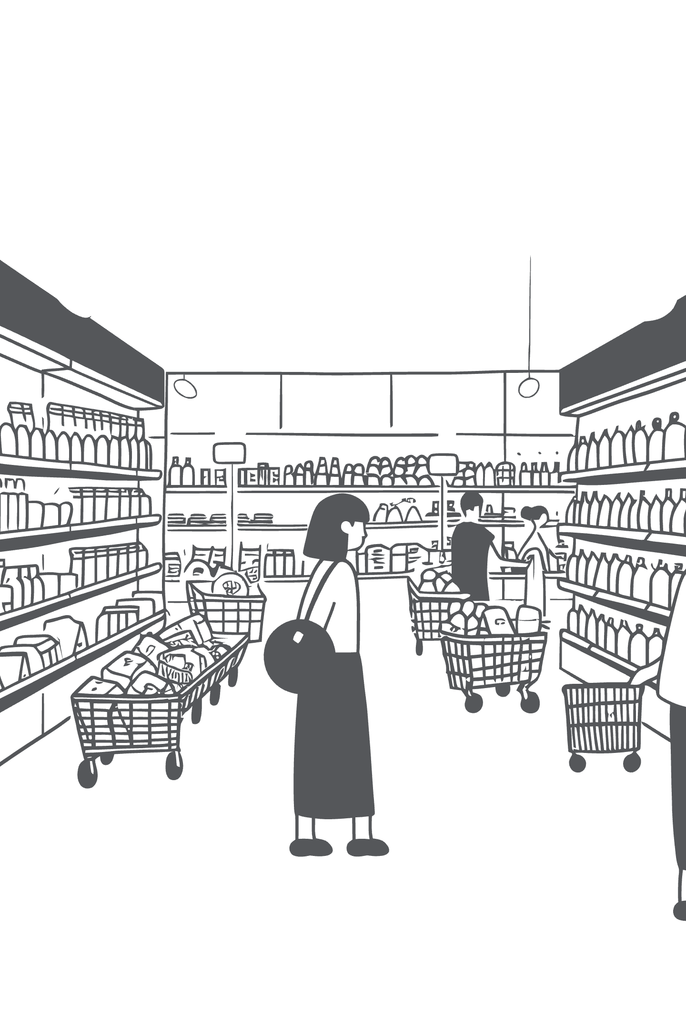
The Challenges in Rural Commerce
Despite rich traditions and unique products, rural businesses face significant barriers in the modern marketplace.
Limited Market Reach
Merchants are often confined to local sales, missing out on vast global opportunities.
Lack of Digital Presence
Many lack online visibility, making it difficult for customers to discover their products.
Absence of Marketing Tools
Without proper tools, promoting products and managing customer relationships becomes a formidable task.
Customer Discovery Issues
Buyers struggle to find authentic rural products, leading to missed connections and economic stagnation.

Slide 4




SuperMall's Holistic Solution
We bridge the gap between traditional craftsmanship and modern commerce.
Unified Marketplace
Smart Organization
Instant professional storefronts for every merchant.
Intuitive categories, location-based mapping, and advanced filters.
Comprehensive Management
Enhanced Customer Experience
Dashboards for inventory, pricing, and promotional offers.
Comparison tools, detailed shop info, and personalized promotions.
This creates a mutually beneficial ecosystem, empowering merchants and satisfying global customer demand.

Slide 5
Core Features & Technical Architecture
For Our Merchants
For Our Customers
Intuitive shop management and real-time content editing.
Advanced search and filter options for precise discovery.
Extensive product catalogs with flexible pricing.
Location-based browsing to find local treasures.
Robust inventory and stock tracking features.
Product comparison, ratings, and authentic reviews.
Powerful promotional tools: discounts, banners, timed offers.
Seamless, responsive design across all devices.
Technical Backbone
Built on a modern stack: React for dynamic UIs, Node.js and Express for scalable APIs, MongoDB for flexible data storage, and JWT Authentication for secure user access. Optimized with caching and lazy loading for peak performance.

Slide 6

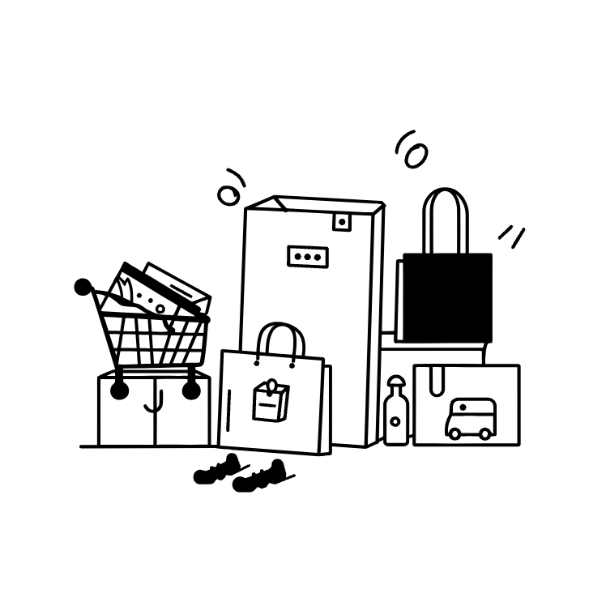

Impact & Future Vision
Global Reach
Unique Products
Economic Empowerment
Merchants can now access international markets, increasing revenue streams.
Customers gain access to authentic, high-quality rural products.
Creating new economic opportunities and fostering sustainable growth in rural areas.
Future Enhancements
Our vision extends to integrated payment solutions, dedicated mobile apps, advanced AI-driven recommendations, and multi-language support to truly become the global platform for rural commerce digitization.

