Slide 1
Tutorial Quick Start * Introduction * import file * Visualization * Layout * Ranking (color) * Metrics * Ranking (size) * Layout again * Show labels * Community-detection * Partition * Filter * Preview * Export * Save * Conclusion
Gephi Tutorial
Quick Start for v0.10.1
Welcome to this introduction tutorial. It will guide you to the basic steps of network visualization and manipulation in Gephi.
Gephi version 0.10.1 was used to do this tutorial.
Inspired by Gephi Quick Start
Editor：Xubo Wang
Edited on Feb 17th, 2025

Slide 2
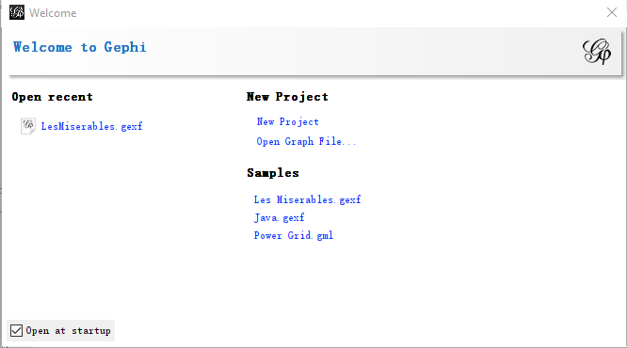
Tutorial Quick Start * Introduction * import file * Visualization * Layout * Ranking (color) * Metrics * Ranking (size) * Layout again * Show labels * Community-detection * Partition * Filter * Preview * Export * Save * Conclusion
Open Gephi
Download the file:
LesMiserables.gexf
Open Gephi then create a new project

Slide 3
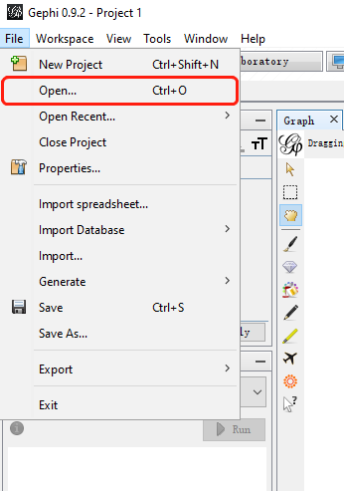
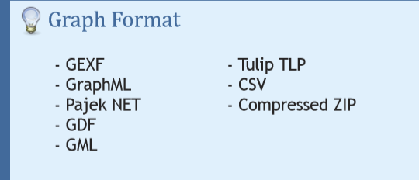
Tutorial Quick Start * Introduction * import file * Visualization * Layout * Ranking (color) * Metrics * Ranking (size) * Layout again * Show labels * Community-detection * Partition * Filter * Preview * Export * Save * Conclusion
Open Graph File
In the menubar, go to File Menu and Open...

Slide 4
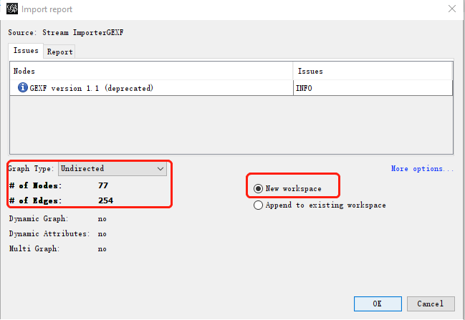
Tutorial Quick Start * Introduction * import file * Visualization * Layout * Ranking (color) * Metrics * Ranking (size) * Layout again * Show labels * Community-detection * Partition * Filter * Preview * Export * Save * Conclusion
Import Report
When your filed is opened, the report sum up data found and issues.
Number of nodes
Number of edges
- Type of graph
•Choose to open it in a new workspace, then Click on OK to validate and see the graph

Slide 5
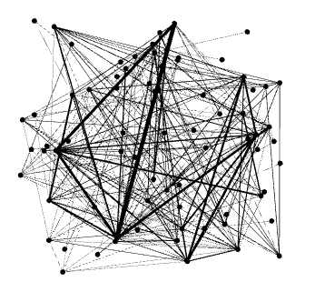
Tutorial Quick Start * Introduction * import file * Visualization * Layout * Ranking (color) * Metrics * Ranking (size) * Layout again * Show labels * Community-detection * Partition * Filter * Preview * Export * Save * Conclusion
You should now see a graph
We imported “Les Miserables” dataset. Coappearance weighted network of characters in the novel “Les Miserables” from Victor Hugo.
Node positions are random at first, so you may see a slightly different representation.

Slide 6
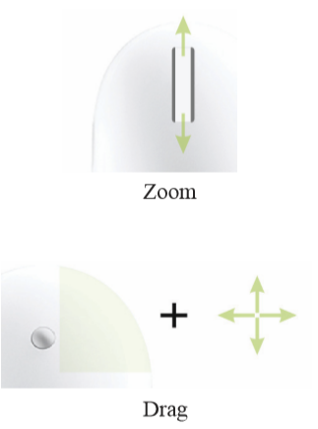

Tutorial Quick Start * Introduction * import file * Visualization * Layout * Ranking (color) * Metrics * Ranking (size) * Layout again * Show labels * Community-detection * Partition * Filter * Preview * Export * Save * Conclusion
Graph Visualization
Use your mouse to move and scale the visualization
Zoom: Mouse Wheel
Pan: Right Mouse Drag
Locate the “Edge Weight Scale” slider on the bottom
If you lose your graph, reset the position
reset position

Slide 7

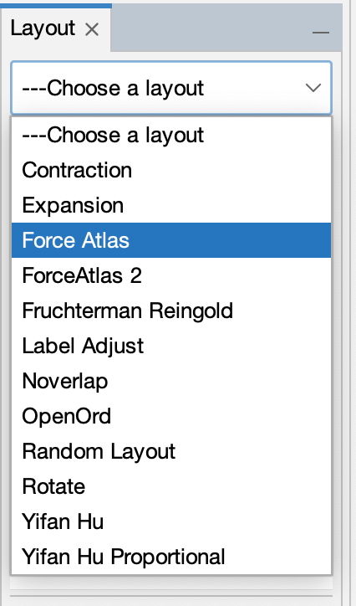
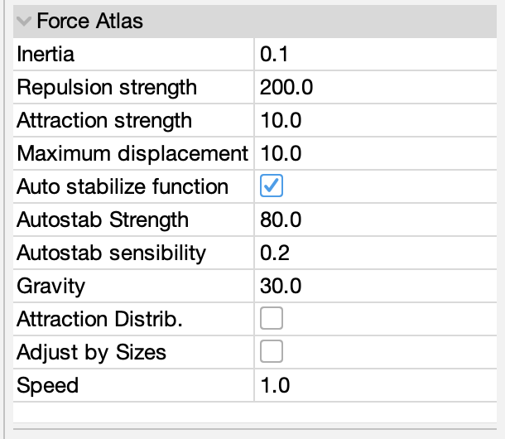
Tutorial Quick Start * Introduction * import file * Visualization * Layout * Ranking (color) * Metrics * Ranking (size) * Layout again * Show labels * Community-detection * Partition * Filter * Preview * Export * Save * Conclusion
Layout the graph
Layout algorithms set the graph shape which is the most essential action.
• Locate the Layout module, on the left panel.
• Choose “Force Atlas”
You can see the layout properties below, leave default values.
• Click on to launch the algorithm
Layout Properties

Slide 8
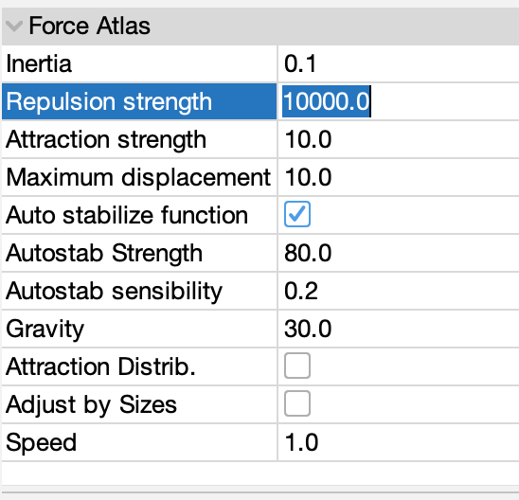
Tutorial Quick Start * Introduction * import file * Visualization * Layout * Ranking (color) * Metrics * Ranking (size) * Layout again * Show labels * Community-detection * Partition * Filter * Preview * Export * Save * Conclusion
Control the layout
The purpose of Layout Properties is to let you control the algorithm in order to make an aesthetically pleasing representation.
Set the “Repulsion strength” at 10000 to expand the graph.
Type “Enter” to validate the changed value.
• And now the algorithm.

Slide 9
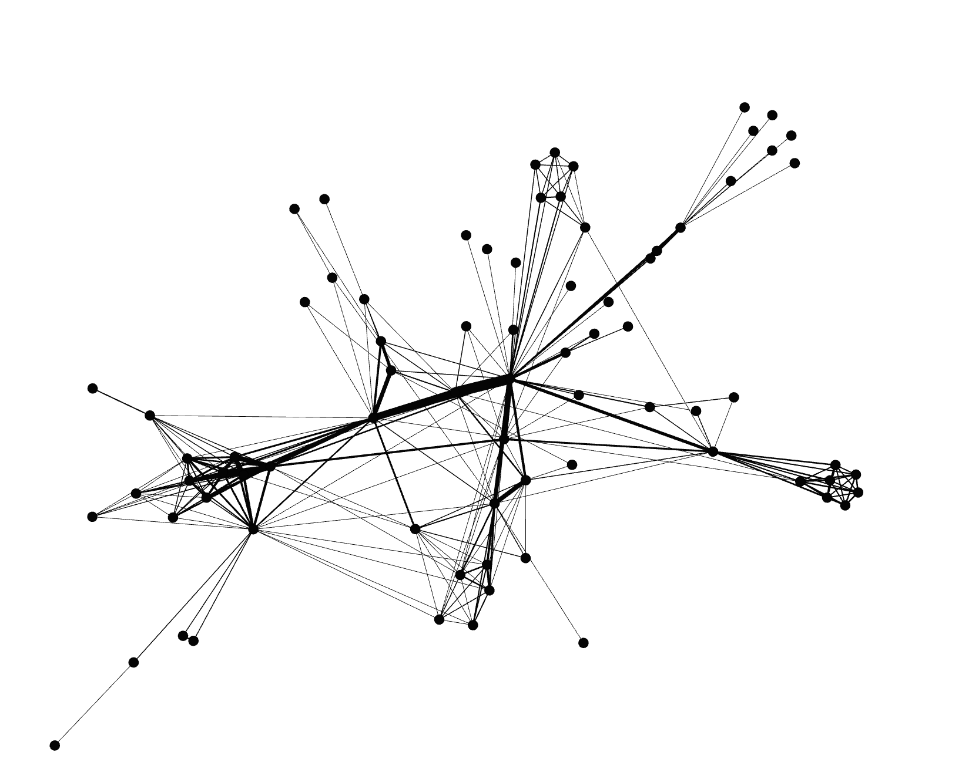
Tutorial Quick Start * Introduction * import file * Visualization * Layout * Ranking (color) * Metrics * Ranking (size) * Layout again * Show labels * Community-detection * Partition * Filter * Preview * Export * Save * Conclusion
You should now see a layouted graph

Slide 10
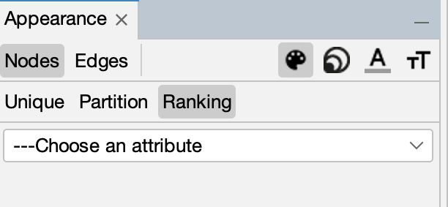
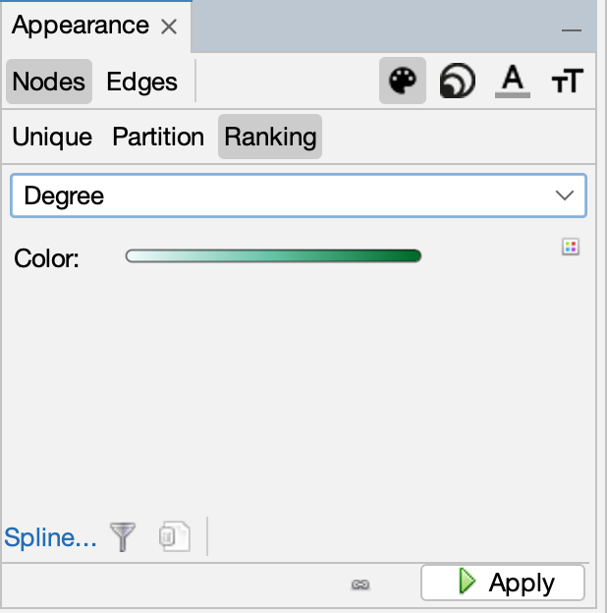
Tutorial Quick Start * Introduction * import file * Visualization * Layout * Ranking (color) * Metrics * Ranking (size) * Layout again * Show labels * Community-detection * Partition * Filter * Preview * Export * Save * Conclusion
Ranking (color)
Ranking module lets you configure node’s color and size.
Locate Ranking module, in the top left.
Choose “Degree” as a rank parameter.
You should obtain the configuration panel
like this:
• Click on to see the result.

Slide 11

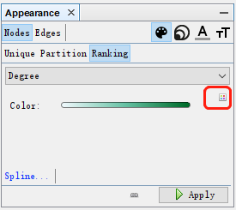
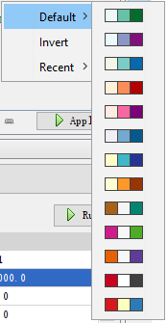
Tutorial Quick Start * Introduction * import file * Visualization * Layout * Ranking (color) * Metrics * Ranking (size) * Layout again * Show labels * Community-detection * Partition * Filter * Preview * Export * Save * Conclusion
Let’s configure colors
Move your mouse over the gradient component.
Use palette to change colors by clicking the four-color square

Slide 12
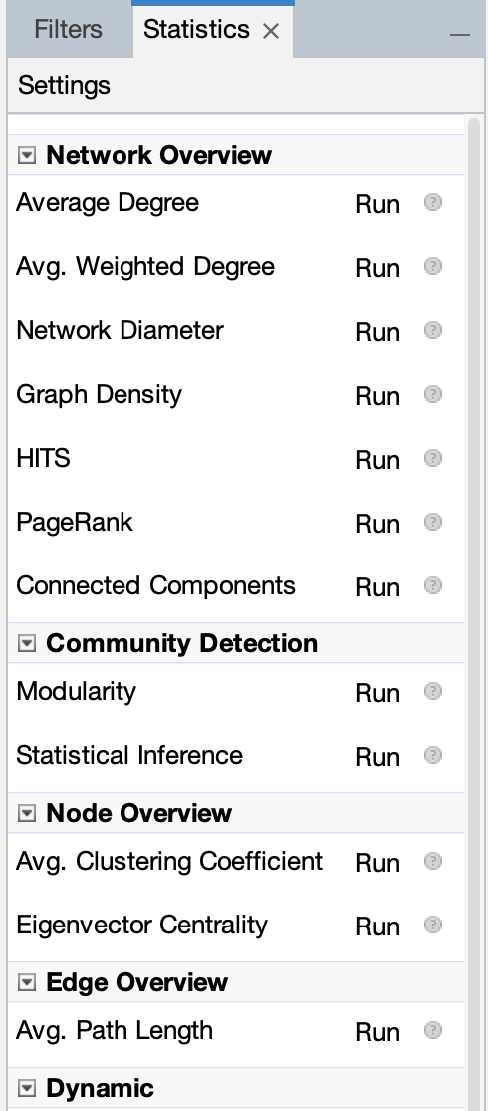
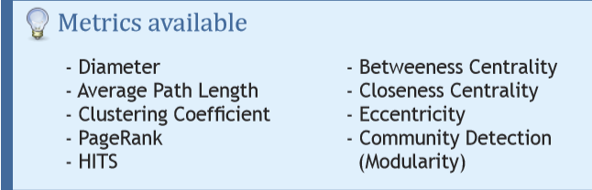
Tutorial Quick Start * Introduction * import file * Visualization * Layout * Ranking (color) * Metrics * Ranking (size) * Layout again * Show labels * Community-detection * Partition * Filter * Preview * Export * Save * Conclusion
Metrics
We will calculate the average path length for the network. It computes the path length for all possible pairs of nodes and give information about how nodes are close from each other.
Locate the Statistics module on the right panel.
Click on near “Avg. Path Length”.

Slide 13
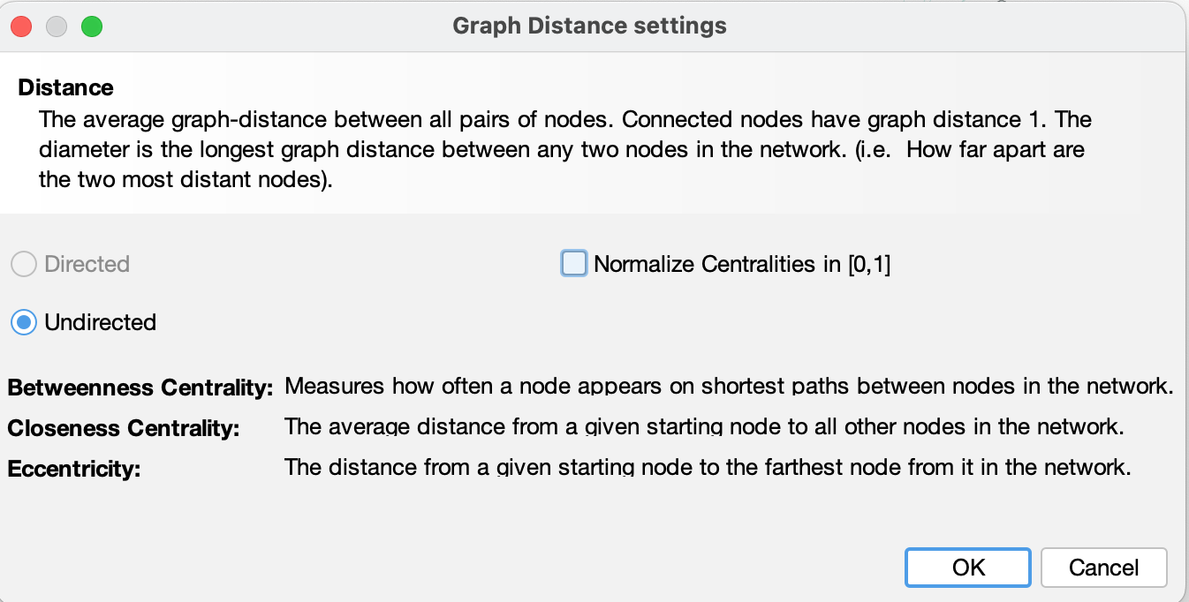
Tutorial Quick Start * Introduction * import file * Visualization * Layout * Ranking (color) * Metrics * Ranking (size) * Layout again * Show labels * Community-detection * Partition * Filter * Preview * Export * Save * Conclusion
Metric settings
The setting panel immediately appears
Select “Undirected” and click on OK to compute the metric

Slide 14
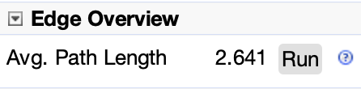
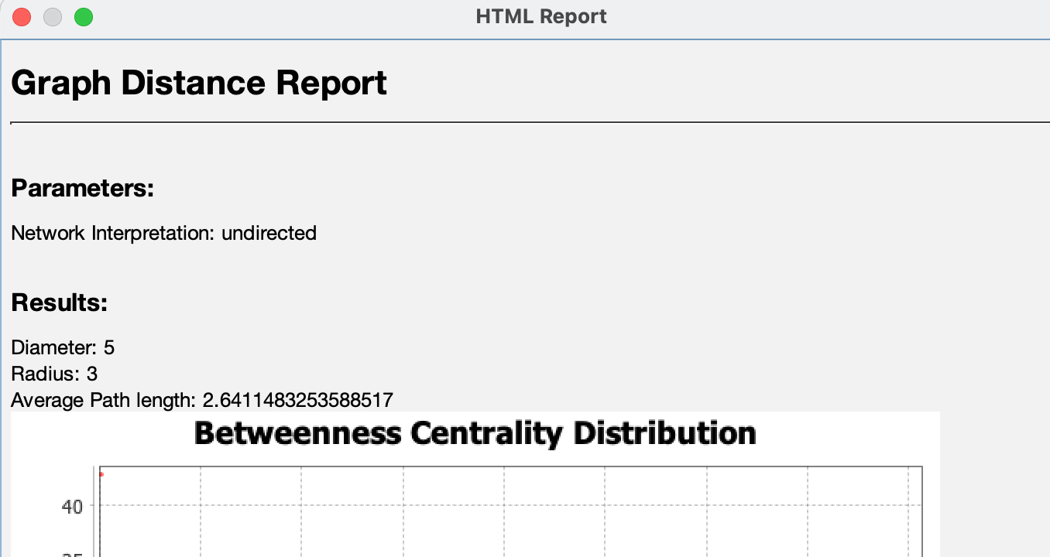
Tutorial Quick Start * Introduction * import file * Visualization * Layout * Ranking (color) * Metrics * Ranking (size) * Layout again * Show labels * Community-detection * Partition * Filter * Preview * Export * Save * Conclusion
Metric result
When finished, the metric displays its result in a report.

Slide 15
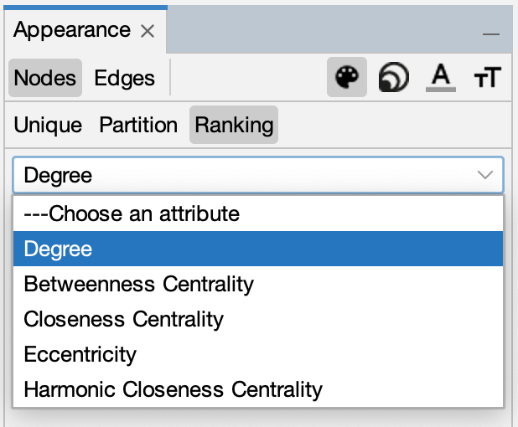
Tutorial Quick Start * Introduction * import file * Visualization * Layout * Ranking (color) * Metrics * Ranking (size) * Layout again * Show labels * Community-detection * Partition * Filter * Preview * Export * Save * Conclusion
Ranking (size)
Metrics generates general reports but also results for each node. Thus three new values have been created by the “Average Path Length” algorithm we ran.
Betweenness Centrality
Closeness Centrality
Eccentricity
Go back to Ranking
You can now see more the new ranking metrics
“Betweenness Centrality” in the list indicates influential nodes for highest value.

Slide 16
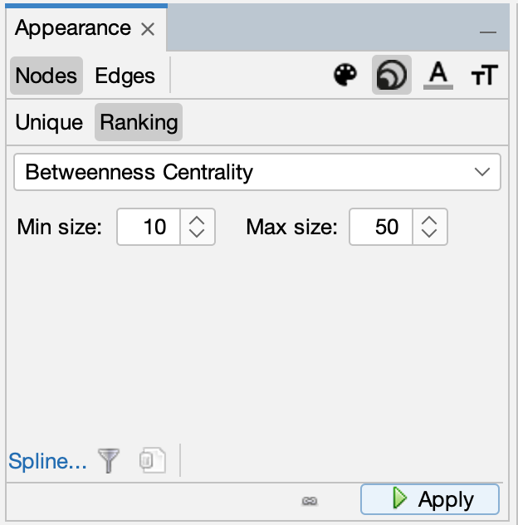
Tutorial Quick Start * Introduction * import file * Visualization * Layout * Ranking (color) * Metrics * Ranking (size) * Layout again * Show labels * Community-detection * Partition * Filter * Preview * Export * Save * Conclusion
Ranking (size)
The node’s size will be set now.
• And click on to see the result.
Select the diamond icon in the toolbar for size.
Set a min size at 10 and a max size at 50.
size

Slide 17
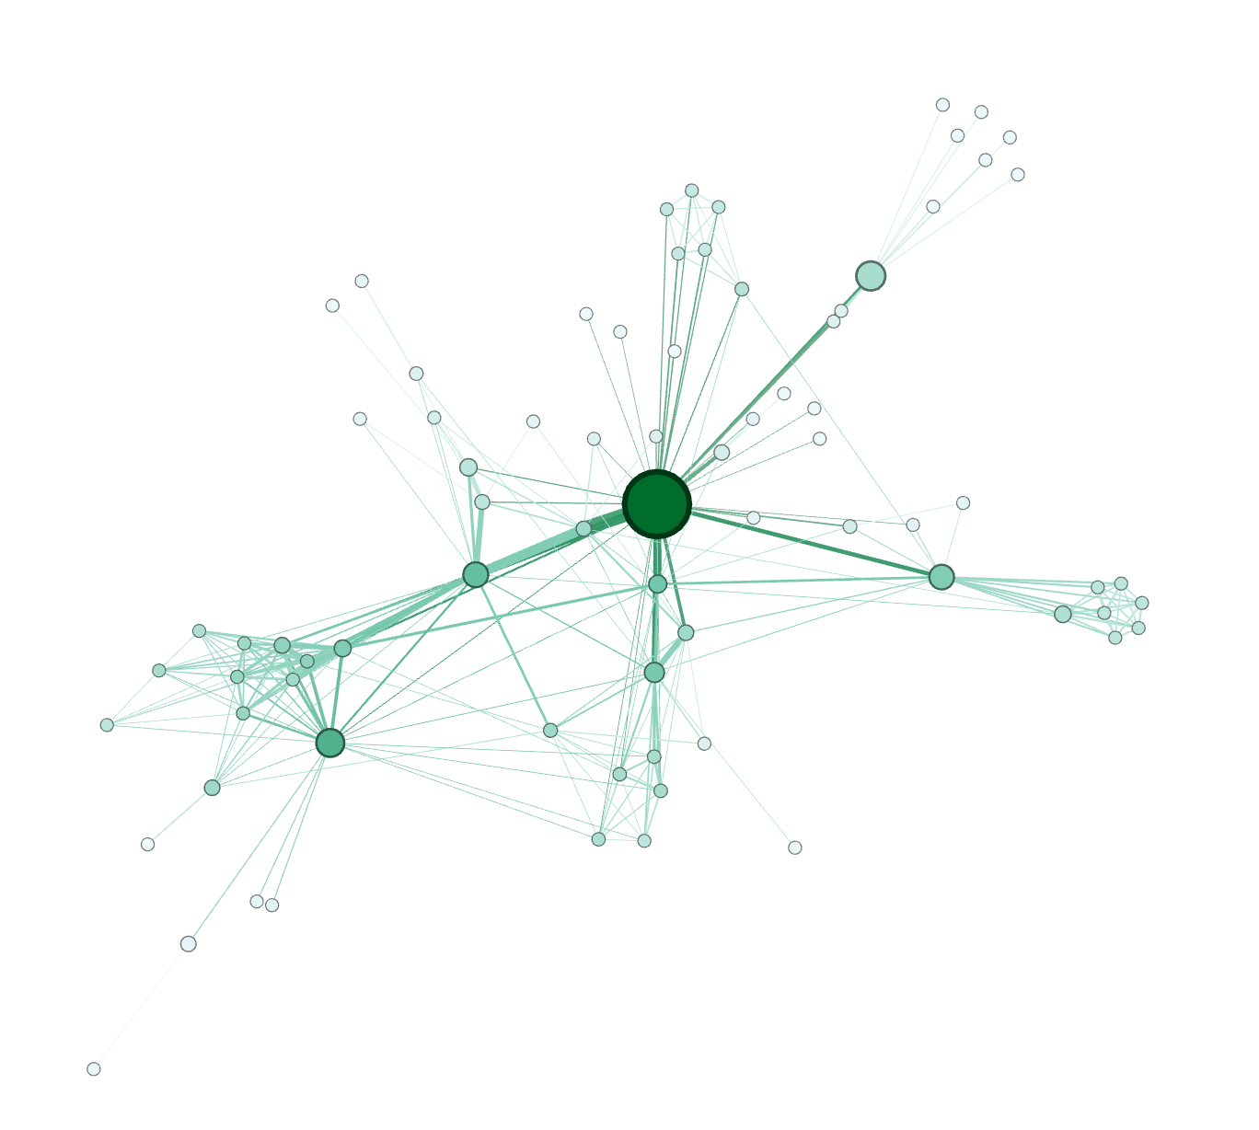
Tutorial Quick Start * Introduction * import file * Visualization * Layout * Ranking (color) * Metrics * Ranking (size) * Layout again * Show labels * Community-detection * Partition * Filter * Preview * Export * Save * Conclusion
You should see a colored and sized graph
Color: Degree
Size: Betweenness Centrality metric

Slide 18
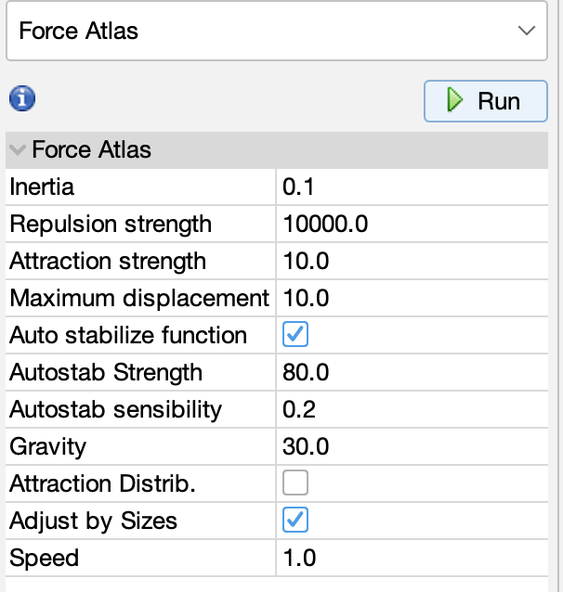
Tutorial Quick Start * Introduction * import file * Visualization * Layout * Ranking (color) * Metrics * Ranking (size) * Layout again * Show labels * Community-detection * Partition * Filter * Preview * Export * Save * Conclusion
Layout again
The layout is not completely satisfying, as big nodes can overlap smaller ones.
The “Force Atlas” algorithm has an option to take node size in account when layouting.
Go Back to the Layout panel.
Check the “Adjust by Sizes” option and run again the algorithm for short moment.
You can see nodes are not overlapping anymore

Slide 19
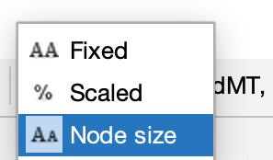

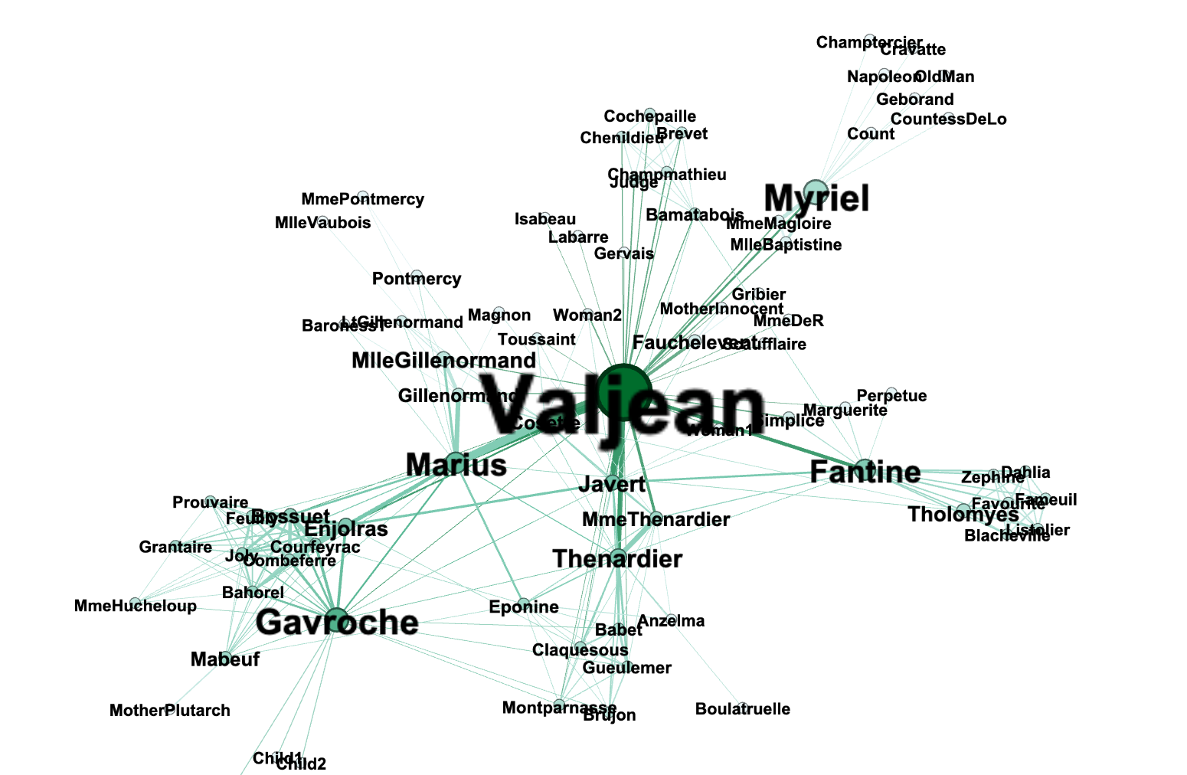
Tutorial Quick Start * Introduction * import file * Visualization * Layout * Ranking (color) * Metrics * Ranking (size) * Layout again * Show labels * Community-detection * Partition * Filter * Preview * Export * Save * Conclusion
Show labels
Let’s explore the network more in details now that colors and size indicates central nodes.
Display node labels
Set label size proportional to node size
Set label size with the scale slider

Slide 20
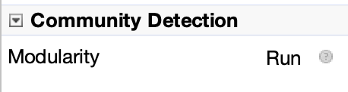
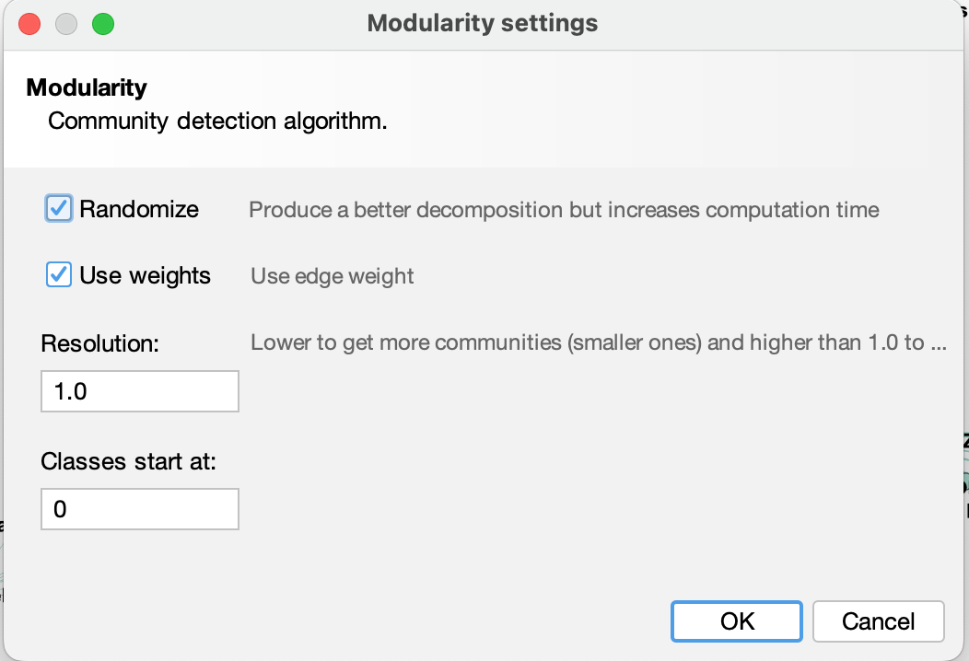
Tutorial Quick Start * Introduction * import file * Visualization * Layout * Ranking (color) * Metrics * Ranking (size) * Layout again * Show labels * Community-detection * Partition * Filter * Preview * Export * Save * Conclusion
Community detection
The ability to detect and study communities is central in network analysis. We would like to colorize clusters in our example.
Gephi implements the Louvain method, available from the Statistics panel.
Click on “Run” near the “Modularity” line
• Select “Randomize” and “Use weights” on the panel.
• Click on “OK” to launch the detection.

Slide 21
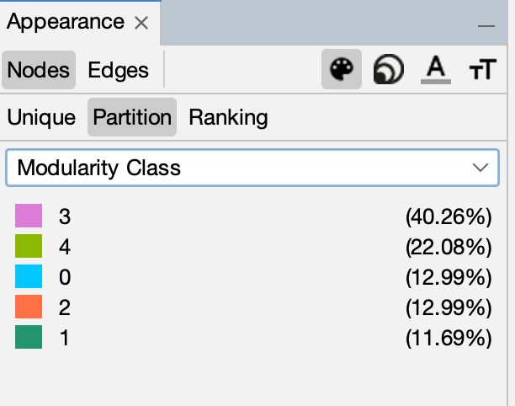
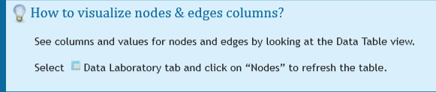
Tutorial Quick Start * Introduction * import file * Visualization * Layout * Ranking (color) * Metrics * Ranking (size) * Layout again * Show labels * Community-detection * Partition * Filter * Preview * Export * Save * Conclusion
Partition
The community detection algorithm created a “Modularity Class” value for each node.
The partition module can use this new data to colorize communities.
• Locate the “Nodes>Partition” on the left panel.
• click palette icon then select “Modularity Class” in the partition list.
You can see that 5 communities were found, could be different for you. A random color has been set for each community identifier.
• Click on to colorize nodes.

Slide 22
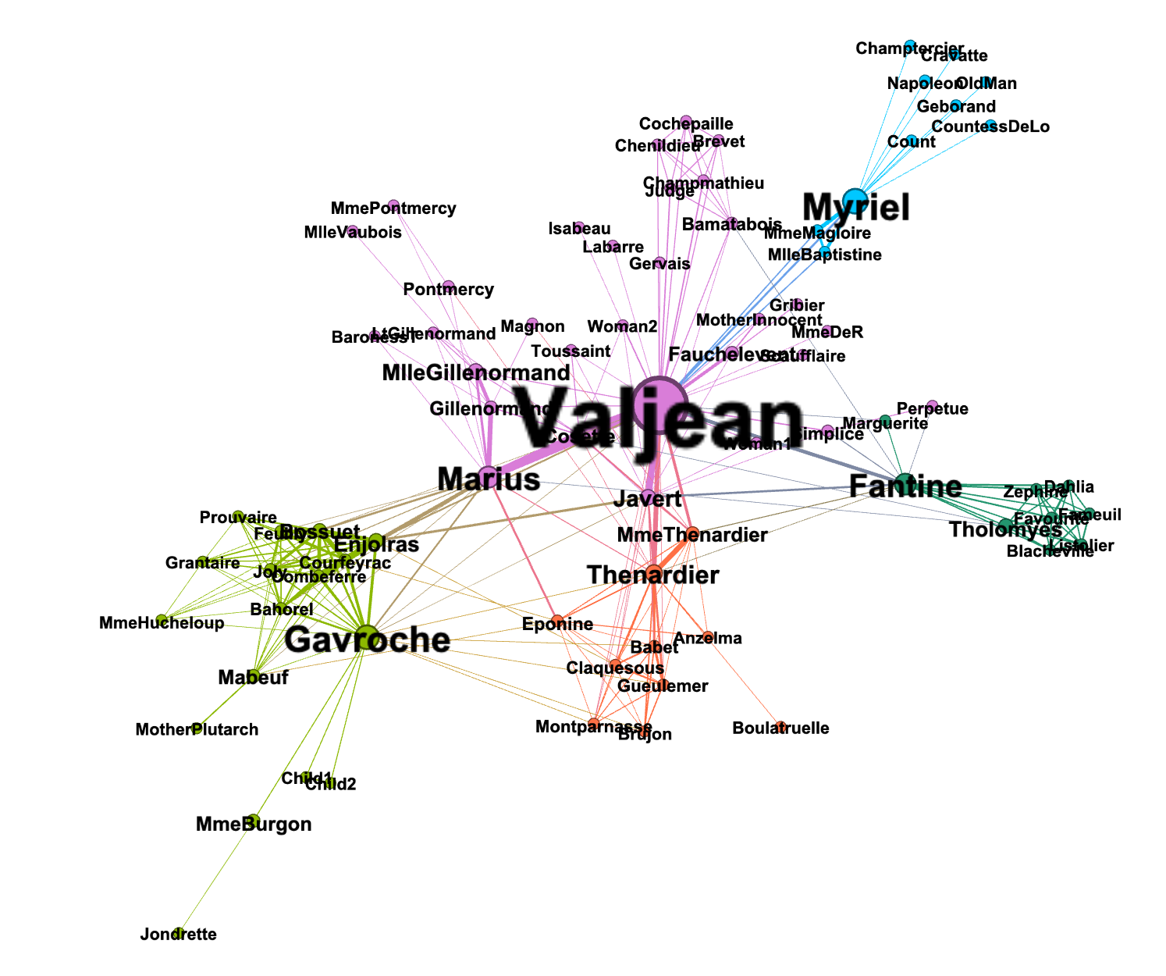
Tutorial Quick Start * Introduction * import file * Visualization * Layout * Ranking (color) * Metrics * Ranking (size) * Layout again * Show labels * Community-detection * Partition * Filter * Preview * Export * Save * Conclusion
What the network looks like now

Slide 23
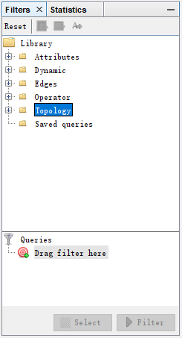
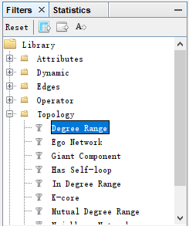
Tutorial Quick Start * Introduction * import file * Visualization * Layout * Ranking (color) * Metrics * Ranking (size) * Layout again * Show labels * Community-detection * Partition * Filter * Preview * Export * Save * Conclusion
Filter
The last manipulation step is filtering. You create filters that can hide nodes and edges on the network. We will create a filter to remove leaves, i.e. nodes with a single edge.
Locate the Filters module on the right panel.
Select “Degree Range” in the “Topology” category.

Slide 24
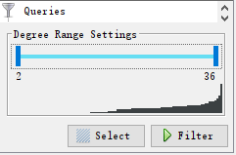
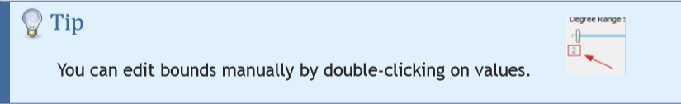
Tutorial Quick Start * Introduction * import file * Visualization * Layout * Ranking (color) * Metrics * Ranking (size) * Layout again * Show labels * Community-detection * Partition * Filter * Preview * Export * Save * Conclusion
Filter
It shows a range slider and the chart that represents the data, the degree distribution here.
Move the slider to set its lower bound to 2.
Enable filtering by pushing the button.
Nodes with a degree inferior to 2 are now hidden.

Slide 25
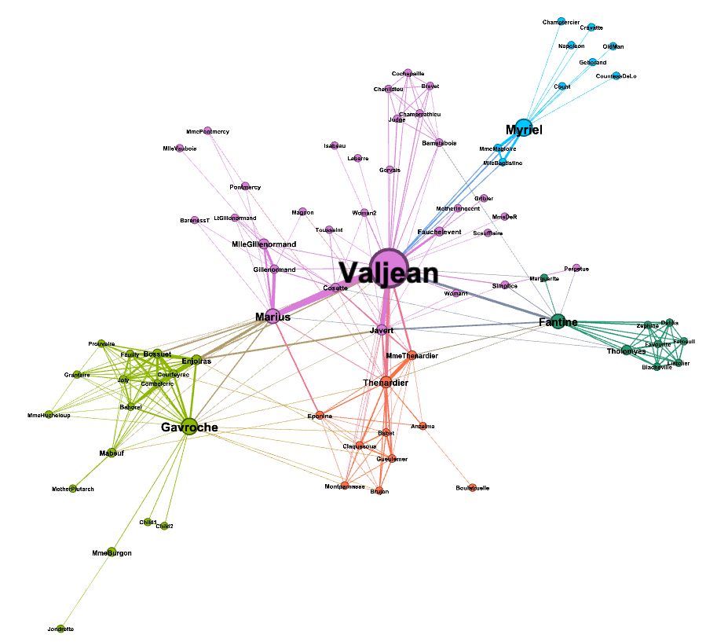
Tutorial Quick Start * Introduction * import file * Visualization * Layout * Ranking (color) * Metrics * Ranking (size) * Layout again * Show labels * Community-detection * Partition * Filter * Preview * Export * Save * Conclusion
The filtered network
That ends the manipulation. We will now preview the rendering and prepare to export.

Slide 26

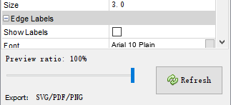
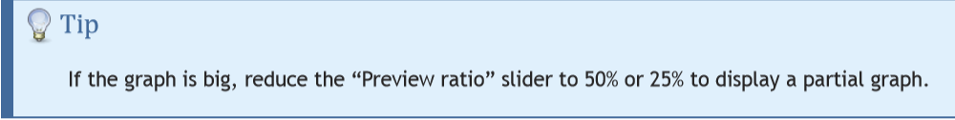
Tutorial Quick Start * Introduction * import file * Visualization * Layout * Ranking (color) * Metrics * Ranking (size) * Layout again * Show labels * Community-detection * Partition * Filter * Preview * Export * Save * Conclusion
Preview
• Before exporting your graph as a SVG or PDF file, go to the Preview to:
See exactly how the graph will look like
Put the last touch
• Select the “Preview” tab in the top banner:
• Click on “Refresh” on the left bottom to see the preview
Different from Zoom

Slide 27
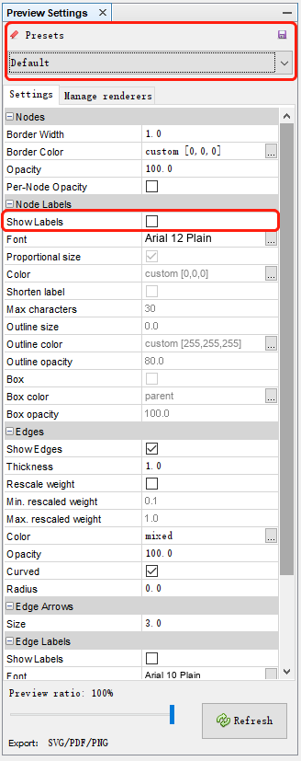

Tutorial Quick Start * Introduction * import file * Visualization * Layout * Ranking (color) * Metrics * Ranking (size) * Layout again * Show labels * Community-detection * Partition * Filter * Preview * Export * Save * Conclusion
Preview
• In the “Node Labels” property, find “Show Labels” and enable the option.
• Click on
Preview Settings also support ”Presets”, click on the presets list and try different configurations.

Slide 28
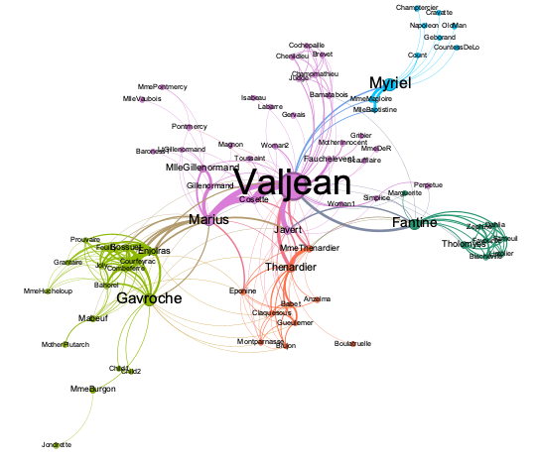
Tutorial Quick Start * Introduction * import file * Visualization * Layout * Ranking (color) * Metrics * Ranking (size) * Layout again * Show labels * Community-detection * Partition * Filter * Preview * Export * Save * Conclusion
The Previewed Graph

Slide 29
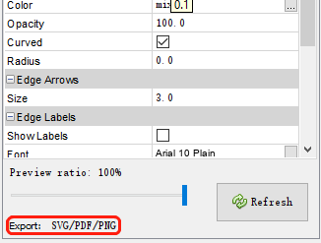
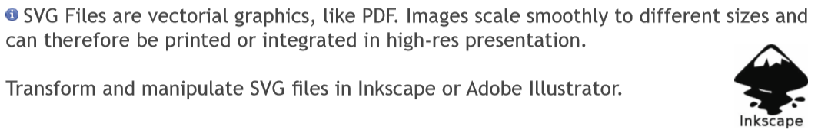
Tutorial Quick Start * Introduction * import file * Visualization * Layout * Ranking (color) * Metrics * Ranking (size) * Layout again * Show labels * Community-detection * Partition * Filter * Preview * Export * Save * Conclusion
Export as SVG/PDF/PNG
From Preview, click on SVG/PDF/PNG near Export.

Slide 30
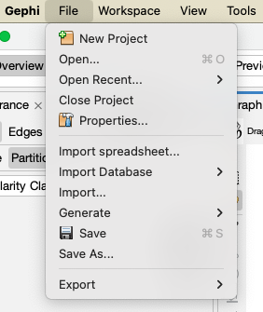
Tutorial Quick Start * Introduction * import file * Visualization * Layout * Ranking (color) * Metrics * Ranking (size) * Layout again * Show labels * Community-detection * Partition * Filter * Preview * Export * Save * Conclusion
Save your project
Saving your project encapsulates all data and results in a single session file.

Slide 31
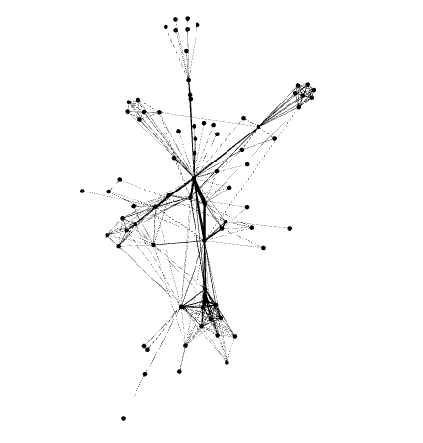
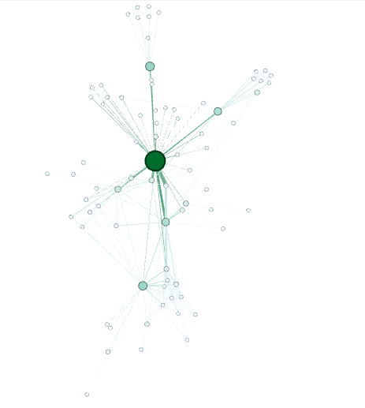
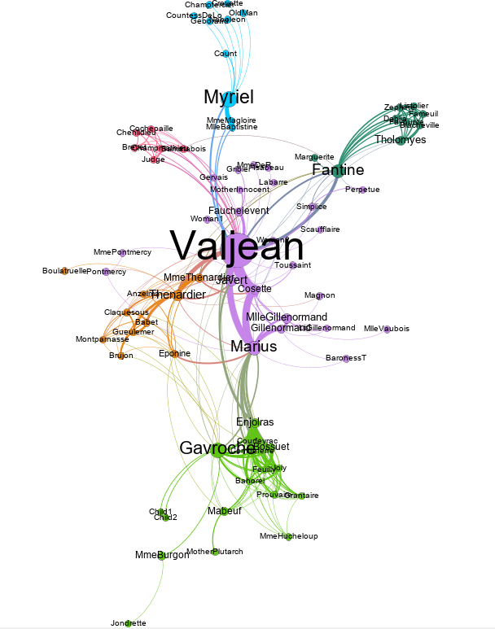
Tutorial Quick Start * Introduction * import file * Visualization * Layout * Ranking (color) * Metrics * Ranking (size) * Layout again * Show labels * Community-detection * Partition * Filter * Preview * Export * Save * Conclusion
Conclusion
In this tutorial you learned the basic process to open, visualize, manipulate and render a network file with Gephi.
Go further:
Gephi website: https://gephi.org/

