Slide 1

Language Engineering Assignment 1
Xuecong Liu

Slide 2
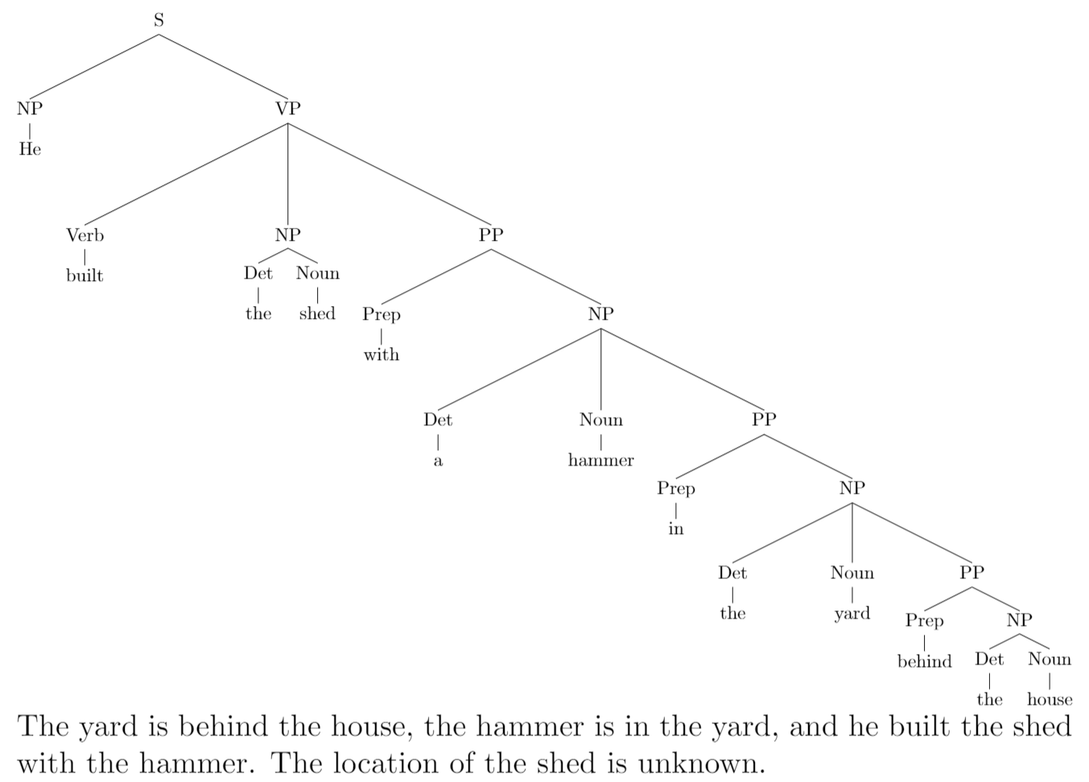
He built the shed with a hammer in the yard behind the house
The yard is behind the house.
The hammer is in the yard.
The location of the shed is unknown.
He built the shed with the hammer.

Slide 3
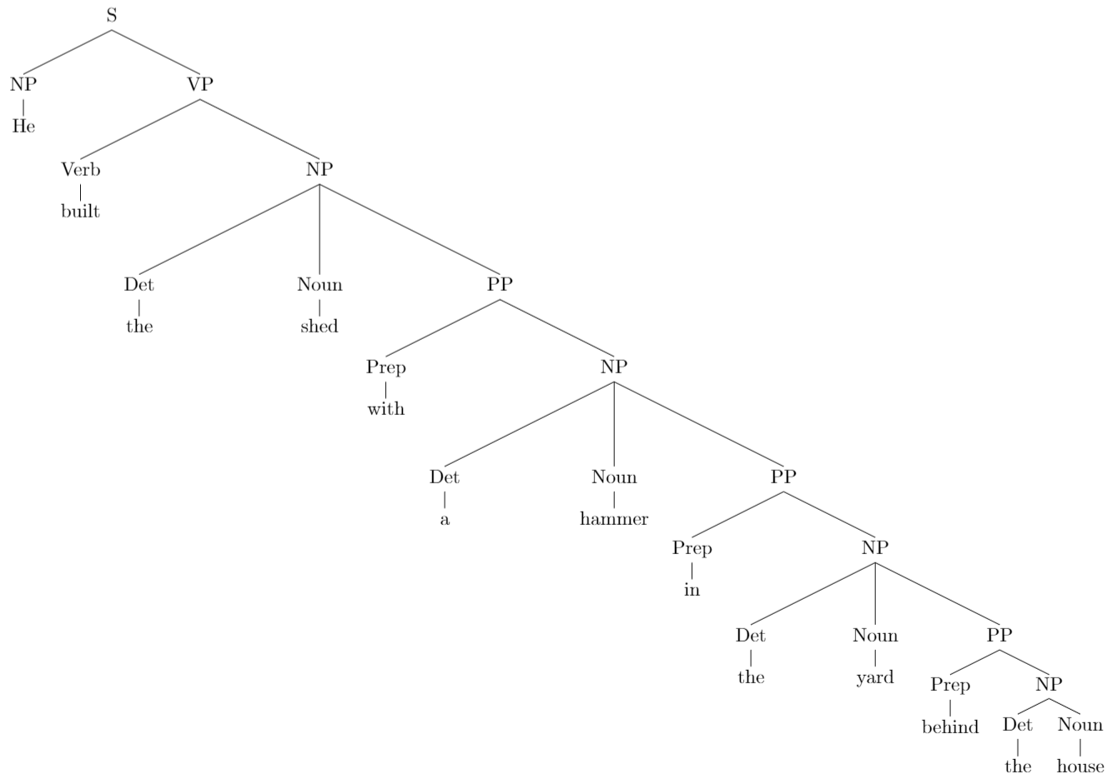
He built the shed with a hammer in the yard behind the house
The yard is behind the house.
The hammer is in the yard.
The shed is with the hammer.

Slide 4
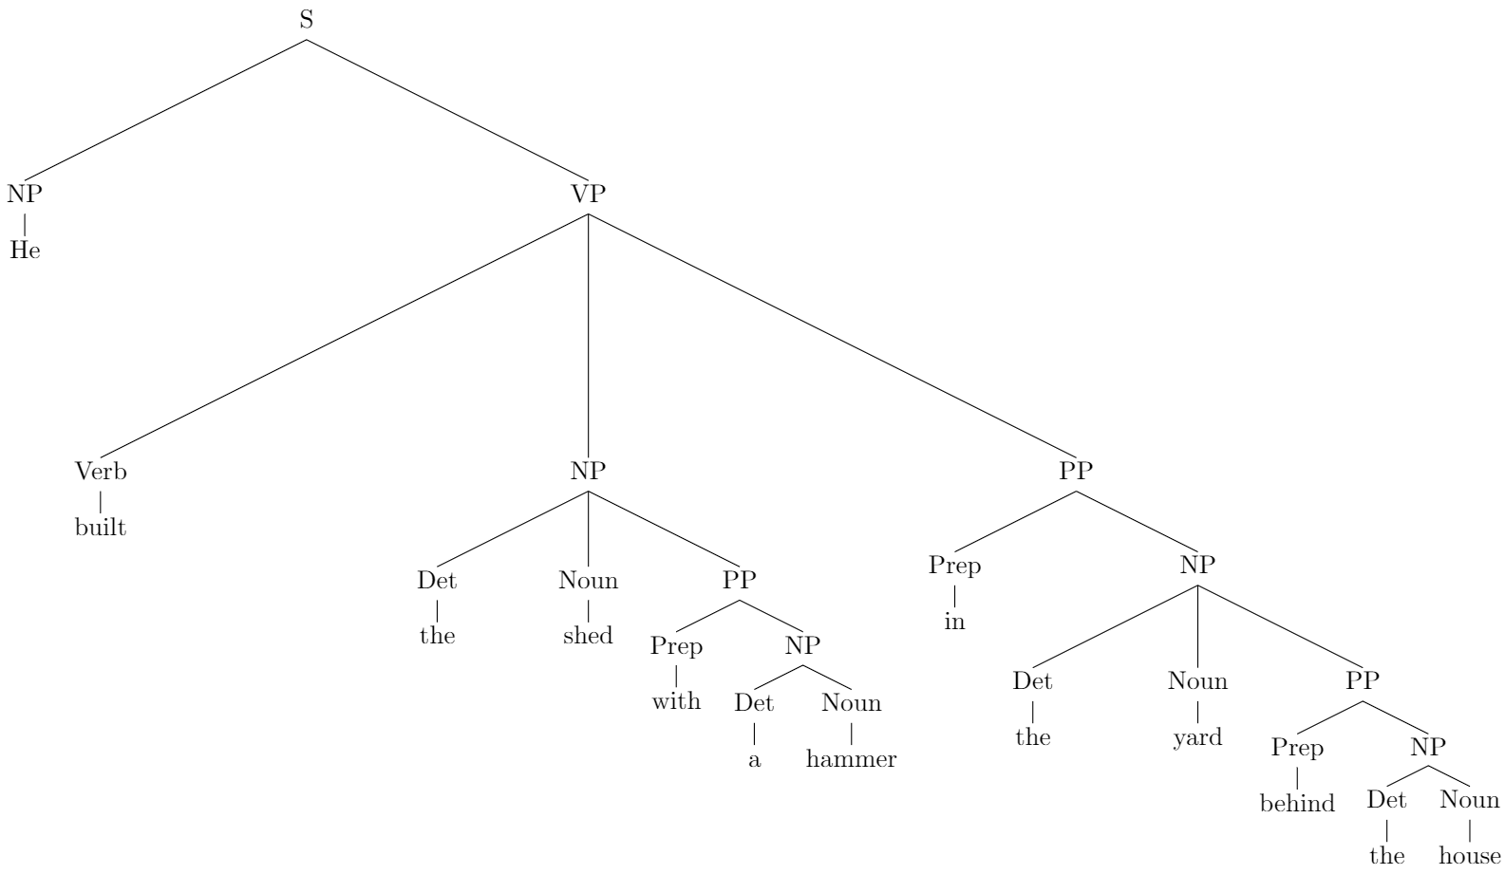
He built the shed with a hammer in the yard behind the house
The yard is behind the house.
The shed is with a hammer.
He did the building in the yard.

Slide 5
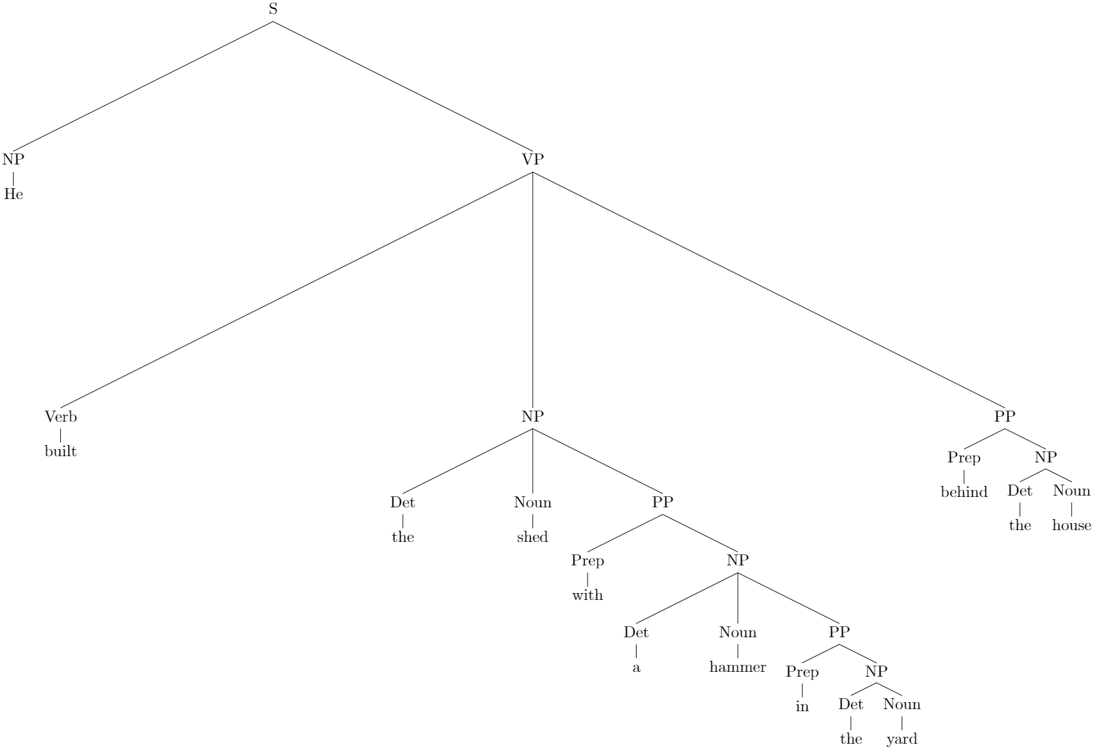
He built the shed with a hammer in the yard behind the house
He built the shed behind the house.
The shed is with a hammer.
The hammer is in the yard now.
The location of the yard is unknown.

Slide 6
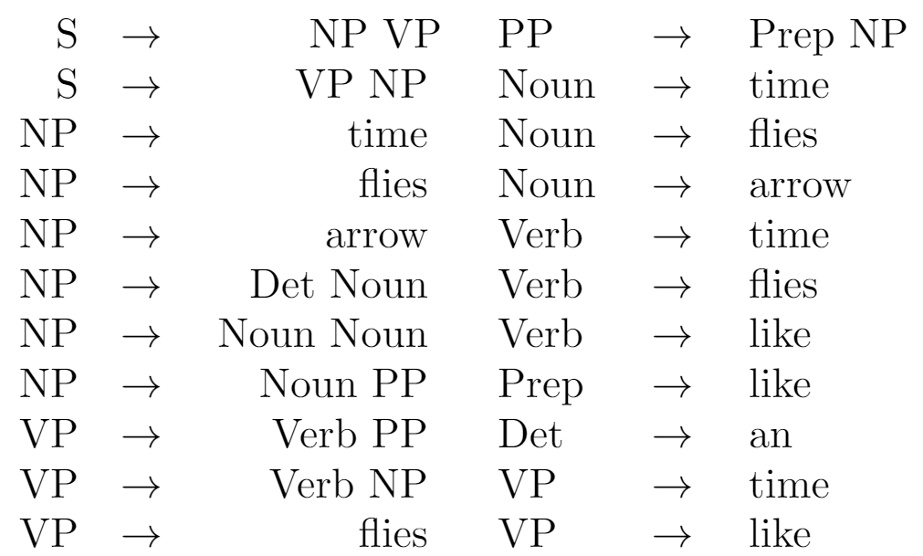
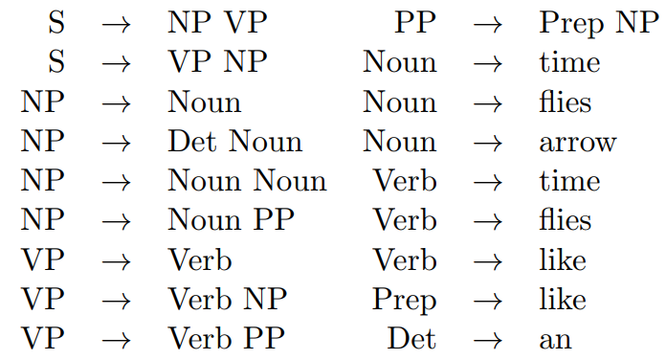
Chomsky normal form grammar
Non-Chomsky normal form
Chomsky normal form

Slide 7
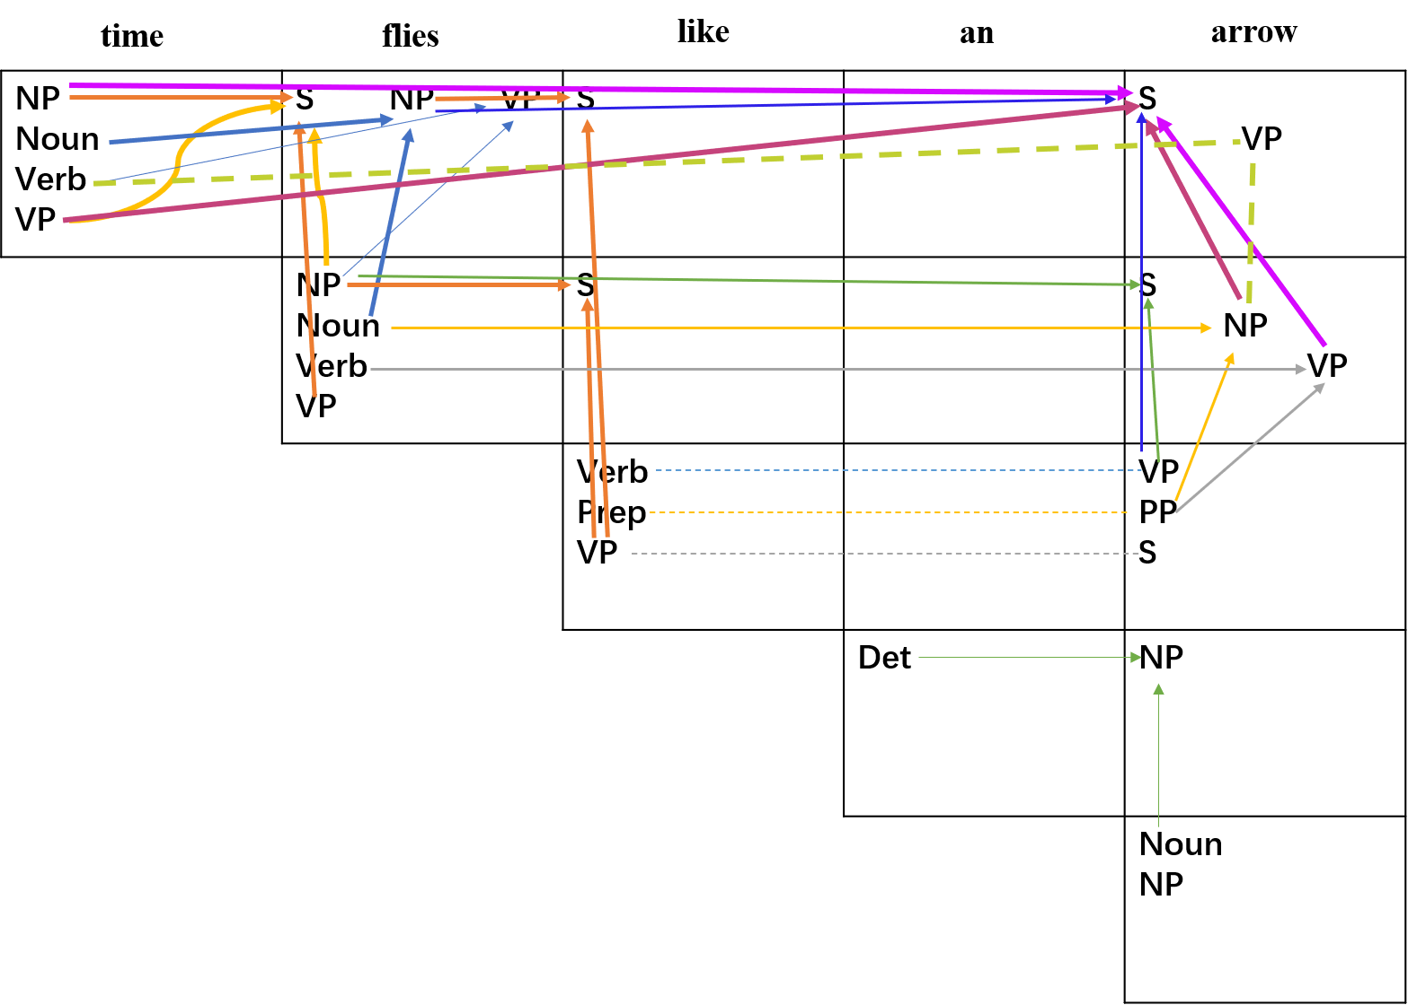
3 possible analysis of the sentence

Slide 8
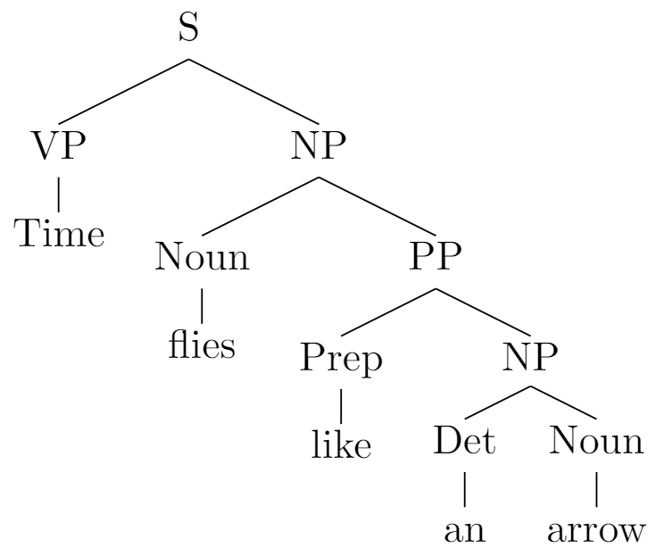
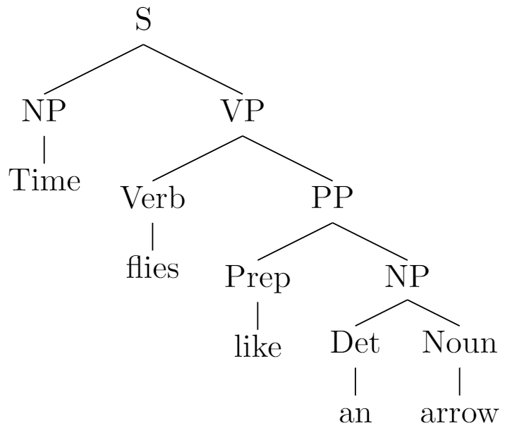
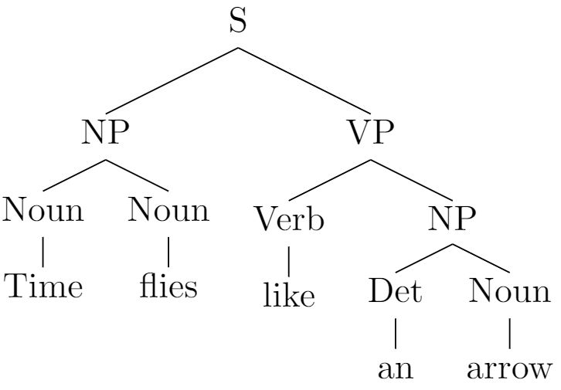
Time flies like an arrow

Slide 9
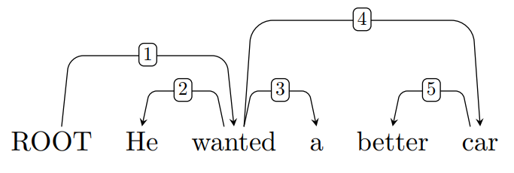
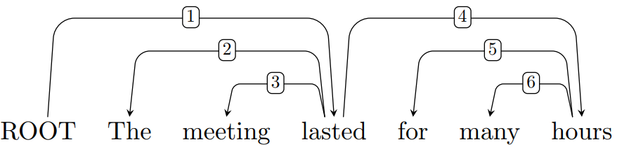
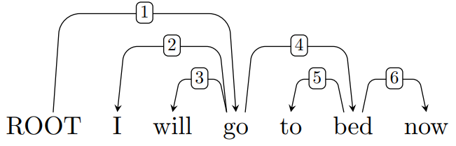
Dependency trees

Slide 10
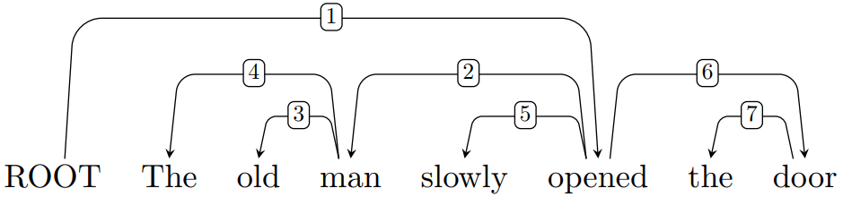
Label dependency tree
root
det
nsubj
obj
amod
advmod
det

Slide 11
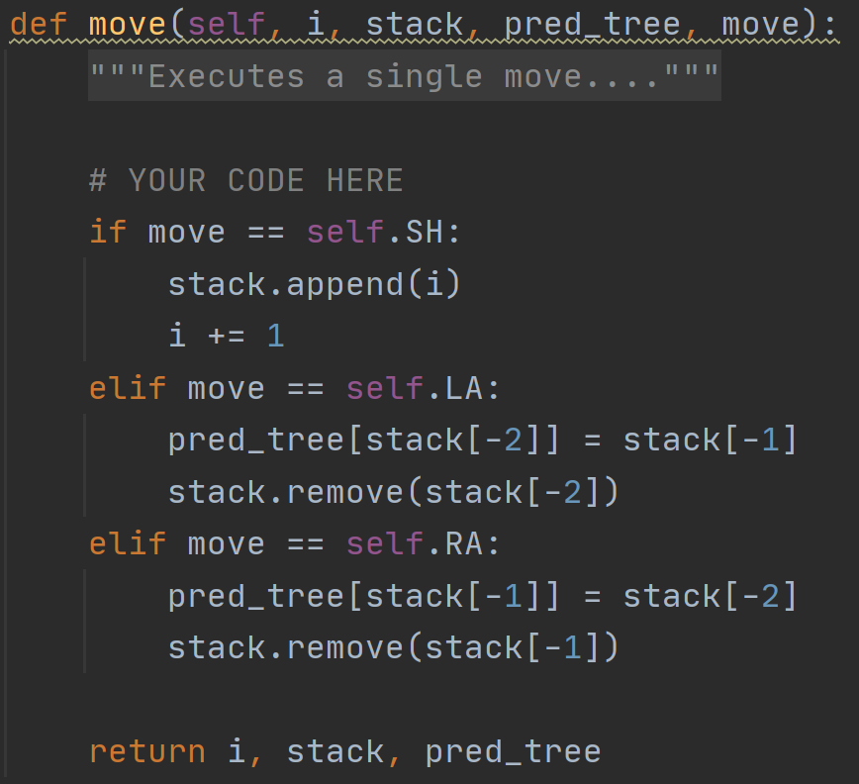
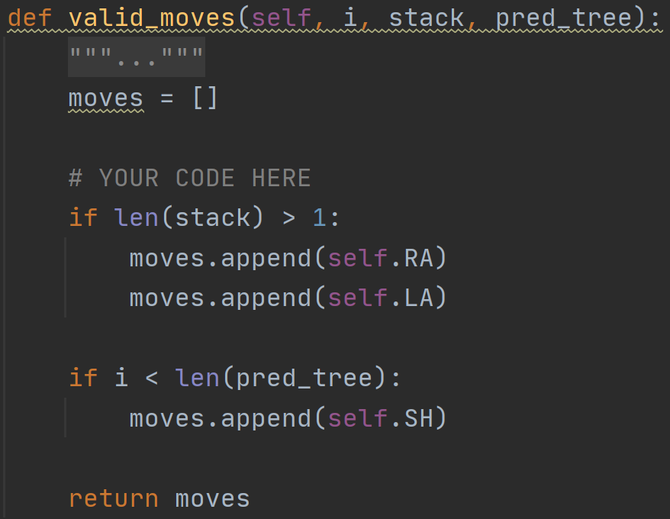
DepParser

Slide 12
Thank you!

Slide 13
time
flies
like
an
arrow
NP Noun Verb VP | S NP VP | S |  | S VP
 | NP Noun Verb VP | S |  | S NP VP
 |  | Verb Prep VP |  | VP PP S
 |  |  | Det | NP
 |  |  |  | Noun NP
3 possible analysis

