Slide 1
H-1B Application Analysis
Lu Yu
Yue Pan
Xun Cao
Wenzheng He

Slide 2
Variables Included
CASE_STATUS
EMPLOYER_NAME
SOC_NAME
JOB_TITLE
PREVAILING_WAGE
YEAR
WORKSITE
Lon
Lat

Slide 3
Analysis Outline
Section I. General Employer Analysis
Section II. Location-Based Analysis
Section III. Data Science related Analysis

Slide 4
General Employer Analysis

Slide 5
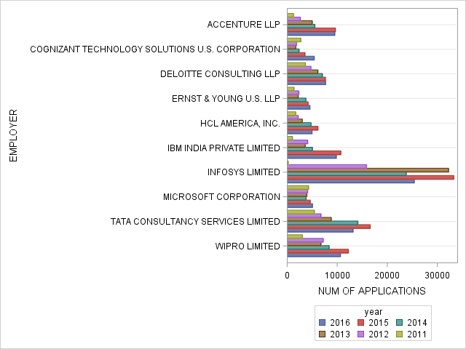
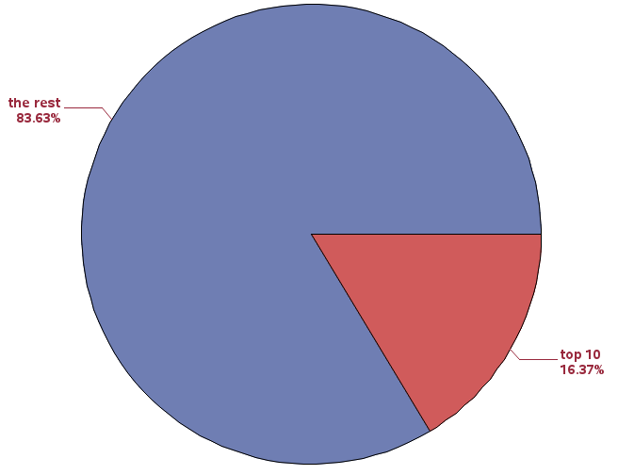
Number of applications for top 10 companies by year

Slide 6
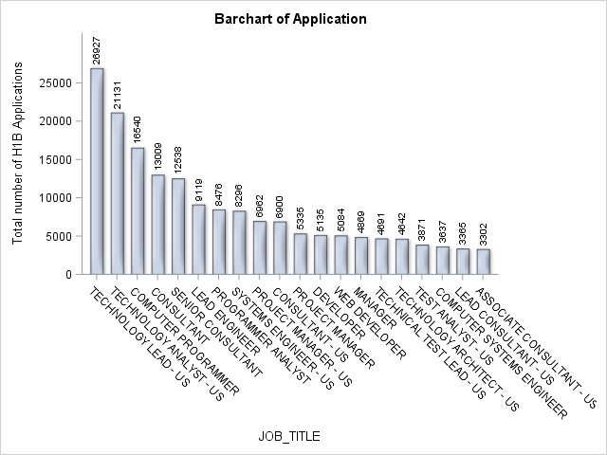
Top job titles for the top ten employers

Slide 7
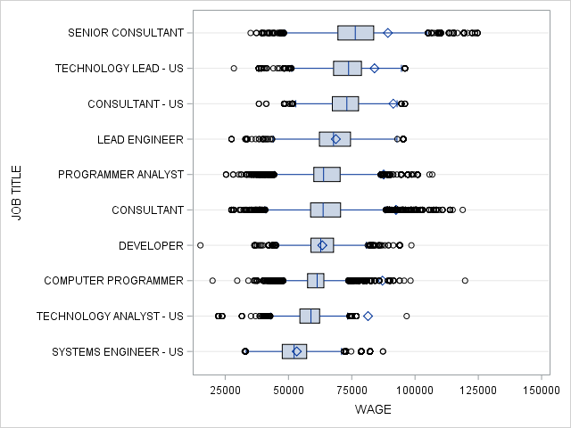
Wage distribution for top ten jobs

Slide 8
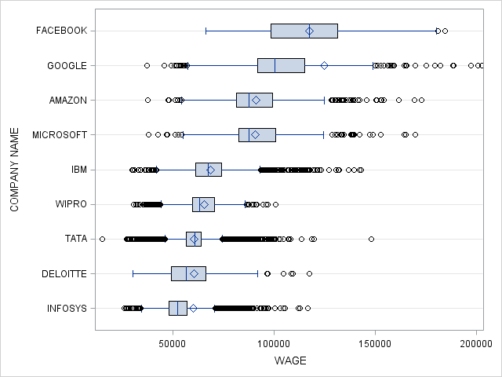
Compare the wage with top software companies

Slide 9
Location-Based Analysis

Slide 10
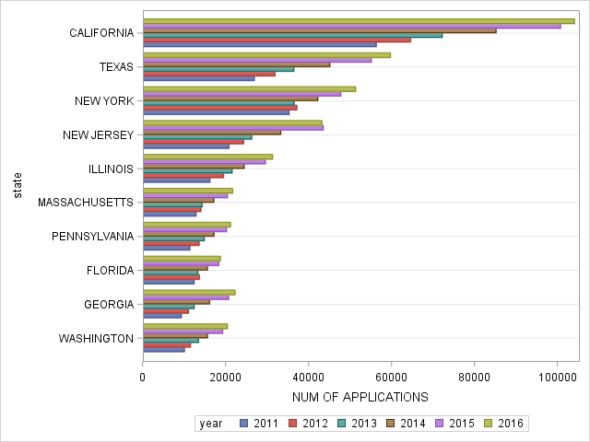
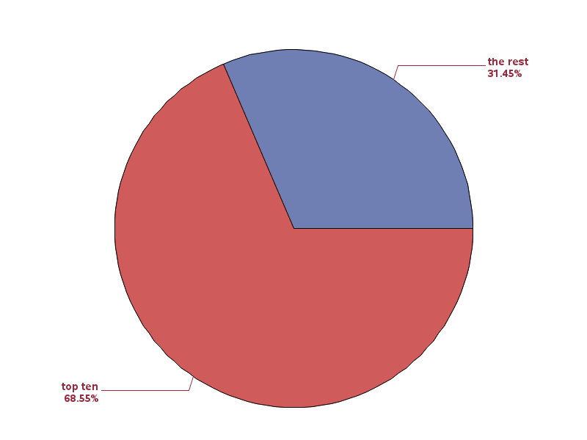
Top 10 States with highest number of applications

Slide 11
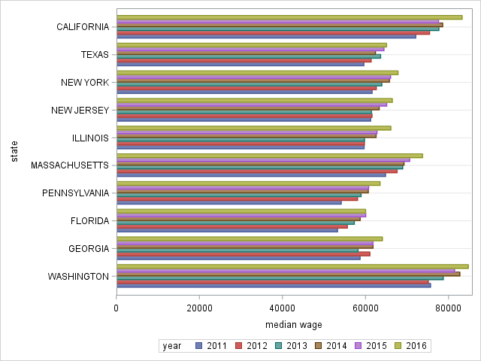
Median Wage by Year for the top ten states

Slide 12
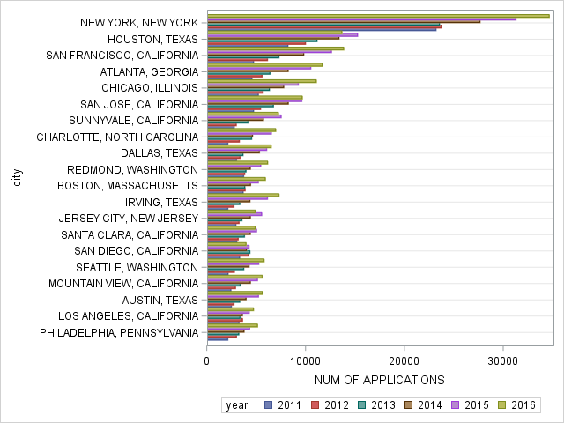
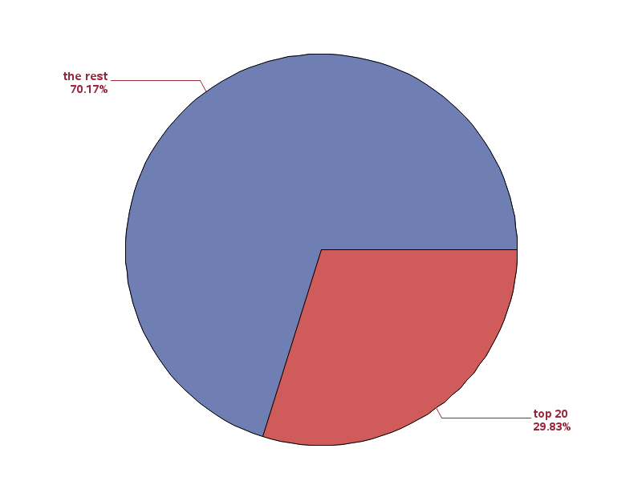
Top 20 cities with highest number of applications

Slide 13
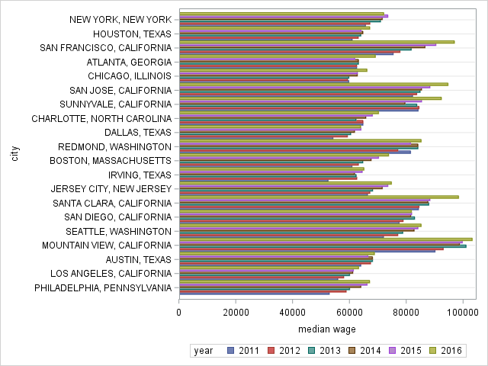
Compare Median Wage among top ten cities

Slide 14
Data Science related Analysis

Slide 15
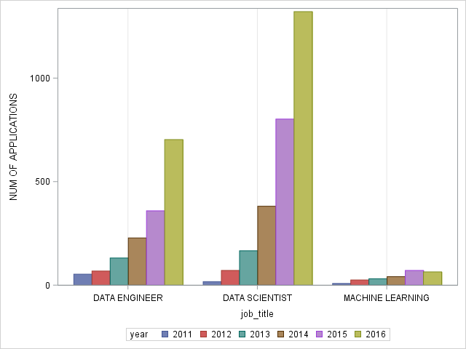
Number of Applications by year for DS jobs

Slide 16
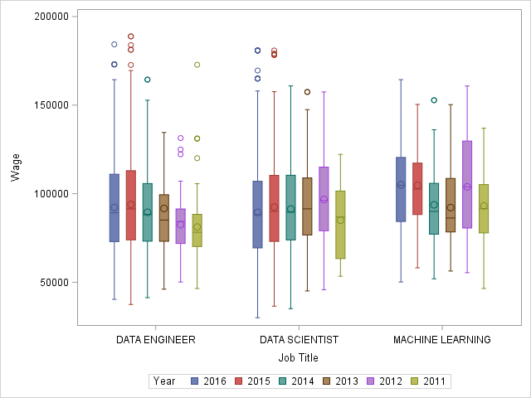
Wage Distribution By Year for DS related positions

Slide 17
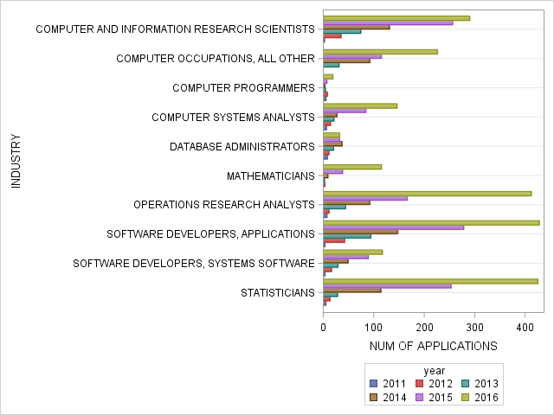
Top ten industries for DS positions

Slide 18
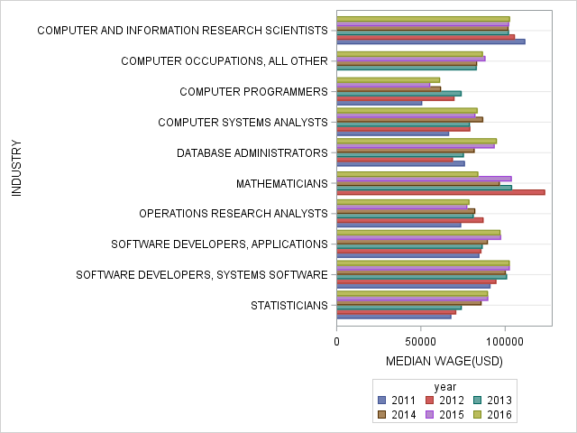
Median wage for DS position in top ten industries

Slide 19
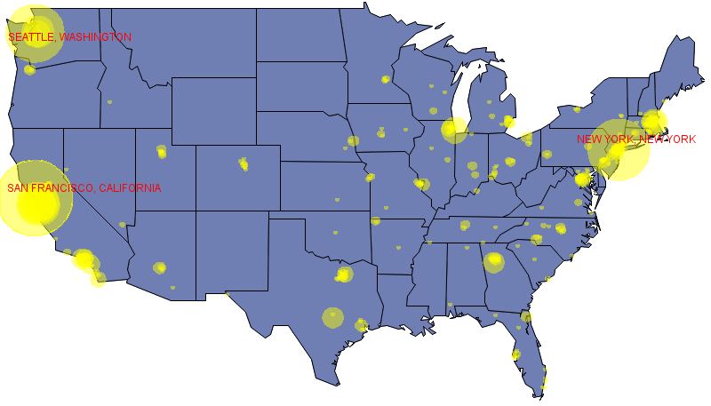
Number of Apps for DS positions by location

Slide 20
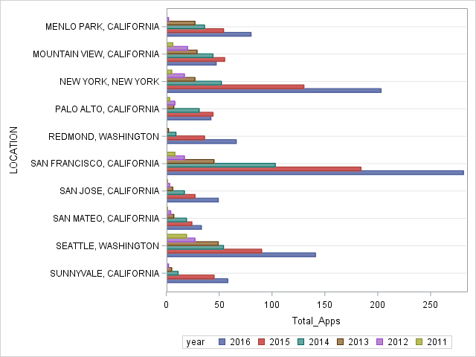
Number of Apps by year for Top Ten DS location

Slide 21
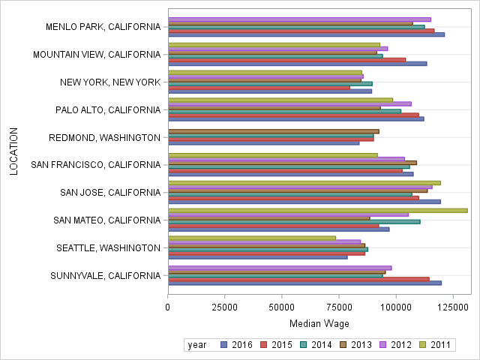
Median Wage by Year at Top ten DS location

Slide 22
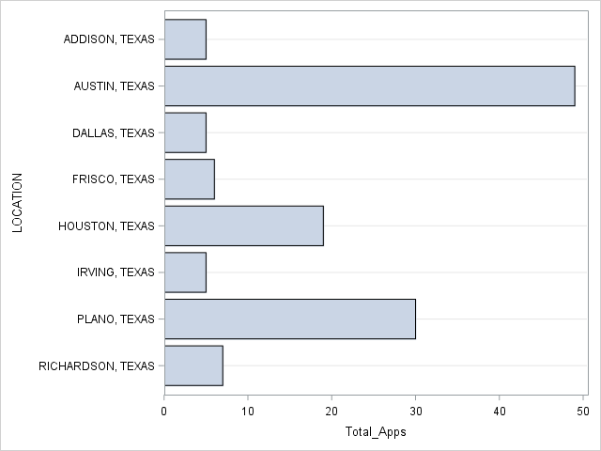
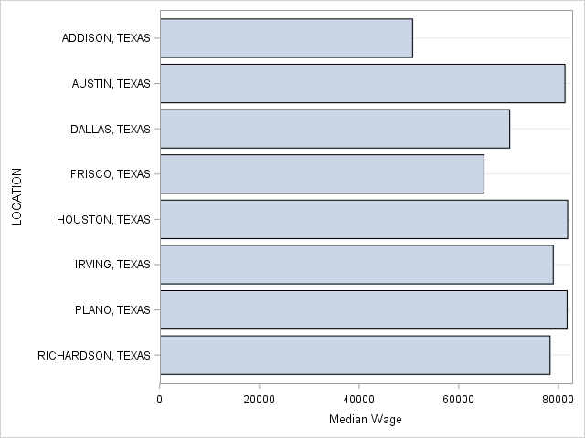
WAGE AND NUM APPS IN TX FOR DS POSITIONS

Slide 23
Takeaways for future data scientists who need h-1b
You will have better chance to get hired for a high-wage job with h-1b sponsorship if you start working on your computer science related knowledge and skills.
Seattle, Silicon Valley and New York City might be where you will end up working
If you want to stay in Texas, Austin and Dallas will be your best bet.

Slide 24
Thank You

