Slide 1
Probability
Yoobee Colleges

Slide 2
Simple Probability -RECAP

Slide 3
Addition rule and Union vs. Intersection
The probability that one event happens or another event happens.
What's the probability that I get at least one 1, or an even sum when we add the dice faces together?
“At least” probability
What is the probability that we get at least one heads when we flip a coin two times?
All possible outcomes of flipping a coin two times
{head, head}, {head, tail}, {tail, head}, {tail, tail}
Looking for the probability that we get at least one head.

Slide 4
Addition rule and Union vs. Intersection
{head, head}, {head, tail}, {tail, head}, {tail, tail}

Slide 5

Addition rule and Union vs. Intersection
Addition rule:
$P\left(A or B\right)=P\left(A\right)+P\left(B\right)−P(A and B)$
$P\left(A∪B\right)=P\left(A\right)+P\left(B\right)−P(A∩B)$
Mutually exclusive / Disjoint events:
$P\left(A or B\right)=P\left(A\right)+P\left(B\right)$

Slide 6
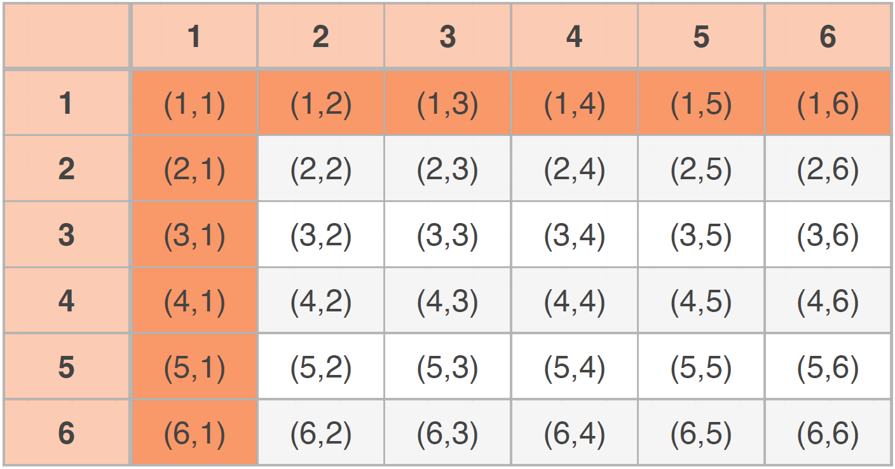
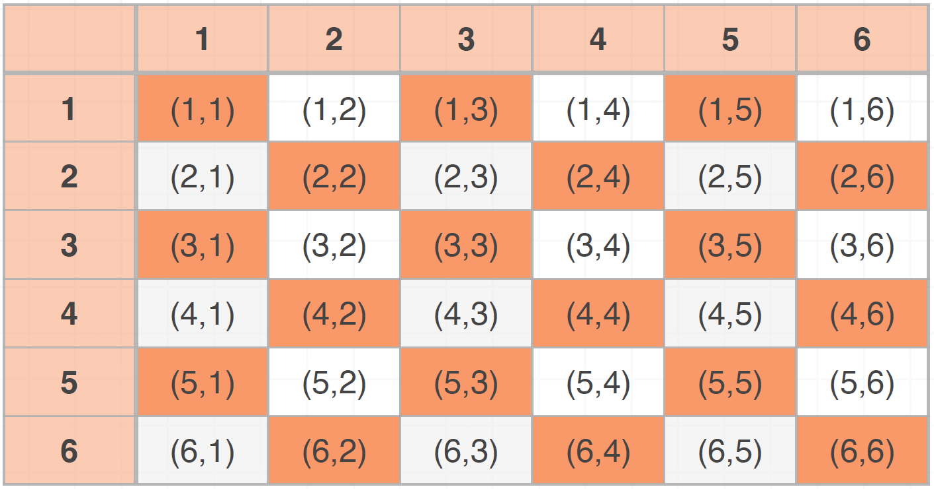
Addition rule and Union vs. Intersection
What’s the probability that we roll a pair of 6-sided dice and either get at least one 1, or an even sum when we add the dice together?
Notes:
To make it more understandable, let’s have a look at another example of rolling the dice.
Here is the question: what’s the probability that we roll a pair of 6-sided dice and either get at least one 1, or an even sum when we add the dice together?
So in this example, we are looking for the probability of at least one of two events happening.
One of the events is get at least one 1 and the other event is getting an even sum when we add the dice together
First, let’s see how many possible outcomes we have in this example (click)
From this table, we can see that there are 36 possible outcomes, and how many outcomes contain at least one 1?
The outcomes with orange background are the ones with at least one 1, so there are 11 of them. So the probability of event 1 P(e1) = 11 / 36
Now let’s move to the second event (click)
So, from the second table, we can see the ones with orange background are the outcomes that satisfy the second event criteria which means the sum of each outcome is even.
So, there are 18 of them satisfy that criteria. The probability of event 2 is P(e2)=18/36=1/2
If we stop here and we just add the probability of event 1 and event 2, which is 11/36 + 18/36 = 29/36, we know that this is wrong because we have learned that there will be overlappings.
（click）We know that a great way to illustrate this kind of overlapping probability is with a Venn Diagram. So, let’s build a Venn diagram to show that. (自己算自己画吧)
Then, from the Venn diagram, we can correct our previous calculation by subtracting the overlapping values (自己写自己讲吧)

Slide 7
BREAK

Slide 8
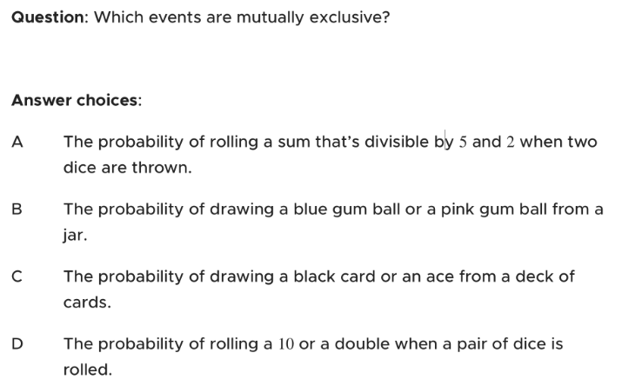
Exercise
Notes:
B

Slide 9
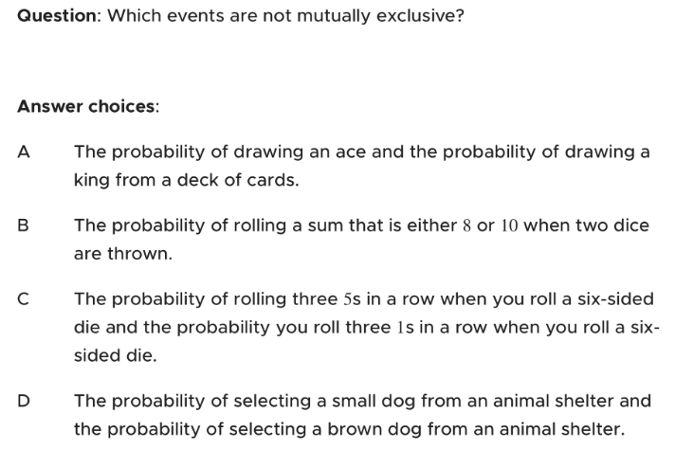
Exercise
Notes:
D

Slide 10
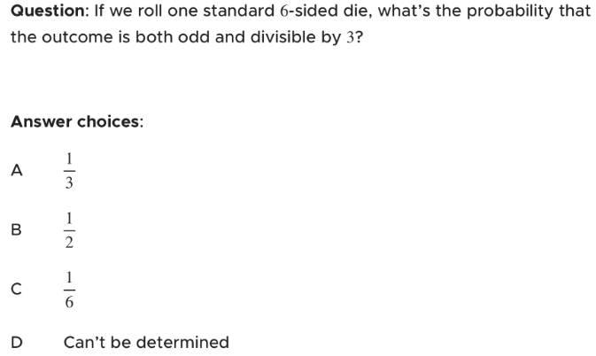
Exercise
Notes:
C

Slide 11
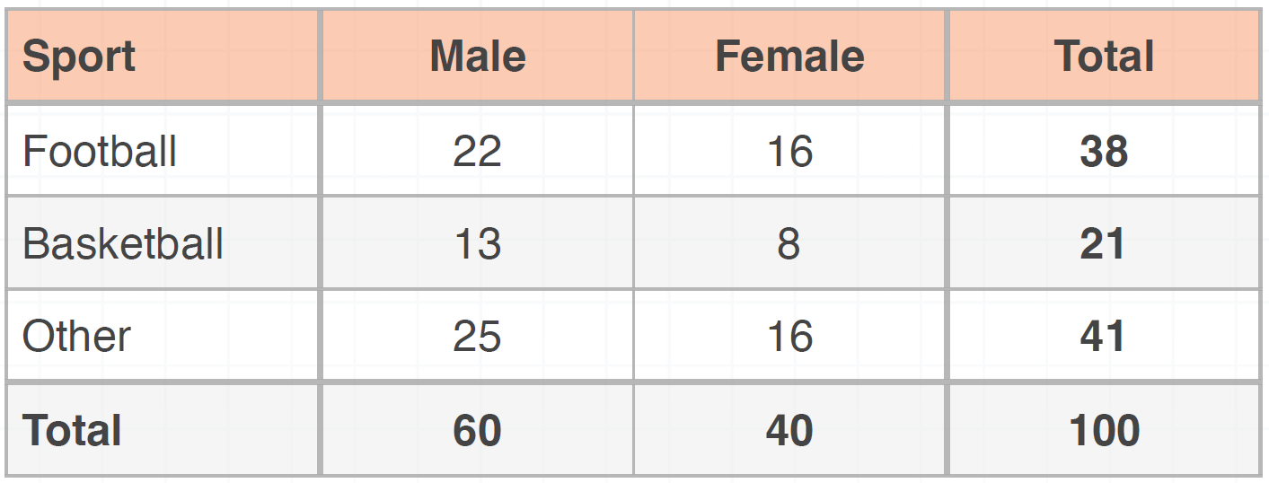
Exercise: Addition rule and Union vs. Intersection
Q1: What is the probability that a participant is male?
Q2: What is the probability that a participant’s favorite sport is football?
Q3: What is the probability that a participant is female or prefers a sport other than football or basketball?

Slide 12
Q/A?

