Slide 1

Solar Power Generation
Group 25: Iris Chen, Franklin Li, Syed Nawshad
Dec 18, 2018

Slide 2
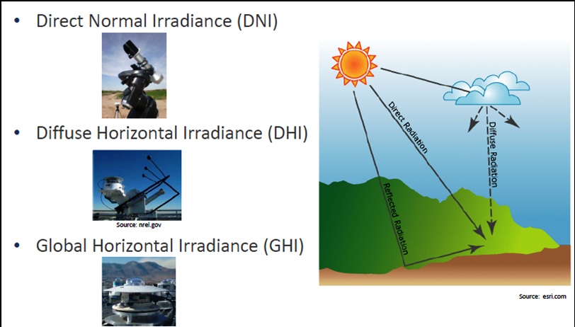
Solar Power Generation
Predict how well an area is suited for solar power generation.
Weather attributes are tested for correlations.
Global Horizontal Irradiance (GHI)
Solar zenith angle
Precipitable water
Relative Humidity
Multi-linear regression models were used to predict how well the weather at the time of day affects the solar irradiance

Slide 3
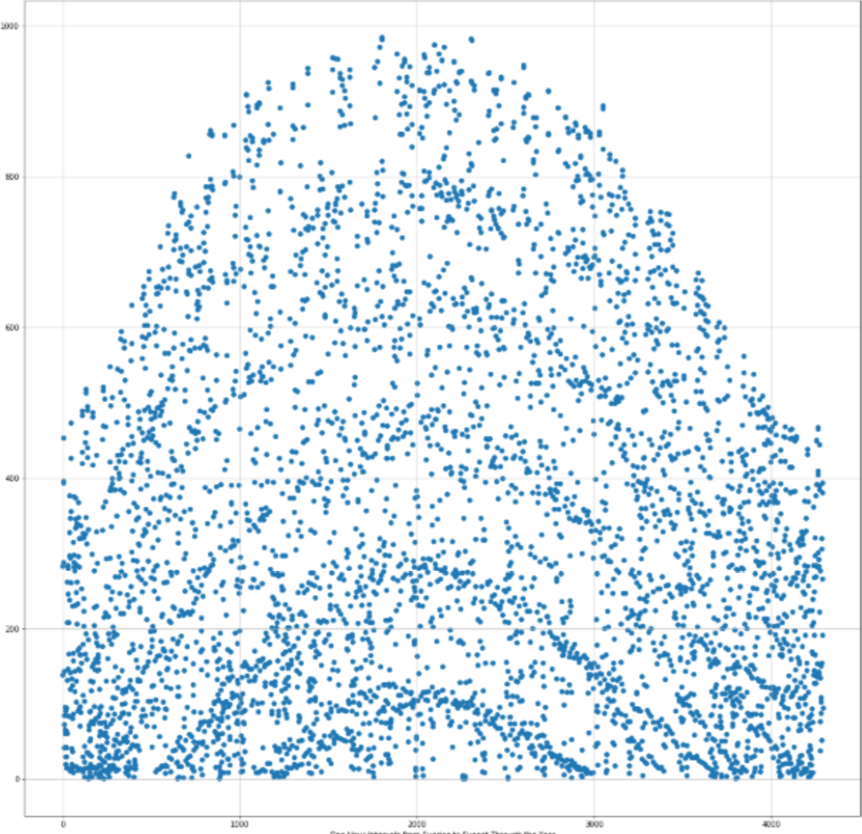
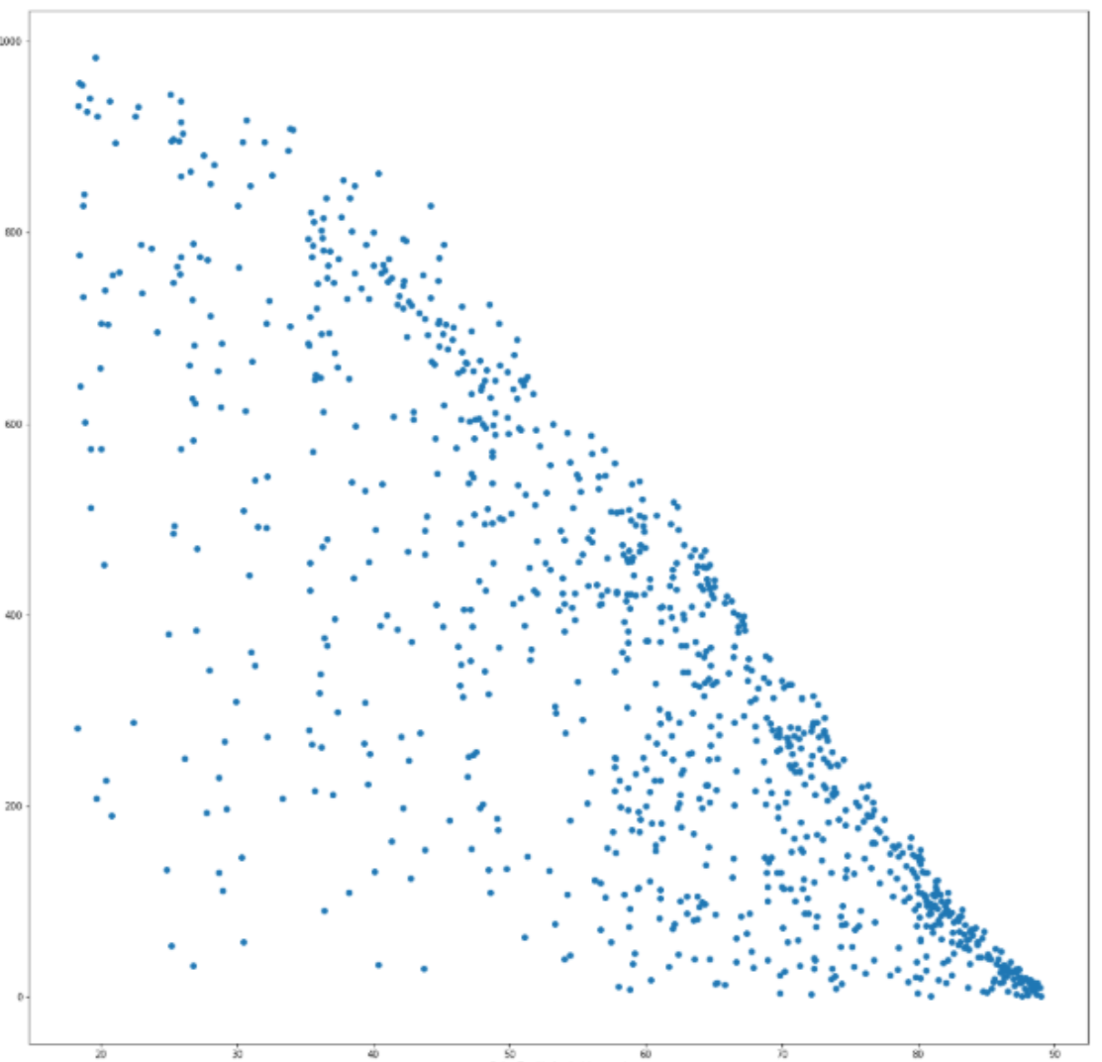
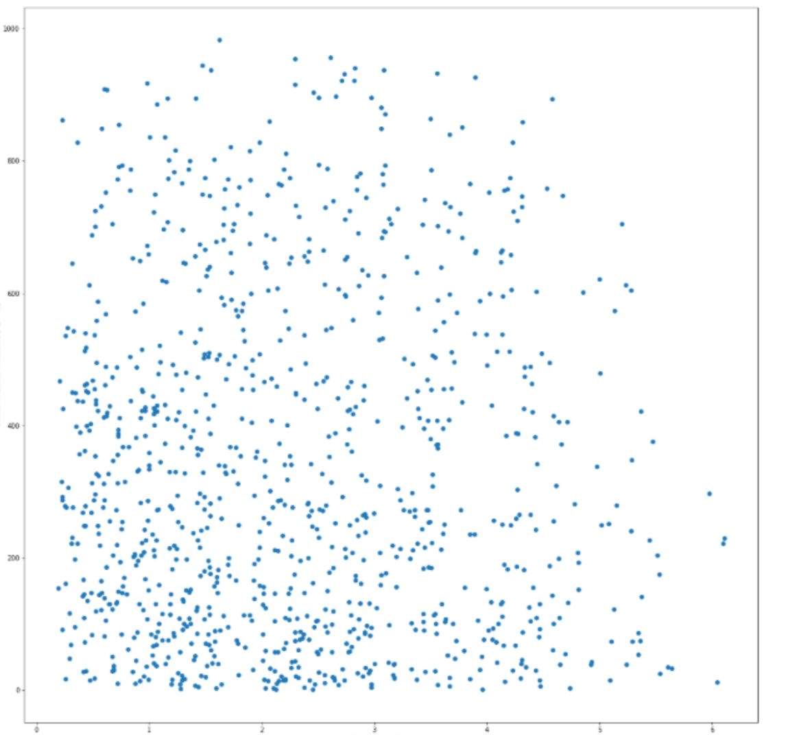
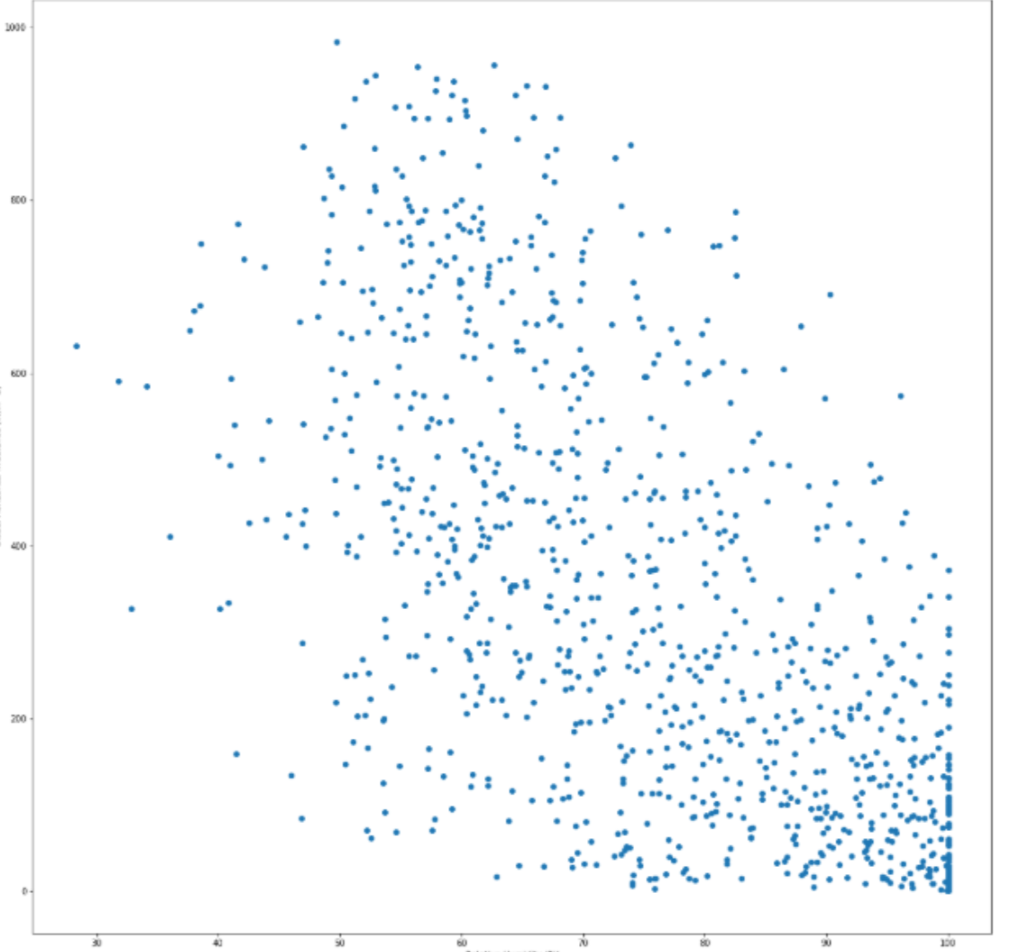
Correlations
GHI vs. One-hour interval from sunrise to sunset
GHI vs. Solar Zenith Angle
GHI vs. Precipitable Water
GHI vs. Relative Humidly

Slide 4
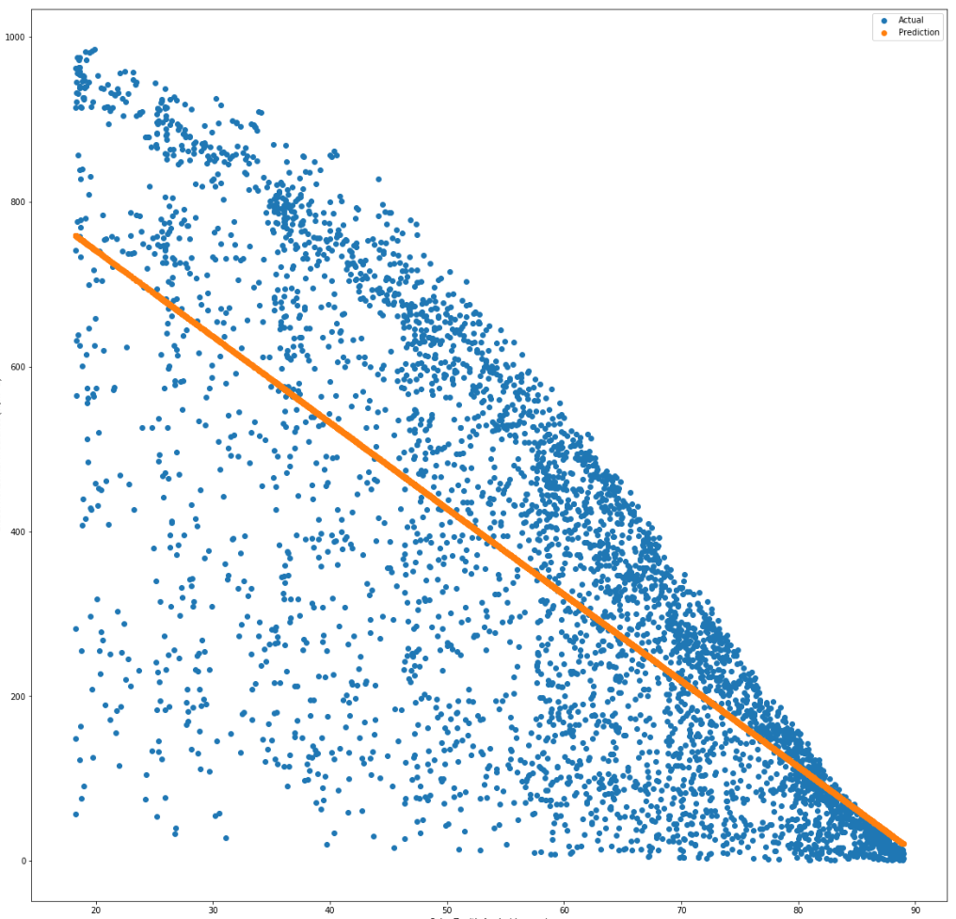
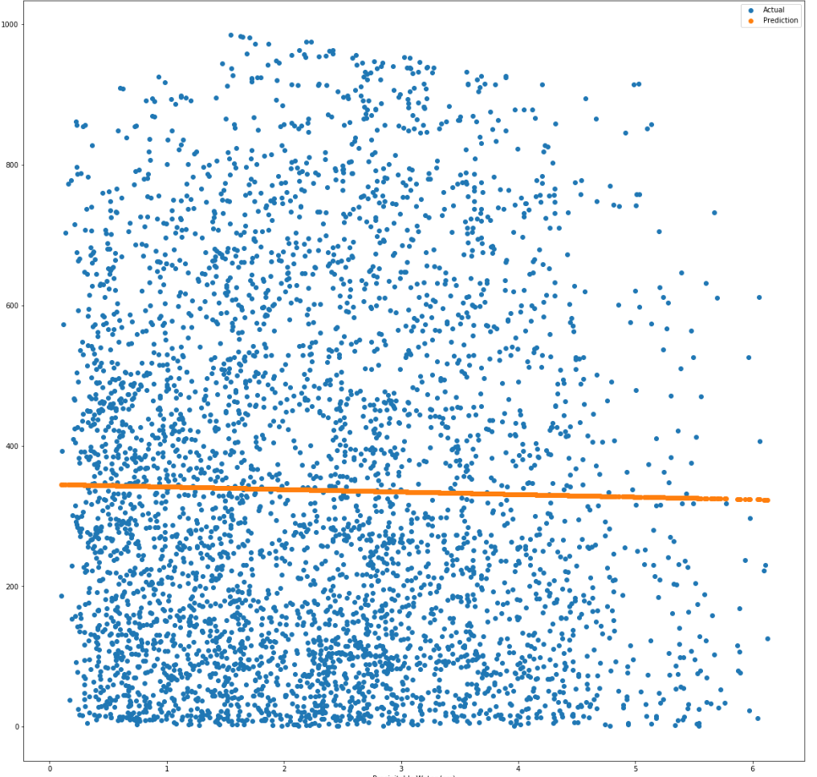
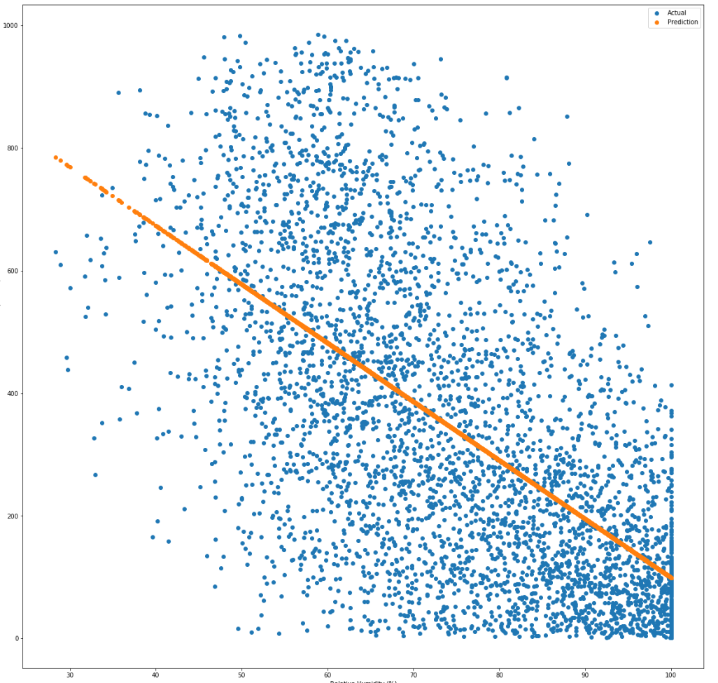
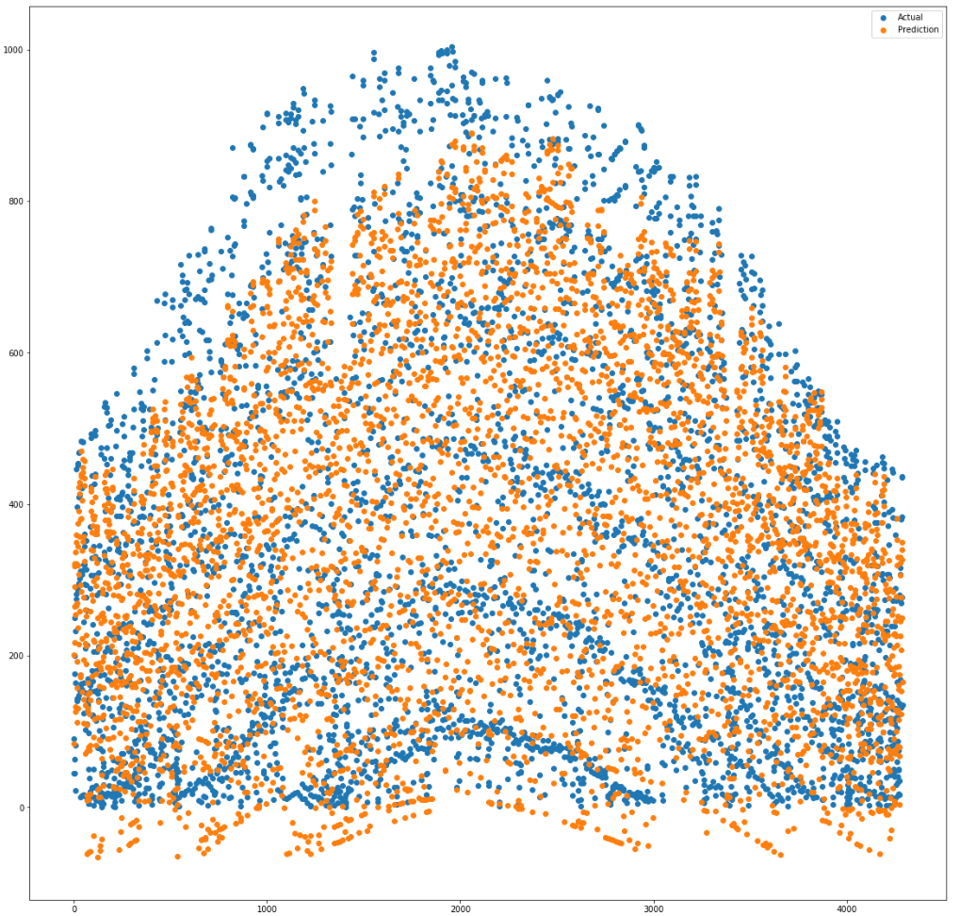
Training data (2017)
GHI vs. Solar Zenith Angle
GHI vs. Precipitable Water
GHI vs. Relative Humidly
GHI vs. One-hour interval from sunrise to sunset

Slide 5
Test data (2016)
GHI vs. One-hour interval from sunrise to sunset

Slide 6

Conclusion
Linear Model:
Y = 1279.971 – 8.396x1 – 5.991x2
Applying this linear model to the 2016 test data set gave us a near 75% R^2 value for Global Horizontal Irradiance.

