Slide 1

XC GRADIENT
Building the Machine
XC Gradient Company Operating System — April 7, 2026
Oriol · Arnau · Adam
Notes:
Good morning. Today's meeting has one job: by the time we leave this room, we have a system. A real operating system for this company. Not slides that sit in a Drive folder — an actual running infrastructure that we use starting today. Give me 30 minutes.

Slide 2
Agenda
01
Notion OS
02
OKRs & Phase Model
03
Daily Logging System
04
Discord
05
Google Drive
06
Meeting Transcription
Duration: ~30 min
Notes:
Six topics. Some will take 5 minutes, some 10. I'll tell you upfront: by the end of this, I need each of you to fill in your Q2 personal KRs live in Notion. That's the deliverable of this meeting.

Slide 3
01
Our Company Brain
Notion as the single source of truth
Notes:
Notion is not a note-taking app. It's the company. If it's not in Notion, it didn't happen.

Slide 4
Why Notion — the philosophy
Document decisions, not activity
If it takes more than 2 minutes to log, it won't get logged. We only write what a future cofounder or investor would need to know.
Passive awareness
Drive
Notion is open all day. In 30 seconds you know where each person is, what's blocked, and what's at risk this week. Without sending a message.
binary files only
Discord
Oriol owns the structure
working memory
ephemeral
Arnau and Adam never touch Notion architecture. Oriol extracts, writes, and distributes. Your cognitive resources go entirely to building and selling.
Notion
long-term memory
single source of truth
Notes:
The rule is simple: Discord is what we're thinking about right now. Notion is what we decided. Drive is for files too big for Notion. That's the whole system.

Slide 5
The six sections
Home
Goals & OKRs
Daily Logs
Your daily landing page
Full goal cascade
Oriol / Arnau / Adam
Weekly Syncs
Company Brain
Archive
Meeting outputs + AI summaries
Strategy, decisions, pipeline
Anything older than 2 quarters
One rule: if it's not in one of these six, it doesn't exist.
Notes:
This is the entire company knowledge base. Six sections. I'll show you each one. The most important one is Company Brain — specifically the Decision Log. That's the one we'll be most disciplined about.

Slide 6
The Home page
Phase Banner
Current phase + north star metric. Updated manually at phase gates.
Phase Banner
Big 3 This Week
Three numbers that tell us if the company is alive and growing.
Metric
Metric
Metric
Streak Tracker
Daily log streak per person. Resets to zero if you miss a day.
Streak Tracker
Company Calendar
Oriol
Arnau
Adam
0
0
0
2-week rolling view. Only company-wide events.
Quick Links
Company Calendar
Sprint card, Decision Log, PoC Pipeline, latest sync.
Quick Links
Notes:
This is what you see when you open your laptop. Before you open anything else — terminal, IDE, whatever — Notion is open. The Home page tells you in 30 seconds if anything needs your attention.

Slide 7
Four tools. One job each.
Notion
Discord
Company OS — all structured knowledge
Real-time async comms + voice
If it's a decision, goal, log, or summary → Notion
Working memory. Ephemeral. Decisions migrate to Notion.
Drive
WhatsApp
Binary blobs only
Personal / emergency only
PPTs, contracts, invoices, CSV exports, large files
Urgent pings that cannot wait for Discord
❌ Slack: not used. Redundant with Discord at 3 people. Revisit at first hire.
Notes:
Slack is a deliberate no. We don't need three messaging systems. When we hire the first employee, we can revisit — they may expect Slack for HR tools. That's a 2027 problem.

Slide 8
02
Where We're Going
Phase model, growth math, and our 2026 OKR cascade
Notes:
This is the strategic layer. I want you to understand not just what the goals are, but why they're structured this way.

Slide 9
Two different questions
KPI
OKR
Is the business healthy right now?
Where are we trying to go this quarter?
Permanent dials on your dashboard. Never disappear. Measured every week forever.
Temporary targets with an expiry date. Die at end of quarter. Hit or missed, then replaced.
ARR
Pipeline count
Burn rate
A score
Runway
Objective: Prove product-market fit in industrial SMEs
KR1: 2 paying PoCs by Jun 30
KR2: A score > 0.80 on Decfa corpus
KR3: 5 qualified pipeline conversations
READ WEEKLY
REVIEWED QUARTERLY
The relationship: OKR defines the destination. KPI tells you if you're moving toward it.
Notes:
You can have great KPIs and be building the wrong thing. OKRs answer 'what matters most right now?' — and that answer changes every 13 weeks.

Slide 10
The ARR equation
Annual target
ARR × 3
5–7%
10%
Quarterly target
ARR × 1.75 per quarter
WoW growth = good
WoW growth = magic
Weekly target
ARR × 1.06 per week
= +6% week over week
Two levers only: N_clients (new logos) and ACV (upsell existing). Every week the question is one of these two — never both.
Notes:
At 10% week-over-week, you 5× in a year. At 5%, you 12× in a year. The math is violent once you have any base at all. Right now we have no base. That changes after today.

Slide 11
Phase 0 — Ignition (Today)
Phase 0 · Ignition
Phase 1 · PoC Execution
Phase 2 · Pipeline
Phase 3 · Launch
TODAY
Apr 7 → Jul 1
Jul → Sep
Oct → Dec
Phase 0 — Ignition
Apr 3 – Apr 7, 2026
Is the team operationally ready to execute?
North Star:
Demo readiness + OS installed — binary by April 7
Phase gate:
This meeting. Exit criteria: all 3 cofounders in Notion with Q2 KRs authored.
Your USP:
Fully on-prem RAG — zero cloud dependency, NIS2-native
⚡ This afternoon: Paver visit. Three possible outcomes → all are fine. Any result gets logged.
Notes:
Phase 0 is the only phase that's about us, not the market. The question is: are we operationally ready? By end of this meeting, yes.

Slide 12
Phase 1 — PoC Execution
Phase 0 · Ignition
Phase 1 · PoC Execution
Phase 2 · Pipeline
Phase 3 · Launch
TODAY
Apr 7 → Jul 1
Jul → Sep
Oct → Dec
Phase 1 — PoC Execution
Apr 7 → Jul 1, 2026
Can we produce a result a client would pay for?
Gate: July 1 — Thesis defense. 2 PoCs with hard numbers → pivot from builder to seller.
North Star: # of PoCs with documented, measurable outcome
#1 PoC count with A score logged
0 / 2
#2 Pipeline conversations / week
0
#3 A score on Decfa corpus
0.00
Target: 5–7% WoW growth on pipeline conversations. A > 0.80 on Decfa.
Notes:
The thesis defense date is not just academic. July 1 is the day we stop being primarily builders and become primarily sellers. The thesis is our credibility asset — a defended academic RAG paper plus two PoCs with numbers is our pitch deck.

Slide 13
The back half of 2026
Phase 2 — Pipeline Building
Phase 3 — Constitution + Launch
Jul 1 → Sep/Oct
Oct → Dec (Q4)
North Star: # of LOIs / verbal Pioneer commitments (€199/mo)
North Star: ARR (€/month, WoW %)
#1 LOI count (target: 10)
#2 Demos given per week (5–7% WoW)
#3 Demo → LOI conversion (track only, no target yet)
Launch state: 10 × €199 = €1,990 MRR on day 1 of legal existence
#1 ARR (5–7% WoW target)
#2 Active users per PoC
#3 Expansion pipeline
Gate: 10 verbal Pioneers before constitution
Gate: End Q4 with first upsell conversation opened
Charging before you can charge. A founder who said yes twice is far more likely to convert than a cold lead.
Yearly goal: Constitute XC Gradient with 10 paying Pioneer clients by Q4 2026
Notes:
Phase 2 is the most underestimated phase. You'll have a working product, a thesis, and two PoCs. You'll feel like the hard part is done. It is not. The hard part is the next 18 months of selling.

Slide 14
Every task traces up to this
YEARLY GOAL
Constitute XC Gradient with 10 paying Pioneers by Q4 2026
Q2 2026 (CURRENT — Apr–Jun)
Arnau and Adam's KRs are blank. We fill them together in the next 15 minutes.
Company: 2 PoCs A>0.80 · 5 qualified leads · Thesis Jul 1
ORIOL
KR1: Notion OS live Apr 7
KR2: 5 pipeline conversations
KR3: Thesis defended Jul 1
ARNAU
KR1: __________
KR2: __________
KR3: __________
ADAM
KR1: __________
KR2: __________
KR3: __________
Q3 2026 (stub)
Build 10 Pioneer LOIs
Q4 2026 (stub)
Launch constituted company
Notes:
The rule on KRs: you define your own. I will never assign KRs to you. Owned KRs get hit. Assigned KRs get ignored. So let's open Notion right now. [PAUSE — open Notion live, navigate to Goals & OKRs, build Arnau and Adam's KRs together]

Slide 15
03
How We Work Every Day
The daily log, sprint cards, and streak system
Notes:
This is the section most people skip and then regret. The logging system is not bureaucracy. It's the mechanism by which I never have to ask you what you're working on.

Slide 16
5 minutes. Every day. No exceptions.
Fill before closing Notion
2026-04-07 · Oriol
If you worked today, you log today. Missing a day resets your streak to zero.
Sprint: W15
DONE TODAY
TOMORROW max 3 items
· Pain point map finalized
· Paver visit — outcome: qualified lead
· Logged 2 decisions
Forces prioritization. If you have 10 things tomorrow, you do not have a plan — you have a list.
TOMORROW
BLOCKERS must be visible
· W15 sprint card with Arnau + Adam
· Decfa demo prep check
If something is blocking you, the other two need to see it. That's the whole point of the system.
BLOCKERS
· Need Arnau: Decfa corpus loaded by Thu?
GOAL PROGRESS
· Notion OS 80% → 100% ✓
Notes:
This is what I wrote last night. It took 4 minutes. Arnau, you can see without messaging me that the Paver visit happened, what came out of it, and that I need an answer from you by Thursday. That's the whole value of the system.

Slide 17
The accountability layer
W15 — Apr 7–13 · Arnau
Daily log streaks
Goal
%
Status
● Not started
Oriol
🔥
0 days
Best: 0
RAG running on Decfa
0%
Arnau
🔥
0 days
Best: 0
Network topology
100%
✓ Done
Adam
🔥
0 days
Best: 0
Latency benchmark < 3s
0%
● Not started
Warning appears at 7pm if no log submitted today. Missing a day → streak resets to zero. Weekends count if submitted.
Week outcome (filled Friday EOD): _______
Gamification rule: we compete on discipline, not output quality. No ranking by performance. Perverse incentives by design avoided.
Notes:
The streak is the only competitive element. We don't rank each other by how much we shipped. That would create terrible incentives. We rank by whether we showed up and logged. That's all.

Slide 18
Define nearer things more completely
Top-down cascading — you can only define a smaller goal correctly once you know the bigger goal it serves
Cadence
Duration
Who
Purpose
◷
Daily EOD log
5 min
Solo
Log done / tomorrow / blockers
◷
Weekly sync
60 min
All 3
Present week, align sprint cards
◷
Monthly close
90 min
All 3
Review month, define next month
◷
Quarterly OKR
Half day
All 3
Review Q, define next Q + 3 months
◷
Annual planning
Full day
All 3
Yearly goal, stub all 4 quarters
Q3 and Q4 are always stubs. Detailing Q4 in April is wasted planning — the world will have changed by then.
Notes:
The most common planning mistake is trying to detail everything at once. We detail only what's next. Everything else is a direction stub that we fill when we get there.

Slide 19
04
Our Communication Layer
Discord is working memory. Notion is long-term memory.
Notes:
Discord is not for decisions. It's for conversations that lead to decisions. Once something resolves, it goes to Notion. That's the contract.

Slide 20
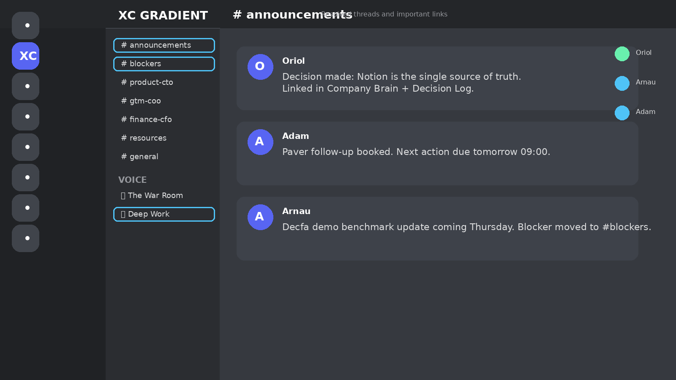
One channel, one job
XC GRADIENT
Every resolved Discord thread ends here + in Notion
# announcements
← decisions made, Notion links
# blockers
← blocking issues, 24h SLA
24h response SLA. If it's here, it's urgent.
# product-cto
← Arnau's domain
# gtm-coo
← Adam's domain
# finance-cfo
← Oriol's domain
# resources
← links to Notion + Drive
# general
← everything else
VOICE
🔊 The War Room
Silent co-working. Join to signal focus mode.
🎧 Deep Work
The key discipline: when a thread resolves into a decision → #announcements + Decision Log in Notion. Discord is ephemeral. Notion is permanent.
Notes:
Notice the channel names include the role. Product-CTO means Arnau owns that channel. GTM-COO means Adam owns it. Finance-CFO means I own it. Nobody posts in someone else's channel without a reason.

Slide 21
Drive: binary blobs only
What goes in Drive
PPT decks
Weekly sync presentations (3 per week, one per person)
Drive/
├── Weekly Syncs/
│ └── 2026-W15_2026-04-07/
│ ├── oriol_w15.pptx
│ ├── arnau_w15.pptx
│ ├── adam_w15.pptx
│ └── adam_notes_w15.txt
├── Contracts/
├── Finance/
└── Thesis/
Contracts & legal
NDAs, PoC agreements, future commercial contracts
Invoices & receipts
Financial paper trail for CFO close
Large exports
Dataset CSVs, model checkpoints, financial exports
What does NOT go in Drive
Meeting notes
Those go in Notion Weekly Syncs
Decisions
Those go in Notion Decision Log
Goal tracking
That's Notion Goals & OKRs
Notes:
If you're ever unsure whether something goes in Drive or Notion, ask: is this a file or is this knowledge? Files go in Drive. Knowledge goes in Notion.

Slide 22
06
Never Lose a Decision Again
The meeting archive pipeline + AI transcription system
Notes:
This is the section I'm most excited about. Right now our meeting outputs are three PPTs in a Drive folder and whatever Adam scribbles down. We're going to fix that.

Slide 23
From PPTs to permanent knowledge
3 PPTs
Adam's raw notes
Claude API
AI Processing
Structured Output
Notion
Executive summary
Full writeup
Action items
Decision log entries
5 bullets, decisions only
~400 words, structured, readable
Owner + deadline + linked goal
Pre-formatted for Notion paste
In 6 months: open any week, read a clean account of what was decided, who owned what, and what happened. Without wading through 3 PPTs.
Notes:
Adam still takes handwritten notes in the meeting — that's important. Raw notes have context that PPTs don't. The AI takes both and produces the clean version. Adam's original notes go in Drive. The AI output goes in Notion.

Slide 24
How it works — the full system
During the meeting
Adam takes handwritten notes on paper or a text file. No typing into Notion during the meeting — stay present.
Weekly Syncs / 2026-W15
After the meeting (same day)
AI Summary
Adam types up raw notes as plain text. No formatting. Upload to Drive folder with the 3 PPTs.
· Paver visit: qualified lead, demo scheduled Apr 14
· Arnau: RAG on Decfa targeted Apr 18
· Decision: skip Slack permanently
Oriol runs the pipeline
Action Items
Feed all 4 inputs (3 PPTs + notes) to Claude with the structured prompt. ~2 minutes to run.
☐ [Arnau] RAG demo on Decfa → Apr 18
☐ [Adam] Paver follow-up email → Apr 8
☐ [Oriol] Decision Log entries → today
Paste to Notion
Copy the 4 artifacts into the Weekly Sync Notion page. Link the Drive folder.
Decision Log links
→ On-prem as hard constraint (reconfirmed)
→ Slack permanently skipped
Drive: 2026-W15 folder
Future reference
Any sync is searchable, readable, and linked to the Decision Log forever.
Future upgrade: Whisper local transcription (runs on our RTX 3090s) for automatic voice-to-text from The War Room voice channel. Zero cloud, fully on-prem.
Notes:
The future version uses Whisper running locally on our GPUs to transcribe The War Room voice calls automatically. On-prem, zero data leaves the machine — consistent with our entire product philosophy. That's a Week 9 project, not today.

Slide 25
Before we leave this room
01
Fill your Q2 KRs in Notion — right now
Goals & OKRs → Q2 2026 → your name. 3 KRs. You define them.
02
Build your W15 sprint card
Sprint Goals → W15 → your 2–3 goals for this week with % and status.
03
Submit your first EOD log today
Daily Logs → your name → new page. Streak starts today.
The system is live when all three of us have a streak of 1. That happens today.
Notes:
Open Notion. I'll walk you through it. We're not leaving until the streaks say 1.

