Slide 1
Introduction to XPath
Lech Rzedzicki , Kode1100 Ltd
Stuart Moorhouse, DK

Slide 2
Traversing XML
XML can be traversed in 9 directions: self, child, parent, preceding-sibling, following-sibling, ancestor, descendant, preceding, following,
You can combine/chain commands filter commands
Example: <A><B><C/></B><D/><E/><F><G><H/></G><I/><J><K/><L><M/><N/></L><O/><P/><Q><R/><S/></Q></J><T/><U><V/></U></F><W/><X/><Y><Z/></Y></A>

Slide 3
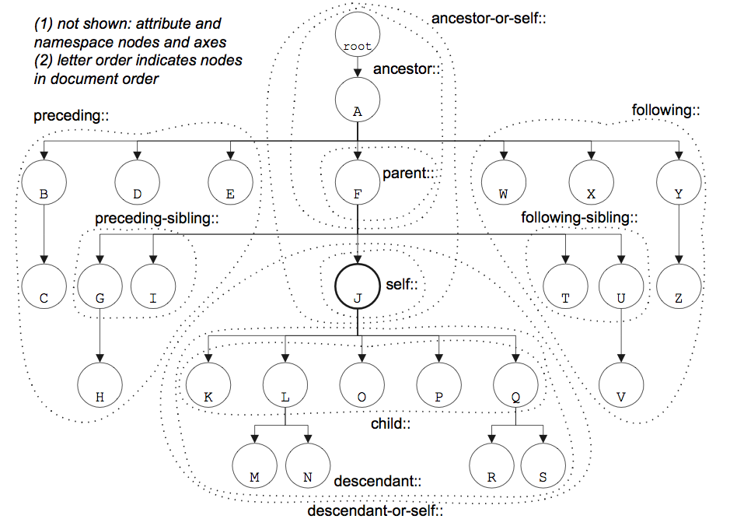
Example in Xpath

Slide 4
7 types of Nodes on the tree
Document
Namespaces
Elements
Attributes
Comments
Processing-instructions
Text

Slide 6
Namespaces
Namespaces are N°1 source of problems.
Remember about the default namespace.
Prefix is not a namespace: dita:book≠dita:book
Define the namespaces properly and then you can even use different prefix (but don’t).

Slide 7
Shortcuts
// any descendant
. Current node
* all/any elements
@* all attributes

Slide 8
Combine with RegExp
In OxygenXML Find/Replace window
In Xpath bar
//section[count(descendant::node())=0]/text() +regexp: .* would select the whole text of the lowest level sections in the document

Slide 9
Exercise: sample-dk.xml
//section[@metaref]
distinct-values(//@metaref/tokenize(.,'\s+'))
/book/part[1]/chapter[1]/section[1]/section[1]/section[1]/section[1]/section[2]/para[1]/address[2]/phrase[1]
//ancestor::node()[substring-after(@rend,'level_LH')='2']

