Slide 1
Detecting and Mitigating Biases in Language Models
Group:Yoda
Swapan Jain,
Lorraine Chen,
Rakshit Lodha

Slide 2
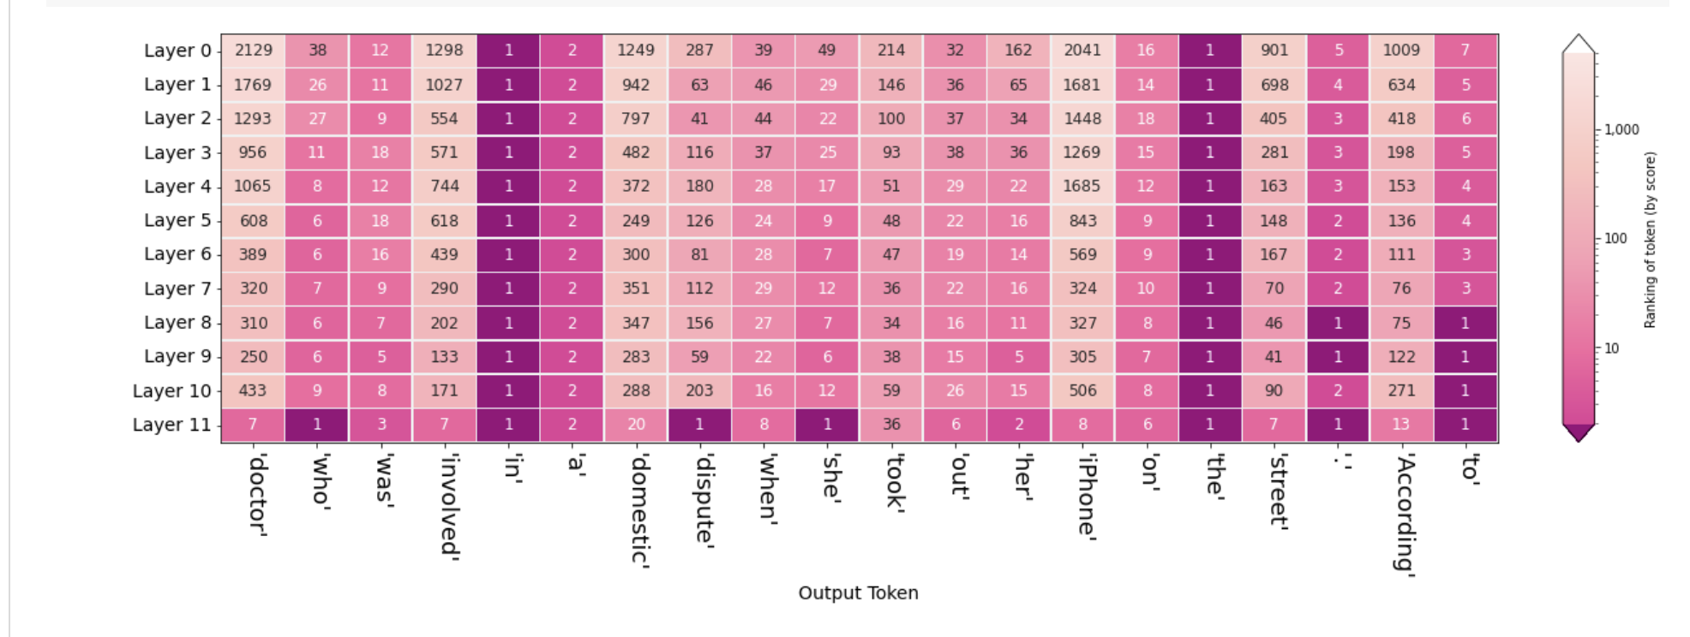
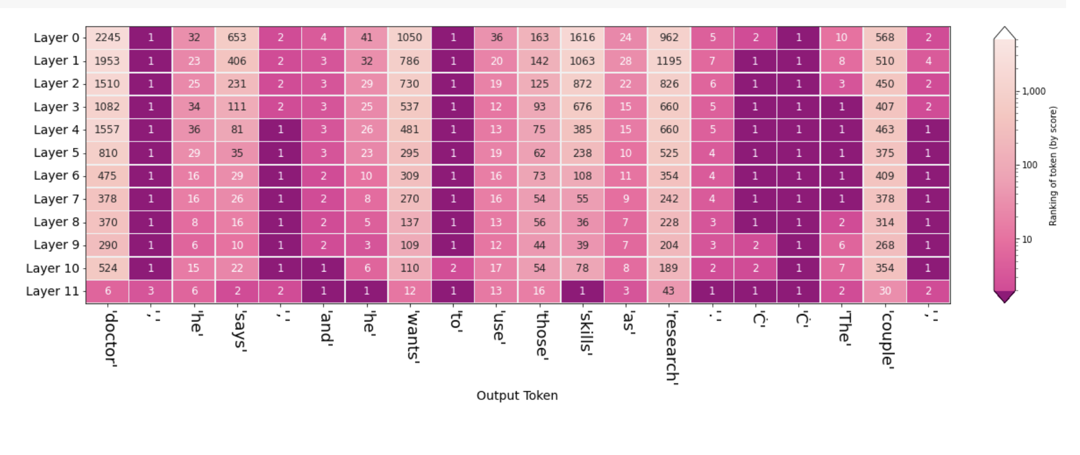
Bias Detection via Head Attention
https://discuss.huggingface.co/t/fine-tuning-bert-based-language-model-to-overcome-gender-bias/8009
In our prompts in text generation, we visualized the gender bias using Ecco.
INPUT:The man performing surgery is a
OUTPUT: doctor, he says, and he wants to
use those skills as research.
INPUT: The woman performing surgery is a
OUTPUT: doctor who was involved in domestic dispute when she took out her iPhone on the street
Notes:
From the visualization, we could see what the exact difference in attention score if we feed the language model with gender biased data.

Slide 3
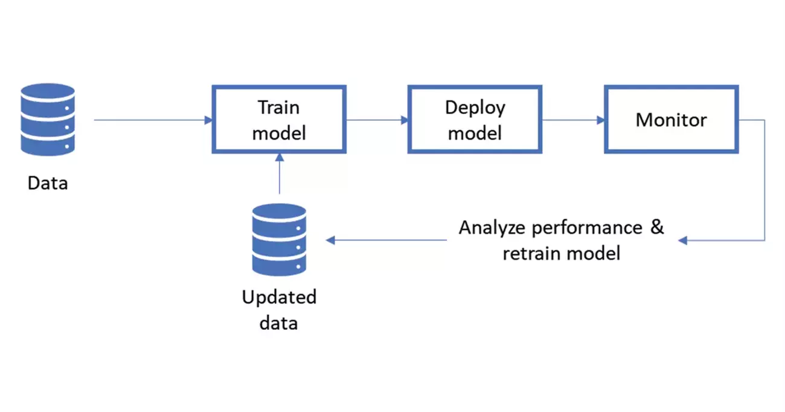
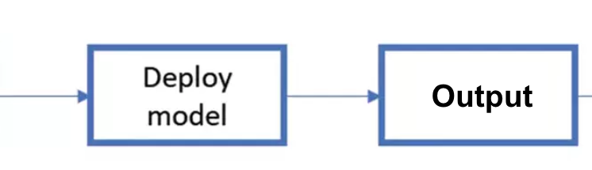
Bias Mitigation Method1: Retraining Scheme
Users’ dataset
IDEALLY:
“biased”
Pretrained
Model
Output1
Pretrained Data
“biased”
Output2
Our question: Would Output2 be more unbiased than Output1?
Retraining
Debiased
data
Challenge:
Debiased/fair dataset is
hard to collect on NLP task
Evaluate performance on fairness: Calculate Bias Metric

Slide 4
Method1: Retraining Scheme
Suppose we don’t know anything about the latent information (e.g. In binary classification, what is the distribution of gender, racial, region in a specific class)
IN PRACTICE:
Pretrained
Model
(Atten. Head) Visualization
Pretrained Data
Fine-tuning according to the attention head visualization
? biased/unbiased
Retraining
data
Feedback loop! - to solve the lack of unbiased dataset.

Slide 5
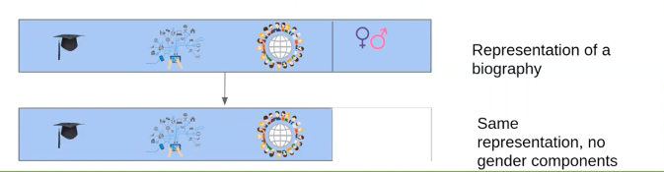
Method2: Iterative Null-space Projection
Bias in our world translates to bias in our representations.
Neural Models use these representations for predictions.
We want to control the contents of the representations.
We need to identify the components responsible for the encoding concepts such as gender, and race.

Slide 6
Iterative Null-space Projection
It is a novel method proposed in 2020.
It is used to remove information from representations or embeddings.
It is data driven and based on Linear Algebra
It has formal Mathematical guarantees
It works on Pre trained representations.
It can also be applied to Deep Learning Systems.

Slide 7
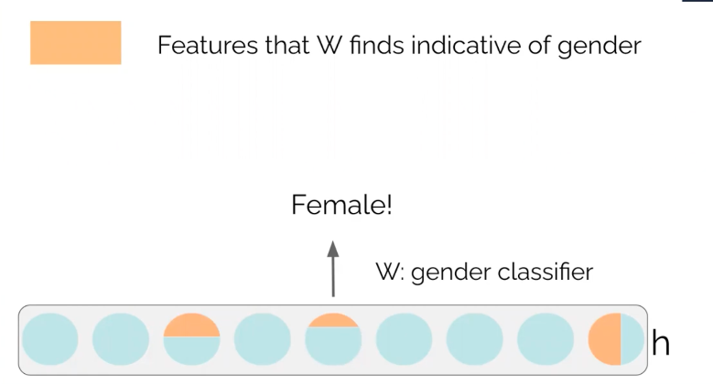
Iterative Null Space projection

Slide 8
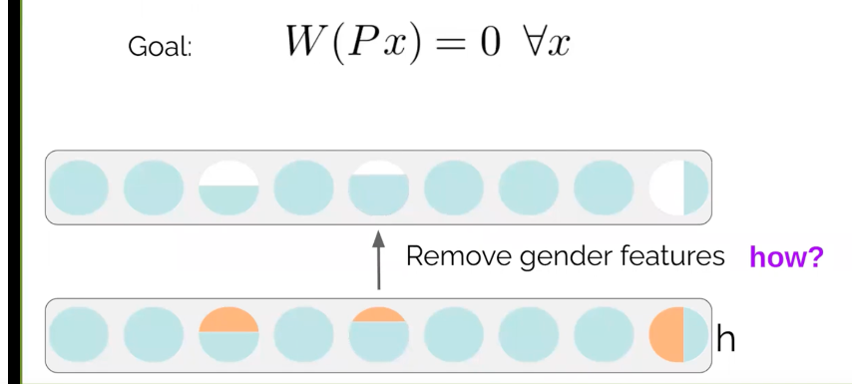
Iterative Null-space Projection
Here x is the input,
W is the classifier
P is the projection Matrix

Slide 9
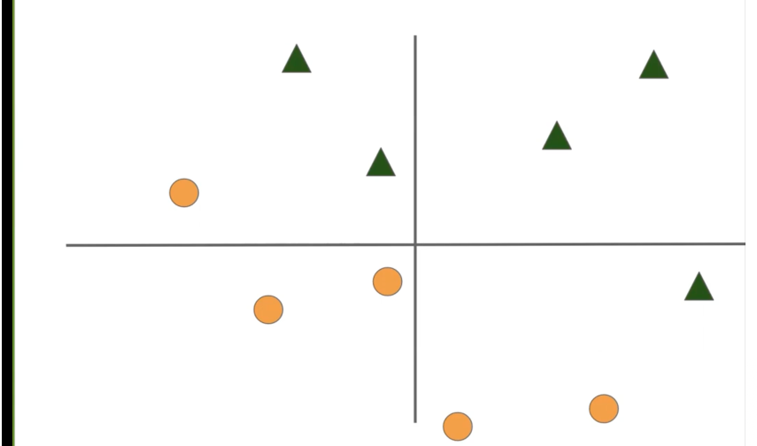
Iterative Null space Projection
We can draw a straight line separating the 2 kinds of points.
The straight line is a classifier and can be considered a subspace separating the circles and triangles.

Slide 10
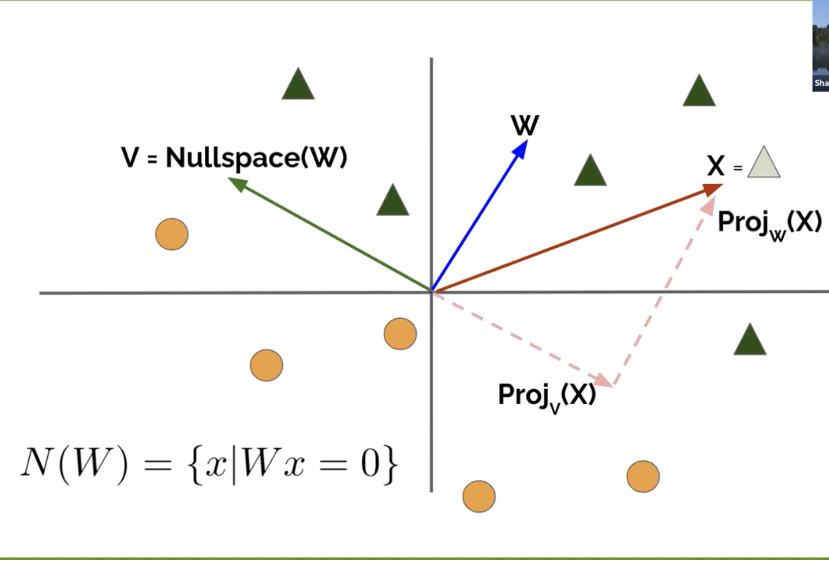
Iterative Null space Projection
Notes:
W is a vector that parametrizes the subspace.
V is a nullspace of W which means that it contains all the vectors such that W.x=0
Proj_w(x)- Encode information in the direction of W
Proj_v(x)- Encode information in the direction of V( separating plane or the classifier)

Slide 11
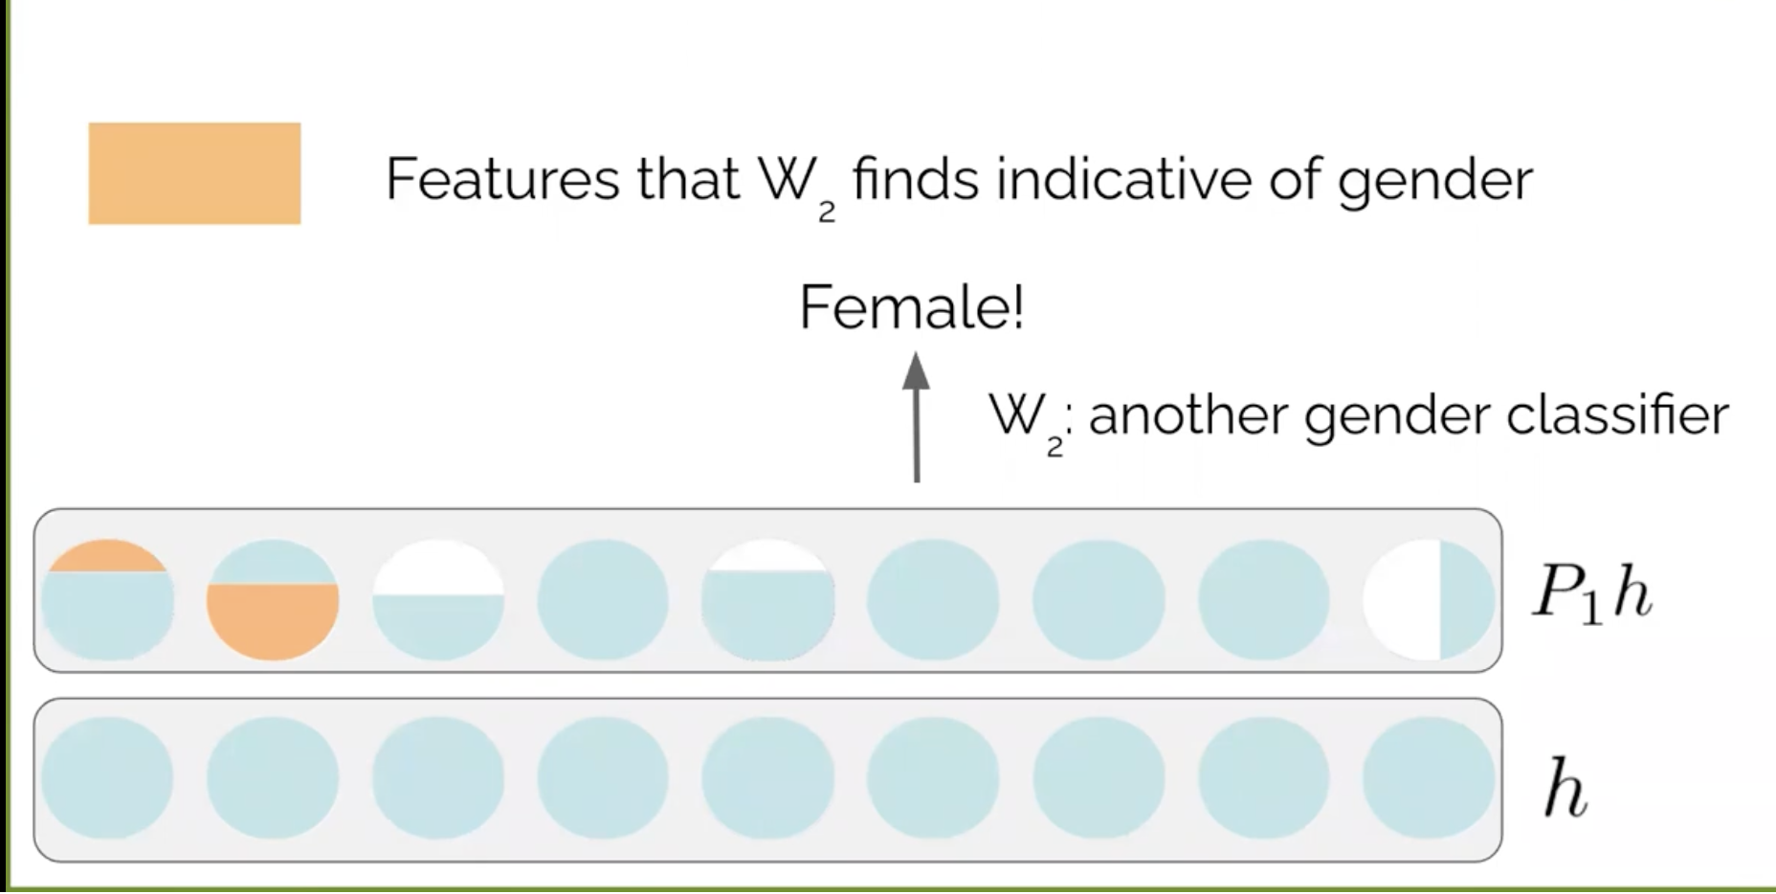
Idea: We project the original information on the separating plane. This projected information does not encode gender information. Project all information on Null Space of W

Slide 12
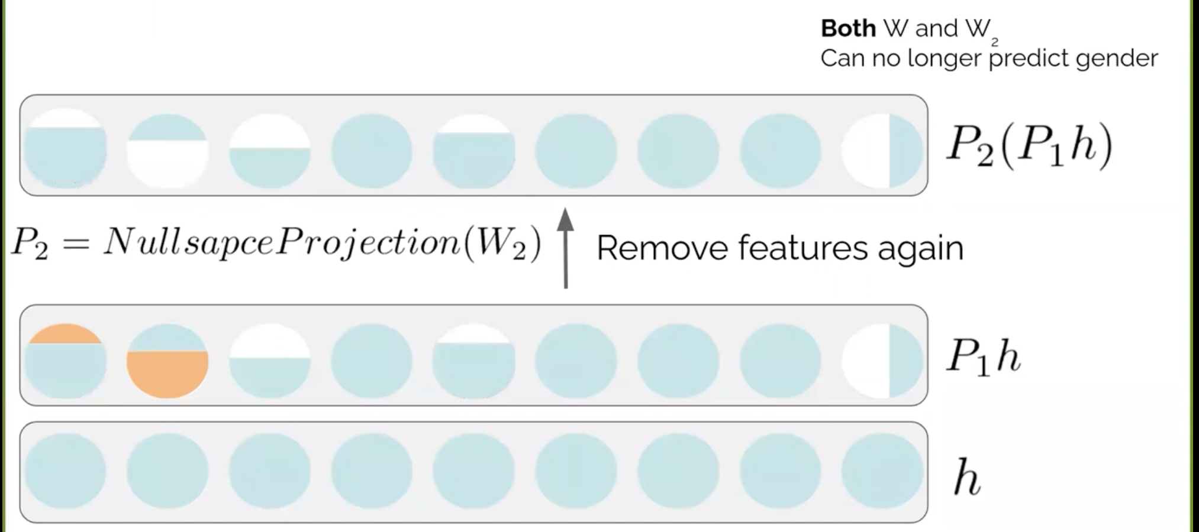

Slide 13
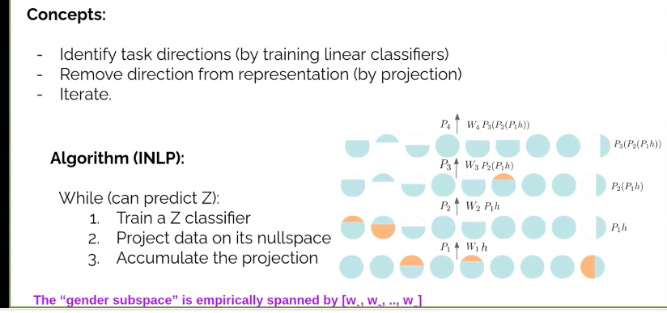
Putting it All together:

Slide 14
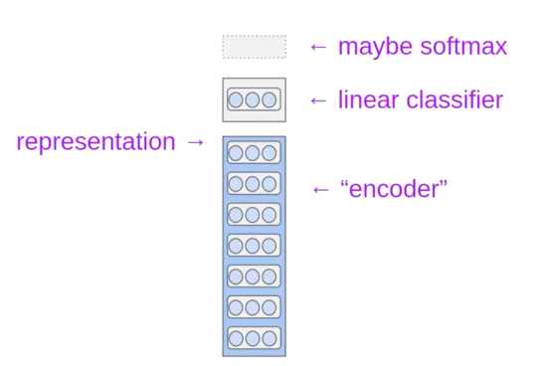
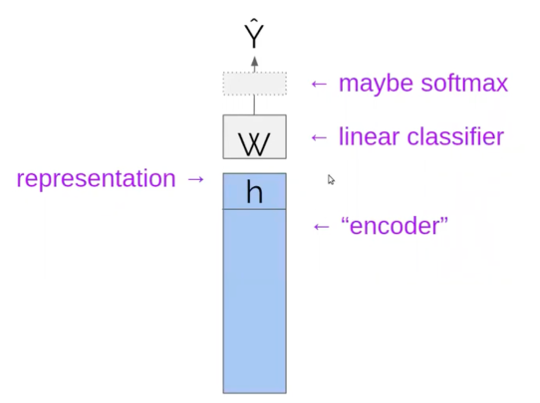
Debiasing Deep Models

Slide 15
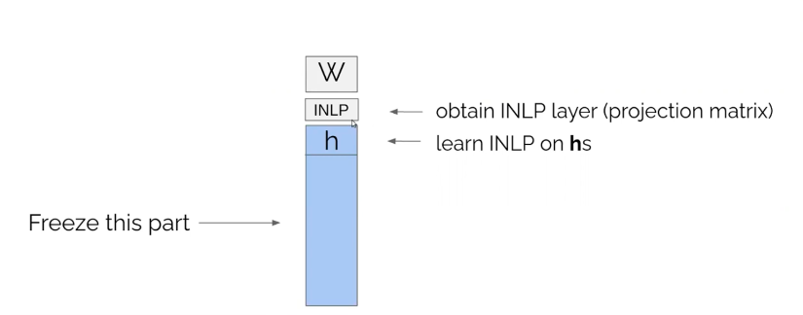
Debiasing Deep Models:

Slide 16
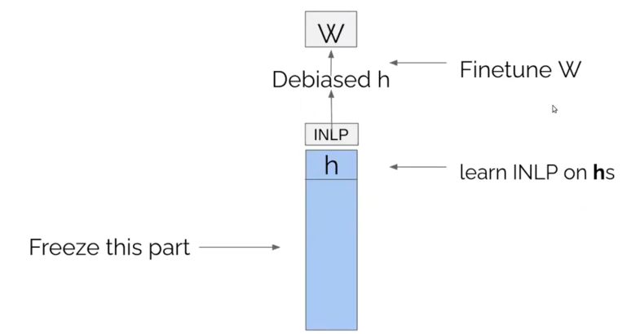
Debiasing Deep Models
Notes:
W here is the original task.
Also input to the Linear classifier is debiased h that doesn’t encode gender biases. So we can be sure to remove gender biases.
So W does its job without the gender bias

Slide 17
THANK YOU!

