Slide 1





Revisit of Automatic Debugging via
Human Focus-tracking Analysis
Xiaoyuan Xie, Zicong Liu, Shuo Song, Zhenyu Chen, Jifeng Xuan, Baowen Xu

Slide 2

Our work - In a Nutshell
How well does automatic debugging work for human
Good? Why?
Not good? Why?
Suggestions?

Slide 3
Outline
Motivation&
RQs
Introduction&
Background
1
2
Results
Insights
3
4
Experiment
5

Slide 4
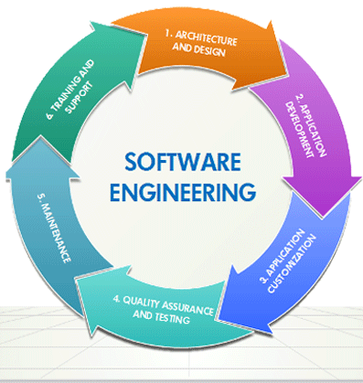
Introduction & Background
Human-centric discipline
Human beings get involved in each activity

Slide 5
Introduction & Background
Studies on human factor cover many areas
Source Code reading, navigation and comprehension
Program model (e.g. UML) comprehension
Static code review and manual debugging
Automatic debugging?

Slide 6
Introduction & Background
Automatic
debugging
Necessary?
Human behaviors
Proposed to reduce human efforts

Slide 7
Introduction & Background
Automatic
debugging
Yes, necessary!
Human behaviors
Approximate results, precision not guaranteed.
Human verification is indispensable
Make decision and perform debugging
Just assistance

Slide 8
Introduction & Background
Human studies in automatic debugging
Weiser & Lyle (first study) and Francel & Spencer (follow-up): the helpfulness of program slicing to programmers in their code comprehension and debugging abilities.
Tao et al.: the effectiveness of human debugging via machine-generated patches.

Slide 9
Introduction & Background
Human studies in automatic debugging
Focused on comparing the actual performance of participants in debugging with and without a technique
Lack of comprehensive or quantitative explanation
Only one related work in SBFL (light-weight and has received much attention during the past two decades)
Parnin & Orso: “can Spectrum-based Fault Localization (SBFL) help programmers”

Slide 10
Outline
Motivation&
RQs
Introduction&
Background
1
2
Results&
Analysis
Insights&
Conclusions
3
4
Experiment
5

Slide 11
Motivation & RQs
Motivated by Parnin and Orso’s work
Only preliminary study, left some aspects to be further investigated
Scale
√ 34 dev, 2 tasks
？ Larger-scale study
→statistically reliable
Testing
√ Only one (failed) per task
√ Descriptive
？ more test cases
？ executable test cases
Tool
√ Hard to comprehend
√ Hard coded
？ Easy-to-follow result
？ Rankings linked to real testing results.

Slide 12
Motivation & RQs
Aspects to be further investigated
Impact of SBFL precision
√ Artificially reordered statements, not considered the ranking at top.
？ Real SBFL precision, with cases of top ranking
Impact on fault detection
√ Not covered
？ Whether SBFL assistance has any impact on fault detection
Insights and explanations
√ Preliminary discussion on code navigation
？ A comprehensive and quantitative analysis
？ More convincing insight

Slide 13

Motivation & RQs
Research questions
RQ1: Can MoocTest benefit debugging?
RQ2: Any particular navigation pattern during debugging with SBFL? If yes, any relation with the debugging performance?
RQ3: Any impact on programmers’ fault detection abilities from SBFL?

Slide 14
Outline
Motivation&
RQs
Introduction&
Background
1
2
Results&
Analysis
Insights&
Conclusions
3
4
Experiment
5

Slide 15


Experiment - MoocTest
What is it?
On-line examination platform for a Coursera course on software testing
Provides all
“?” features
MDebug:
module for SBFL
Platform of our
experiments

Slide 16
Experiment - MoocTest
What does MOOCTest include
Fault Localizer
Operation Tracker
Static code analysis;
CFG generation;
Test execution, coverage profile construction;
Risk evaluation, ranking;
Result visualization
Log Analyzer
Provides full tracking analysis by recording each operation during debugging with a time stamp
Receives log files, performs various analyses to provide in-depth knowledge about the SBFL-assisted debugging process

Slide 17
Experiment - MoocTest

Slide 18

Experiment - Participants

Slide 19


Experiment - Participants
Class I: 97 students
3rd-year college students from
our university
1
Class II: 110 students
Enrolled in our “Software Testing”
(a compulsory course)
2
3
2-year Java programming experience
4
Diverse programming skills

Slide 20
Experiment - Programs
17 faulty versions from 7 programs

Slide 21
Experiment - Programs
About the 17 mutants
Single fault per mutant
Multiple failures
Executable Junit test suite

Slide 22
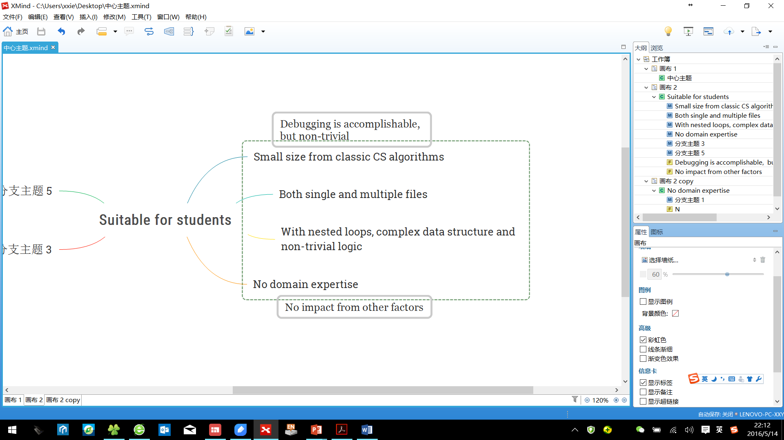
Experiment - Programs
Why these programs?

Slide 23
Experiment - Programs
About the 17 mutants: categorized based on SBFL results
hit: sf is ranked at top
dist: line distance between sf and the top
dep: sf has data/control dependence on the top
p=1/1+Nc
Accurate Group
Inaccurate Group

Slide 24
Experiment - Programs
About the 17 mutants: categorized based on SBFL results
Different precision in SBFL results

Slide 25
Experiment - Procedure
Tutorial on SBFL and MoocTest
Exam: 90 mins, 2 tasks, scored based on fix or not

Slide 26
Outline
Motivation&
RQs
Introduction&
Background
1
2
Results&
Analysis
Insights&
Conclusions
3
4
Experiment
5

Slide 27

RQ1
RQ1:
Can MoocTest Benefit Debugging

Slide 28

Results-RQ1: Can MoocTest benefit debugging?
(1) Completion rate Rc
For each task, Rc = completed/all
Hypothesis
A and B shall have increased Rc;
Helpfulness: A > B > {C > {D, E} > F}

Slide 29
Results-RQ1: Can MoocTest benefit debugging?
(1) Completion rate Rc
SBFL hardly shows any advantages in C,D,E,F
A and B comply with the hypothesis
False positive shows not much negative impact
Dependence lead to
no difference (C~D, E~F)
Small line distance is not helping (C,D do not have better performance than E,F)

Slide 30
Results-RQ1: Can MoocTest benefit debugging?
(1) Completion rate Rc
Concluded observations
MoocTest only helps to improve Rc in “top-ranking cases”
Accurate Group ={A, B};
Inaccurate Group = {C, D, E, F}

Slide 31
Results-RQ1: Can MoocTest benefit debugging?
(2) Completion time Tc
Tc is the time cost to fix a bug
Hypothesis
MoocTest can be helpful in decreasing Tc

Slide 32
Results-RQ1: Can MoocTest benefit debugging?
(2) Completion time Tc
Time increasing is more obvious in Inaccurate Group
Even in Accurate Group, debugging becomes longer
While it takes similar time in manual debugging; inaccurate SBFL significantly prolongs bug fixing process

Slide 33
Results-RQ1: Can MoocTest benefit debugging?
(2) Completion time Tc
Concluded observations
SBFL in MoocTest is NOT helping in reducing time cost
Time cost significantly increases
with inaccurate SBFL results

Slide 34
RQ2
RQ2:
Any navigation pattern

Slide 35
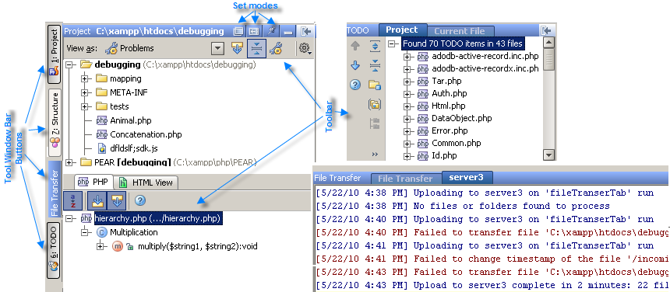
Results-RQ2: Any navigation pattern?
Tracking participants’ focus of attention
Capture participants’ operations on the screen (cursor movement, mouse clicking, file opening, code modification) to achieve this goal. --- supported by both Psychology and CHI studies.

Slide 36
Results-RQ2: Any navigation pattern?
First, consider case without SBFL
Followed by several rounds of navigation along through all the code lines sequentially
A first code scan
Finally reach a particular area and fix the bug.

Slide 37
Results-RQ2: Any navigation pattern?
Now, let’s consider SBFL
A first code scan, i.e. a skim of the entire or part of the code before inspecting the top
Until they identify the bug and fix it
During Follow-up browsing, i.e. all navigation after “first scan”, programmers switch between the top and others.

Slide 38

Results-RQ2: Any navigation pattern?
(1) “First scan” pattern
duration of scan has an
inverse correlation with
static code review efficiency
And its duration is quite diverse among different participants.
Almost nobody directly jumped into the pinpointed line at their first visit --- “First scan” is preserved in debugging with SBFL

Slide 39
Results-RQ2: Any navigation pattern?
Relation between “First scan” duration (T1) and Tc
R1 = T1/Tc, Long scan (R1>10%) v.s. Short scan (R1<=10%)
Tc with “short scan” is larger than with “long scan”
Tc with “short scan” is even larger than manual debugging
“Long scan” results in similar efficiency to manual debugging

Slide 40
Results-RQ2: Any navigation pattern?
Relation between “First scan” duration (T1) and Tc

Slide 41
Results-RQ2: Any navigation pattern?
About “First scan”
Concluded observations
First scan is preserved in SBFL
SBFL may result in insufficient first code scan---could be harmful to the efficiency
Careful scan leads to better code comprehension---inevitable to efficient debugging

Slide 42
Results-RQ2: Any navigation pattern?
About “First scan”
Re-examine one of SBFL’s motivations
To help programmers quickly enter the most suspicious code, without wasting time on other lines
Conflict: debugging process may not
be accelerated in this way

Slide 43
Results-RQ2: Any navigation pattern?
(2) “Follow-up browsing” pattern
All navigation after “first scan” belong to “follow-up browsing”
switches between these lines and others
Duration of focus on highlighted lines
v.s.
Duration of focus on other lines

Slide 44
Results-RQ2: Any navigation pattern?
Focus on highlighted lines v.s. on others
R2 = T2/(Tc-T1): T2 is the duration on non-highlighted code in follow-up browsing
98.0% of the participants have an R2 over 50%, and 85.7% of the participants even have an R2 higher than 70%.
Much more time is spent on other statements

Slide 45
Results-RQ2: Any navigation pattern?
About “Follow-up browsing”
Concluded observations
Programmers tend to spend most of their rest debugging time (after the first scan) outside the highlighted lines

Slide 46
Results-RQ2: Any navigation pattern?
About “Follow-up browsing”
Re-examine another one of SBFL’s motivations
Pinpoint the most suspicious statements and make programmers concentrate on these risky lines without wasting time on other “safe” lines.
Conflict: “wasting time” on “safe” code is unavoidable

Slide 47
Results-RQ2: Any navigation pattern?
Summary of RQ2:
Partly explained RQ1
Colorization affects debugging behaviors more or less
Quickly starting the inspection on the highlighted code without a careful first scan shows obvious harmfulness
In follow-up browsing, inspection on the context is generally more necessary for debugging
Code comprehension is critical
Time that we have tried to save may not be savable
Human’s habit in code comprehension may not be changed by SBFL
Human factor cannot be ignored in automatic debugging.
We should provide assistance really needed by programmers

Slide 48
RQ3
RQ3:
Will SBFL affect fault detection

Slide 49



Results-RQ3: Will SBFL affect fault detection?
No perfect bug detection in SBFL
!=
Will SBFL affect bug detection?

Slide 50
Results-RQ3: Will SBFL affect fault detection?
Revisit on faulty code
More revisits on sf (without detecting it) with SBFL
Vf: frequency of visits on sf without detecting it.

Slide 51
Results-RQ3: Will SBFL affect fault detection?
Revisit on faulty code
More time spent on sf (without detecting it) with SBFL
Df: average duration of all revisits

Slide 52
Results-RQ3: Will SBFL affect fault detection?
Concluded observations
Partly explained RQ1
SBFL leads to more revisit and longer time to spend on sf, in order to detect it
May confuse programmers in their code comprehension and slightly weaken their bug detection abilities.

Slide 53
Outline
Motivation&
RQs
Introduction&
Background
1
2
Results&
Analysis
Insights&
Conclusions
3
4
Experiment
5

Slide 54
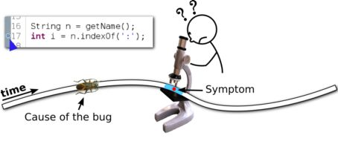
Insights & Conclusions
Automatic debugging: highlight a suspicious area for dev to focus on
SAVED!
As quickly as possible
?
As small as possible

Slide 55
Insights & Conclusions
What is an actual debugging process like?
As quickly as possible
! miss a good global understanding;
! more time to
compensate
As small as possible
! Generally unrealistic
! Browsing context is indispensable

Slide 56
Insights & Conclusions
What is an actual debugging process like?
Detect the fault (comprehend, identify, fix it)
Detect the fault (comprehend, identify, fix it)
Isolate the buggy lines
Isolate the buggy lines
Comprehension matters!
To be done by human!

Slide 57
Insights & Conclusions
Automatic debugging is useful!
provided that they well support code comprehension
Apply automatic debugging on more abstract level
Try to give any information to assist comprehension
To be verified!

Slide 58
Thank you!

