Slide 1
Search-Based Inference of Polynomial Metamorphic Relations
By: Jie Zhang
Peking University, China
zhangjie12@sei.pku.edu.cn

Slide 2
Outline
1.background
2.motivation
3.approach
4.Empirical
setup
5. results
6.Summary
7.Future work

Slide 3
Outline
1.background
2.motivation
3.approach
4.Empirical
setup
5. results
6.Summary
7.Future work

Slide 4
Background — oracle
Oracle is unavailable
Test oracle
Oracle problem
Non-testable
programs
Programs that have oracle problem
to determine whether the program under test exhibits an acceptable behavior
obtaining an oracle for a given program may be difficult or even impossible
programs that have oracle problems. E.g., scientific programs

Slide 5
Non-testable programs
How to solve the oracle problem
and test the non-testable programs?

Slide 6
Non-testable programs
How to solve the oracle problem
and test the non-testable programs?

Slide 7
Non-testable programs
How to solve the oracle problem
and test the non-testable programs?
A possible solution:
find some pseudo oracles

Slide 8
Non-testable programs
How to solve the oracle problem
and test the non-testable programs?
A possible solution:
find some pseudo oracles
Metamorphic relations

Slide 9
Metamorphic relations
Typically, an MR specifies how a particular change
to the input would change the output

Slide 10

Metamorphic relations
Typically, an MR specifies how a particular change
to the input would change the output
$$R_{i} (I_{1}, I_{2}) ⇒ R_{0} (O_{1}, O_{2})$$

Slide 11


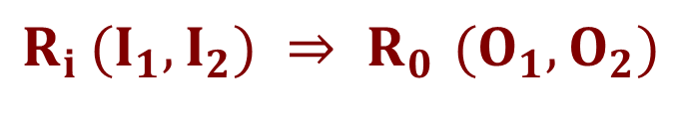
Metamorphic relations
$$R_{i} (I_{1}, I_{2}) ⇒ R_{0} (O_{1}, O_{2})$$
$$I_{1}$$
$$O_{1}$$

Slide 12


Metamorphic relations
$$R_{i} (I_{1}, I_{2}) ⇒ R_{0} (O_{1}, O_{2})$$
$$I_{1}$$
$$O_{1}$$
$$R_{i}$$
$$I_{2}$$

Slide 13



Metamorphic relations
$$R_{i} (I_{1}, I_{2}) ⇒ R_{0} (O_{1}, O_{2})$$
$$I_{1}$$
$$O_{1}$$
$$R_{i}$$
$$R_{o}$$
$$I_{2}$$
$$O_{2}$$

Slide 14
Metamorphic relations
$$R_{i} (I_{1}, I_{2}) ⇒ R_{0} (O_{1}, O_{2})$$
$$I_{1}$$
$$O_{1}$$
$$R_{i}$$
$$R_{o}$$
$$I_{2}$$
$$O_{2}$$

Slide 15
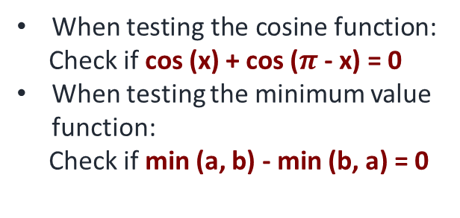






Metamorphic relations
$$R_{i} (I_{1}, I_{2}) ⇒ R_{0} (O_{1}, O_{2})$$
When testing the cosine function:
Check if cos (x) + cos ($π$ - x) = 0
When testing the minimum value function:
Check if min (a, b) - min (b, a) = 0
$$I_{1}$$
$$O_{1}$$
$$R_{i}$$
$$R_{o}$$
$$I_{2}$$
$$O_{2}$$

Slide 16
Metamorphic relations
$$R_{i} (I_{1}, I_{2}) ⇒ R_{0} (O_{1}, O_{2})$$
When testing the cosine function:
Check if cos (x) + cos ($π$ - x) = 0
When testing the minimum value function:
Check if min (a, b) - min (b, a) = 0
$$I_{1}$$
$$O_{1}$$
$$R_{i}$$
$$R_{o}$$
Metamorphic
Testing
$$I_{2}$$
$$O_{2}$$

Slide 17
Outline
1.background
2.motivation
3.approach
4.Empirical
setup
5. results
6.Summary
7.Future work

Slide 18
Motivation
can be regarded as program invariants. Very important in helping understand the program under test
Testers often lack of thorough knowledge of the PUT：
In many circumstances, it’s difficult to manually acquire MRs
more MRs： help achieve more adequate testing

Slide 19

Motivation
can be regarded as program invariants. Very important in helping understand the program under test
Testers often lack of thorough knowledge of the PUT：
In many circumstances, it’s difficult to manually acquire MRs
more MRs： help achieve more adequate testing

Slide 20
Motivation
can be regarded as program invariants. Very important in helping understand the program under test
Our work:
automatically infer MRs for programs under test
Testers often lack of thorough knowledge of the PUT：
In many circumstances, it’s difficult to manually acquire MRs
more MRs： help achieve more adequate testing

Slide 21
Outline
1.background
2.motivation
3.approach
4.Empirical
setup
5. results
6.Summary
7.Future work

Slide 22
Approach
Use general formula to represent polynomial MRS
Use search-based algorithm to search for suitable parameters
MR filtering

Slide 23
Approach
Use general formula to represent polynomial MRS
MR filtering
Use search-based algorithm to search for suitable parameters

Slide 24
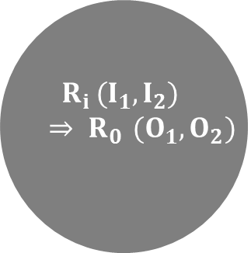

Metamorphic Relations
$R_{i}$:linear
equation
$R_{o}$:linear
equation
𝑅_𝑖:linear
equation
𝑅_𝑜:linear
equation
$R_{i}$:linear
equation
$R_{o}$:quadratic
equation
𝑅_𝑖:linear
equation
𝑅_𝑜:quadratic
equation
$${ R}_{i} (I_{1}, I_{2}) ⇒ R_{0} (O_{1}, O_{2})$$
60%
$$polynomial$$
$$Metamorphic$$
$$Relations$$
50%

Slide 25

Metamorphic Relations
$R_{i}$:linear
equation
$R_{o}$:linear
equation
𝑅_𝑖:linear
equation
𝑅_𝑜:linear
equation
$R_{i}$:linear
equation
$R_{o}$:quadratic
equation
𝑅_𝑖:linear
equation
𝑅_𝑜:quadratic
equation
1-MR
$${ R}_{i} (I_{1}, I_{2}) ⇒ R_{0} (O_{1}, O_{2})$$
60%
$$polynomial$$
$$Metamorphic$$
$$Relations$$
50%
2-MR

Slide 26
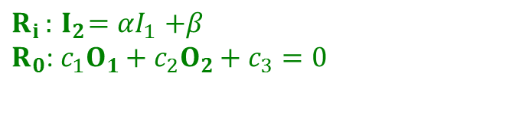




$$R_{i} (I_{1}, I_{2}) ⇒ R_{0} (O_{1}, O_{2})$$
1-MR
$$R_{i }:{ I}_{2}{=αI}_{1}+β$$
$R_{0}$: $c_{1}O_{1}+c_{2}O_{2}+c_{3}=0$
$$P\left(I_{1}\right)$$
$$P\left({αI}_{1}+β\right)$$
$$c_{1}P^{2}\left(I_{1}\right)+c_{2}P^{2}\left(αI_{1}+β\right)+c_{3}P\left(I_{1}\right)P\left(αI_{1}+β\right)+c_{4}P\left(I_{1}\right)\text{+}c_{5}P\left(αI_{1}+β\right)+c_{6}=0$$

Slide 27
$$R_{i} (I_{1}, I_{2}) ⇒ R_{0} (O_{1}, O_{2})$$
1-MR
$$R_{i }:{ I}_{2}{=αI}_{1}+β$$
$R_{0}$: $c_{1}O_{1}+c_{2}O_{2}+c_{3}=0$
$$P\left(I_{1}\right)$$
$$P\left({αI}_{1}+β\right)$$
$$c_{1}P\left(I_{1}\right)+c_{2}P\left({αI}_{1}+β\right)+c_{3}=0$$
$$c_{1}P^{2}\left(I_{1}\right)+c_{2}P^{2}\left(αI_{1}+β\right)+c_{3}P\left(I_{1}\right)P\left(αI_{1}+β\right)+c_{4}P\left(I_{1}\right)\text{+}c_{5}P\left(αI_{1}+β\right)+c_{6}=0$$

Slide 28
$$R_{i} (I_{1}, I_{2}) ⇒ R_{0} (O_{1}, O_{2})$$
1-MR
$$R_{i }:{ I}_{2}{=αI}_{1}+β$$
$R_{0}$: $c_{1}O_{1}+c_{2}O_{2}+c_{3}=0$
$$P\left(I_{1}\right)$$
$$P\left({αI}_{1}+β\right)$$
$$c_{1}P\left(I_{1}\right)+c_{2}P\left({αI}_{1}+β\right)+c_{3}=0$$
2-MR
$$c_{1}P^{2}\left(I_{1}\right)+c_{2}P^{2}\left(αI_{1}+β\right)+c_{3}P\left(I_{1}\right)P\left(αI_{1}+β\right)+c_{4}P\left(I_{1}\right)\text{+}c_{5}P\left(αI_{1}+β\right)+c_{6}=0$$

Slide 29
Infer MRs
Find polynomial equations

Slide 30
Infer MRs
Find polynomial equations
Search problem

Slide 31
Infer MRs
Find polynomial equations
Search problem
First step
second step

Slide 32
Approach
Use general formula to represent polynomial MRS
Use search-based algorithm to search for suitable parameters
MR filtering

Slide 33

Approach — search-based algorithm
PSO algorithm:
each candidate solution is called a particle
Each particle has a velocity and a location which keep changing
A fitness function is used to evaluate how close the location of a particle is to an optimal location
PSO algorithm
(Particle Swarm Optimization)
simulating the birds foraging behavior.
Why PSO :
very effective to search in continuous space
can lead a particle to escape local optimal locations.
Simple, no many parameters to adjust

Slide 34
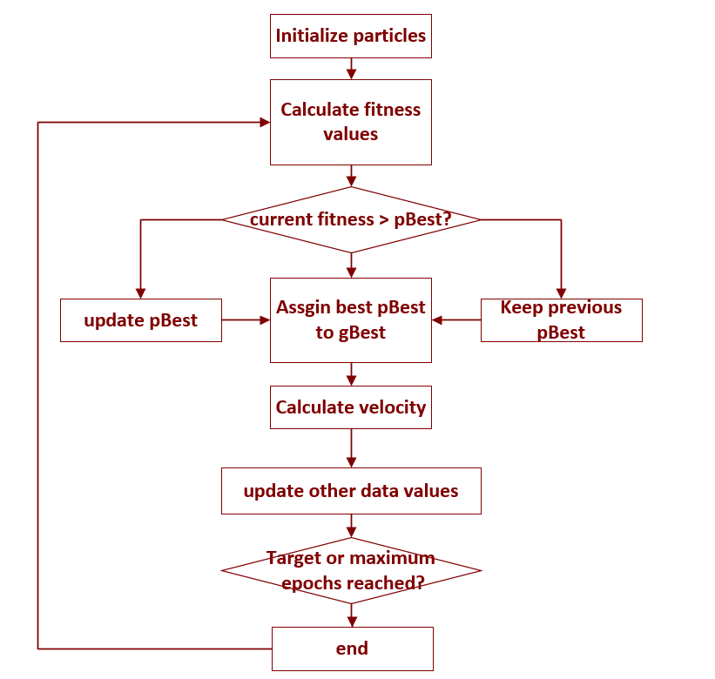
Y
N

Slide 35
Y
N

Slide 36
Y
N

Slide 37

Fitness function
The vector of parameters
The k-th input
Fitness(L) = $\sum_{k=1}^{M}{f(L,k)}$
If L and the k-th input satisfy the general formula, we define f(L,k) = 1, otherwise we define f(L,k) = 0.
The fitness function: actually counts the number of inputs that satisfy the general formula.

Slide 38
Process
In the beginning, the N particles are assigned with locations (initial values of the parameters).
The N particles keep updating their velocities and locations according to pBest and gBest.
When reaching the termination threshold, over.
The global optimum location that any particle has ever reached is returned as the final solution.

Slide 39
Approach
Use general formula to represent polynomial MRs
Use search-based algorithm to search for suitable parameters
MR filtering

Slide 40
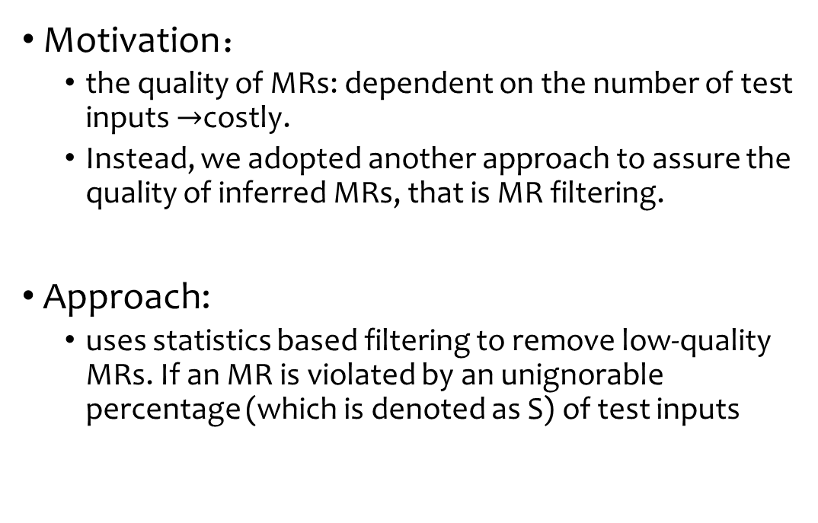
MR Filtering
Motivation：
the quality of MRs: dependent on the number of test inputs $→$costly.
Instead, we adopted another approach to assure the quality of inferred MRs, that is MR filtering.
Approach:
uses statistics based filtering to remove low-quality MRs. If an MR is violated by an unignorable percentage (which is denoted as S) of test inputs

Slide 41
Approach
I’ve got high-quality MRs automatically and timely
MRs
Use general formula to represent polynomial MRS
Use search-based algorithm to search for suitable parameters
MR filtering

Slide 42
Outline
1.background
2.motivation
3.approach
4.Empirical
setup
5. results
6.Summary
7.Future work

Slide 43
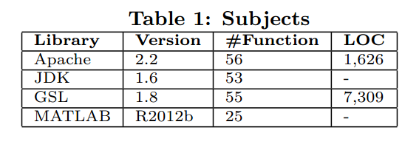
Subjects

Slide 44
Subjects
Java
C/C++
Matlab

Slide 45
Subjects
Java
C/C++
Matlab
Totally: 189 scientific functions
From various scientific libraries and of various languages
Our approach: a black-box approach

Slide 46
Subjects
Java
C/C++
Matlab
Totally: 189 scientific functions
From various scientific libraries and of various languages
Our approach: a black-box approach
We evaluated our approach in many scenarios

Slide 47
Empirical Setup
Study I
is our approach able to infer MRs?
Study II
how is the quality of MRs inferred by our approach?
Study III
does MR filtering improve the quality of inferred MRs?

Slide 48
Empirical Setup — studyI
Study I
is our approach able to infer MRs?
Run our three-step approach on our subjects
Record the results and
the time

Slide 49
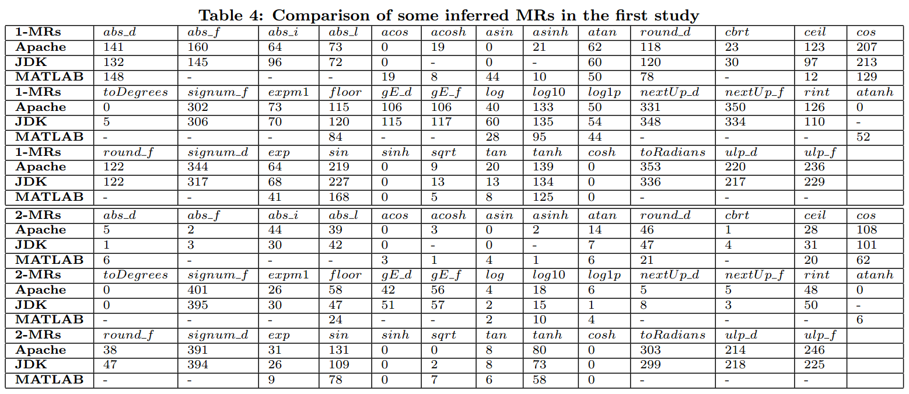
Results: study I

Slide 50

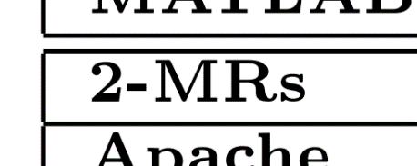
Results: study I

Slide 51
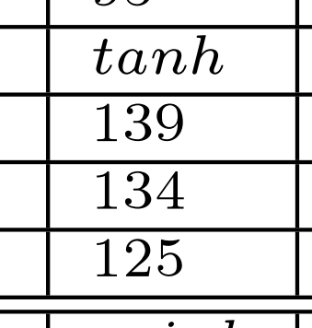
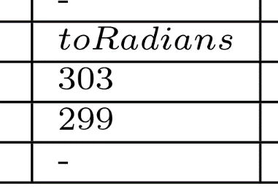
Results: study I

Slide 52

Some Typical MRs
$\sin\left(x\right)−\sin\left(x−2π\right)=0$
$\cos\left(x\right)+\cos\left(−x−π\right)=0$
$\tan\left(x\right)+\tan\left(−x\right)=0$
$\sin^{2}\left(x\right)+\sin^{2}\left(−x+0.5π\right)−1=0$
……

Slide 53

Some Surprising MRs
$\tan^{2}\left(x\right)−2\tan\left(x\right)\tan\left(2x−1.5π\right)−1=0$
$\tan^{2}\left(0.5x+1.25π\right)−2\tan\left(x\right)\tan\left(0.5x+1.25π\right)−1=0$
$\cos^{2}\left(−0.5x−1.5π\right)+0.5\cos\left(x\right)−0.5=0$
$\sin^{2}\left(x\right)+0.5\sin\left(2x+0.5π\right)−0.5=0$
……

Slide 54
Empirical Setup — study II
Study II
how is the quality of MRs inferred by our approach?

Slide 55
Empirical Setup — study II
Study II
how is the quality of MRs inferred by our approach?
For simple functions: manually check the quality

Slide 56
Empirical Setup — study II
Study II
how is the quality of MRs inferred by our approach?
For simple functions: manually check the quality
Compare the number of MRs inferred from different libraries

Slide 57
Empirical Setup — study II
Study II
how is the quality of MRs inferred by our approach?
For simple functions: manually check the quality
Compare the number of MRs inferred from different libraries
Investigate the fault-detection capability of inferred MRs

Slide 58
Empirical Setup — study II
Study II
how is the quality of MRs inferred by our approach?
For simple functions: manually check the quality
Compare the number of MRs inferred from different libraries
Investigate the fault-detection capability of inferred MRs
Simulate the regression testing in software evolution
Apply the MRs inferred from the correct version on detecting faults in the subsequent version
Faults construction: use mutation tools to generate mutants only in the changed lines

Slide 59
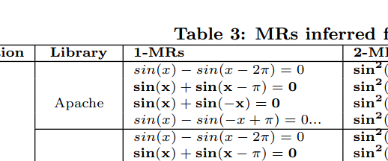
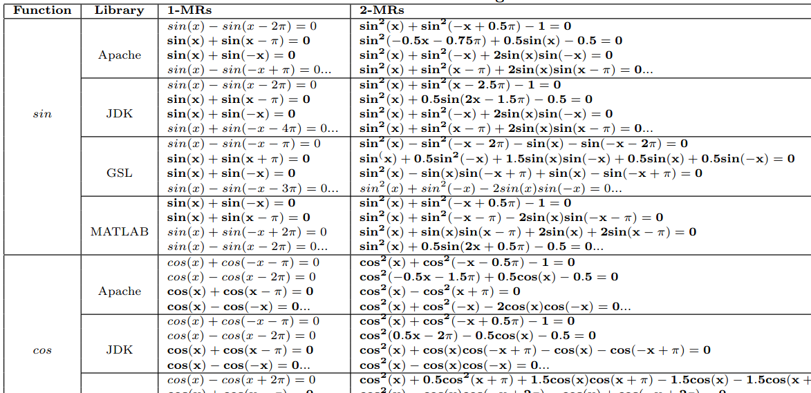
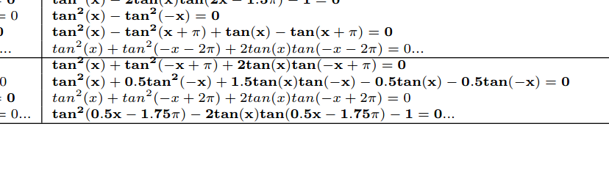
Results: study II

Slide 60
Results: study II

Slide 61
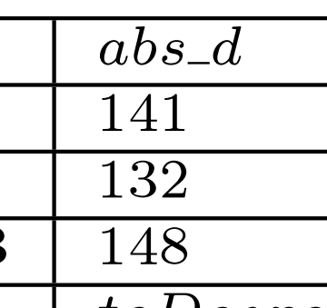
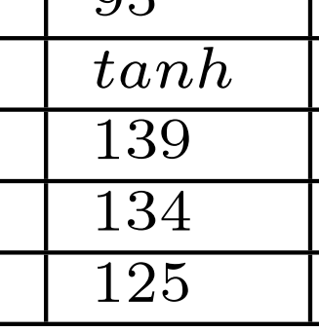
Results: study II

Slide 62
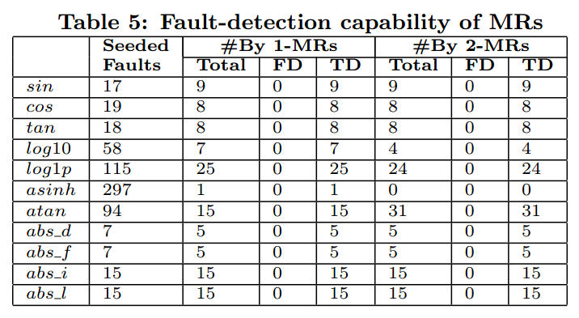
Results: study II

Slide 63

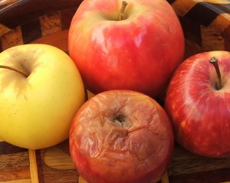
Empirical Setup — study III
Study III
does MR filtering improve the quality of the inferred MRs?
Compare the quality of MRs inferred with MR filtering and without MR filtering (true detections and false detections)
VS

Slide 64
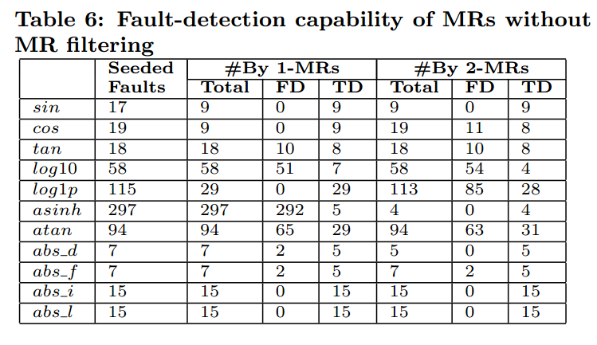
Results: study III

Slide 65


Results: study III

Slide 66
Outline
1.background
2.motivation
3.approach
4.Empirical
setup
5. results
6.Summary
7.Future work

Slide 67
Summary
We propose a novel approach to automatically inferring polynomial metamorphic relations
We view the problem of MR inference as a searching problem and thus use a typical optimization algorithm PSO to solve the problem.
We conducted three empirical studies and got the finding that our approach is able to infer many MRs with high quality in acceptable time, which are effective in detecting faults with no false detection.

Slide 68
Outline
1.background
2.motivation
3.approach
4.Empirical
setup
5. results
6.Summary
7.Future work

Slide 69
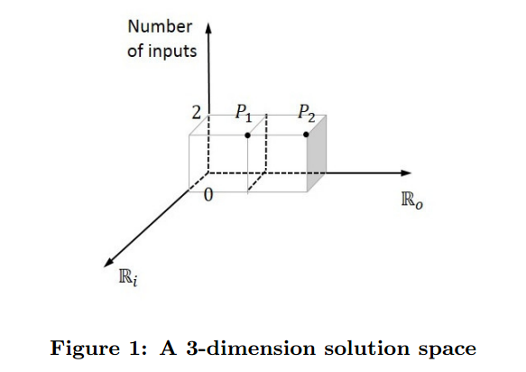
Future Work

Slide 70
Future Work
$R_{i}$: to a higher degree
𝑹_𝒊: to a higher degree
$R_{o}$: to a higher degree
𝑹_𝒐: to a higher degree
other optimization algorithms
polynomial inequalities
𝑹_𝒊: to a higher degree
𝑹_𝒊: to a higher degree
Among more executions

Slide 71
Q
&
A

